Slide 1
Year 1 Pure Mathematics
Algebraic Expressions
- Surds
Chapter 1
(Part 3 of 3)

Slide 2
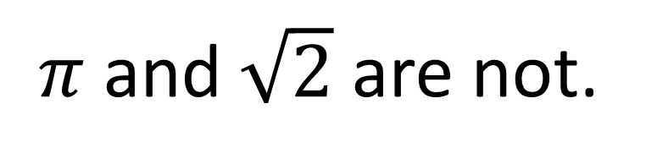
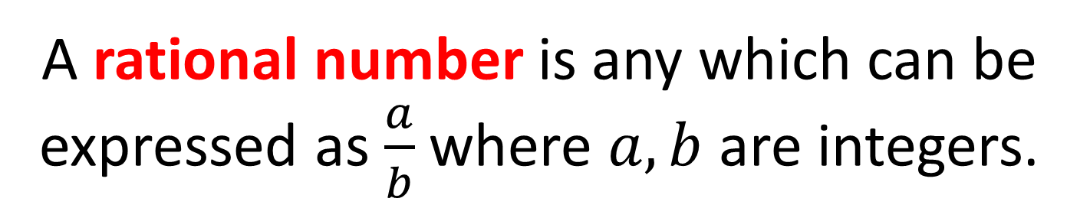
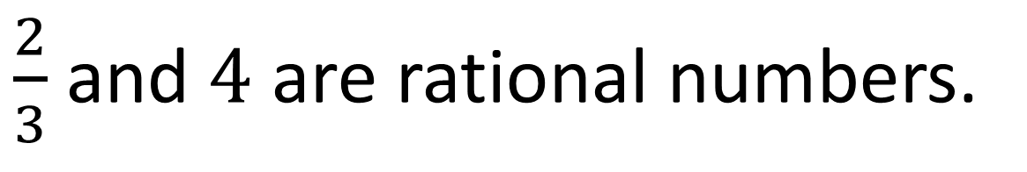
Surds – What is a surd?
A rational number is any which can be expressed as $\frac{a}{b}$ where $a,b$ are integers.
$\frac{2}{3}$ and $4$ are rational numbers.
$π$ and $\sqrt{2}$ are not.

Slide 3
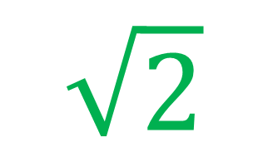
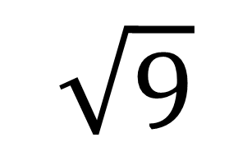
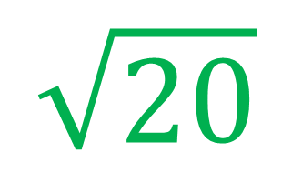
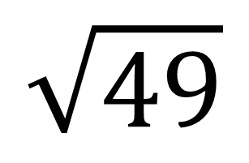
Surds – What is a surd?
A surd is a root of a number that does not simplify to a rational number.
Rational numbers
Irrational numbers/Surds
$$\sqrt{9}$$
$$\sqrt{2}$$
$$\sqrt{49}$$
$$\sqrt{20}$$

Slide 4
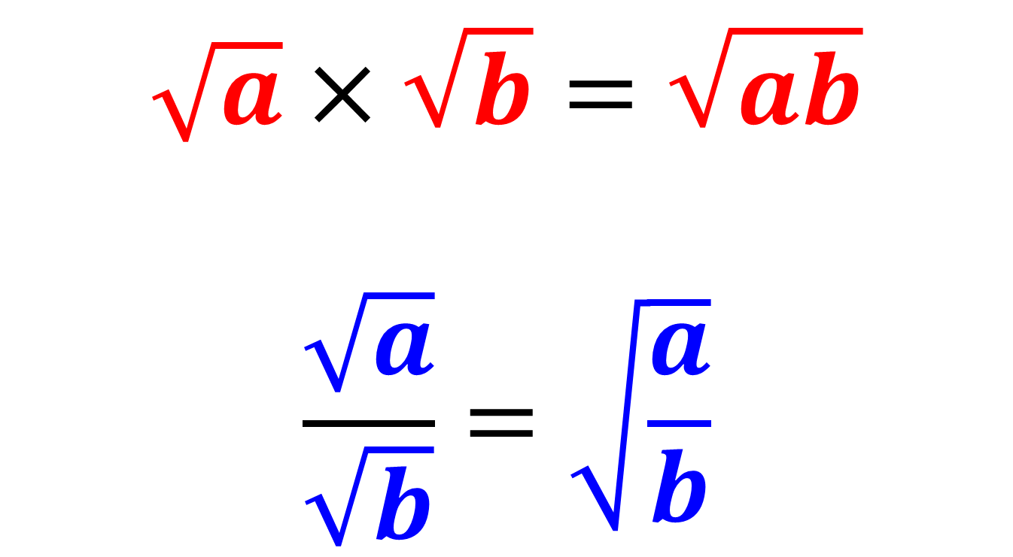
Surds – Calculating
Laws to follow:
$$\sqrt{a}×\sqrt{b}=\sqrt{ab}$$
$$\frac{\sqrt{a}}{\sqrt{b}}=\sqrt{\frac{a}{b}}$$

Slide 5
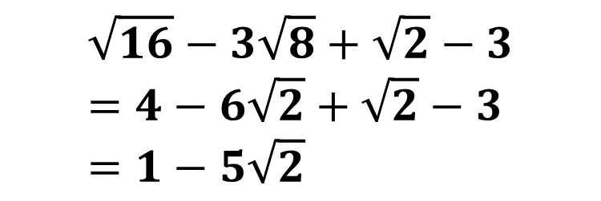
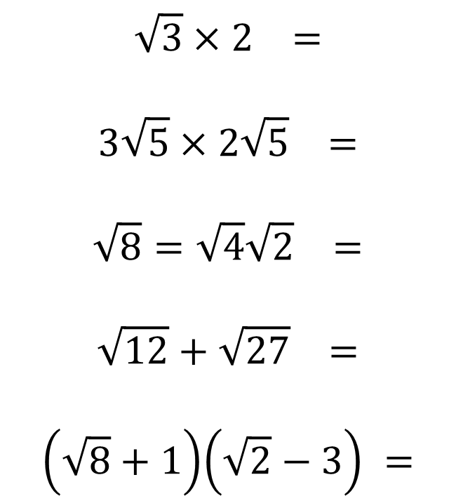




Surds - Calculating
$$\sqrt{3}×2 =$$
$$3\sqrt{5}×2\sqrt{5} =$$
$$\sqrt{8}=\sqrt{4}\sqrt{2} =$$
$$\sqrt{12}+\sqrt{27} =$$
$$\left(\sqrt{8}+1\right)\left(\sqrt{2}−3\right) =$$
$$2\sqrt{3}$$
$$30$$
$$2\sqrt{2}$$
$$2\sqrt{3}+3\sqrt{3}=5\sqrt{3}$$
$$\sqrt{16}−3\sqrt{8}+\sqrt{2}−3 \\ =4−6\sqrt{2}+\sqrt{2}−3 \\ =1−5\sqrt{2}$$

Slide 6
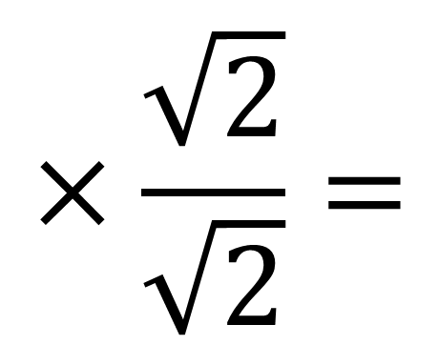
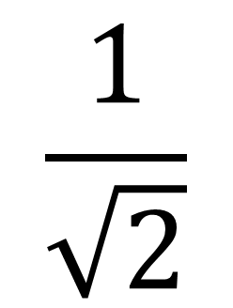
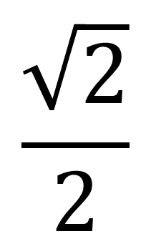
Surds - Rationalising The Denominator
In this fraction, the denominator is irrational.
‘Rationalising the denominator’
means making the denominator a rational number
(not a Surd).
$$\frac{1}{\sqrt{2}}$$
$$×\frac{\sqrt{2}}{\sqrt{2}}=$$
$$\frac{\sqrt{2}}{2}$$

Slide 7



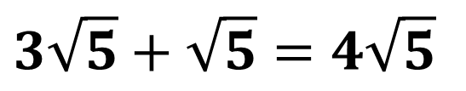

Surds - Rationalising The Denominator
$$\frac{3\sqrt{2}}{2}$$
$$\frac{3}{\sqrt{2}}=$$
$$\frac{6}{\sqrt{3}}=$$
$$\frac{4\sqrt{2}}{\sqrt{8}}=$$
$$\frac{15}{\sqrt{5}}+\sqrt{5}=$$
$$\frac{6\sqrt{3}}{3}=2\sqrt{3}$$
$$\frac{16}{8}=2$$
$$3\sqrt{5}+\sqrt{5}=4\sqrt{5}$$

Slide 8
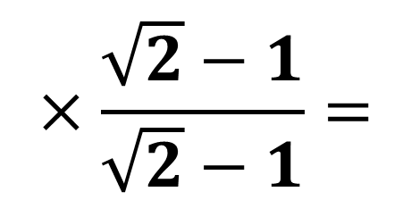
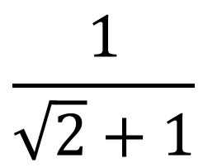
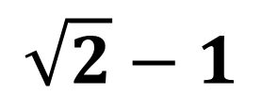
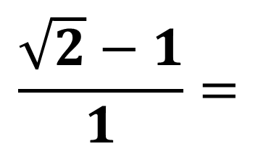
Surds - Rationalising The Denominator
More complicated denominator!
We basically use the same expression
but with the sign
$$\frac{1}{\sqrt{2}+1}$$
$$×\frac{\sqrt{2}−1}{\sqrt{2}−1}=$$
$$\frac{\sqrt{2}−1}{1}=$$
$$\sqrt{2}−1$$

Slide 9
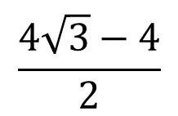
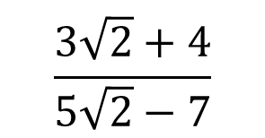
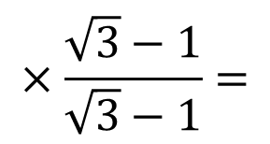

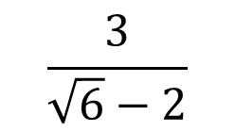
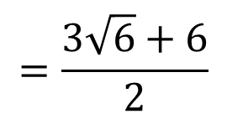
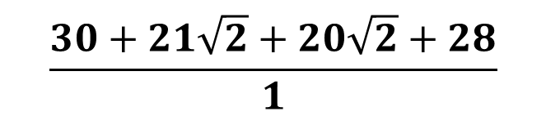
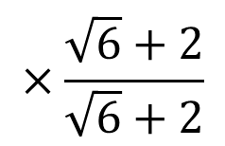
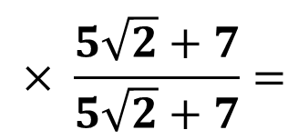
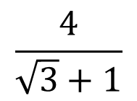

Surds - Rationalising The Denominator
$$\frac{3}{\sqrt{6}−2}$$
$$×\frac{\sqrt{6}+2}{\sqrt{6}+2}$$
$$=\frac{3\sqrt{6}+6}{2}$$
$$\frac{4}{\sqrt{3}+1}$$
$$×\frac{\sqrt{3}−1}{\sqrt{3}−1}=$$
$$\frac{4\sqrt{3}−4}{2}$$
$$=2\sqrt{3}−2$$
$$\frac{3\sqrt{2}+4}{5\sqrt{2}−7}$$
$$× \frac{5\sqrt{2}+7}{5\sqrt{2}+7}=$$
$$\frac{30+21\sqrt{2}+20\sqrt{2}+28}{1}$$
$$= 58+41\sqrt{2}$$

Slide 10
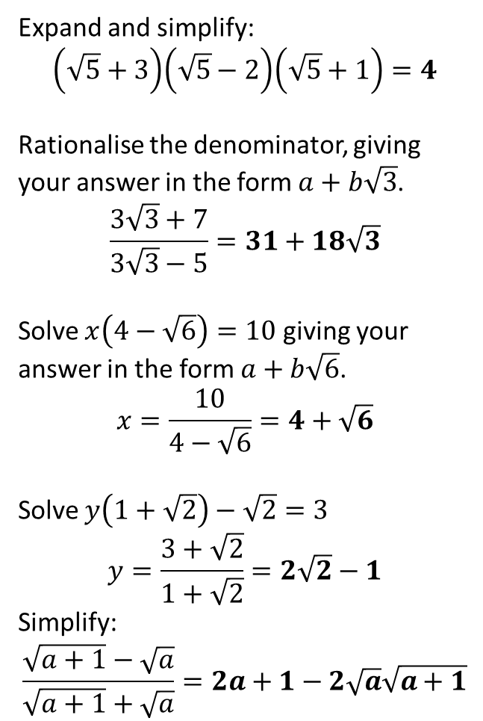
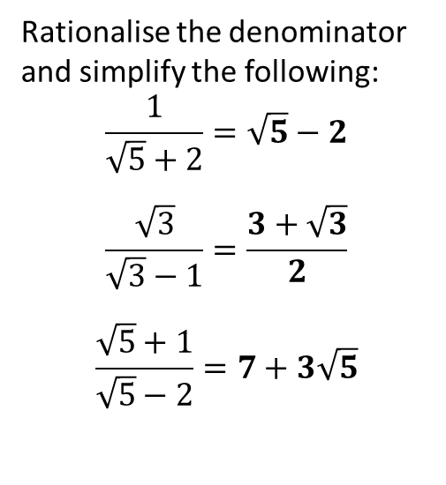
Exercise 1F (Page 15)
or alternatively: (not in textbook)
1
Rationalise the denominator and simplify the following:
$$\frac{1}{\sqrt{5}+2}=\sqrt{5}−2$$
$$\frac{\sqrt{3}}{\sqrt{3}−1}=\frac{3+\sqrt{3}}{2}$$
$$\frac{\sqrt{5}+1}{\sqrt{5}−2}=7+3\sqrt{5}$$
2
Expand and simplify:
$$\left(\sqrt{5}+3\right)\left(\sqrt{5}−2\right)\left(\sqrt{5}+1\right)=4$$
Rationalise the denominator, giving your answer in the form $a+b\sqrt{3}$.
$$\frac{3\sqrt{3}+7}{3\sqrt{3}−5}=31+18\sqrt{3}$$
Solve $x\left(4−\sqrt{6}\right)=10$ giving your answer in the form $a+b\sqrt{6}$.
$$x=\frac{10}{4−\sqrt{6}}=4+\sqrt{6}$$
Solve $y\left(1+\sqrt{2}\right)−\sqrt{2}=3$
$$y=\frac{3+\sqrt{2}}{1+\sqrt{2}}=2\sqrt{2}−1$$
Simplify:
$$\frac{\sqrt{a+1}−\sqrt{a}}{\sqrt{a+1}+\sqrt{a}}=2a+1−2\sqrt{a}\sqrt{a+1}$$
?
?
a
3
?
b
?
c
?
4
?
Complete before the lesson
Q1 from both Ex1E & Ex1F
In Class Ex1C:
Green Ex1E Q2-3
Amber Ex1F2-4
Red Extension Q’s
5
?
6
?

