Slide 1
Year 1 Pure Mathematics
Exponentials and Logs
- Graphing
Chapter 14
(Part 1 of 7)

Slide 2
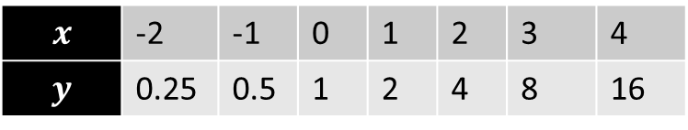

8
20
16
12
8
4
-4
$$y=2^{x}$$
$$x$$ | -2 | -1 | 0 | 1 | 2 | 3 | 4
$$y$$ | 0.25 | 0.5 | 1 | 2 | 4 | 8 | 16
-2 -1 1 2 3 4 5 6 7
Notes:
Get students to sketch axes and tables in their books.

Slide 3
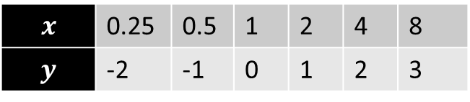

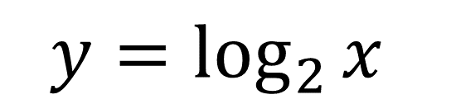
8
4
3
2
1
-1
-2
$$y=\log_{2}{x}$$
$$x$$ | 0.25 | 0.5 | 1 | 2 | 4 | 8
$$y$$ | -2 | -1 | 0 | 1 | 2 | 3
Root is 1.
-2 -1 1 2 3 4 5 6 7
We have a vertical asymptote $x=0$
Notes:
Get students to sketch axes and tables in their books.

Slide 4

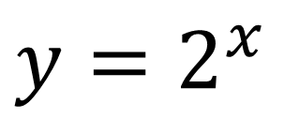
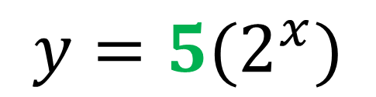
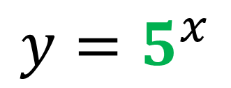
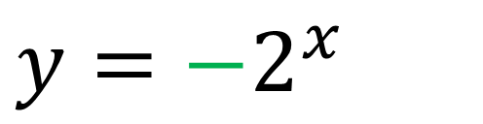
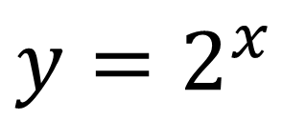
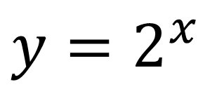
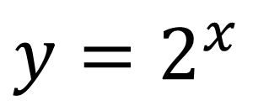
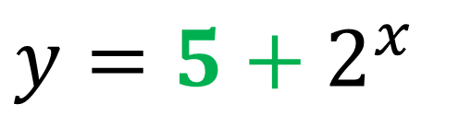
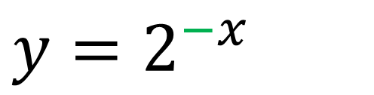
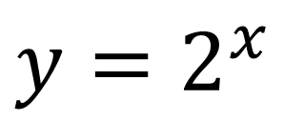
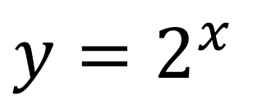
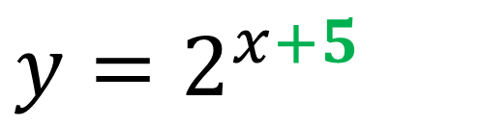
Exponential graphs
Using autograph, plot the following pairs of graphs
and identify the transformation.
A
$y=2^{x}$
and
$$y=5^{x}$$
B
$y=2^{x}$
and
$$y={5(2}^{x})$$
C
$y=2^{x}$
and
$$y=2^{−x}$$
D
$y=2^{x}$
and
$$y={−2}^{x }$$
E
$y=2^{x}$
and
$$y=2^{x+5 }$$
F
$y=2^{x}$
and
$$y={5+2}^{x }$$

Slide 5
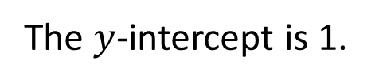






Exponential graphs
Positive power = Increasing gradients
$$y=3^{x}$$
$$y$$
The $y$-intercept is 1.
$$y=2^{x}$$
$$y={1.5}^{x}$$
$$1$$
$$x$$

Slide 6




Exponential graphs
Negative power = Decreasing gradient
$$y=3^{−x}$$
$$y$$
$$y=2^{−x}$$
$$y={1.5}^{−x}$$
$$1$$
$$x$$

Slide 7


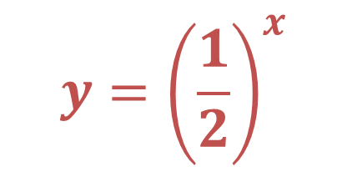


Exponential graphs
Base value between 0 and 1 = decreasing gradient
$$y$$
$$y={\left(\frac{1}{2}\right)}^{x}$$
$$y=2^{x}$$
$$1$$
$$x$$

Slide 8
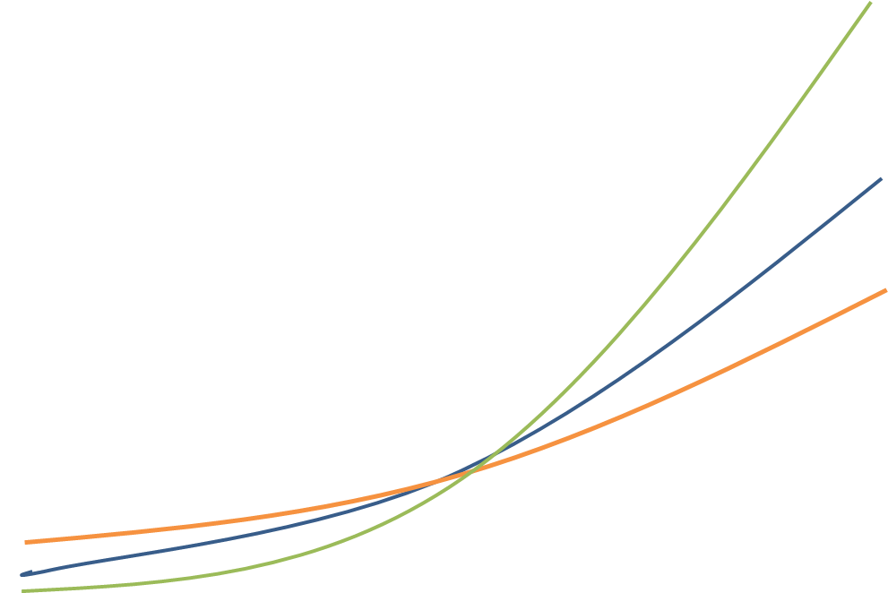









Exponential graphs
Negative coefficient = reflection in the x axis
$$y=3^{x}$$
$$y$$
$$y=2^{x}$$
$$y={1.5}^{x}$$
$$1$$
$$x$$
$$−1$$
$$y=−1{(1.5}^{x})$$
$$y={−1(2}^{x})$$
$$y={−1(3}^{x})$$

Slide 9





Exponential graphs
e is a special value
$$y$$
$$y=e^{x}$$
$$y=2^{x}$$
$$1$$
$$x$$
e ≈ 2.71821

Slide 10







Exponential graphs
Sketch $y={3+ 2}^{x}$
$$y$$
$$y={3+2}^{x}$$
$$y=2^{x}$$
$$4$$
$$1$$
$$x$$
f(x) + 3
translation up by 3

Slide 11



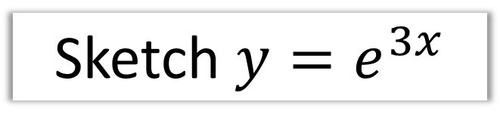


Exponential graphs
Sketch $y=e^{3x}$
$$y$$
$$y=e^{3x}$$
$$y=e^{x}$$
$$1$$
$$x$$
f(3x)
stretch of scale factor $\frac{1}{3}$ on $x$-axis.

Slide 12


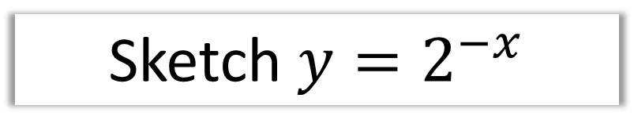
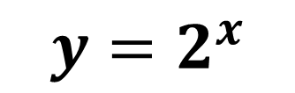
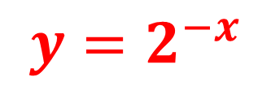

Exponential graphs
Sketch $y=2^{−x}$
$$y$$
$$y=2^{−x}$$
$$y=2^{x}$$
$$1$$
$$x$$
reflection in the y axis

Slide 13




Exponential graphs
Sketch $y=2^{x+3}$
$$y$$
$$y=2^{x+3}$$
$$y=2^{x}$$
$$8$$
$$1$$
$$x$$
f(x + 3)
translation to the left by 3

Slide 14

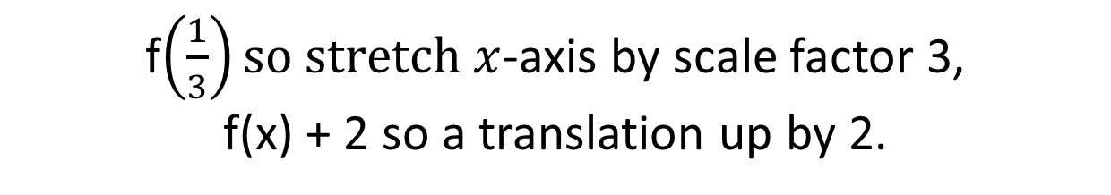
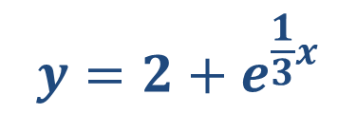
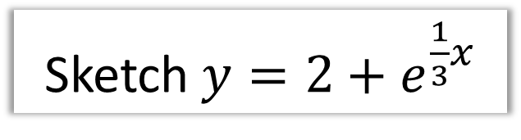





Exponential graphs
Sketch $y=2+e^{\frac{1}{3}x}$
$$y=2+e^{\frac{1}{3}x}$$
$$y$$
$$y=e^{x}$$
$$3$$
$$y=2$$
$$1$$
$$x$$
f$\left(\frac{1}{3}\right)so stretch x$-axis by scale factor 3,
f(x) + 2 so a translation up by 2.

Slide 15


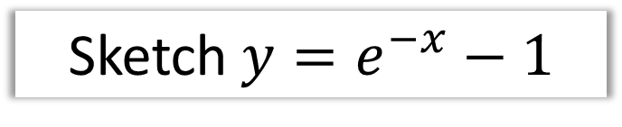



Exponential graphs
Sketch $y=e^{−x}−1$
$$y$$
$$y=e^{−x}−1$$
$$x$$
$$y=−1$$
f$\left(−x\right)$ reflection in the y axis
f(x) – 1 translation down by 1

Slide 16
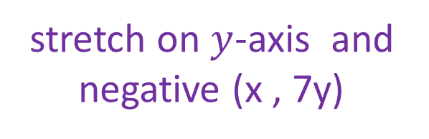
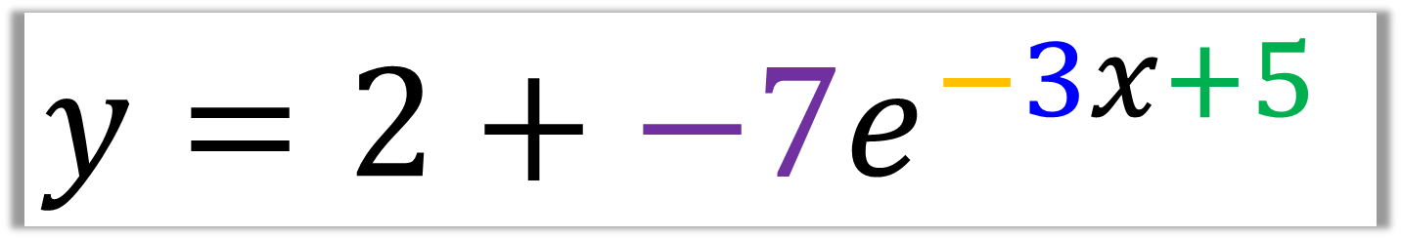
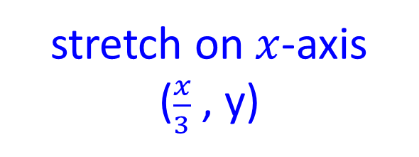
Exponential graphs
$$y=2+{−7e}^{−3x+5}$$
Reflection
in y axis
left and right
up and down
Negative coefficient
reflection on the x axis
stretch on $x$-axis
($\frac{x}{3}$ , y)
stretch on $y$-axis and negative (x , 7y)

Slide 17
Exercise 14A
Pearson Pure Mathematics Year 1/AS
Pages 313-314
Complete before the lesson Ex3B Q2-4
Green Complete Ex3B
Amber Ex3C Q1-6
Red Ex3C Q7-9

