Slide 1
Year 2 Pure Mathematics
Vectors
- Mechanics
Chapter 12
(Part 6 of 6)

Slide 2
Year 2 Pure Mathematics
Velocity is a vector and the magnitude of this vector is the speed.
Mass is a scalar.
Time is a scalar.

Slide 3
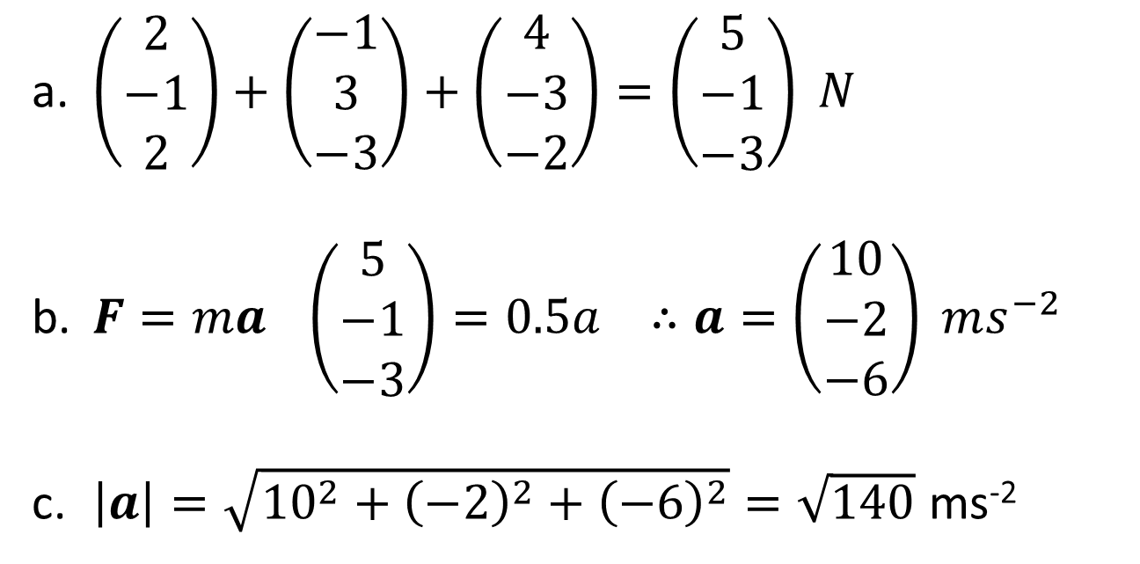
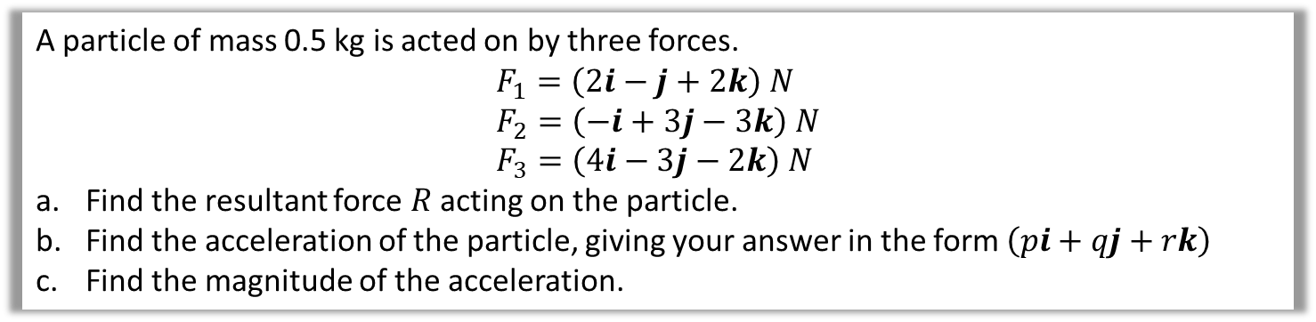
Vectors - Application to Mechanics
A particle of mass 0.5 kg is acted on by three forces.
$$F_{1}=\left(2i−j+2k\right) N \\ F_{2}=\left(−i+3j−3k\right) N \\ F_{3}=\left(4i−3j−2k\right) N$$
Find the resultant force $R$ acting on the particle.
Find the acceleration of the particle, giving your answer in the form $\left(pi+qj+rk\right)$
Find the magnitude of the acceleration.
$\left(\begin{matrix}2 \\ −1 \\ 2\end{matrix}\right)+\left(\begin{matrix}−1 \\ 3 \\ −3\end{matrix}\right)+\left(\begin{matrix}4 \\ −3 \\ −2\end{matrix}\right)=\left(\begin{matrix}5 \\ −1 \\ −3\end{matrix}\right) N$
$F=ma \left(\begin{matrix}5 \\ −1 \\ −3\end{matrix}\right)=0.5a ∴a=\left(\begin{matrix}10 \\ −2 \\ −6\end{matrix}\right) ms^{−2}$
$\left|a\right|=\sqrt{{10}^{2}+{\left(−2\right)}^{2}+{\left(−6\right)}^{2}}=\sqrt{140}$ ms⁻²

Slide 4
Exercise 12D
Pearson Pure Mathematics Year 2/AS
Pages 348-349
Complete before the lesson Q1-3
In Class:
Green Q4
Red Q5-6

