Slide 1
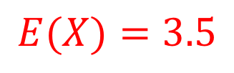



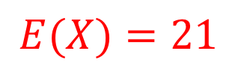
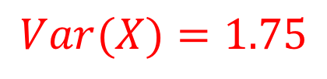
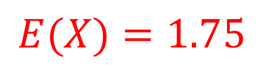






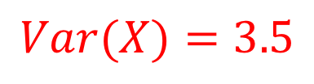

MEAN AND VARIANCE OF THE POISSON DISTRIBUTION
If $X \sim Po(λ)$ then
$$E\left(X\right)=λ$$
$$Var\left(X\right)=λ$$
The number of calls arriving at a switchboard in a 10-minute period can be modelled by a Poisson distribution with parameter 3.5. Give the mean and variance of the number of calls which arrive in
(a) 10 minutes (b) an hour (c) 5 minutes
$$\left(a\right)$$
$$λ=3.5$$
$$\left(b\right)$$
$$λ=21$$
$$\left(c\right)$$
$$λ=1.75$$
$$E(X)=3.5$$
$$E(X)=21$$
$$E(X)=1.75$$
$$Var(X)=3.5$$
$$Var(X)=21$$
$$Var(X)=1.75$$
Notes:
For a Poisson model to be appropriate for a particular situation, you need the mean and variance to be very close to each other.

Slide 2
A dual carriageway has one lane blocked off due to roadworks. The number of cars passing a point in a road in a number of one-minute intervals is summarised in the table.
Calculate the mean and variance of the number of cars passing in one minute intervals.
Is the Poisson distribution likely to be an adequate model for the distribution of the number of cars passing in one-minute intervals?
Number of Cars | 0 | 1 | 2 | 3 | 4 | 5 | 6
Frequency | 3 | 4 | 4 | 25 | 30 | 3 | 1

Slide 3
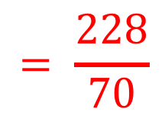
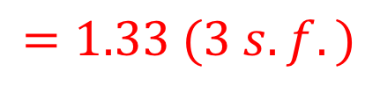
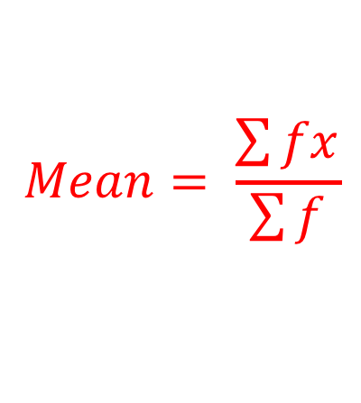
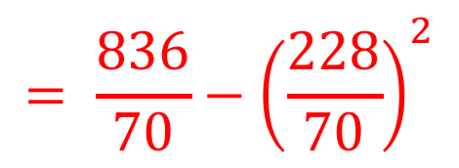
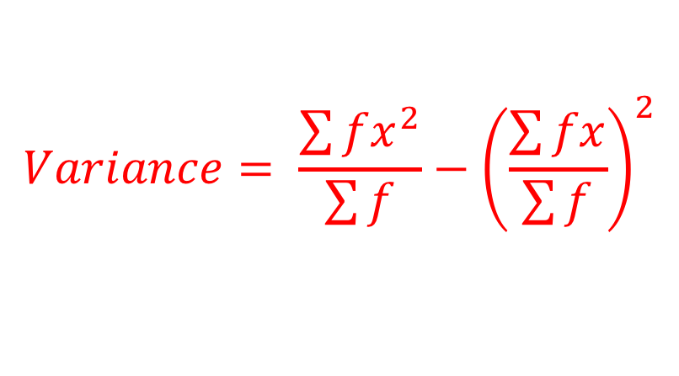
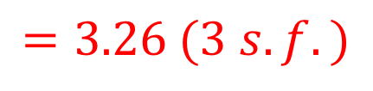
Number of Cars | 0 | 1 | 2 | 3 | 4 | 5 | 6
Frequency | 3 | 4 | 4 | 25 | 30 | 3 | 1
Calculate the mean and variance of the number of cars passing in one minute intervals.
$$Mean= \frac{\sum{fx}}{\sum{f}}$$
$$= \frac{228}{70}$$
$$=3.26 (3 s.f.)$$
$$Variance= \frac{\sum{fx^{2}}}{\sum{f}}−{\left(\frac{\sum{fx}}{\sum{f}}\right)}^{2}$$
$$= \frac{836}{70}−{\left(\frac{228}{70}\right)}^{2}$$
$$=1.33 (3 s.f.)$$

Slide 4


(b) Is the Poisson distribution likely to be an adequate
model for the distribution of the number of cars
passing in one-minute intervals?
$$Mean=3.26$$
$$Variance=1.33$$
For a Poisson distribution to be valid, the mean and variance need to be equal or very close.
In this situation they are not close and so a Poisson distribution would not be a likely model.

Slide 5
The number of cyclists passing a village post office during the day can be modelled as a Poisson random variable.
On average two cyclists pass by in an hour.
What is the probability that
Between 10am and 11am
(i) no cyclists passes (ii) more than 3 cyclists pass
Exactly one cyclist passes while the shop-keeper is on a 20-minute tea break.
More than 3 cyclists pass in an hour exactly once in a six-hour period?

Slide 6

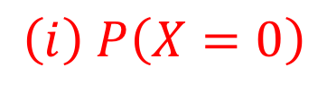
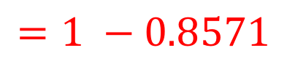
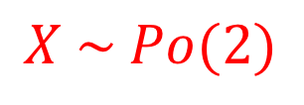
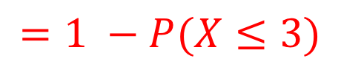
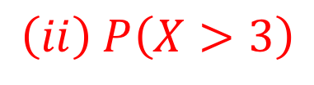

The number of cyclists passing a village post office during the day can be modelled as a Poisson random variable.
On average two cyclists pass by in an hour.
What is the probability that
Between 10am and 11am
(i) no cyclists passes (ii) more than 3 cyclists pass
$$X \sim Po(2)$$
$$\left(i\right) P\left(X=0\right)$$
$$=0.1353$$
$$\left(ii\right) P\left(X>3\right)$$
$$=1 −P(X≤3)$$
$$=1 −0.8571$$
$$=0.1429$$

Slide 7

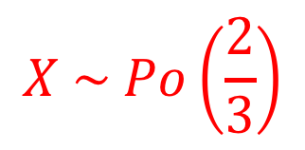
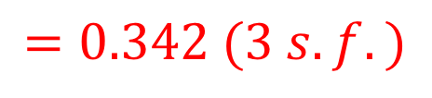
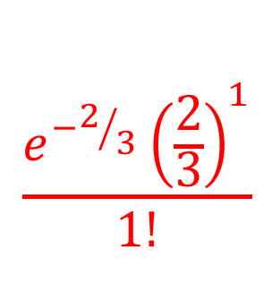
The number of cyclists passing a village post office during the day can be modelled as a Poisson random variable.
On average two cyclists pass by in an hour.
What is the probability that
Exactly one cyclist passes while the shop-keeper is on a 20-minute tea break.
$$X \sim Po\left(\frac{2}{3}\right)$$
$$\frac{e^{−2/3}{\left(\frac{2}{3}\right)}^{1}}{1!}$$
$$P\left(X=1\right)=$$
$$=0.342 (3 s.f.)$$

Slide 8
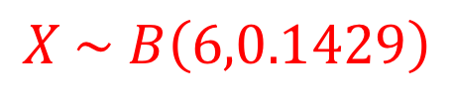

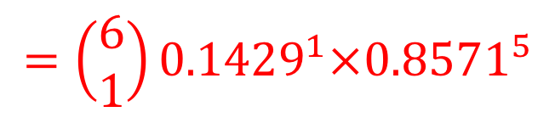
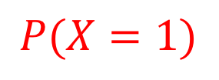
The number of cyclists passing a village post office during the day can be modelled as a Poisson random variable.
On average two cyclists pass by in an hour.
What is the probability that
More than 3 cyclists pass in an hour exactly once in a
  six-hour period?
$$X \sim B\left(6,0.1429\right)$$
$$=\left(\begin{aligned}6 \\ 1\end{aligned}\right){0.1429}^{1}×{0.8571}^{5}$$
$$P(X=1)$$
$$=0.3966$$
Notes:
This is an example of where you are using a Poisson probability within a binomial model – this often happens. You need to read the question for the tell-tale signs – at the end of part (c) you can see a six-hour period, which means n = 6. p = P(more 3 cyclists pass in an hour) which was found in a(ii).

Slide 9
Exercise 2E
Pearson Further Statistics 1
Page 31
Complete before the lesson Q1
In Class:
Green Q2
Amber Q3
Red Challenge

