Slide 1
Series
Twitter: @Owen134866
www.mathsfreeresourcelibrary.com

Slide 2

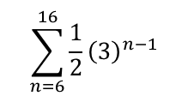

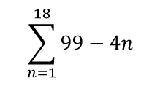

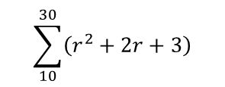
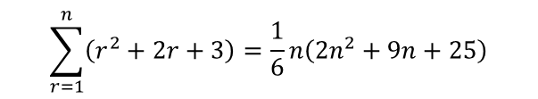

Prior Knowledge Check
Find the sums of the following series:
2) Show that:
$$\sum_{r=1}^{n}{\left(r^{2}+2r+3\right)=\frac{1}{6}n\left({2n}^{2}+9n+25\right)}$$
$$\sum_{n=1}^{18}{99−4n}$$
a)
1098
$$\sum_{10}^{30}{\left(r^{2}+2r+3\right)}$$
Hence, find:
10073
$$\sum_{n=6}^{16}{\frac{1}{2}{\left(3\right)}^{n−1}}$$
b)
10,761,619.5
3) Given that $y=sin3x$, find:
a) $\frac{dy}{dx}$ b) $\frac{d^{2}y}{{dx}^{2}}$
$$3cos3x$$
$$−9sin3x$$

Slide 3
Teachings for
Exercise 2A

Slide 4
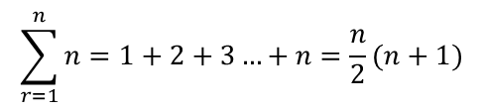
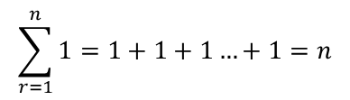
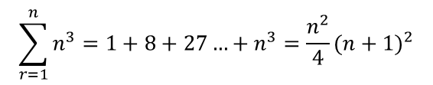
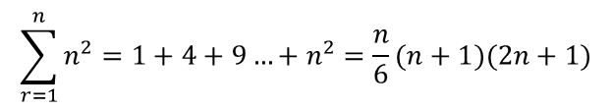
Series
$$\sum_{r=1}^{n}{n=1+2+3…+n=\frac{n}{2}(n+1)}$$
You need to be able to use the method of differences to sum simple finite series
You should (hopefully!) remember the following summations from Core Pure 1:
The sum of the first ‘n’ natural numbers is given by this formula
$$\sum_{r=1}^{n}{1=1+1+1…+1=n}$$
$$\sum_{r=1}^{n}{n^{2}=1+4+9…+n^{2}=\frac{n}{6}(n+1)(2n+1)}$$
The sum of the first ‘n’ square numbers is given by this formula
The sum of ‘n’ 1’s is given by the number n
$$\sum_{r=1}^{n}{n^{3}=1+8+27…+n^{3}=\frac{n^{2}}{4}{(n+1)}^{2}}$$
The sum of the first ‘n’ cube numbers is given by this formula
2A

Slide 5
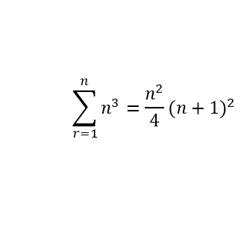

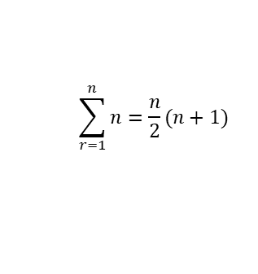

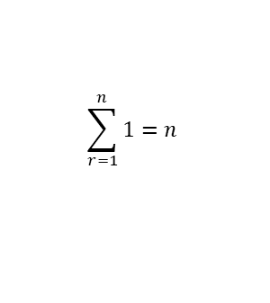

Series
$$\sum_{r=1}^{n}{n=\frac{n}{2}(n+1)}$$
$$\sum_{r=1}^{n}{n^{3}=\frac{n^{2}}{4}{(n+1)}^{2}}$$
$$\sum_{r=1}^{n}{1=n}$$
$$\sum_{r=1}^{n}{n^{2}=\frac{n}{6}(n+1)(2n+1)}$$
You need to be able to use the method of differences to sum simple finite series
You should also (hopefully!) remember this rule:
$$\sum_{r=1}^{n}{{2n}^{2}}$$
You can bring the 2 to the front and then use the summation for n² rather than 2n²!
$$2\sum_{r=1}^{n}{n^{2}}$$
2A

Slide 6
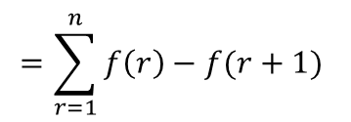
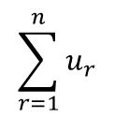

Series
$$\sum_{r=1}^{n}{n=\frac{n}{2}(n+1)}$$
$$\sum_{r=1}^{n}{n^{3}=\frac{n^{2}}{4}{(n+1)}^{2}}$$
$$\sum_{r=1}^{n}{1=n}$$
$$\sum_{r=1}^{n}{n^{2}=\frac{n}{6}(n+1)(2n+1)}$$
You need to be able to use the method of differences to sum simple finite series
The method of differences is as follows to the right:
→ This formula makes sense because if the top parts are equivalent, then their summations must be equal in value as well!
If a sequence can be written as:
$$u_{r}=f\left(r\right)−f(r+1)$$
The general term of the sequence
A function of that term subtract the same function with the next term
Then:
$$\sum_{r=1}^{n}{u_{r}}$$
$$=\sum_{r=1}^{n}{f\left(r\right)−f(r+1) }$$
The sum of ‘n’ general terms
The sum of ‘n’ terms written in this alternative way
2A

Slide 7



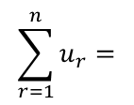






Series
$$\sum_{r=1}^{n}{n=\frac{n}{2}(n+1)}$$
$$\sum_{r=1}^{n}{n^{3}=\frac{n^{2}}{4}{(n+1)}^{2}}$$
$$\sum_{r=1}^{n}{1=n}$$
$$\sum_{r=1}^{n}{n^{2}=\frac{n}{6}(n+1)(2n+1)}$$
$$u_{r}=f\left(r\right)−f(r+1)$$
You need to be able to use the method of differences to sum simple finite series
The method of differences is as follows to the right:
To show where this comes from…
If we imagine what each term will look like, starting with r = 1…
We now want to add all these terms up!!
You hopefully see that almost all the terms will cancel out and you are left with a simple sum instead!
$$u_{1}=f\left(1\right)−f(2)$$
$$u_{2}=f\left(2\right)−f(3)$$
f(5) will cancel with the next term
$$u_{3}=f\left(3\right)−f(4)$$
f(n) will be cancelled by the previous term
$$u_{4}=f\left(4\right)−f(5)$$
$$…$$
$$…$$
$$u_{n}=f\left(n\right)−f(n+1)$$
$$\sum_{r=1}^{n}{u_{r}}=$$
$$f\left(1\right)−f(n+1)$$
With these types of questions you should start by writing out f(1), f(2), f(3) etc, up to f(n) and then look to see what cancels…
→ Sometimes terms cancel the other way round!
2A

Slide 8


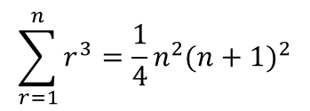





Series
$$\sum_{r=1}^{n}{n=\frac{n}{2}(n+1)}$$
$$\sum_{r=1}^{n}{n^{3}=\frac{n^{2}}{4}{(n+1)}^{2}}$$
$$\sum_{r=1}^{n}{1=n}$$
$$\sum_{r=1}^{n}{n^{2}=\frac{n}{6}(n+1)(2n+1)}$$
You need to be able to use the method of differences to sum simple finite series
Show that:
Hence, prove using the method of differences that:
$$r^{2}{(r+1)}^{2}−{(r−1)}^{2}r^{2}$$
Square the brackets
$$r^{2}(r^{2}+2r+1)$$
$$− (r^{2}−2r+1)r^{2}$$
Now expand the larger bracket. Use brackets again to avoid negative-related mistakes!
$$4r^{3}=r^{2}{(r+1)}^{2}−{(r−1)}^{2}r^{2}$$
$${(r}^{4}+{2r}^{3}+r^{2})$$
$$− (r^{4}−{2r}^{3}+r^{2})$$
All the terms will cancel when grouped except for the x³ ones
$$=4r^{3}$$
$$\sum_{r=1}^{n}{r^{3}=\frac{1}{4}n^{2}{(n+1)}^{2}}$$
2A

Slide 9
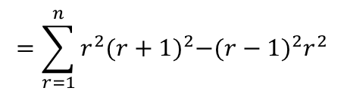


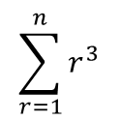

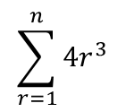






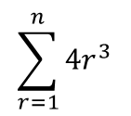






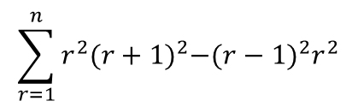

Series
$$\sum_{r=1}^{n}{n=\frac{n}{2}(n+1)}$$
$$\sum_{r=1}^{n}{n^{3}=\frac{n^{2}}{4}{(n+1)}^{2}}$$
$$\sum_{r=1}^{n}{1=n}$$
$$\sum_{r=1}^{n}{n^{2}=\frac{n}{6}(n+1)(2n+1)}$$
$$\sum_{r=1}^{n}{{4r}^{3}}$$
$$=\sum_{r=1}^{n}{r^{2}{(r+1)}^{2}−{(r−1)}^{2}r^{2}}$$
You need to be able to use the method of differences to sum simple finite series
Show that:
Hence, prove using the method of differences that:
Write out the first few terms and the last one, and see what cancels
Add what you have left and this is the sum of the series!
This term will cancel with the next term
$$r=1$$
$${(1)}^{2}{(2)}^{2}$$
$${− (0)}^{2}{(1)}^{2}$$
$$4r^{3}=r^{2}{(r+1)}^{2}−{(r−1)}^{2}r^{2}$$
$$r=2$$
$${(2)}^{2}{(3)}^{2}$$
$${− (1)}^{2}{(2)}^{2}$$
This term will cancel with the previous term
$$r=3$$
$${(3)}^{2}{(4)}^{2}$$
$${− (2)}^{2}{(3)}^{2}$$
$$…$$
$$\sum_{r=1}^{n}{r^{3}=\frac{1}{4}n^{2}{(n+1)}^{2}}$$
$$r=n$$
$${(n)}^{2}{(n+1)}^{2}$$
$${− (n−1)}^{2}{(n)}^{2}$$
$$\sum_{r=1}^{n}{r^{2}{(r+1)}^{2}−{(r−1)}^{2}r^{2}}$$
$$={ n}^{2}{(n+1)}^{2}$$
This is equivalent to the original expression
$$\sum_{r=1}^{n}{{4r}^{3}}$$
$$={ n}^{2}{(n+1)}^{2}$$
$$\sum_{r=1}^{n}{r^{3}}$$
Divide by 4
$$=\frac{1}{4}{ n}^{2}{(n+1)}^{2}$$
2A

Slide 10

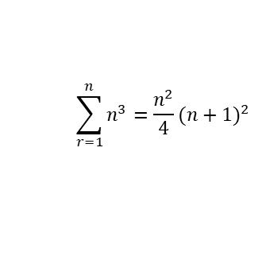

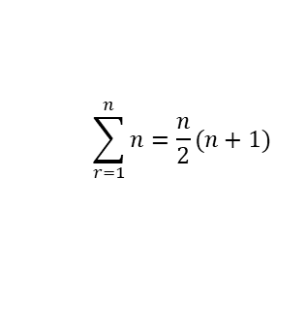


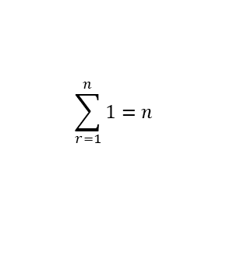

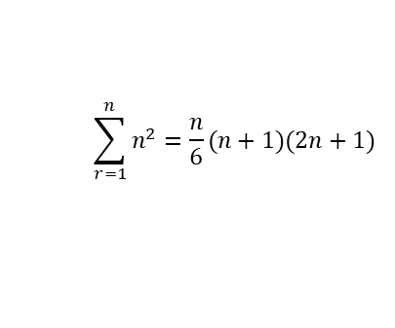

Series
$$\sum_{r=1}^{n}{n=\frac{n}{2}(n+1)}$$
$$\sum_{r=1}^{n}{n^{3}=\frac{n^{2}}{4}{(n+1)}^{2}}$$
$$\sum_{r=1}^{n}{1=n}$$
$$\sum_{r=1}^{n}{n^{2}=\frac{n}{6}(n+1)(2n+1)}$$
You need to be able to use the method of differences to sum simple finite series
Verify that:
And hence find the following using the method of differences:
$$\frac{1}{r}−\frac{1}{r+1}$$
Multiply by the opposite’s denominator to make them equivalent
$$\frac{1(r+1)}{r(r+1)}−\frac{1(r)}{r(r+1)}$$
$$\frac{1}{r(r+1)}=\frac{1}{r}−\frac{1}{r+1}$$
Simplify numerators (you could do this in the first step!)
$$\frac{r+1}{r(r+1)}−\frac{r}{r(r+1)}$$
Group the fractions up and collect like terms where possible
$$=\frac{1}{r(r+1)}$$
$$\sum_{r=1}^{n}{ \frac{1}{r(r+1)}}$$
2A

Slide 11
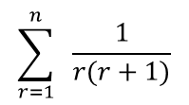




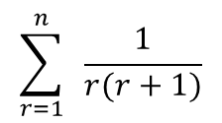








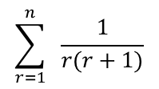


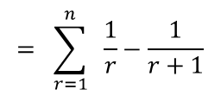


Series
$$\sum_{r=1}^{n}{n=\frac{n}{2}(n+1)}$$
$$\sum_{r=1}^{n}{n^{3}=\frac{n^{2}}{4}{(n+1)}^{2}}$$
$$\sum_{r=1}^{n}{1=n}$$
$$\sum_{r=1}^{n}{n^{2}=\frac{n}{6}(n+1)(2n+1)}$$
$$\sum_{r=1}^{n}{ \frac{1}{r(r+1)}}$$
$$= \sum_{r=1}^{n}{ \frac{1}{r}−\frac{1}{r+1}}$$
You need to be able to use the method of differences to sum simple finite series
Verify that:
And hence find the following using the method of differences:
As before, write out the first few terms and then the last one
Cancel where possible and simplify the answer!
This term will cancel with the next term
$$r=1$$
$$\frac{1}{1}$$
$$− \frac{1}{2}$$
$$r=2$$
$$\frac{1}{2}$$
$$− \frac{1}{3}$$
$$\frac{1}{r(r+1)}=\frac{1}{r}−\frac{1}{r+1}$$
$$r=3$$
$$\frac{1}{3}$$
$$− \frac{1}{4}$$
This term will cancel with the previous term
$$…$$
$$\sum_{r=1}^{n}{ \frac{1}{r(r+1)}}$$
$$r=n$$
$$\frac{1}{n}$$
$$− \frac{1}{n+1}$$
$$\sum_{r=1}^{n}{ \frac{1}{r(r+1)}}$$
$$= 1−\frac{1}{n+1}$$
Write ‘1’ with the denominator ‘n + 1’ so it can be grouped up
$$= \frac{n+1}{n+1}−\frac{1}{n+1}$$
Group fractions
$$= \frac{n}{n+1}$$
2A

Slide 12











Series
$$\sum_{r=1}^{n}{n=\frac{n}{2}(n+1)}$$
$$\sum_{r=1}^{n}{n^{3}=\frac{n^{2}}{4}{(n+1)}^{2}}$$
$$\sum_{r=1}^{n}{1=n}$$
$$\sum_{r=1}^{n}{n^{2}=\frac{n}{6}(n+1)(2n+1)}$$
$$\frac{1}{{4r}^{2}−1}$$
You need to be able to use the method of differences to sum simple finite series
Find the following summation using the method of differences:
Firstly you will need to express this as two functions, one subtract the other
→ You can do this by writing the expression using partial fractions
Factorise the denominator
$$=\frac{1}{(2r+1)(2r−1)}$$
Write as separate fractions added together – we need to find the numerators
$$=\frac{A}{2r+1}+\frac{B}{2r−1}$$
Multiply each fraction by the opposite’s denominator
$$\sum_{r=1}^{n}{ \frac{1}{{4r}^{2}−1}}$$
$$=\frac{A(2r−1)}{(2r+1)(2r−1)}+\frac{B(2r+1)}{(2r+1)(2r−1)}$$
Group up
$$=\frac{A\left(2r−1\right)+B(2r+1)}{(2r+1)(2r−1)}$$
The value of the numerator must be equal to 1, as above…
$$A\left(2r−1\right)+B\left(2r+1\right)=1$$
Let r = ¹/₂
Let r = -¹/₂
$$2B=1$$
$$−2A=1$$
$$B=\frac{1}{2}$$
Calculate
$$A=−\frac{1}{2}$$
Calculate
2A

Slide 13



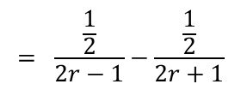
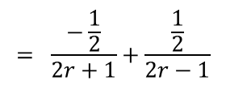

Series
$$\sum_{r=1}^{n}{n=\frac{n}{2}(n+1)}$$
$$\sum_{r=1}^{n}{n^{3}=\frac{n^{2}}{4}{(n+1)}^{2}}$$
$$\sum_{r=1}^{n}{1=n}$$
$$\sum_{r=1}^{n}{n^{2}=\frac{n}{6}(n+1)(2n+1)}$$
$$\frac{1}{{4r}^{2}−1}$$
$$= \frac{A}{2r+1}+\frac{B}{2r−1}$$
$$A=−\frac{1}{2}$$
$$B=\frac{1}{2}$$
You need to be able to use the method of differences to sum simple finite series
Find the following summation using the method of differences:
Firstly you will need to express this as two functions, one subtract the other
→ You can do this by writing the expression using partial fractions
Sub in values for A and B
$$= \frac{−\frac{1}{2}}{2r+1}+\frac{\frac{1}{2}}{2r−1}$$
Swap the fractions (just to make it look simpler!)
$$\sum_{r=1}^{n}{ \frac{1}{{4r}^{2}−1}}$$
$$= \frac{\frac{1}{2}}{2r−1}−\frac{\frac{1}{2}}{2r+1}$$
Take ¹/₂ out as a factor (again to make it look simpler!)
$$= \frac{1}{2}\left(\frac{1}{2r−1}−\frac{1}{2r+1}\right)$$
2A

Slide 14
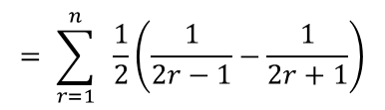



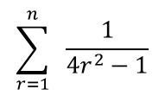











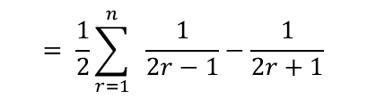
Series
$$\sum_{r=1}^{n}{n=\frac{n}{2}(n+1)}$$
$$\sum_{r=1}^{n}{n^{3}=\frac{n^{2}}{4}{(n+1)}^{2}}$$
$$\sum_{r=1}^{n}{1=n}$$
$$\sum_{r=1}^{n}{n^{2}=\frac{n}{6}(n+1)(2n+1)}$$
$$\sum_{r=1}^{n}{ \frac{1}{{4r}^{2}−1}}$$
$$= \sum_{r=1}^{n}{ \frac{1}{2}\left(\frac{1}{2r−1}−\frac{1}{2r+1}\right)}$$
You need to be able to use the method of differences to sum simple finite series
Find the following summation using the method of differences:
→ As before, write out the first few terms and the last term
→ You can ignore the ‘¹/₂’ at the start and put it back in at the end…
Move the ‘¹/₂’ to the start
$$= \frac{1}{2}\sum_{r=1}^{n}{ \frac{1}{2r−1}−\frac{1}{2r+1}}$$
$$\frac{1}{1}$$
$$− \frac{1}{3}$$
$$\sum_{r=1}^{n}{ \frac{1}{{4r}^{2}−1}}$$
$$r=1$$
This term will cancel with the next term
$$\frac{1}{3}$$
$$− \frac{1}{5}$$
$$r=2$$
$$\frac{1}{5}$$
$$− \frac{1}{7}$$
This term will cancel with the previous term
$$r=3$$
$$…$$
$$\frac{1}{2n−1}$$
$$− \frac{1}{2n+1}$$
$$r=n$$
$$=1−\frac{1}{2n+1}$$
Don’t forget to bring the ‘¹/₂’ back!
$$=\frac{1}{2}\left(1−\frac{1}{2n+1}\right)$$
2A

Slide 15




Series
$$\sum_{r=1}^{n}{n=\frac{n}{2}(n+1)}$$
$$\sum_{r=1}^{n}{n^{3}=\frac{n^{2}}{4}{(n+1)}^{2}}$$
$$\sum_{r=1}^{n}{1=n}$$
$$\sum_{r=1}^{n}{n^{2}=\frac{n}{6}(n+1)(2n+1)}$$
$$\sum_{r=1}^{n}{ \frac{1}{{4r}^{2}−1}}$$
$$= \sum_{r=1}^{n}{ \frac{1}{2}\left(\frac{1}{2r−1}−\frac{1}{2r+1}\right)}$$
You need to be able to use the method of differences to sum simple finite series
Find the following summation using the method of differences:
→ As before, write out the first few terms and the last term
→ You can ignore the ‘¹/₂’ at the start and put it back in at the end…
$$= \frac{1}{2}\sum_{r=1}^{n}{ \frac{1}{2r−1}−\frac{1}{2r+1}}$$
$$=\frac{1}{2}\left(1−\frac{1}{2n+1}\right)$$
$$\sum_{r=1}^{n}{ \frac{1}{{4r}^{2}−1}}$$
Write ‘1’ as a fraction with the same denominator
$$=\frac{1}{2}\left(\frac{2n+1}{2n+1}−\frac{1}{2n+1}\right)$$
Group up
$$=\frac{1}{2}\left(\frac{2n}{2n+1}\right)$$
Simplify
$$=\frac{n}{2n+1}$$
2A

Slide 16
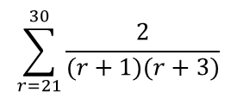

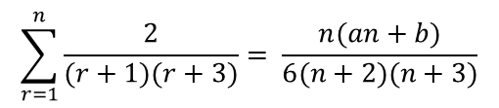









Series
$$\sum_{r=1}^{n}{n=\frac{n}{2}(n+1)}$$
$$\sum_{r=1}^{n}{n^{3}=\frac{n^{2}}{4}{(n+1)}^{2}}$$
$$\sum_{r=1}^{n}{1=n}$$
$$\sum_{r=1}^{n}{n^{2}=\frac{n}{6}(n+1)(2n+1)}$$
$$\frac{2}{(r+1)(r+3)}$$
You need to be able to use the method of differences to sum simple finite series
a) Express the following using partial fractions:
b) Hence prove, by the method of differences, that:
Where a and b are constants to be found.
c) Find the value of the following to 5 decimal places:
Write as separate fractions
$$=\frac{A}{(r+1)}+\frac{B}{(r+3)}$$
Multiply by the opposite denominator and group up
$$=\frac{A\left(r+3\right)+B(r+1)}{(r+1)(r+3)}$$
$$\frac{2}{(r+1)(r+3)}$$
$$A\left(r+3\right)+B\left(r+1\right)=2$$
Let r = -1
Let r = -3
$$\sum_{r=1}^{n}{\frac{2}{(r+1)(r+3)}}= \frac{n(an+b)}{6(n+2)(n+3)}$$
$$2A=2$$
$$−2B=2$$
$$A=1$$
$$B=−1$$
$$=\frac{1}{(r+1)}−\frac{1}{(r+3)}$$
$$\sum_{r=21}^{30}{\frac{2}{(r+1)(r+3)}}$$
2A

Slide 17
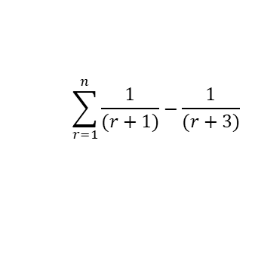





















Series
$$\sum_{r=1}^{n}{n=\frac{n}{2}(n+1)}$$
$$\sum_{r=1}^{n}{n^{3}=\frac{n^{2}}{4}{(n+1)}^{2}}$$
$$\sum_{r=1}^{n}{1=n}$$
$$\sum_{r=1}^{n}{n^{2}=\frac{n}{6}(n+1)(2n+1)}$$
You need to be able to use the method of differences to sum simple finite series
a) Express the following using partial fractions:
b) Hence prove, by the method of differences, that:
Where a and b are constants to be found.
c) Find the value of the following to 5 decimal places:
$$\frac{2}{(r+1)(r+3)}=\frac{1}{(r+1)}−\frac{1}{(r+3)}$$
This is slightly different, terms cancel with those 2 positions earlier/later!
(This is why r = n – 1 has been included…)
$$\sum_{r=1}^{n}{\frac{1}{(r+1)}−\frac{1}{(r+3)}}$$
$$\frac{2}{(r+1)(r+3)}$$
$$r=1$$
$$\frac{1}{2}$$
$$− \frac{1}{4}$$
$$r=2$$
$$\frac{1}{3}$$
$$− \frac{1}{5}$$
These terms will cancel with those 2 ahead
$$r=3$$
$$\frac{1}{4}$$
$$− \frac{1}{6}$$
$$\sum_{r=1}^{n}{\frac{2}{(r+1)(r+3)}}= \frac{n(an+b)}{6(n+2)(n+3)}$$
$$\frac{1}{5}$$
$$− \frac{1}{7}$$
$$r=4$$
These terms will cancel with those 2 before
$$…$$
$$r=n−1$$
$$\frac{1}{n}$$
$$− \frac{1}{n+2}$$
$$r=n$$
$$\frac{1}{n+1}$$
$$− \frac{1}{n+3}$$
$$\sum_{r=21}^{30}{\frac{2}{(r+1)(r+3)}}$$
Now we need to group these up by making the denominators equivalent…
$$= \frac{1}{2}+\frac{1}{3}−\frac{1}{n+2}−\frac{1}{n+3}$$
2A

Slide 18









Series
$$\sum_{r=1}^{n}{n=\frac{n}{2}(n+1)}$$
$$\sum_{r=1}^{n}{n^{3}=\frac{n^{2}}{4}{(n+1)}^{2}}$$
$$\sum_{r=1}^{n}{1=n}$$
$$\sum_{r=1}^{n}{n^{2}=\frac{n}{6}(n+1)(2n+1)}$$
You need to be able to use the method of differences to sum simple finite series
a) Express the following using partial fractions:
b) Hence prove, by the method of differences, that:
Where a and b are constants to be found.
c) Find the value of the following to 5 decimal places:
$$\frac{1}{2}+\frac{1}{3}−\frac{1}{n+2}−\frac{1}{n+3}$$
You need to make all the denominators equivalent (into 6(n+2)(n+3) )
→ Multiply each fraction by all the other denominators
$$= \frac{3(n+2)(n+3)}{6(n+2)(n+3)}$$
$$+ \frac{2(n+2)(n+3)}{6(n+2)(n+3)}$$
$$− \frac{6(n+3)}{6(n+2)(n+3)}$$
$$− \frac{6(n+2)}{6(n+2)(n+3)}$$
$$\frac{2}{(r+1)(r+3)}$$
Group up!
$$= \frac{3\left(n+2\right)\left(n+3\right)+2\left(n+2\right)\left(n+3\right)−6\left(n+3\right)−6(n+2)}{6(n+2)(n+3)}$$
Multiply out the brackets
$$\sum_{r=1}^{n}{\frac{2}{(r+1)(r+3)}}= \frac{n(an+b)}{6(n+2)(n+3)}$$
$$= \frac{3n^{2}+15n+18+2n^{2}+10n+12−6n−18−6n−12}{6(n+2)(n+3)}$$
Group terms
$$= \frac{5n^{2}+13n}{6(n+2)(n+3)}$$
Factorise the numerator
$$\sum_{r=21}^{30}{\frac{2}{(r+1)(r+3)}}$$
$$= \frac{n(5n+13)}{6(n+2)(n+3)}$$
2A

Slide 19
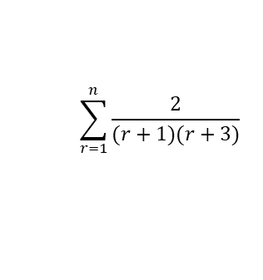



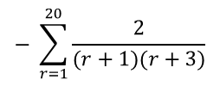


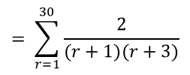



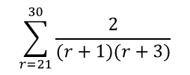

Series
$$\sum_{r=1}^{n}{n=\frac{n}{2}(n+1)}$$
$$\sum_{r=1}^{n}{n^{3}=\frac{n^{2}}{4}{(n+1)}^{2}}$$
$$\sum_{r=1}^{n}{1=n}$$
$$\sum_{r=1}^{n}{n^{2}=\frac{n}{6}(n+1)(2n+1)}$$
You need to be able to use the method of differences to sum simple finite series
a) Express the following using partial fractions:
b) Hence prove, by the method of differences, that:
Where a and b are constants to be found.
c) Find the value of the following to 5 decimal places:
$$\sum_{r=1}^{n}{\frac{2}{(r+1)(r+3)}}$$
$$= \frac{n(5n+13)}{6(n+2)(n+3)}$$
We need to find the sum of terms 21 to 30 (so 1-30 subtract 1-20)
→ This was covered in FP1!
$$\sum_{r=21}^{30}{\frac{2}{(r+1)(r+3)}}$$
$$= \sum_{r=1}^{30}{\frac{2}{(r+1)(r+3)}}$$
$$− \sum_{r=1}^{20}{\frac{2}{(r+1)(r+3)}}$$
We will need to use the formula from b) with two inputs
$$\frac{2}{(r+1)(r+3)}$$
$$= \frac{n(5n+13)}{6(n+2)(n+3)}$$
$$− \frac{n(5n+13)}{6(n+2)(n+3)}$$
Sub in n = 30 and n = 20
$$= \frac{(30)(5(30)+13)}{6(30+2)(30+3)}$$
$$− \frac{(20)(5(20)+13)}{6(20+2)(20+3)}$$
$$\sum_{r=1}^{n}{\frac{2}{(r+1)(r+3)}}= \frac{n(an+b)}{6(n+2)(n+3)}$$
Calculate
$$= \frac{815}{1056}$$
$$− \frac{565}{759}$$
Group up
$$= \frac{665}{24288}$$
Give the answer in the required form
$$\sum_{r=21}^{30}{\frac{2}{(r+1)(r+3)}}$$
$$=0.02738 (2dp)$$
2A

Slide 20
Exercise 2A
Pearson Core Pure Year 2
Pages 36-37
Note: This exercise has few examples of the “differ by 2” type questions that were extremely common in the old FP2 exams.
I have a compilation of exam questions on this topic here:
https://www.drfrostmaths.com/resource.php?rid=19
Complete before the lesson Q1-2
In Class:
Green Q3-4
Amber Q5-7
Red Q8-13 & Challenge

