Slide 1
Year 2 Pure Mathematics
Parametric Equations
- Trig Identities
Chapter 8
(Part 2 of 3)

Slide 2
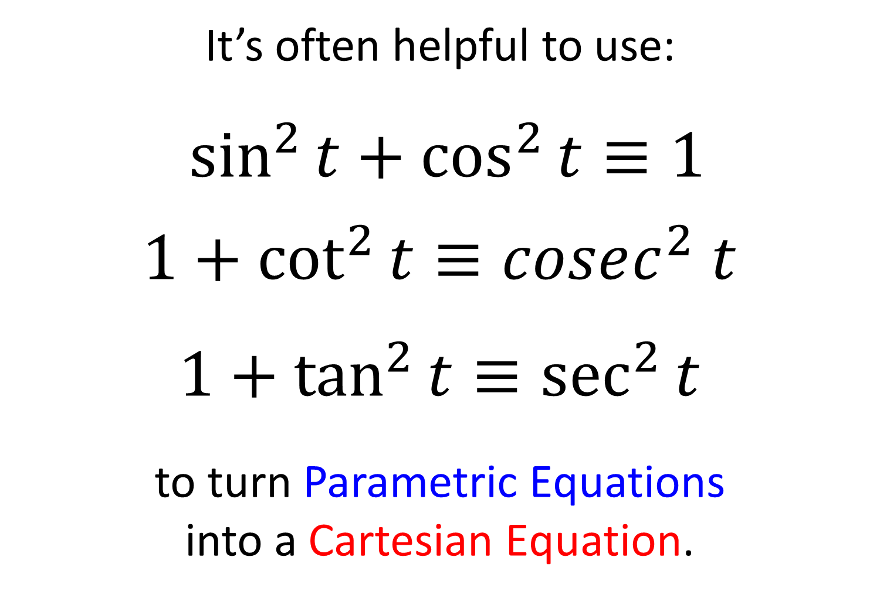
Parametric Equations - Trig Identities
It’s often helpful to use:
$\sin^{2}{t}+\cos^{2}{t}≡1$
$1+\cot^{2}{t}≡cosec^{2} t$
$1+\tan^{2}{t}≡\sec^{2}{t}$
to turn Parametric Equations
into a Cartesian Equation.

Slide 3
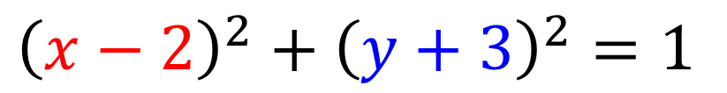
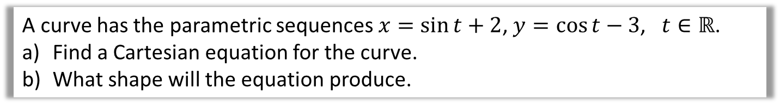
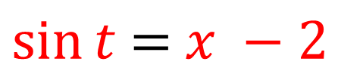
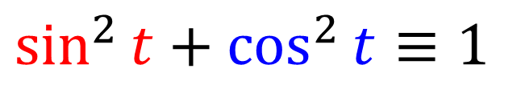
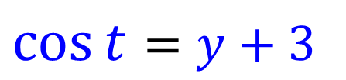
Parametric Equations - Trig Identities
A curve has the parametric sequences $x=\sin{t}+2$, $y=\cos{t}−3$, $t∈ℝ$.
Find a Cartesian equation for the curve.
What shape will the equation produce.
Make sin t the
subject of the equation
$\sin{t}$ $=$ $x −2$
Make cos t the
subject of the equation
$$\cos{t}=y+3$$
$$\sin^{2}{t}+\cos^{2}{t}≡1$$
Use the identity:
Substitution:
$${\left(x−2\right)}^{2}+{\left(y+3\right)}^{2}=1$$
A circle!

Slide 4
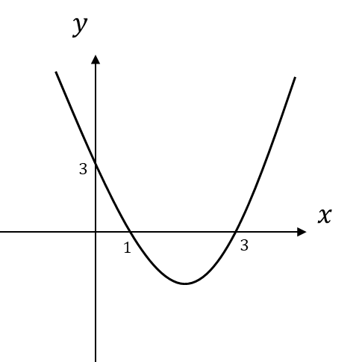
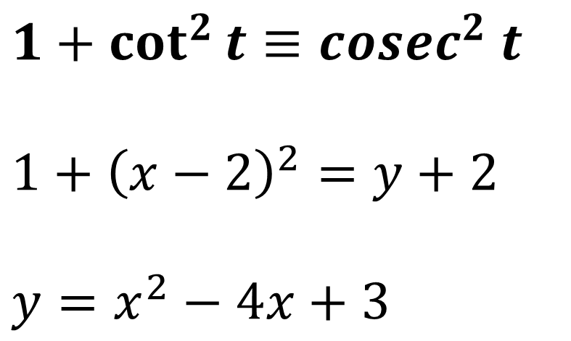
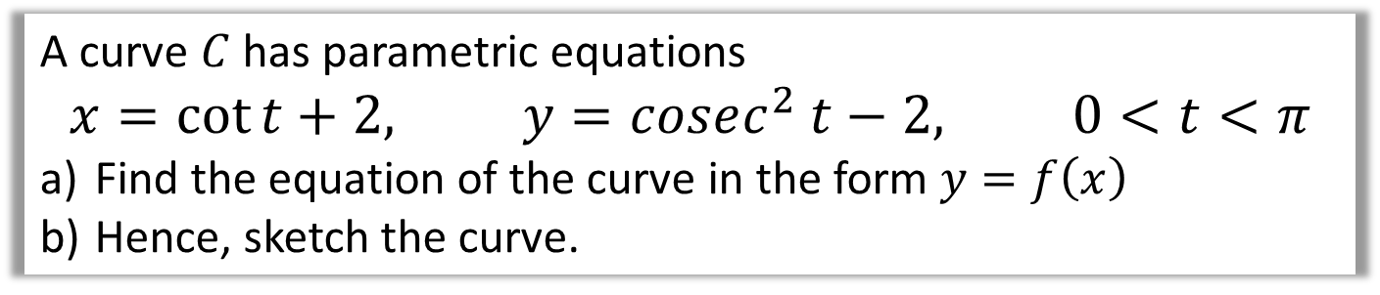
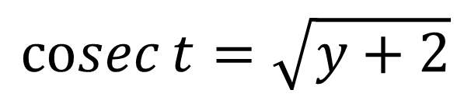
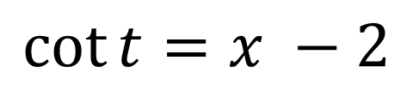
Parametric Equations - Trig Identities
A curve $C$ has parametric equations
$$x=\cot{t}+2, y=cosec^{2} t−2, 0<t<π$$
Find the equation of the curve in the form $y=f\left(x\right)$
Hence, sketch the curve.
$$\cot{t}=x −2$$
$$\operatorname{cosec}{t}=\sqrt{y+2}$$
$$1+\cot^{2}{t}≡cosec^{2} t$$
$$1+{\left(x−2\right)}^{2}=y+2$$
$$y=x^{2}−4x+3$$

Slide 5
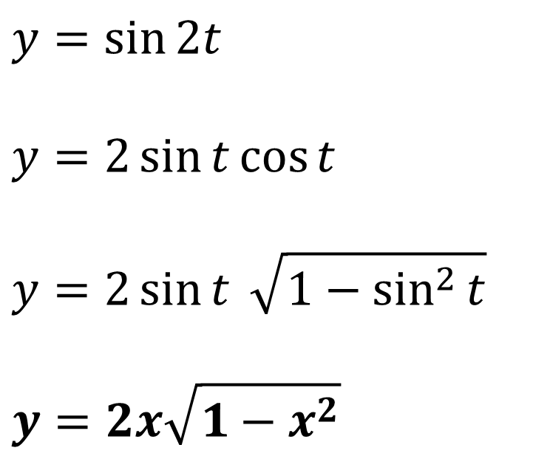
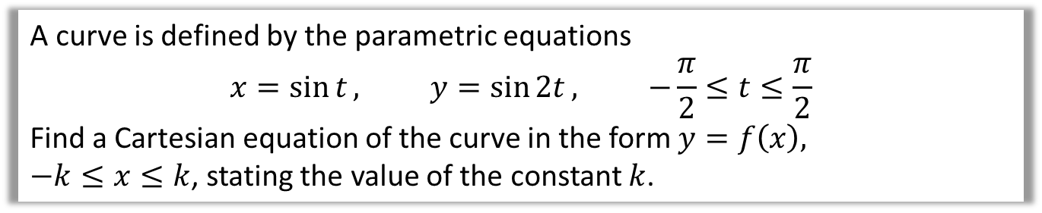
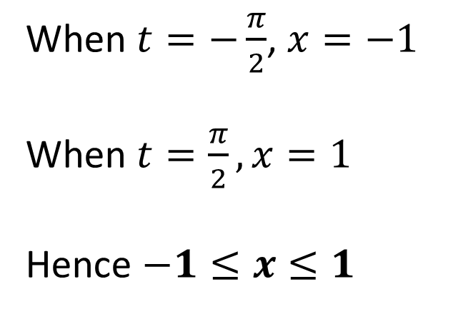
Parametric Equations - Trig Identities
A curve is defined by the parametric equations
$$x=\sin{t}, y=\sin{2t}, −\frac{π}{2}≤t≤\frac{π}{2}$$
Find a Cartesian equation of the curve in the form $y=f\left(x\right),$
$−k≤x≤k$, stating the value of the constant $k$.
When $t=−\frac{π}{2}$, $x=−1$
When $t=\frac{π}{2}, x=1$
Hence $−1≤x≤1$
$$y=\sin{2t}$$
$$y=2\sin{t}\cos{t}$$
$$y=2\sin{t} \sqrt{1−\sin^{2}{t}}$$
$$y=2x\sqrt{1−x^{2}}$$

Slide 6
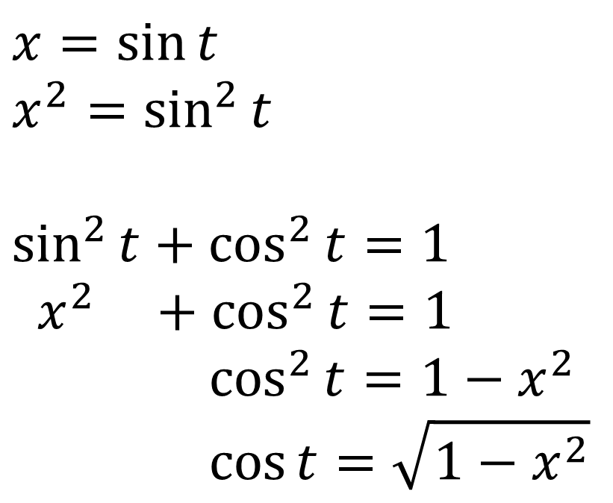
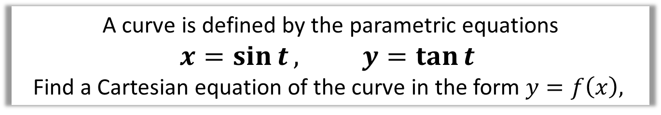
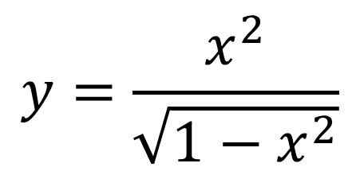
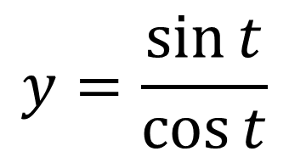
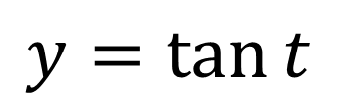
Parametric Equations - Trig Identities
A curve is defined by the parametric equations
$$x=\sin{t}, y=\tan{t}$$
Find a Cartesian equation of the curve in the form $y=f\left(x\right),$
$$x=\sin{t}$$
$$x^{2}=\sin^{2}{t}$$
$$\sin^{2}{t}+\cos^{2}{t}=1$$
$$x^{2} +\cos^{2}{t}=1$$
$$\cos^{2}{t}=1−x^{2}$$
$$\cos{t}=\sqrt{1−x^{2}}$$
$$y=\tan{t}$$
$$y=\frac{\sin{t}}{\cos{t}}$$
$$y=\frac{x^{2}}{\sqrt{1−x^{2}}}$$

Slide 7
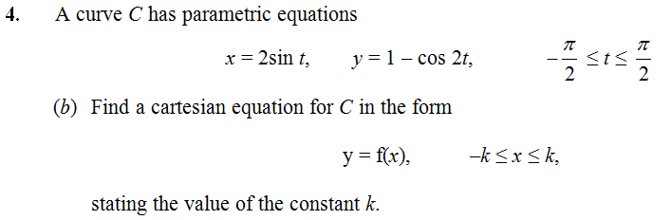
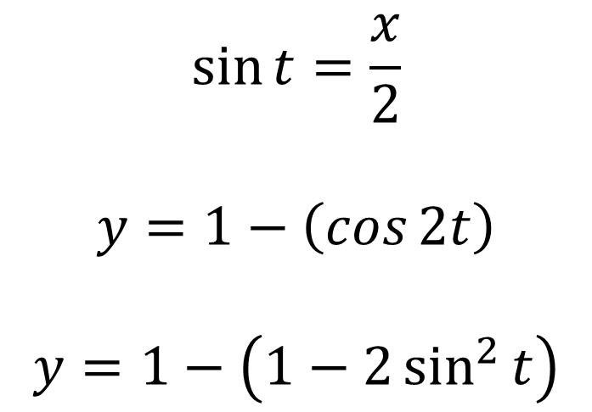

Parametric Equations - Trig Identities
$$\sin{t}=\frac{x}{2}$$
$$y=1−\left(\cos{2t}\right)$$
$$y=1−\left(1−2\sin^{2}{t}\right)$$
$$y=2\sin^{2}{t}$$
$$y=2{\left(\frac{x}{2}\right)}^{2}$$
$$y=\frac{x^{2}}{2}$$
$$k=2$$
Double angle formula

Slide 8
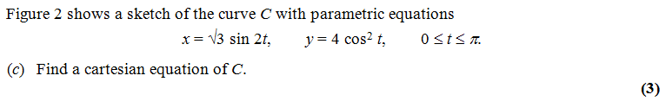

Exercise 8B
Pearson Pure Mathematics Year 2/AS
Pages 204-206
Complete before the lesson Q1-2
In Class:
Green Q4-5
Amber Q6-8
Red Q9-11 & Challenge & Ext
Further Exam Practice
?
$$x=2\sqrt{3}\sin{t}\cos{t} \\ x^{2}=12\sin^{2}{t}\cos^{2}{t} \\ x^{2}=12\left(1−\cos^{2}{t}\right)\cos^{2}{t} \\ x^{2}=12\left(1−\frac{y}{4}\right)\left(\frac{y}{4}\right)$$
C4 June 2012 Q6

