Slide 1
Year 2 Applied Mathematics
Probability
- Set Notation
Chapter 2
(Part 1 of 4)

Slide 2
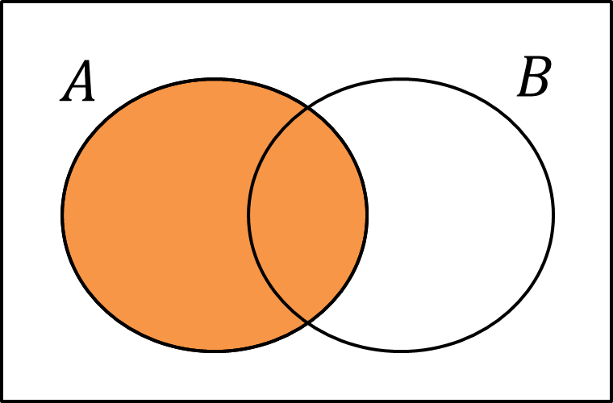
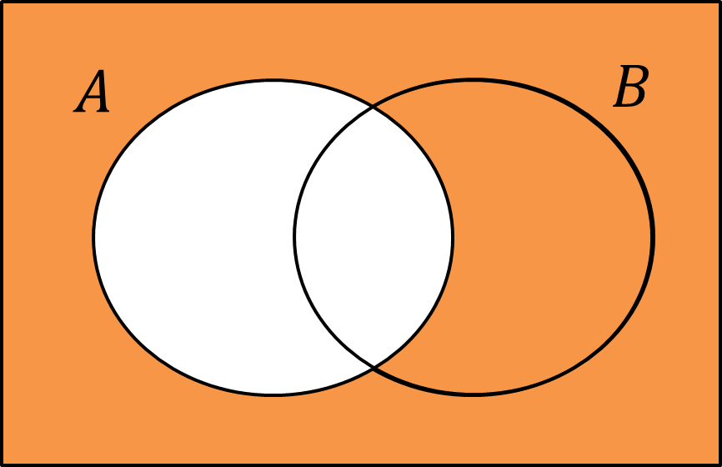
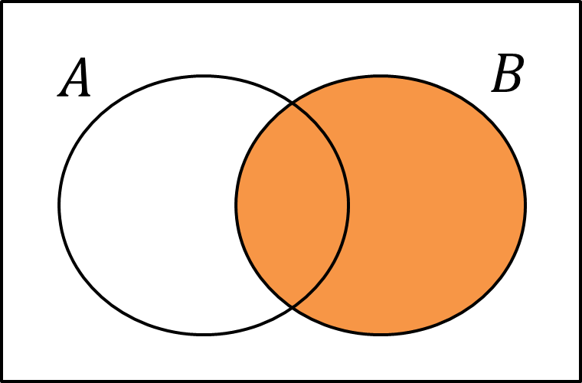
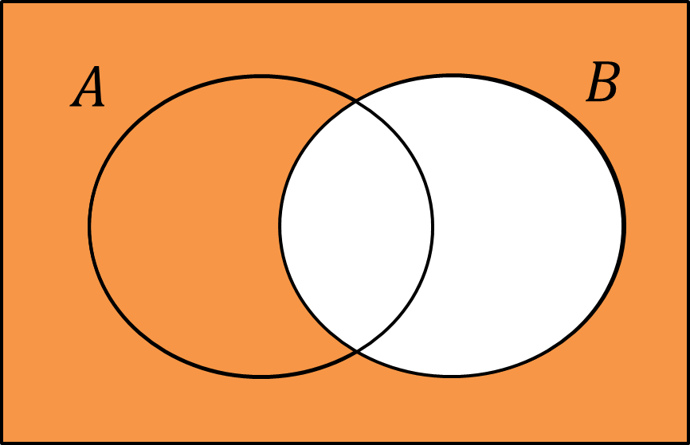
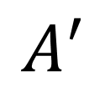
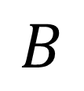
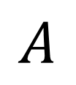
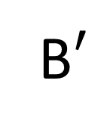
Set Notion - Venn Diagrams
$$A$$
$$A′$$
$$B$$
B$′$

Slide 3
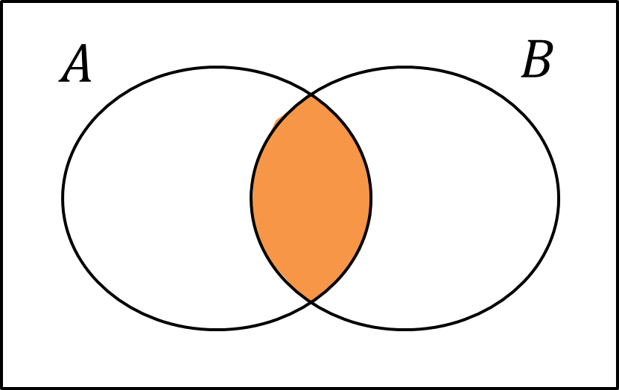
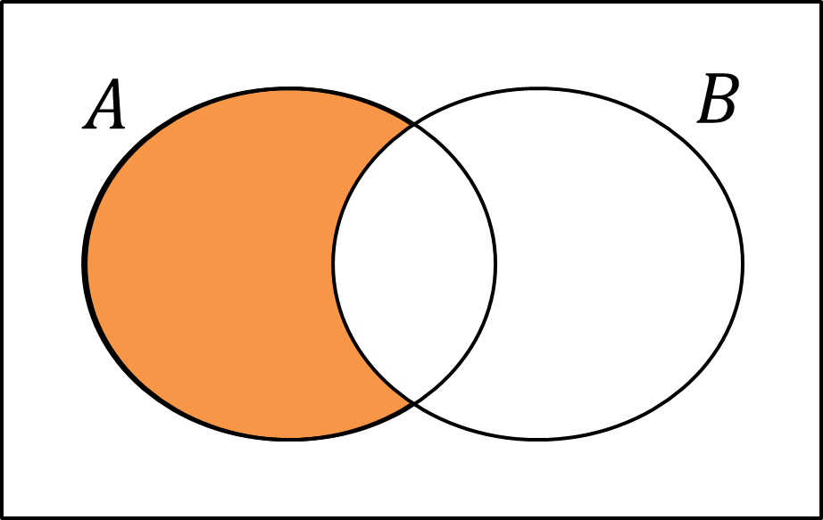
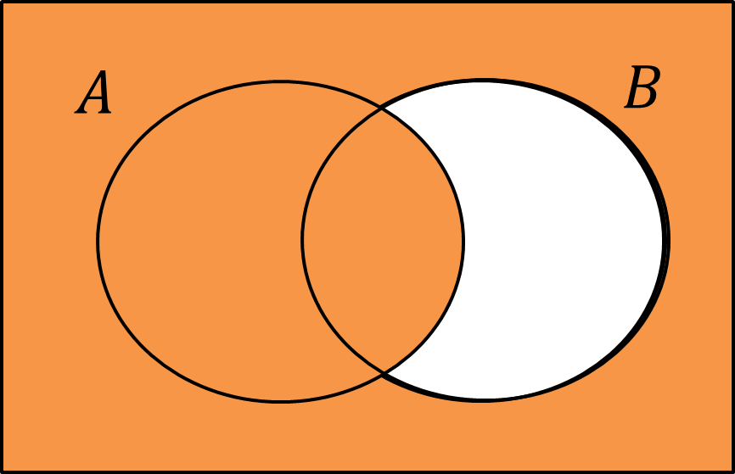
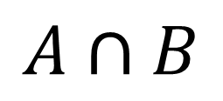
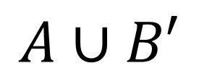
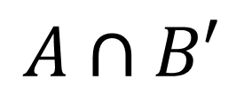
Set Notion - Venn Diagrams
$$A∩B$$
$$A∩B′$$
$$A∪B′$$

Slide 4
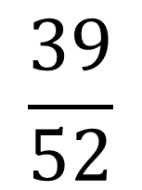

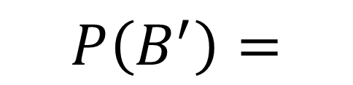
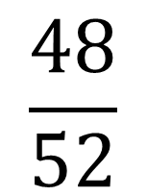
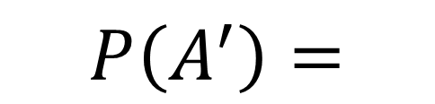

Set Notion - Venn Diagrams
$$A$$
$$B$$
3
1
12
36
$$\frac{48}{52}$$
$$P\left(A^{′}\right)=$$
12 + 36 = 48
$$\frac{39}{52}$$
$$P\left(B^{′}\right)=$$
3 + 36 = 39

Slide 5
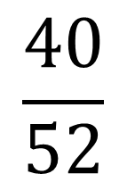
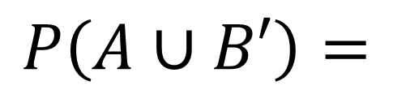
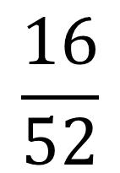
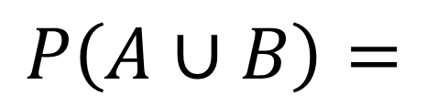
Set Notion - Venn Diagrams
$$A$$
$$B$$
3
1
12
36
$$\frac{16}{52}$$
$$P\left(A∪B\right)=$$
3 + 1 + 12 = 16
$$\frac{40}{52}$$
$$P\left(A∪B′\right)=$$
3 + 1 + 36 = 40

Slide 6
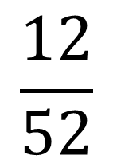
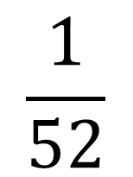
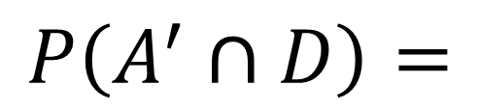
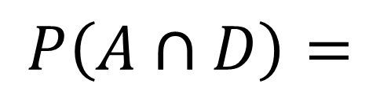

Set Notion - Venn Diagrams
$$A$$
$$D$$
3
1
12
36
$$\frac{1}{52}$$
$$P\left(A∩D\right)=$$
$$\frac{12}{52}$$
$$P\left(A^{′}∩D\right)=$$

Slide 7
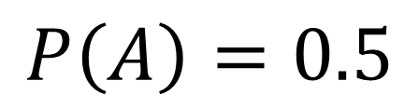
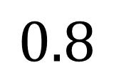
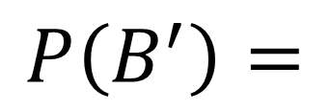
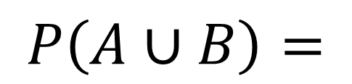
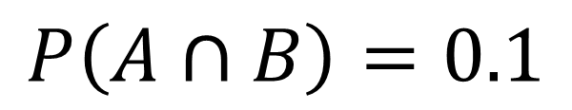

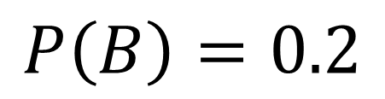
Set Notion - Venn Diagrams
$$P\left(A\right)=0.5$$
$$A$$
$$B$$
$$P\left(B\right)=0.2$$
0.4
0.1
0.1
$$P\left(A∩B\right)=0.1$$
0.4
$$P\left(A∪B\right)=$$
0.4
0.4 + 0.1 + 0.1 = 0.6
$$P\left(B^{′}\right)=$$
$$0.8$$
0.4 + 0.4 = 0.8

Slide 8
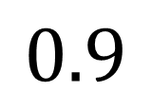
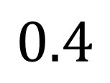
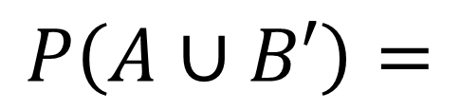
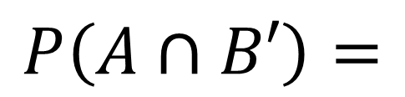
Set Notion - Venn Diagrams
$$P\left(A\right)=0.5$$
$$A$$
$$B$$
$$P\left(B\right)=0.2$$
0.4
0.1
0.1
$$P\left(A∩B\right)=0.1$$
0.4
$$P\left(A∩B′\right)=$$
$$0.4$$
$$P\left(A∪B′\right)=$$
$$0.9$$
0.4 + 0.1 + 0.4 = 0.9

Slide 9


Set Notion - Venn Diagrams
If $A$ and $B$ are mutually exclusive then
$$P\left(A∪B\right)= P\left(A\right)+P\left(B\right)$$
If $A$ and $B$ are independent then
$$P\left(A∩B\right)= P\left(A\right)×P\left(B\right)$$

Slide 10
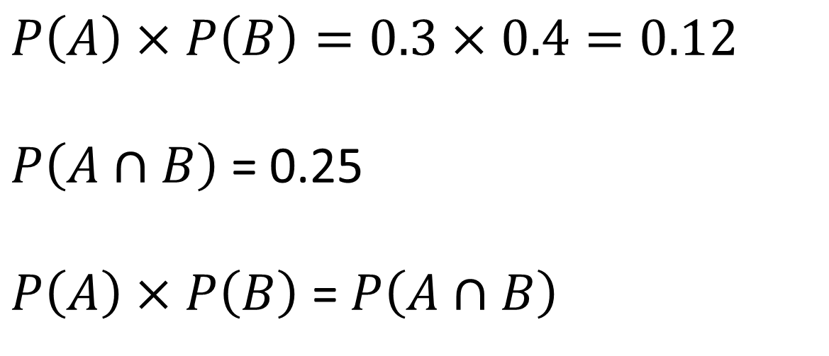
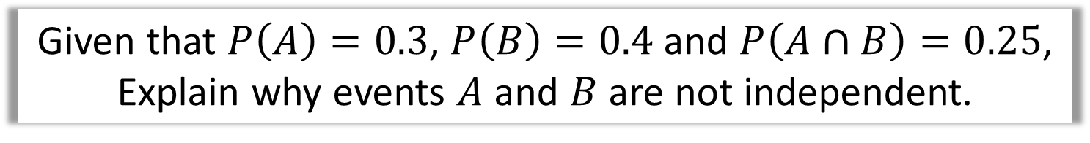
Set Notion - Venn Diagrams
Given that $P\left(A\right)=0.3$, $P\left(B\right)=0.4$ and $P\left(A∩B\right)=0.25$,
Explain why events $A$ and $B$ are not independent.
$$P\left(A\right)×P\left(B\right)=0.3×0.4=0.12$$
$P\left(A∩B\right)$ = 0.25
$P\left(A\right)×P\left(B\right)$ = $P\left(A∩B\right)$

Slide 11
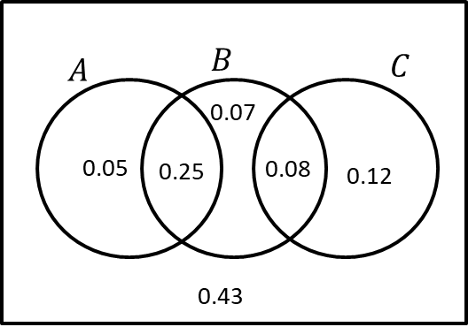
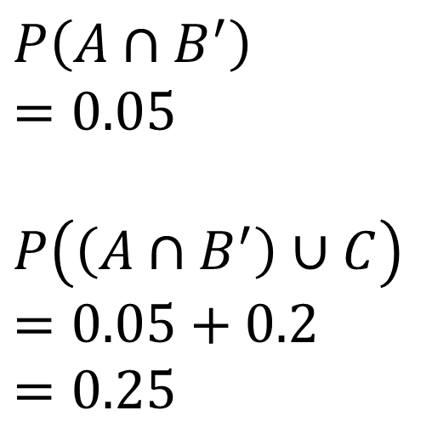
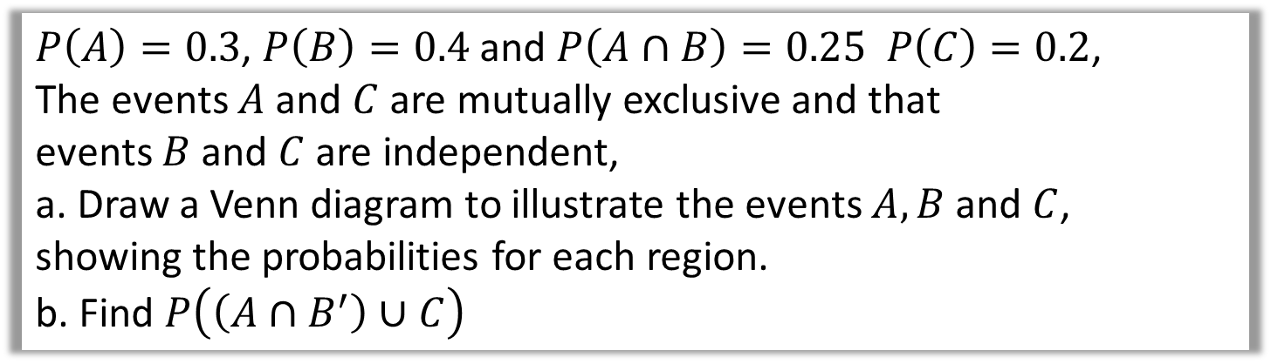
Set Notion - Venn Diagrams
$P\left(A\right)=0.3$, $P\left(B\right)=0.4$ and $P\left(A∩B\right)=0.25 P\left(C\right)=0.2$,
The events $A$ and $C$ are mutually exclusive and that
events $B$ and $C$ are independent,
a. Draw a Venn diagram to illustrate the events $A, B$ and $C$,
showing the probabilities for each region.
b. Find $P\left(\left(A∩B^{′}\right)∪C\right)$
$$P\left(A∩B^{′}\right)$$
$$=0.05$$
$$P\left(\left(A∩B^{′}\right)∪C\right)$$
$$=0.05+0.2$$
$$=0.25$$

Slide 12
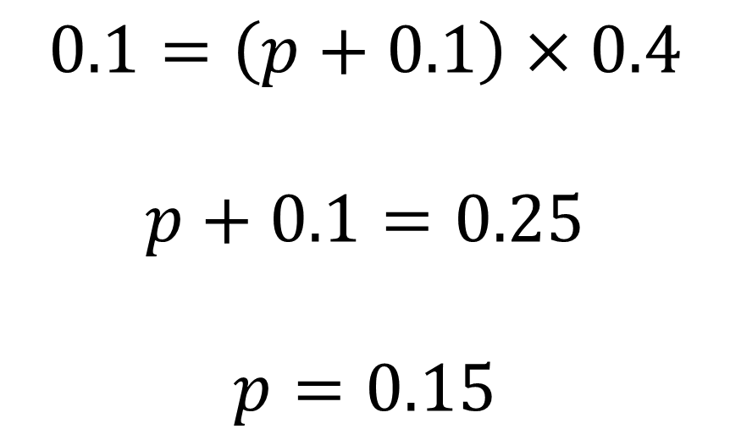
Set Notion - Venn Diagrams
The Venn diagram in Figure 1 shows three events A, B and C and the probabilities associated with each region of B. The constants p, q and r each represent probabilities associated with the three separate regions outside B.
The events A and B are independent.
Find the value of p. (3)
$$0.1=\left(p+0.1\right)×0.4$$
$$p+0.1=0.25$$
$$p=0.15$$

Slide 13
Exercise 2A
Pearson Stats/Mechanics Year 2
Pages 19-21
Complete before the lesson Q1-3
In Class:
Green Q4-6
Amber Q7&8
Red Q9-12 & Challenge

