Slide 1
Hyperbolic
Functions
Twitter: @Owen134866
www.mathsfreeresourcelibrary.com

Slide 2
Teachings for
Exercise 6B

Slide 3
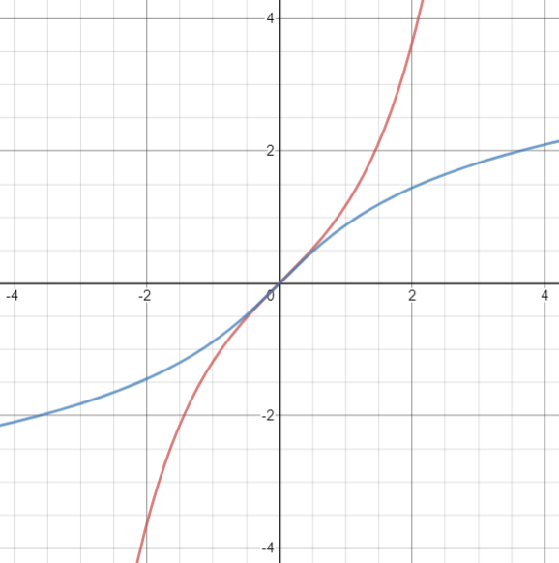


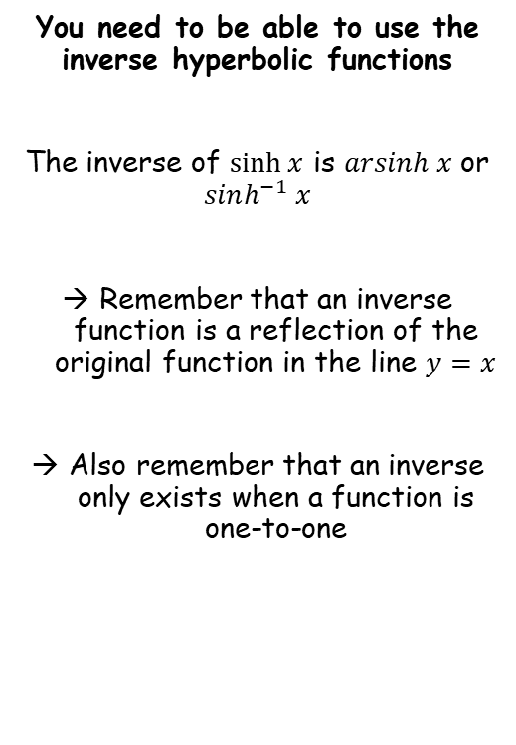




Hyperbolic Functions
$$sinhx=\frac{e^{x}−e^{−x}}{2}$$
$$coshx=\frac{e^{x}+e^{−x}}{2}$$
$$tanhx=\frac{e^{2x}−1}{e^{2x}+1}$$
You need to be able to use the inverse hyperbolic functions
The inverse of $\sinh{x}$ is $arsinh x$ or $sinh^{−1} x$
Remember that an inverse function is a reflection of the original function in the line $y=x$
Also remember that an inverse only exists when a function is one-to-one
$$y=\sinh{x}$$
$$y=x$$
$$y=\operatorname{arsinh}{x}$$
6B

Slide 4
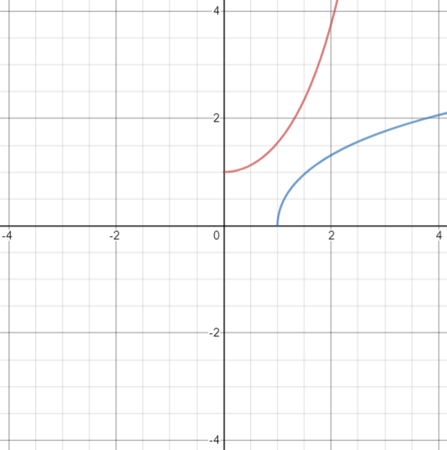
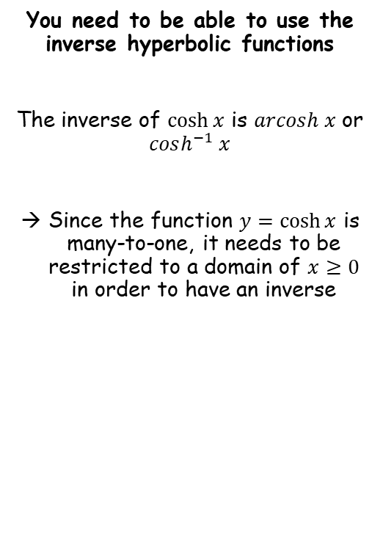



Hyperbolic Functions
$$sinhx=\frac{e^{x}−e^{−x}}{2}$$
$$coshx=\frac{e^{x}+e^{−x}}{2}$$
$$tanhx=\frac{e^{2x}−1}{e^{2x}+1}$$
$$y=\cosh{x}$$
You need to be able to use the inverse hyperbolic functions
The inverse of $\cosh{x}$ is $arcosh x$ or $cosh^{−1} x$
Since the function $y=\cosh{x}$ is many-to-one, it needs to be restricted to a domain of $x≥0$ in order to have an inverse
$$y=x$$
$$y=\operatorname{arcosh}{x}$$
6B

Slide 5
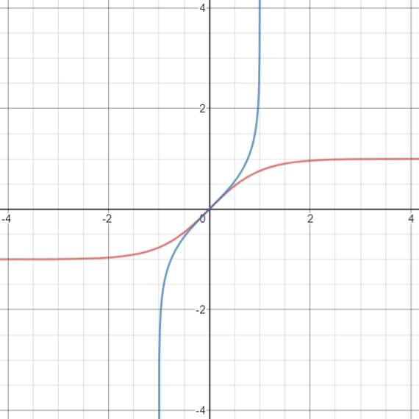
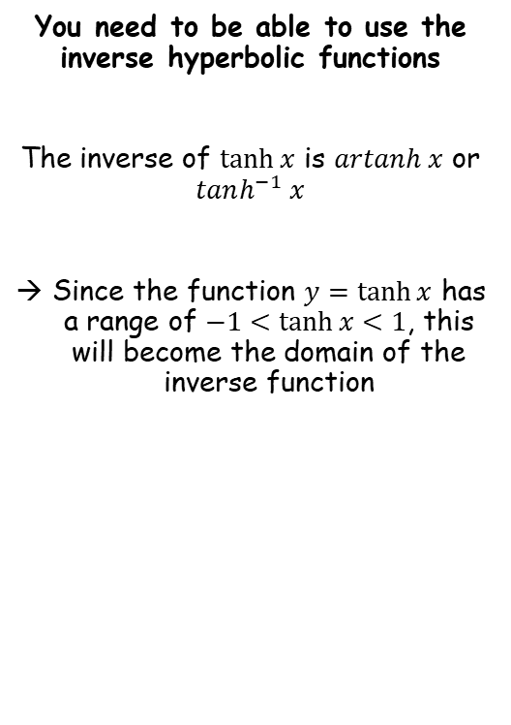


Hyperbolic Functions
$$sinhx=\frac{e^{x}−e^{−x}}{2}$$
$$coshx=\frac{e^{x}+e^{−x}}{2}$$
$$tanhx=\frac{e^{2x}−1}{e^{2x}+1}$$
$$y=\operatorname{artanh}{x}$$
$$y=x$$
You need to be able to use the inverse hyperbolic functions
The inverse of $\tanh{x}$ is $artanh x$ or $tanh^{−1} x$
Since the function $y=\tanh{x}$ has a range of $−1<\tanh{x}<1$, this will become the domain of the inverse function
$$y=\tanh{x}$$
6B

Slide 6
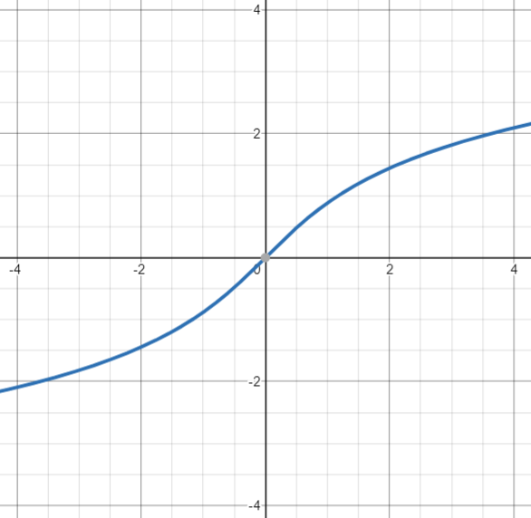
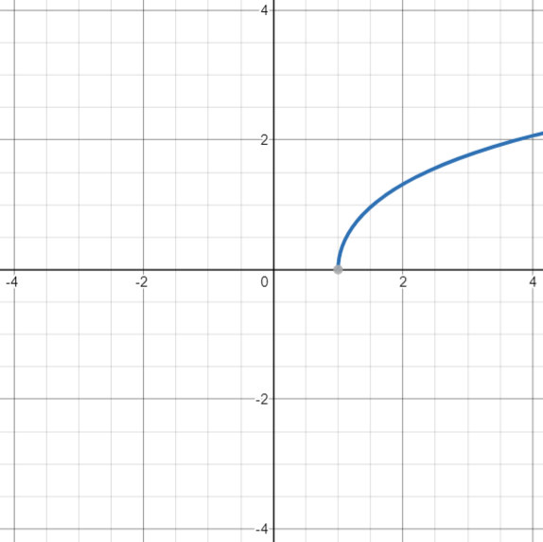
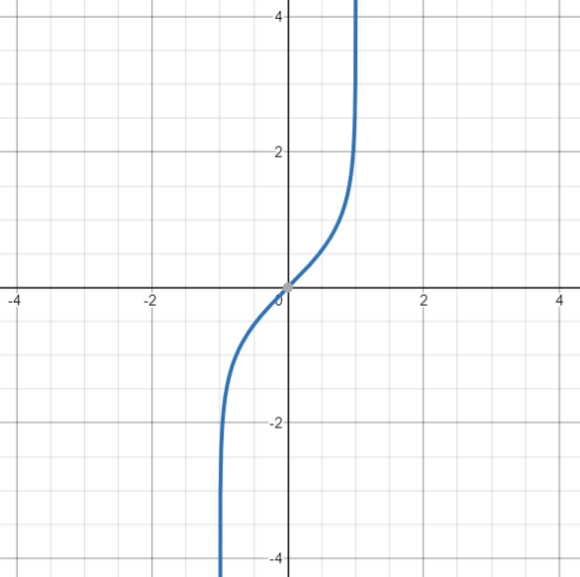






Hyperbolic Functions
$$sinhx=\frac{e^{x}−e^{−x}}{2}$$
$$coshx=\frac{e^{x}+e^{−x}}{2}$$
$$tanhx=\frac{e^{2x}−1}{e^{2x}+1}$$
You need to be able to use the inverse hyperbolic functions
$$y=\operatorname{artanh}{x}$$
$$y=\operatorname{arsinh}{x}$$
$$y=\operatorname{arcosh}{x}$$
Domain $x∈ℝ$
Domain $x≥1$
Domain $\left|x\right|<1$
6B

Slide 7







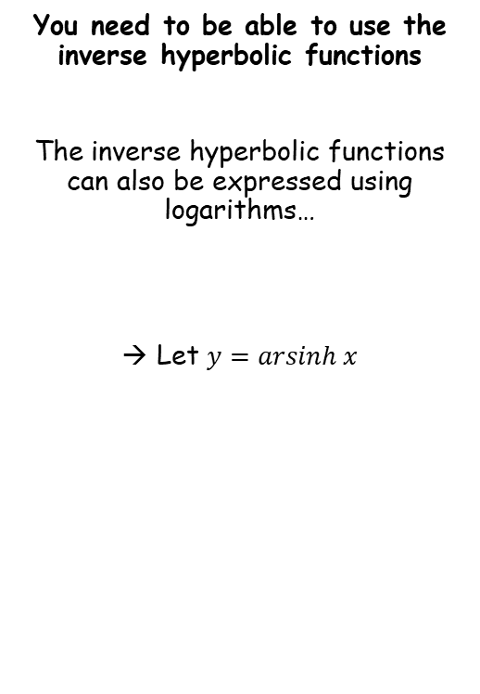









Hyperbolic Functions
$$sinhx=\frac{e^{x}−e^{−x}}{2}$$
$$coshx=\frac{e^{x}+e^{−x}}{2}$$
$$tanhx=\frac{e^{2x}−1}{e^{2x}+1}$$
You need to be able to use the inverse hyperbolic functions
The inverse hyperbolic functions can also be expressed using logarithms…
Let $y=arsinh x$
$$y=arsinh x$$
Inverse $sinh$
$$sinhy=x$$
Replace using the expression we saw in section 6A
$$\frac{e^{y}−e^{−y}}{2}=x$$
Multiply by 2
$$e^{y}−e^{−y}=2x$$
Show that $arsinh x=ln\left(x+\sqrt{x^{2}+1}\right)$
Multiply by $e^{y}$
$$e^{2y}−1=2xe^{y}$$
Subtract ${2xe}^{y}$
$$e^{2y}−2xe^{y}−1=0$$
Complete the square for the first two terms
$${\left(e^{y}−x\right)}^{2}−{\left(x\right)}^{2}−1=0$$
Add $x^{2}+1$
$${\left(e^{y}−x\right)}^{2}=x^{2}+1$$
Square root
$$e^{y}−x=±\sqrt{x^{2}+1}$$
Add $x$
$$e^{y}=x±\sqrt{x^{2}+1}$$
6B

Slide 8


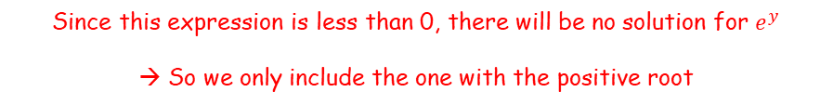



Hyperbolic Functions
$$sinhx=\frac{e^{x}−e^{−x}}{2}$$
$$coshx=\frac{e^{x}+e^{−x}}{2}$$
$$tanhx=\frac{e^{2x}−1}{e^{2x}+1}$$
You need to be able to use the inverse hyperbolic functions
The inverse hyperbolic functions can also be expressed using logarithms…
Let $y=arsinh x$
$$e^{y}=x±\sqrt{x^{2}+1}$$
It is clearly true that:
$\sqrt{x^{2}+1}>\sqrt{x^{2}}$
Simplify right side
$\sqrt{x^{2}+1}>x$
Show that $arsinh x=ln\left(x+\sqrt{x^{2}+1}\right)$
Rearrange
$$0>x−\sqrt{x^{2}+1}$$
Swap around
$$x−\sqrt{x^{2}+1}<0$$
Since this expression is less than 0, there will be no solution for $e^{y}$
→ So we only include the one with the positive root
6B

Slide 9




Hyperbolic Functions
$$sinhx=\frac{e^{x}−e^{−x}}{2}$$
$$coshx=\frac{e^{x}+e^{−x}}{2}$$
$$tanhx=\frac{e^{2x}−1}{e^{2x}+1}$$
You need to be able to use the inverse hyperbolic functions
The inverse hyperbolic functions can also be expressed using logarithms…
Let $y=arsinh x$
$$e^{y}=x±\sqrt{x^{2}+1}$$
There are only solutions for the positive root
$$e^{y}=x+\sqrt{x^{2}+1}$$
Natural logarithm of both sides
$$y=ln\left(x+\sqrt{x^{2}+1}\right)$$
Replace $y$
$$arsinh x=ln\left(x+\sqrt{x^{2}+1}\right)$$
Show that $arsinh x=ln\left(x+\sqrt{x^{2}+1}\right)$
6B

Slide 10





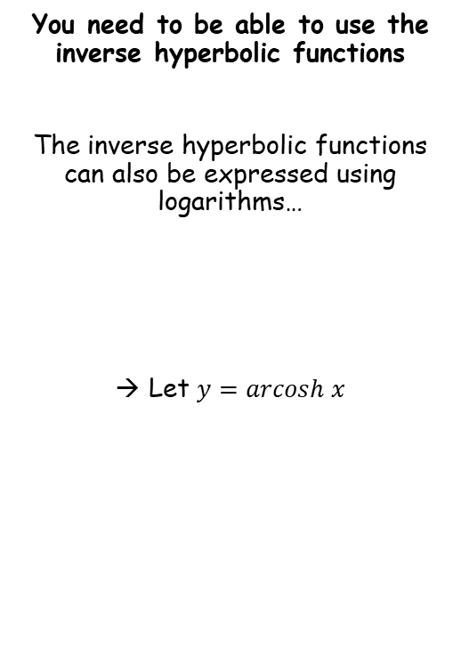








Hyperbolic Functions
$$sinhx=\frac{e^{x}−e^{−x}}{2}$$
$$coshx=\frac{e^{x}+e^{−x}}{2}$$
$$tanhx=\frac{e^{2x}−1}{e^{2x}+1}$$
You need to be able to use the inverse hyperbolic functions
The inverse hyperbolic functions can also be expressed using logarithms…
Let $y=arcosh x$
$$y=arcosh x$$
Inverse $cosh$
$$coshy=x$$
Replace using the expression we saw in section 6A
$$\frac{e^{y}+e^{−y}}{2}=x$$
Multiply by 2
$$e^{y}+e^{−y}=2x$$
Show that $arcosh x=ln\left(x+\sqrt{x^{2}−1}\right)$
$$x≥1$$
Multiply by $e^{y}$
$$e^{2y}+1=2xe^{y}$$
Subtract ${2xe}^{y}$
$$e^{2y}−2xe^{y}+1=0$$
Complete the square for the first two terms
$${\left(e^{y}−x\right)}^{2}−{\left(x\right)}^{2}+1=0$$
Add $x^{2}−1$
$${\left(e^{y}−x\right)}^{2}=x^{2}−1$$
Square root
$$e^{y}−x=±\sqrt{x^{2}−1}$$
Add $x$
$$e^{y}=x±\sqrt{x^{2}−1}$$
6B

Slide 11






Hyperbolic Functions
$$sinhx=\frac{e^{x}−e^{−x}}{2}$$
$$coshx=\frac{e^{x}+e^{−x}}{2}$$
$$tanhx=\frac{e^{2x}−1}{e^{2x}+1}$$
$$e^{y}=x±\sqrt{x^{2}−1}$$
You need to be able to use the inverse hyperbolic functions
The inverse hyperbolic functions can also be expressed using logarithms…
Let $y=arcosh x$
For the square root to work, $x$ has to be greater than or equal to 1
$$x≥1$$
It is true that:
$\sqrt{x^{2}−1}<\sqrt{x^{2}}$
Simplify right side
Show that $arcosh x=ln\left(x+\sqrt{x^{2}−1}\right)$
$$x≥1$$
$\sqrt{x^{2}−1}<x$
Rearrange
$$0<x−\sqrt{x^{2}−1}$$
Swap around
$$x−\sqrt{x^{2}−1}>0$$
So for this example, both the positive and negative roots would work…
→ So we need another way to eliminate the negative possibility…
6B

Slide 12
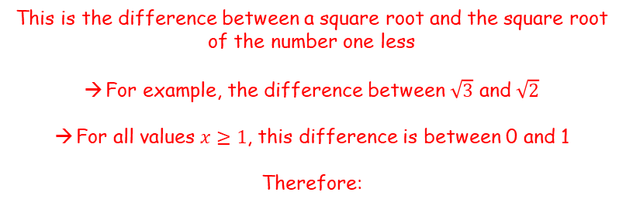




Hyperbolic Functions
$$sinhx=\frac{e^{x}−e^{−x}}{2}$$
$$coshx=\frac{e^{x}+e^{−x}}{2}$$
$$tanhx=\frac{e^{2x}−1}{e^{2x}+1}$$
$$e^{y}=x±\sqrt{x^{2}−1}$$
You need to be able to use the inverse hyperbolic functions
The inverse hyperbolic functions can also be expressed using logarithms…
Let $y=arcosh x$
For the square root to work, $x$ has to be greater than or equal to 1
$$x≥1$$
$$x−\sqrt{x^{2}−1}$$
Show that $arcosh x=ln\left(x+\sqrt{x^{2}−1}\right)$
$$x≥1$$
Let $u=x^{2}−1$
Then $x=\sqrt{u+1}$
$$\sqrt{u+1}−\sqrt{u}$$
This is the difference between a square root and the square root of the number one less
For example, the difference between $\sqrt{3}$ and $\sqrt{2}$
For all values $x≥1$, this difference is between 0 and 1
Therefore:
$$0<x−\sqrt{x^{2}−1}<1$$
6B

Slide 13




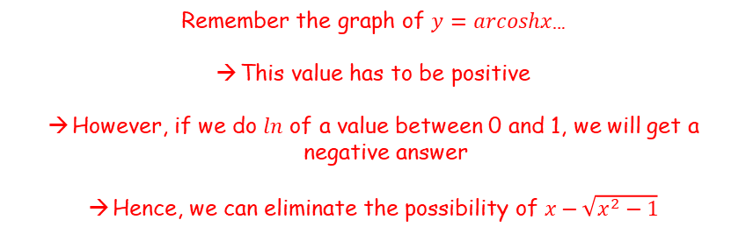



Hyperbolic Functions
$$sinhx=\frac{e^{x}−e^{−x}}{2}$$
$$coshx=\frac{e^{x}+e^{−x}}{2}$$
$$tanhx=\frac{e^{2x}−1}{e^{2x}+1}$$
$$e^{y}=x±\sqrt{x^{2}−1}$$
You need to be able to use the inverse hyperbolic functions
The inverse hyperbolic functions can also be expressed using logarithms…
Let $y=arcosh x$
Take natural logarithms of both sides
$$y=ln\left(x±\sqrt{x^{2}−1}\right)$$
Replace $y$
$$arcosh x=ln\left(x±\sqrt{x^{2}−1}\right)$$
Eliminate the negative possibility
$$arcosh x=ln\left(x+\sqrt{x^{2}−1}\right)$$
Remember the graph of $y=arcoshx$…
This value has to be positive
However, if we do $ln$ of a value between 0 and 1, we will get a negative answer
Hence, we can eliminate the possibility of $x−\sqrt{x^{2}−1}$
Show that $arcosh x=ln\left(x+\sqrt{x^{2}−1}\right)$
$$x≥1$$
$$x≥1$$
$$0<x−\sqrt{x^{2}−1}<1$$
$$y=\operatorname{arcosh}{x}$$
6B

Slide 14






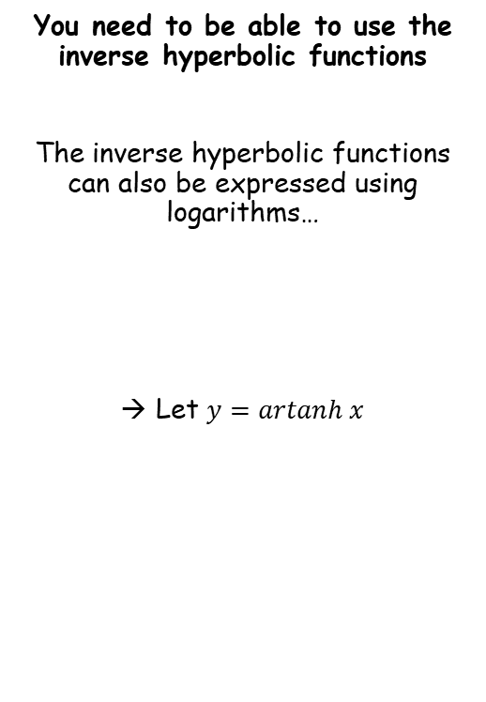









Hyperbolic Functions
$$sinhx=\frac{e^{x}−e^{−x}}{2}$$
$$coshx=\frac{e^{x}+e^{−x}}{2}$$
$$tanhx=\frac{e^{2x}−1}{e^{2x}+1}$$
$$y=artanh x$$
You need to be able to use the inverse hyperbolic functions
The inverse hyperbolic functions can also be expressed using logarithms…
Let $y=artanh x$
Inverse $tanh$
$$tanhy=x$$
Replace using the expression we saw in section 6A
$$\frac{e^{2y}−1}{e^{2y}+1}=x$$
Multiply by $e^{2y}+1$
$$e^{2y}−1=x\left(e^{2y}+1\right)$$
Expand the bracket
Find an expression for $artanh x$ using logarithms
$$e^{2y}−1=xe^{2y}+x$$
Subtract $xe^{2y}$ and add 1
$$e^{2y}−xe^{2y}=1+x$$
Factorise left side
$$e^{2y}\left(1−x\right)=1+x$$
$$e^{2y}=\frac{1+x}{1−x}$$
Divide by $1−x$
Take natural logarithms
$$2y=ln\left|\frac{1+x}{1−x}\right|$$
Divide by 2
$$y=\frac{1}{2}ln\left|\frac{1+x}{1−x}\right|$$
6B

Slide 15







Hyperbolic Functions
$$sinhx=\frac{e^{x}−e^{−x}}{2}$$
$$coshx=\frac{e^{x}+e^{−x}}{2}$$
$$tanhx=\frac{e^{2x}−1}{e^{2x}+1}$$
$$y=\frac{1}{2}ln\left|\frac{1+x}{1−x}\right|$$
You need to be able to use the inverse hyperbolic functions
The inverse hyperbolic functions can also be expressed using logarithms…
Let $y=artanh x$
Replace $y$
$$artanhx=\frac{1}{2}ln\left|\frac{1+x}{1−x}\right|$$
Remember that $artanhx$ is only valid for $\left|x\right|<1$, so this needs to be included as well…
Find an expression for $artanh x$ using logarithms
$$y=\operatorname{artanh}{x}$$
$$artanhx=\frac{1}{2}ln\left|\frac{1+x}{1−x}\right|, \left|x\right|<1$$
Domain $\left|x\right|<1$
6B

Slide 16








Hyperbolic Functions
$$sinhx=\frac{e^{x}−e^{−x}}{2}$$
$$arsinh x=ln\left(x+\sqrt{x^{2}+1}\right)$$
$$arcosh x=ln\left(x+\sqrt{x^{2}−1}\right), x≥1$$
$$artanhx=\frac{1}{2}ln\left|\frac{1+x}{1−x}\right|, \left|x\right|<1$$
$$coshx=\frac{e^{x}+e^{−x}}{2}$$
$$tanhx=\frac{e^{2x}−1}{e^{2x}+1}$$
You need to be able to use the inverse hyperbolic functions
Express using natural logarithms:
$$arsinh 1$$
$$arsinh x=ln\left(x+\sqrt{x^{2}+1}\right)$$
Sub in $x=1$
$$arsinh 1=ln\left(1+\sqrt{1^{2}+1}\right)$$
Simplify
$$=ln\left(1+\sqrt{2}\right)$$
6B

Slide 17





Hyperbolic Functions
$$sinhx=\frac{e^{x}−e^{−x}}{2}$$
$$arsinh x=ln\left(x+\sqrt{x^{2}+1}\right)$$
$$arcosh x=ln\left(x+\sqrt{x^{2}−1}\right), x≥1$$
$$artanhx=\frac{1}{2}ln\left|\frac{1+x}{1−x}\right|, \left|x\right|<1$$
$$coshx=\frac{e^{x}+e^{−x}}{2}$$
$$tanhx=\frac{e^{2x}−1}{e^{2x}+1}$$
You need to be able to use the inverse hyperbolic functions
Express using natural logarithms:
$$arcosh 2$$
$$arcosh x=ln\left(x+\sqrt{x^{2}−1}\right)$$
Sub in $x=2$
$$arcosh 2=ln\left(2+\sqrt{2^{2}−1}\right)$$
Simplify
$$=ln\left(2+\sqrt{3}\right)$$
6B

Slide 18

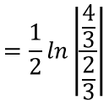


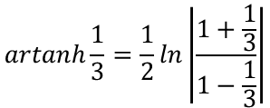


Hyperbolic Functions
$$sinhx=\frac{e^{x}−e^{−x}}{2}$$
$$arsinh x=ln\left(x+\sqrt{x^{2}+1}\right)$$
$$arcosh x=ln\left(x+\sqrt{x^{2}−1}\right), x≥1$$
$$artanhx=\frac{1}{2}ln\left|\frac{1+x}{1−x}\right|, \left|x\right|<1$$
$$coshx=\frac{e^{x}+e^{−x}}{2}$$
$$tanhx=\frac{e^{2x}−1}{e^{2x}+1}$$
You need to be able to use the inverse hyperbolic functions
Express using natural logarithms:
$$artanh \frac{1}{3}$$
$$artanhx=\frac{1}{2}ln\left|\frac{1+x}{1−x}\right|$$
Sub in $x=\frac{1}{3}$
$$artanh\frac{1}{3}=\frac{1}{2}ln\left|\frac{1+\frac{1}{3}}{1−\frac{1}{3}}\right|$$
Simplify right side
$$=\frac{1}{2}ln\left|\frac{\frac{4}{3}}{\frac{2}{3}}\right|$$
Calculate
$$=\frac{1}{2}ln2$$
Use the power law
$$=ln\sqrt{2}$$
6B

Slide 19
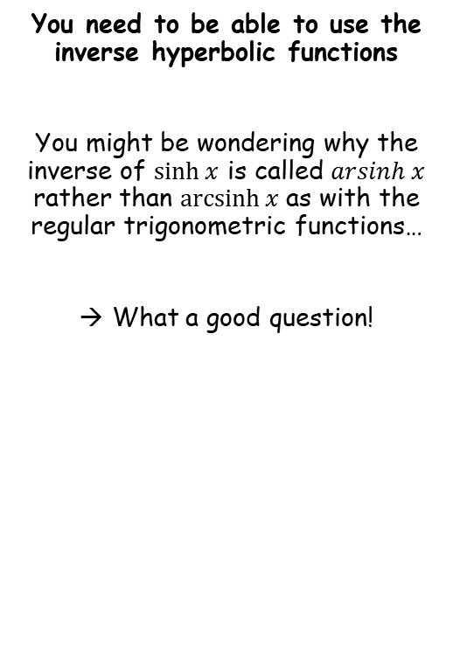
Hyperbolic Functions
$$sinhx=\frac{e^{x}−e^{−x}}{2}$$
$$arsinh x=ln\left(x+\sqrt{x^{2}+1}\right)$$
$$arcosh x=ln\left(x+\sqrt{x^{2}−1}\right), x≥1$$
$$artanhx=\frac{1}{2}ln\left|\frac{1+x}{1−x}\right|, \left|x\right|<1$$
$$coshx=\frac{e^{x}+e^{−x}}{2}$$
$$tanhx=\frac{e^{2x}−1}{e^{2x}+1}$$
You need to be able to use the inverse hyperbolic functions
You might be wondering why the inverse of $\sinh{x}$ is called $arsinh x$ rather than $\operatorname{arcsinh}{x}$ as with the regular trigonometric functions…
What a good question!
6B

Slide 20




















Hyperbolic Functions
$$sinhx=\frac{e^{x}−e^{−x}}{2}$$
$$arsinh x=ln\left(x+\sqrt{x^{2}+1}\right)$$
$$arcosh x=ln\left(x+\sqrt{x^{2}−1}\right), x≥1$$
$$artanhx=\frac{1}{2}ln\left|\frac{1+x}{1−x}\right|, \left|x\right|<1$$
$$coshx=\frac{e^{x}+e^{−x}}{2}$$
$$tanhx=\frac{e^{2x}−1}{e^{2x}+1}$$
Lets start with, ‘why arcsin?’
$$y$$
$$y$$
Find $θ$
$$x^{2}+y^{2}=1$$
Find $l$
$$x^{2}+y^{2}=1$$
$$1$$
$$1$$
$$l$$
$$0.3$$
$$0.3$$
$$θ$$
$$x$$
$$θ$$
$$x$$
$$sinθ=\frac{Opp}{Hyp}$$
$$=\frac{0.3}{1}$$
If $θ$ is in radians…
$$l=rθ$$
$$θ=\sin^{−1}\left(0.3\right)$$
We can combine these…
$$l=θ$$
$$θ=\sin^{−1}\left(0.3\right)$$
In the unit circle, the length of the arc is given by the inverse sine of its y-coordinate
(you can do a similar thing for cos, using the horizontal distance instead!)
$$l=\sin^{−1}\left(0.3\right)$$
$$l=arcsin\left(0.3\right)$$
6B

Slide 21





Hyperbolic Functions
$$sinhx=\frac{e^{x}−e^{−x}}{2}$$
$$arsinh x=ln\left(x+\sqrt{x^{2}+1}\right)$$
$$arcosh x=ln\left(x+\sqrt{x^{2}−1}\right), x≥1$$
$$artanhx=\frac{1}{2}ln\left|\frac{1+x}{1−x}\right|, \left|x\right|<1$$
$$coshx=\frac{e^{x}+e^{−x}}{2}$$
$$tanhx=\frac{e^{2x}−1}{e^{2x}+1}$$
Lets start with, ‘why arcsin?’
$$y$$
$$x^{2}+y^{2}=1$$
$$(x,y)$$
$$l$$
$$x$$
→ So, generally speaking, for the unit circle, $l=arcsiny$
Notice that you would use arcsin or arccos depending on the coordinate used…
→ Or, alternatively… $l=arccosx$
6B

Slide 22





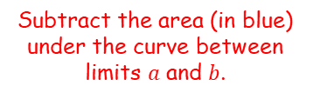










Hyperbolic Functions
$$sinhx=\frac{e^{x}−e^{−x}}{2}$$
$$arsinh x=ln\left(x+\sqrt{x^{2}+1}\right)$$
$$arcosh x=ln\left(x+\sqrt{x^{2}−1}\right), x≥1$$
$$artanhx=\frac{1}{2}ln\left|\frac{1+x}{1−x}\right|, \left|x\right|<1$$
$$coshx=\frac{e^{x}+e^{−x}}{2}$$
$$tanhx=\frac{e^{2x}−1}{e^{2x}+1}$$
Now, ‘why arsinh?’
$$y$$
Ok, this is going to give it away slightly…
$$(x,y)$$
→ On the diagram, area $A$ will be given by:
$$A=\frac{1}{2}xy−\int_{a}^{b}{y} dx$$
$$y$$
$$A$$
→ Remember that the $x$ and $y$ coordinates can also be expressed in terms of a third parameter $t$…
$$x$$
Area of the triangle shown
Subtract the area (in blue) under the curve between limits $a$ and $b$.
$$a$$
$$b$$
$$x$$
$$x=\frac{e^{t}+e^{−t}}{2}$$
$$y=\frac{e^{t}−e^{−t}}{2}$$
→ This means that the integral will need to be done parametrically..
$$x^{2}−y^{2}=1$$
$$A=\frac{1}{2}xy−\int_{0}^{t}{y}\frac{dx}{dt} dt$$
At $b$, $t=t$ (basically whatever value we are choosing it to be!)
At $a$, $t=0$ (subbing $t=0$ gives the coordinate (1,0))
6B

Slide 23
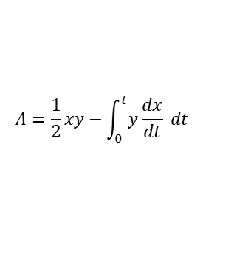








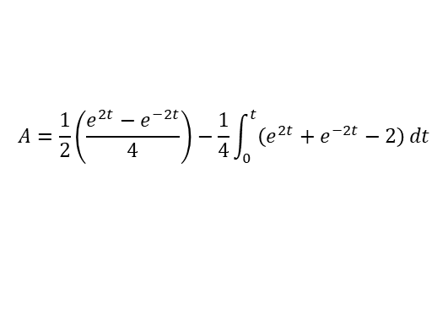

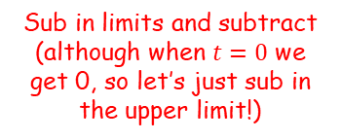
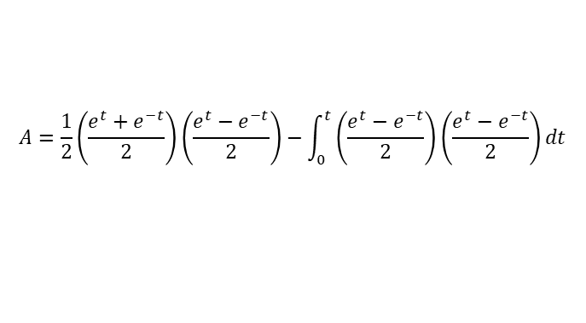
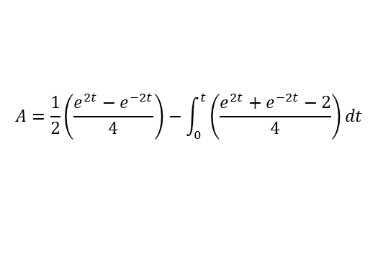
Hyperbolic Functions
$$sinhx=\frac{e^{x}−e^{−x}}{2}$$
$$arsinh x=ln\left(x+\sqrt{x^{2}+1}\right)$$
$$arcosh x=ln\left(x+\sqrt{x^{2}−1}\right), x≥1$$
$$artanhx=\frac{1}{2}ln\left|\frac{1+x}{1−x}\right|, \left|x\right|<1$$
$$coshx=\frac{e^{x}+e^{−x}}{2}$$
$$tanhx=\frac{e^{2x}−1}{e^{2x}+1}$$
Now, ‘why arsinh?’
$$y=\frac{e^{t}−e^{−t}}{2}$$
$$x=\frac{e^{t}+e^{−t}}{2}$$
$$A=\frac{1}{2}xy−\int_{0}^{t}{y}\frac{dx}{dt} dt$$
$$\frac{dx}{dt}=\frac{e^{t}−e^{−t}}{2}$$
Differentiate
Replace in terms of $t$
$$A=\frac{1}{2}\left(\frac{e^{t}+e^{−t}}{2}\right)\left(\frac{e^{t}−e^{−t}}{2}\right)−\int_{0}^{t}{\left(\frac{e^{t}−e^{−t}}{2}\right)}\left(\frac{e^{t}−e^{−t}}{2}\right)dt$$
Simplify each pair of brackets
$$A=\frac{1}{2}\left(\frac{e^{2t}−e^{−2t}}{4}\right)−\int_{0}^{t}{\left(\frac{e^{2t}+e^{−2t}−2}{4}\right)}dt$$
Take the $\frac{1}{4}$ out of the integral
$$A=\frac{1}{2}\left(\frac{e^{2t}−e^{−2t}}{4}\right)−\frac{1}{4}\int_{0}^{t}{\left(e^{2t}+e^{−2t}−2\right)}dt$$
Integrate and use a square bracket
$$A=\frac{1}{2}\left(\frac{e^{2t}−e^{−2t}}{4}\right)−\frac{1}{4}{\left[\frac{1}{2}e^{2t}−\frac{1}{2}e^{−2t}−2t\right]}_{0}^{t}$$
Sub in limits and subtract (although when $t=0$ we get 0, so let’s just sub in the upper limit!)
$$A=\frac{1}{2}\left(\frac{e^{2t}−e^{−2t}}{4}\right)−\frac{1}{4}\left(\frac{1}{2}e^{2t}−\frac{1}{2}e^{−2t}−2t\right)$$
Expand everything!
$$A=\frac{1}{8}e^{2t}−\frac{1}{8}e^{−2t}−\frac{1}{8}e^{2t}+\frac{1}{8}e^{−2t}+\frac{1}{2}t$$
Simplify
$$A=\frac{1}{2}t$$
6B

Slide 24











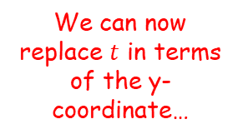





Hyperbolic Functions
$$sinhx=\frac{e^{x}−e^{−x}}{2}$$
$$arsinh x=ln\left(x+\sqrt{x^{2}+1}\right)$$
$$arcosh x=ln\left(x+\sqrt{x^{2}−1}\right), x≥1$$
$$artanhx=\frac{1}{2}ln\left|\frac{1+x}{1−x}\right|, \left|x\right|<1$$
$$coshx=\frac{e^{x}+e^{−x}}{2}$$
$$tanhx=\frac{e^{2x}−1}{e^{2x}+1}$$
Now, ‘why arsinh?’
$$y$$
We can now replace $t$ in terms of the y-coordinate…
$$y=\frac{e^{t}−e^{−t}}{2}$$
$$(x,y)$$
Multiply by 2
$$2y=e^{t}−e^{−t}$$
Multiply by $e^{t}$
$$2ye^{t}=e^{2t}−1$$
Subtract $2ye^{t}$
$$0=e^{2t}−2ye^{t}−1$$
Complete the square
$$A$$
$$a$$
$$b$$
$$x$$
$$0={\left(e^{t}−y\right)}^{2}−y^{2}−1$$
Add $y^{2}+1$
$$y^{2}+1={\left(e^{t}−y\right)}^{2}$$
Square root
$$\sqrt{y^{2}+1}=e^{t}−y$$
Add $y$
$$x^{2}−y^{2}=1$$
$$y+\sqrt{y^{2}+1}=e^{t}$$
$$A=\frac{1}{2}t$$
Take natural logs (we saw the limits on this earlier…)
$$ln\left(y+\sqrt{y^{2}+1}\right)=t$$
$$x=\frac{e^{t}+e^{−t}}{2}$$
$$y=\frac{e^{t}−e^{−t}}{2}$$
This is equivalent to the expression above
$$arsinh y=t$$
6B

Slide 25






Hyperbolic Functions
$$sinhx=\frac{e^{x}−e^{−x}}{2}$$
$$arsinh x=ln\left(x+\sqrt{x^{2}+1}\right)$$
$$arcosh x=ln\left(x+\sqrt{x^{2}−1}\right), x≥1$$
$$artanhx=\frac{1}{2}ln\left|\frac{1+x}{1−x}\right|, \left|x\right|<1$$
$$coshx=\frac{e^{x}+e^{−x}}{2}$$
$$tanhx=\frac{e^{2x}−1}{e^{2x}+1}$$
Now, ‘why arsinh?’
$$y$$
$$A=\frac{1}{2}t$$
$$(x,y)$$
Replace $t$ using the expression we just had
$$A=\frac{1}{2}arsinh y$$
Change to the entire region shown and labelled $Q$
$$Q=arsinh y$$
$$A$$
(You could also do it using the $x$ coordinate and $\operatorname{arcosh}{x}$)
$$Q$$
$$a$$
$$b$$
$$x$$
$$x^{2}−y^{2}=1$$
$$A=\frac{1}{2}t$$
$$x=\frac{e^{t}+e^{−t}}{2}$$
$$y=\frac{e^{t}−e^{−t}}{2}$$
6B

Slide 26
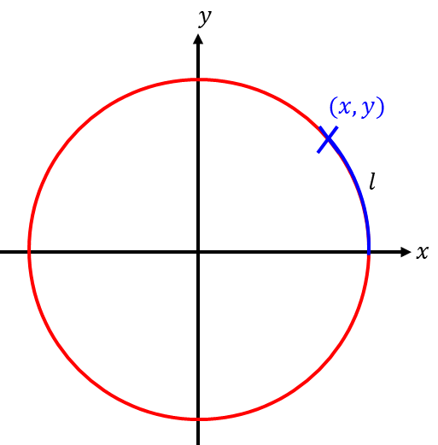
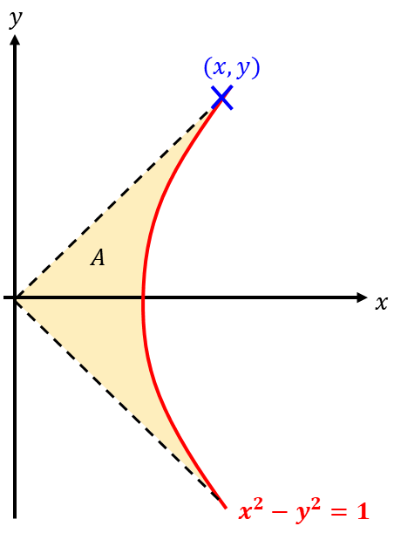

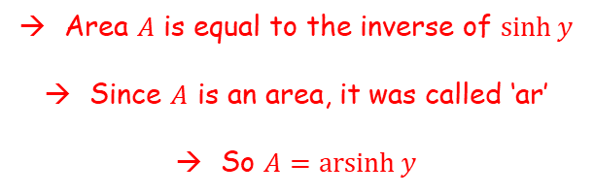

Hyperbolic Functions
$$sinhx=\frac{e^{x}−e^{−x}}{2}$$
$$arsinh x=ln\left(x+\sqrt{x^{2}+1}\right)$$
$$arcosh x=ln\left(x+\sqrt{x^{2}−1}\right), x≥1$$
$$artanhx=\frac{1}{2}ln\left|\frac{1+x}{1−x}\right|, \left|x\right|<1$$
$$coshx=\frac{e^{x}+e^{−x}}{2}$$
$$tanhx=\frac{e^{2x}−1}{e^{2x}+1}$$
Now, ‘why arsinh?’
$$x^{2}+y^{2}=1$$
Length $l$ is equal to the inverse of $siny$
Since $l$ is an arc, it was called arc
So $l=\arcsin{y}$
Area $A$ is equal to the inverse of $\sinh{y}$
Since $A$ is an area, it was called ‘ar’
So $A=\operatorname{arsinh}{y}$
6B

Slide 27
Exercise 6B
Pearson Core Pure Year 2
Pages 124-125
Complete before the lesson Q1
In Class:
Green Q2
Amber Q3-6
Red Q7

