Slide 1
Year 2 Applied Mathematics
Probability
– Full Laws of Probability
Chapter 2
(Part 3 of 4)

Slide 2




Full Laws of Probability
If events $A$ and $B$ are independent:
$P\left(A∩B\right)=P\left(A\right)×P\left(B\right)$
If events $A$ and $B$ are mutually exclusive:
$P\left(A∪B\right)=P\left(A\right)+P\left(B\right)$

Slide 3
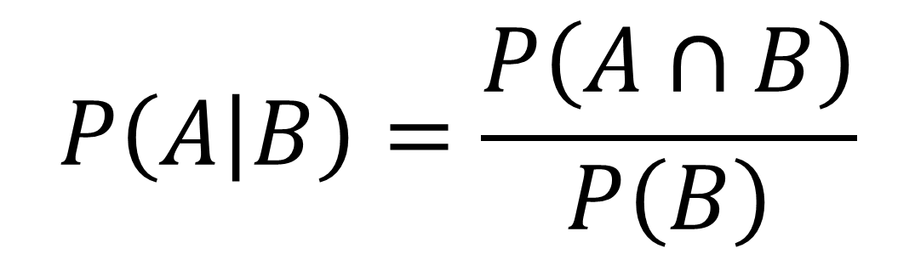
Full Laws of Probability
In general:
$$P\left(A | B\right)=\frac{P\left(A∩B\right)}{P\left(B\right)}$$
$$P\left(A∪B\right)=P\left(A\right)+P\left(B\right)−P\left(A∩B\right)$$

Slide 4
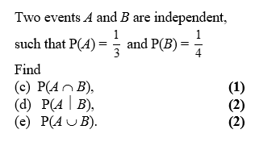
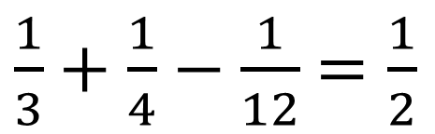
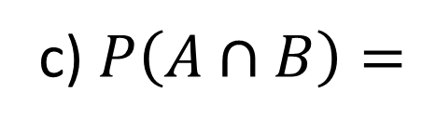
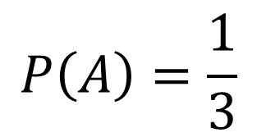
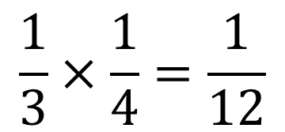
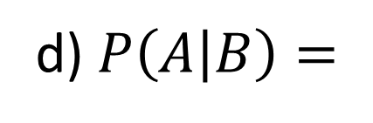
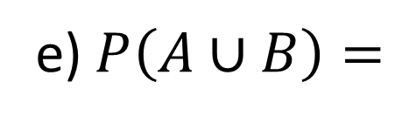
Full Laws of Probability
$$\frac{1}{3}×\frac{1}{4}=\frac{1}{12}$$
c) $P\left(A∩B\right)=$
$$P\left(A\right)=\frac{1}{3}$$
d) $P\left(A | B\right)=$
$\frac{1}{3}+\frac{1}{4}−\frac{1}{12}$ $=\frac{1}{2}$
e) $P\left(A∪B\right)=$

Slide 5
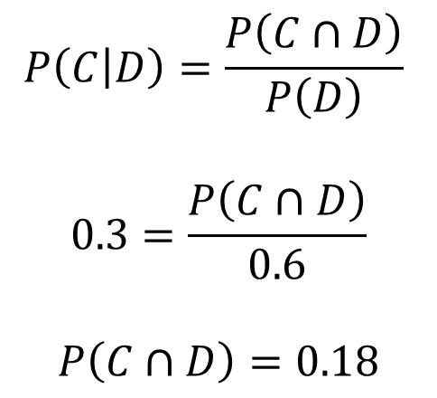
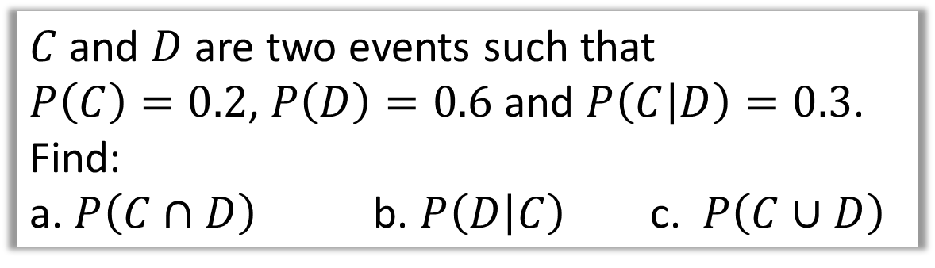
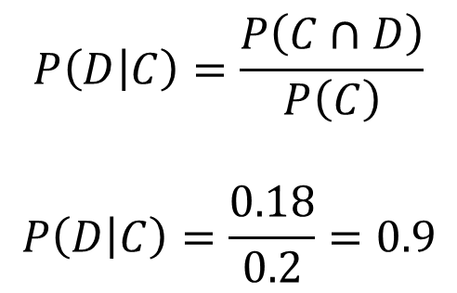
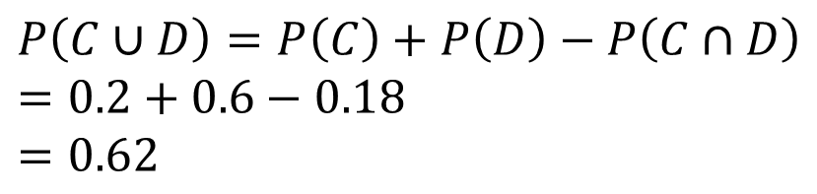
Full Laws of Probability
$C$ and $D$ are two events such that
$P\left(C\right)=0.2$, $P\left(D\right)=0.6$ and $P\left(C | D\right)=0.3$.
Find:
a. $P\left(C∩D\right)$ b. $P\left(D | C\right)$ c. $P\left(C∪D\right)$
$$P\left(C | D\right)=\frac{P\left(C∩D\right)}{P\left(D\right)}$$
$$0.3=\frac{P\left(C∩D\right)}{0.6}$$
$$P\left(C∩D\right)=0.18$$
b)
$$P\left(D | C\right)=\frac{P\left(C∩D\right)}{P\left(C\right)}$$
$$P\left(D | C\right)=\frac{0.18}{0.2}=0.9$$
a)
c)
$$P\left(C∪D\right)=P\left(C\right)+P\left(D\right)−P\left(C∩D\right)=0.2+0.6−0.18$$
$$=0.62$$

Slide 6
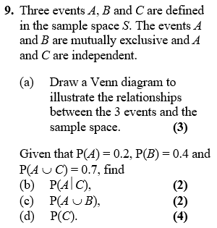

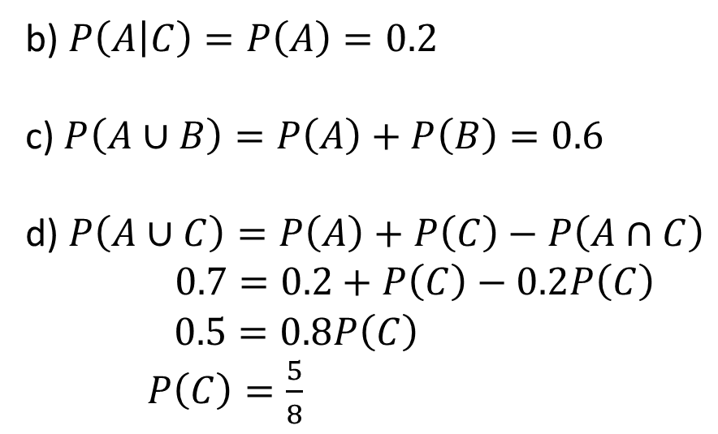



Full Laws of Probability
a)
$$ξ$$
$$C$$
$$A$$
$$B$$
b) $P\left(A | C\right)=P\left(A\right)=0.2$
c) $P\left(A∪B\right)=P\left(A\right)+P\left(B\right)=0.6$
d) $P\left(A∪C\right)=P\left(A\right)+P\left(C\right)−P\left(A∩C\right)$
$0.7=0.2+P\left(C\right)−0.2P\left(C\right)$
$0.5=0.8P\left(C\right)$
$P\left(C\right)=\frac{5}{8}$

Slide 7





Test Your Understanding
Edexcel S1
a)
?
$$ξ$$
$$C$$
$$A$$
$$B$$
b) $P\left(A | C\right)=P\left(A\right)=0.2$
c) $P\left(A∪B\right)=P\left(A\right)+P\left(B\right)=0.6$
d) $P\left(A∪C\right)=P\left(A\right)+P\left(C\right)−P\left(A∩C\right)$
$$0.7=0.2+P\left(C\right)−0.2P\left(C\right) \\ 0.5=0.8P\left(C\right) \\ P\left(C\right)=\frac{5}{8}$$
?
?
?

Slide 8

SUPER IMPORTANT TIPS
If I were to identify two tips that will possible help you the most in probability questions:
If you see the words ‘given that’, Immediately write out the law for conditional probability.
Example: “Given Bob walks to school, find the probability that he’s not late…”
?
First thing you should write: $P\left(L^{′} | W\right)=\frac{P\left(L^{′}∩W\right)}{P\left(W\right)}=…$
If you see the words ‘are independent’, Immediately write out the laws for independence.
(Even before you’ve finished reading the question!)
Example: “$A$ is independent from $B$…”
?
First thing you should write: $P\left(A∩B\right)=P\left(A\right)P\left(B\right)$
$$P\left(A | B\right)=P(A)$$
If you’re stuck on a question where you have to find a probability given others, it’s probably because you’ve failed to take into account that two events are independent or mutually exclusive, or you need to use the conditional probability or additional law.

Slide 9
Exercise 2D
Pearson Stats/Mechanics Year 2
Pages 29-30
Complete before the lesson Q1&3
In Class:
Green Q4-5
Amber Q6-8
Red Q9-12 & Challenge

