Slide 1
Year 1 Pure Mathematics
Quadratics
- Discriminate
Chapter 2
(Part 4 of 4)

Slide 2
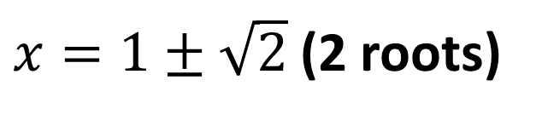
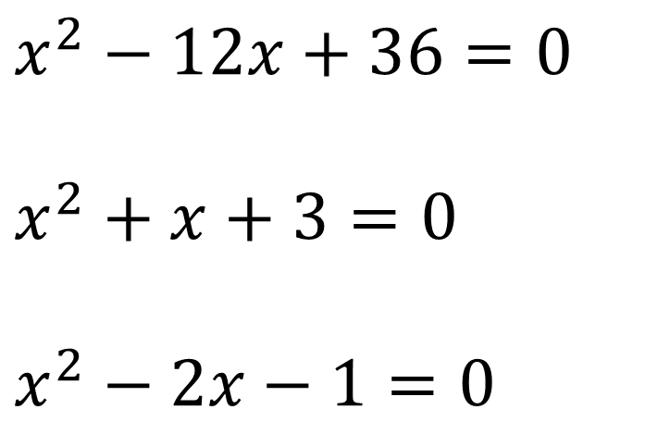
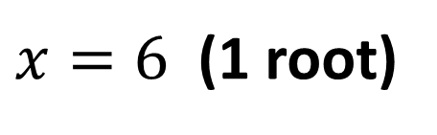
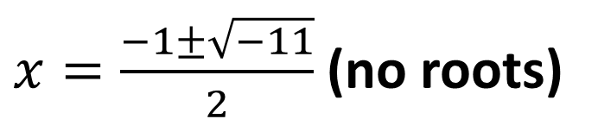
The Discriminant
How many roots do each of the following quadratics have?
$x^{2}−12x+36=0$
$x^{2}+x+3=0$
$$x^{2}−2x−1=0$$
$x=6$ (1 root)
$x=\frac{−1±\sqrt{−11}}{2}$ (no roots)
$x=1±\sqrt{2}$ (2 roots)

Slide 3
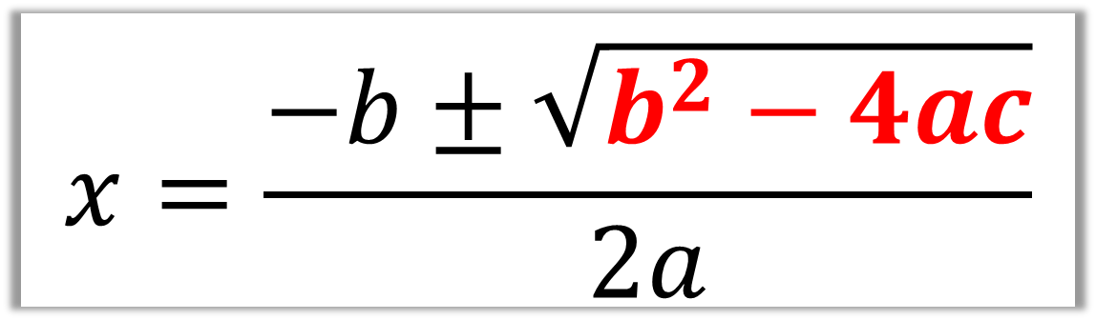

The Discriminant
$$x=\frac{−b±\sqrt{b^{2}−4ac}}{2a}$$
$b^{2}−4ac$
is known as the discriminant

Slide 4
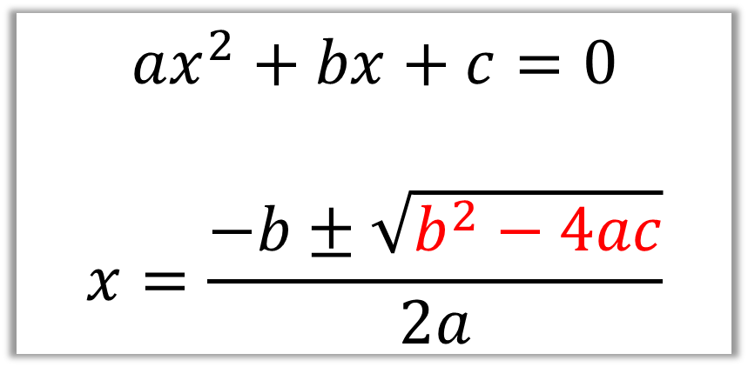
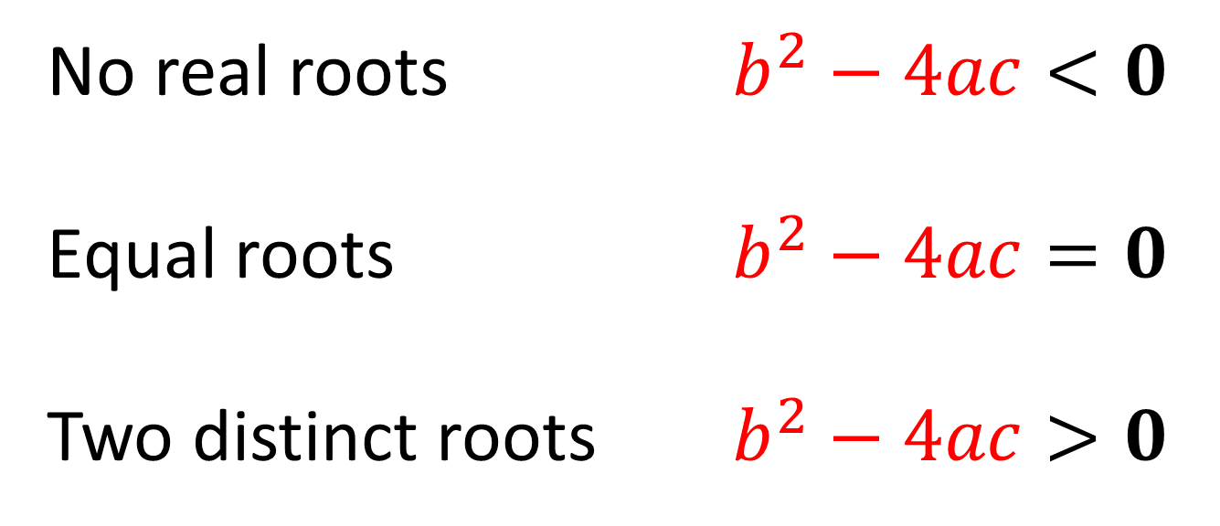
The Discriminant
$$ax^{2}+bx+c=0$$
$$x=\frac{−b±\sqrt{b^{2}−4ac}}{2a}$$
No real roots $b^{2}−4ac<0$
Equal roots $b^{2}−4ac=0$
Two distinct roots $b^{2}−4ac>0$

Slide 5









The Discriminant
$$y$$
$$y$$
We say the graph “touches” the axis.
$$x$$
$$x$$
$$y$$
Distinct real roots
Equal roots
$$b^{2}−4ac>0$$
$$b^{2}−4ac=0$$
$$x$$
No real roots
$$b^{2}−4ac<0$$

Slide 6


















The Discriminant
Equation
Discriminant Value
Number Roots
$$x^{2}+3x+4=0$$
$$−7$$
$$0$$
$$x^{2}−4x+1=0$$
$$12$$
$$2$$
$$x^{2}−4x+4=0$$
$$0$$
$$1$$
$$2x^{2}−6x−3=0$$
$$60$$
$$2$$
$$x−4−3x^{2}=0$$
$$−47$$
$$0$$
$$1−x^{2}=0$$
$$4$$
$$2$$

Slide 7
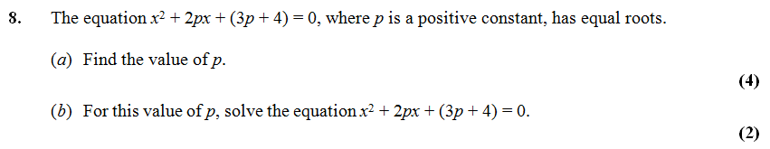
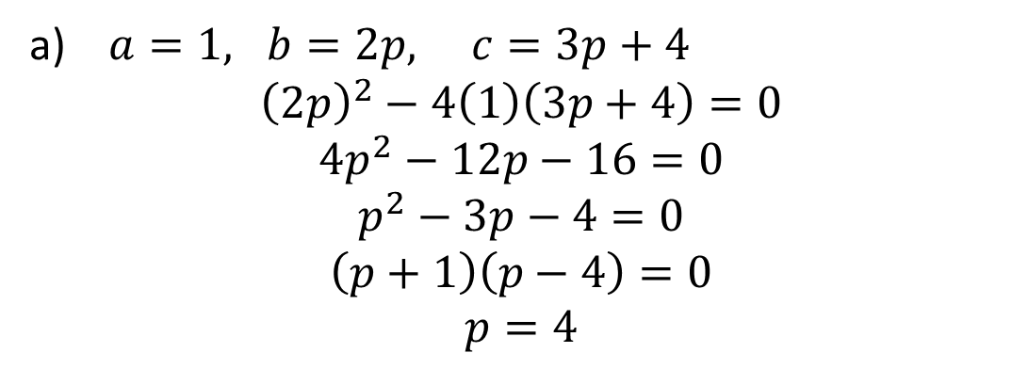

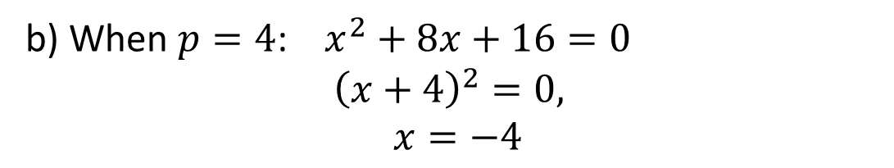
The Discriminant – Exam Questions
Tip: Always start by writing the value of $a, b$ and $c$
a) $a=1, b=2p, c=3p+4$
$${\left(2p\right)}^{2}−4\left(1\right)\left(3p+4\right)=0 \\ 4p^{2}−12p−16=0 \\ p^{2}−3p−4=0 \\ \left(p+1\right)\left(p−4\right)=0 \\ p=4$$
b) When $p=4$: $x^{2}+8x+16=0$
$${\left(x+4\right)}^{2}=0,$$
$$x=−4$$

Slide 8
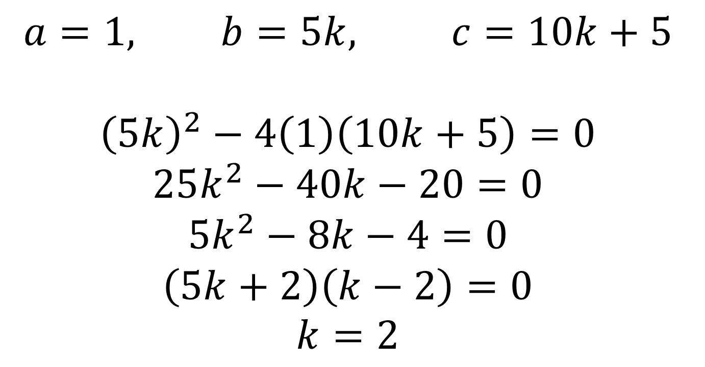
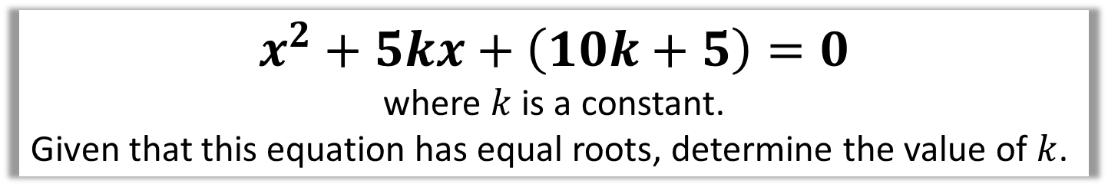
The Discriminant
$$x^{2}+5kx+\left(10k+5\right)=0$$
where $k$ is a constant.
Given that this equation has equal roots, determine the value of $k$.
$$a=1, b=5k, c=10k+5$$
$${\left(5k\right)}^{2}−4\left(1\right)\left(10k+5\right)=0 \\ 25k^{2}−40k−20=0 \\ 5k^{2}−8k−4=0 \\ \left(5k+2\right)\left(k−2\right)=0 \\ k=2$$

Slide 9
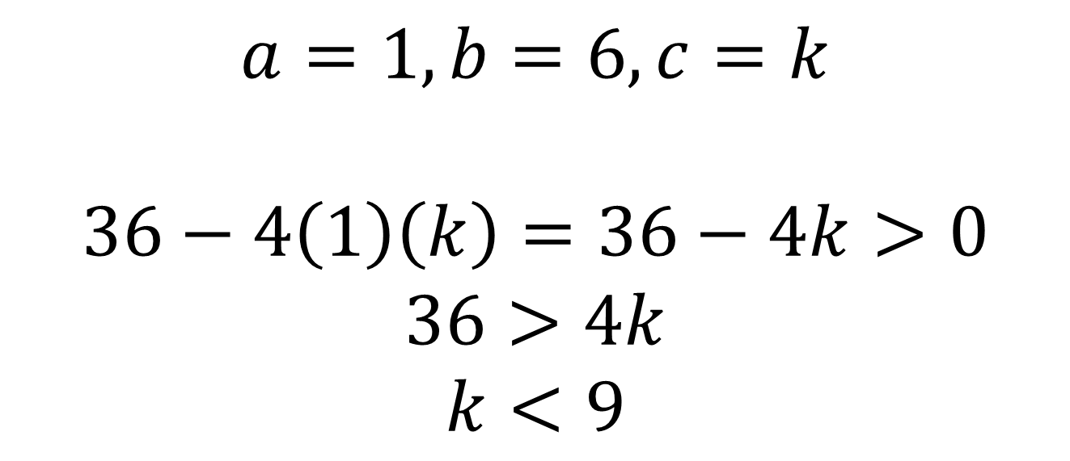

The Discriminant
Find the range of values of $k$ for which
$x^{2}+6x+k=0$
has two distinct real solutions.
$$a=1, b=6, c=k$$
$$36−4\left(1\right)\left(k\right)=36−4k>0 \\ 36>4k \\ k<9$$

Slide 10



Exercise 2G
Complete before the lesson Q1 a-c
In Class:
Green Q2-3
Amber Q4-6
Red Q7,8 & Challenge & Ext
Pearson Pure Mathematics Year 1/AS Page 32
Extension Questions:
1
[MAT 2009 1C] Given a real constant $c$, the equation
$$x^{4}={\left(x−c\right)}^{2}$$
Has four real solutions (including possible repeated roots) for:
$c≤\frac{1}{4}$
$−\frac{1}{4}≤c≤\frac{1}{4}$
$c≤−\frac{1}{4}$
all values of $c$
Square rooting: $x^{2}=±(x−c)$
Case 1:
$$x^{2}−x+c=0$$
Discriminant: $1−4c≥0∴c≤\frac{1}{4}$
Case 2:
$$x^{2}+x−c=0$$
Discriminant: $1+4c≥0∴c≥−\frac{1}{4}$
Answer is B.
[MAT 2006 1B] The equation
${\left(2+x−x^{2}\right)}^{2}=16$ has how many real root(s)?
$$2+x−x^{2}=±4$$
First case:
$$2+x−x^{2}=4 \\ x^{2}−x+2=0$$
As $b^{2}−4ac<0$ no real roots.
Second case:
$$2+x−x^{2}=−4 \\ x^{2}−x−6=0 \\ \left(x+2\right)\left(x−3\right)=0 \\ x=−2 or x=3$$
So 2 distinct real roots.
[MAT 2011 1B] A rectangle has perimeter $P$ and area $A$. The values $P$ and $A$ must satisfy:
$P^{3}>A$
$A^{2}>2P+1$
$P^{2}≥16A$
$PA>A+P$
Let $x$ and $y$ be the width and height. Then $A=xy, P=2x+2y$. Substituting:
$$P=2x+2\left(\frac{A}{x}\right) \\ Px=2x^{2}+2A \\ 2x^{2}−Px+2A=0$$
Discriminant: $a=2, b=−P, c=2A$
$${\left(−P\right)}^{2}−4\left(2\right)\left(2A\right)≥0 \\ P^{2}−16A≥0 \\ P^{2}≥16A$$
2
3
?
?
?

