Slide 1
CENTRAL LIMIT THEOREM
specifies a theoretical distribution
formulated by the selection of all possible random samples of a fixed size n
a sample mean is calculated for each sample and the distribution of sample means is considered

Slide 2
SAMPLING DISTRIBUTION OF THE MEAN
The mean of the sample means is equal to the mean of the population from which the samples were drawn.
The variance of the distribution is σ divided by the square root of n. (the standard error.)

Slide 3
STANDARD ERROR
Standard Deviation of the Sampling Distribution of Means
σ_{x} = σ/ \/n

Slide 4
How Large is Large?
If the sample is normal, then the sampling distribution of will also be normal, no matter what the sample size.
When the sample population is approximately symmetric, the distribution becomes approximately normal for relatively small values of n.
When the sample population is skewed, the sample size must be at least 30 before the sampling distribution of becomes approximately normal.

Slide 5
EXAMPLE
A certain brand of tires has a mean life of 25,000 miles with a standard deviation of 1600 miles.
What is the probability that the mean life of 64 tires is less than 24,600 miles?

Slide 6
Example continued
The sampling distribution of the means has a mean of 25,000 miles (the population mean)
μ = 25000 mi.
and a standard deviation (i.e.. standard error) of:
1600/8 = 200

Slide 7
Parameters and Statistics
Parameter ≡ a constant that describes a population or probability model, e.g., μ from a Normal distribution
Statistic ≡ a random variable calculated from a sample e.g., “x-bar”
These are related but are not the same!
For example, the average age of the SJSU student population µ = 23.5 (parameter), but the average age in any sample x-bar (statistic) is going to differ from µ

Slide 8
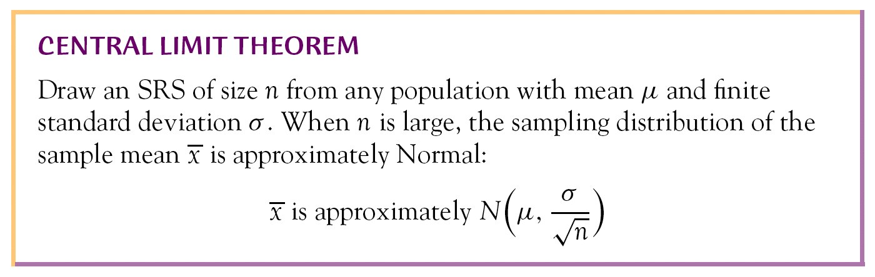
Central Limit Theorem
No matter the shape of the population, the distribution of x-bars tends toward Normality

Slide 9
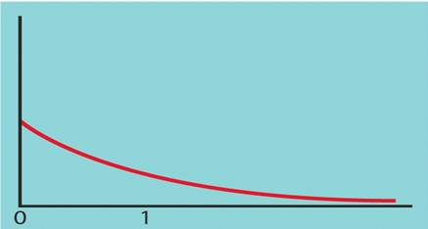
Central Limit Theorem
Time to Complete Activity Example
Let X ≡ time to perform an activity.
X has µ = 1 & σ = 1 but is NOT Normal:

Slide 10
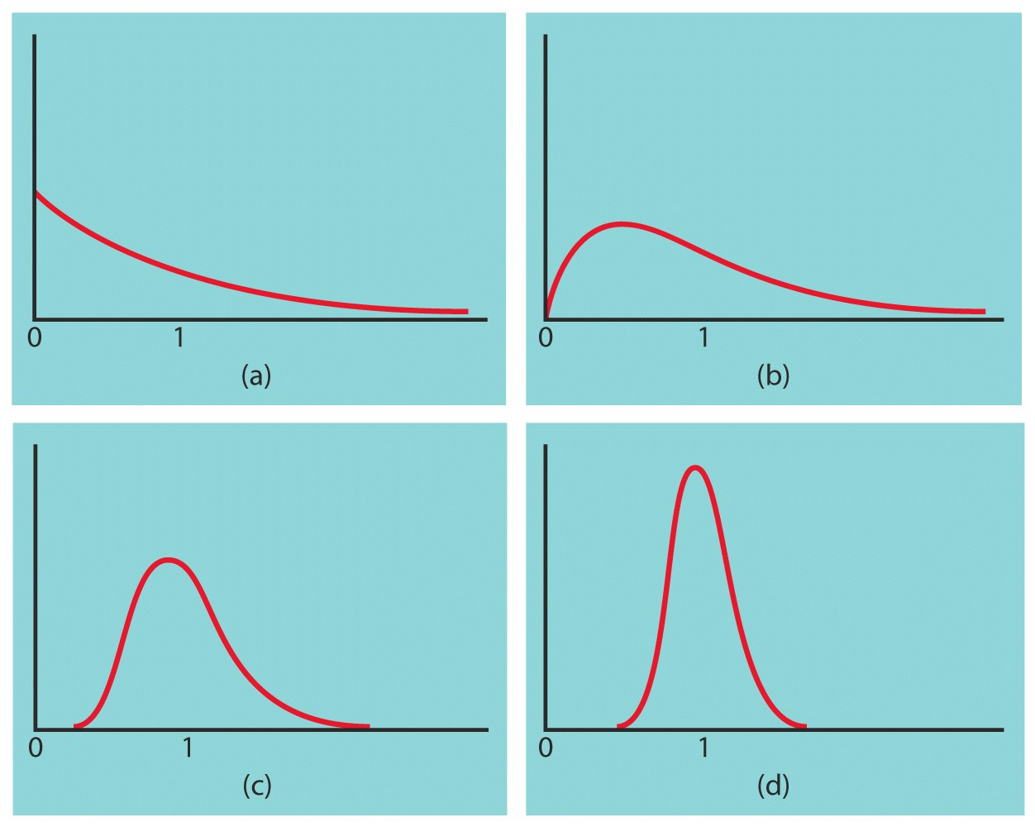
Central Limit Theorem
Time to Complete Activity Example
These figures illustrate the sampling distributions of x-bars based on
n = 1
n = 10
n = 20
n = 70

Slide 11
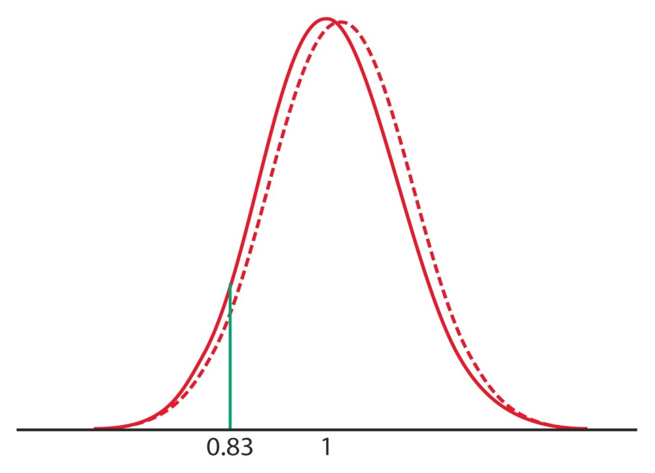
Central Limit Theorem
Time to Complete Activity Example
The variable X is NOT Normal, but the sampling distribution of x-bar based on n = 70 is Normal with μ_{x-bar} = 1 and σ_{x-bar} = 1 / sqrt(70) = 0.12, i.e., xbar~N(1,0.12)
What proportion of x-bars will be less than 0.83 hours?
(A) State: Pr(xbar < 0.83)
(B) Standardize:
z = (0.83 – 1) / 0.12 = −1.42
(C) Sketch: right
(D) Pr(Z < −1.42) = 0.0778
xbar
z
-1.42
0

Slide 12
Example continued
Convert 24,600 mi. to a z-score and use the normal table to determine the required probability.
z = (24600-25000)/200 = -2
P(z< -2) = 0.0228
or 2.28% of the sample means will be less than 24,600 mi.

Slide 13
Exercise 5A
Pearson Further Statistics 1
Pages 78-80
Complete before the lesson Q1-2
In Class:
Green Q3-4
Amber Q5-6
Red Q7-10

