Slide 1
Year 2 Applied Mathematics
Application of Forces
- Dynamics and Friction
Chapter 7
(Part 4 of 5)

Slide 2
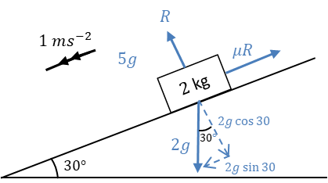
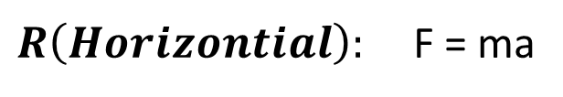
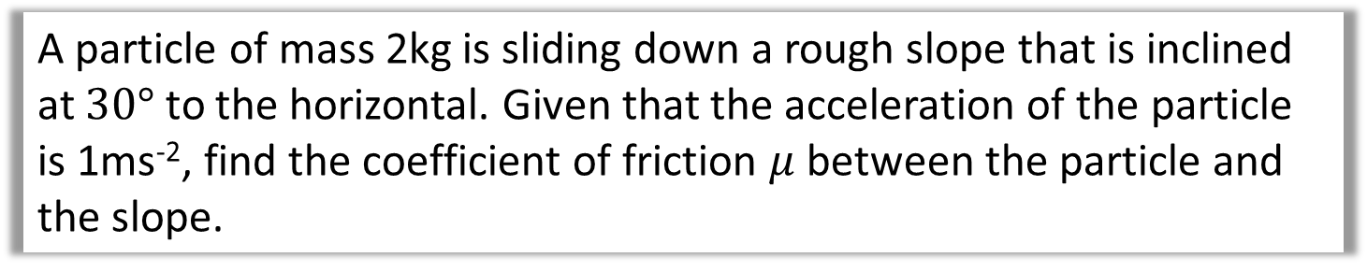
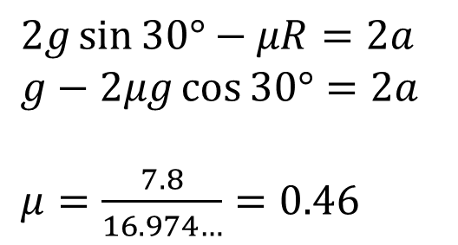

Friction - Inclined Plane Example
A particle of mass 2kg is sliding down a rough slope that is inclined at $30°$ to the horizontal. Given that the acceleration of the particle is 1ms⁻², find the coefficient of friction $μ$ between the particle and the slope.
$R\left(Vertical\right): R=2g\cos{30°}$
$R\left(Horizontial\right):$ F = ma
$$2g\sin{30°}−μR=2a \\ g−2μg\cos{30°}=2a$$
$μ=\frac{7.8}{16.974…}=0.46$

Slide 3
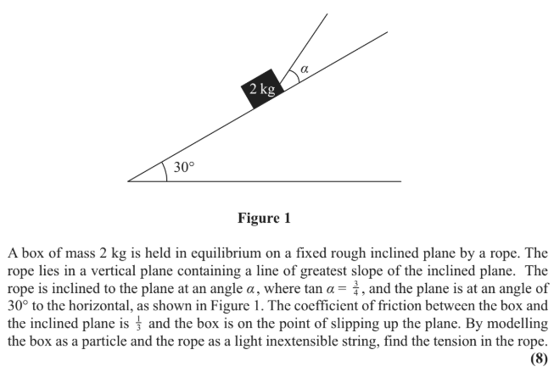
Friction – Exam Question

Slide 4
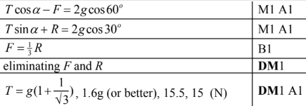
Friction – Exam Question Answers

Slide 5
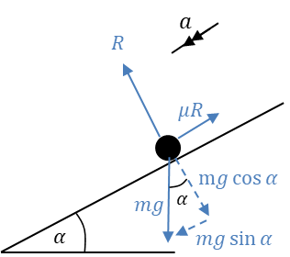
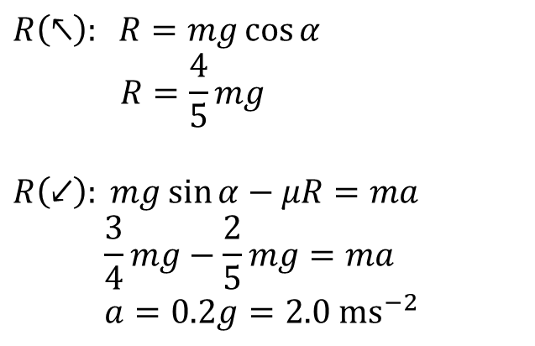
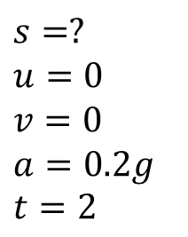
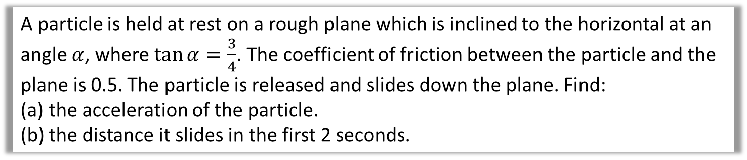
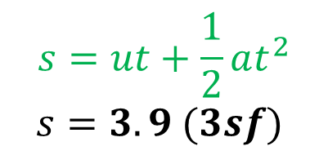
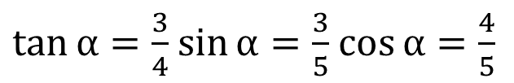
Dynamics and Friction
A particle is held at rest on a rough plane which is inclined to the horizontal at an angle $α$, where $\tan{α}=\frac{3}{4}$. The coefficient of friction between the particle and the plane is 0.5. The particle is released and slides down the plane. Find:
the acceleration of the particle.
the distance it slides in the first 2 seconds.
$$R\left(↖\right): R=mg\cos{α} \\ R=\frac{4}{5}mg$$
$$R\left(↙\right): mg\sin{α}−μR=ma \\ \frac{3}{4}mg−\frac{2}{5}mg=ma \\ a=0.2g=2.0 ms^{−2}$$
$\tan{α=\frac{3}{4}}$ $\sin{α}=\frac{3}{5}$ $\cos{α=\frac{4}{5}}$
$$s=?$$
$$u=0$$
$$v=0$$
$$a=0.2g$$
$$t=2$$
$$s=ut+\frac{1}{2}at^{2}$$
$$s=3.9 (3sf)$$

Slide 6
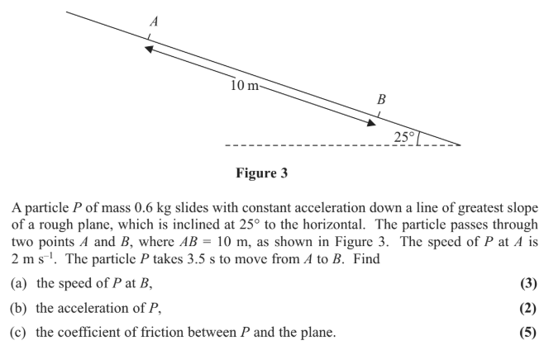
Dynamics and Friction – Exam Questions

Slide 7
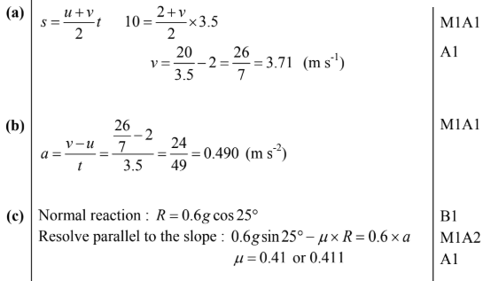
Dynamics and Friction – Exam Questions Answers

Slide 8
Exercise 7E
Pearson Stats/Mechanics Year 2
Pages 148-150
Complete before the lesson Q1-2
In Class:
Green Q5-6
Amber Q3-4
Red Q7-11

