Slide 1


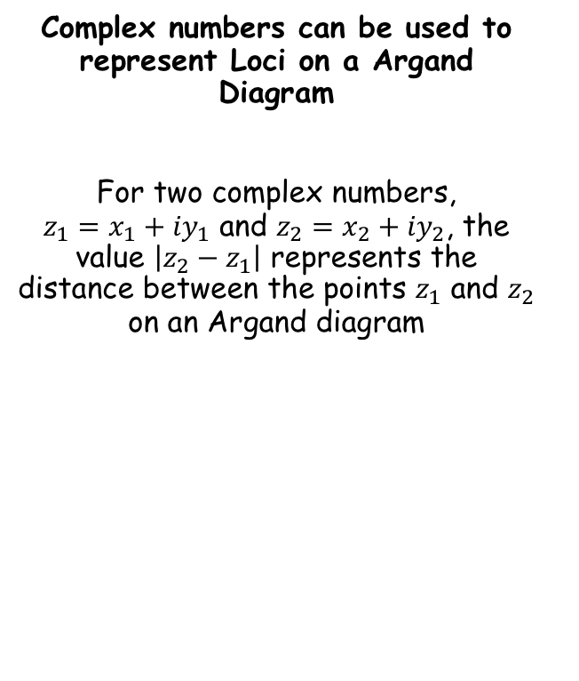



Argand Diagrams
$$z_{2}=x_{2}+{iy}_{2}$$
Complex numbers can be used to represent Loci on a Argand Diagram
For two complex numbers, $z_{1}=x_{1}+{iy}_{1}$ and $z_{2}=x_{2}+{iy}_{2}$, the value $\left|z_{2}−z_{1}\right|$ represents the distance between the points $z_{1}$ and $z_{2}$ on an Argand diagram
$$z_{2}$$
$$z_{2}−z_{1}$$
$$z_{1}$$
$$z_{1}=x_{1}+{iy}_{1}$$
2E

Slide 2

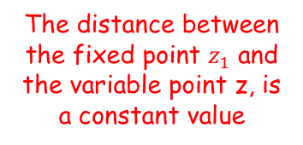
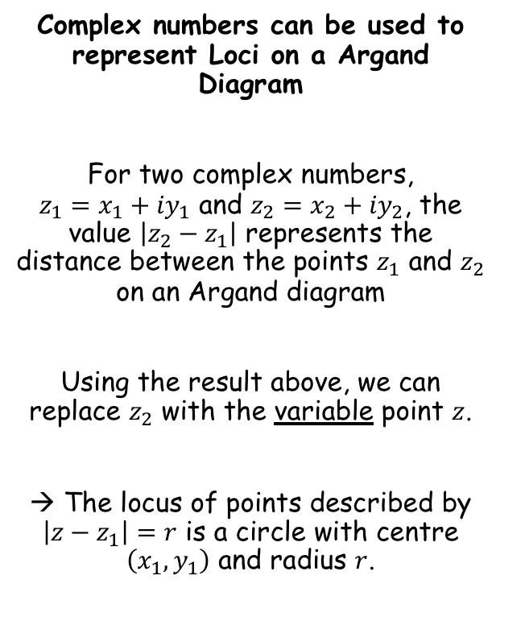

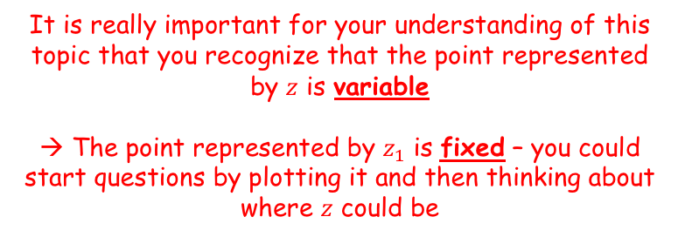

Argand Diagrams
$$z=x+iy$$
Complex numbers can be used to represent Loci on a Argand Diagram
For two complex numbers, $z_{1}=x_{1}+{iy}_{1}$ and $z_{2}=x_{2}+{iy}_{2}$, the value $\left|z_{2}−z_{1}\right|$ represents the distance between the points $z_{1}$ and $z_{2}$ on an Argand diagram
Using the result above, we can replace $z_{2}$ with the variable point $z$.
→ The locus of points described by $\left|z−z_{1}\right|=r$ is a circle with centre $\left(x_{1},y_{1}\right)$ and radius $r$.
$$\left|z−z_{1}\right|=r$$
The distance between the fixed point $z_{1}$ and the variable point z, is a constant value
$$z_{1}=x_{1}+{iy}_{1}$$
It is really important for your understanding of this topic that you recognize that the point represented by $z$ is variable
→ The point represented by $z_{1}$ is fixed – you could start questions by plotting it and then thinking about where $z$ could be
2E

Slide 3

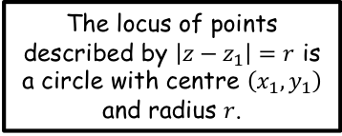

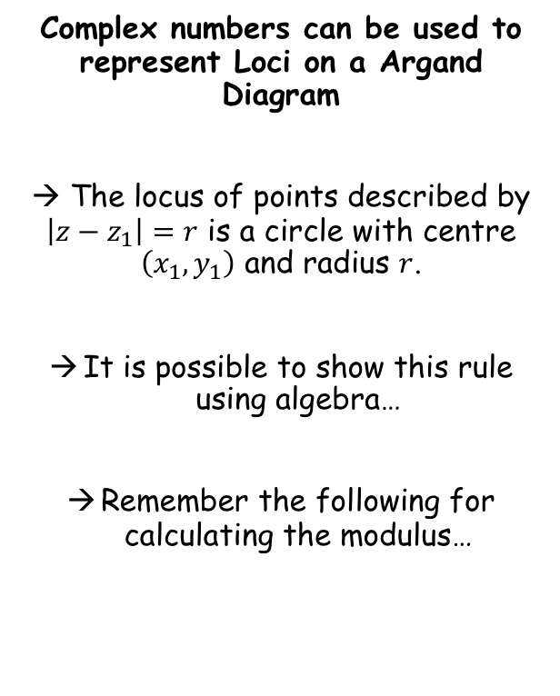






Argand Diagrams
The locus of points described by $\left|z−z_{1}\right|=r$ is a circle with centre $\left(x_{1},y_{1}\right)$ and radius $r$.
Complex numbers can be used to represent Loci on a Argand Diagram
→ The locus of points described by $\left|z−z_{1}\right|=r$ is a circle with centre $\left(x_{1},y_{1}\right)$ and radius $r$.
It is possible to show this rule using algebra…
Remember the following for calculating the modulus…
$$\left|z−z_{1}\right|=r$$
Replace with the x and y notation eg) $z=x+iy$
$$\left|(x+iy)−(x_{1}+{iy}_{1})\right|=r$$
Rearrange to collect real and imaginary terms
$$\left|\left(x−x_{1}\right)+i(y−y_{1})\right|=r$$
The modulus can be rewritten…
$$\sqrt{{\left(x−x_{1}\right)}^{2}+{\left(y−y_{1}\right)}^{2}}=r$$
Square both sides
$${\left(x−x_{1}\right)}^{2}+{\left(y−y_{1}\right)}^{2}=r^{2}$$
This is a circle with centre (x₁, y₁) and radius r!
If:
$$z=x+iy$$
Then:
$$\left|z\right|=\left|x+iy\right|=\sqrt{x^{2}+y^{2}}$$
(By Pythagoras’ Theorem)
2E

Slide 4


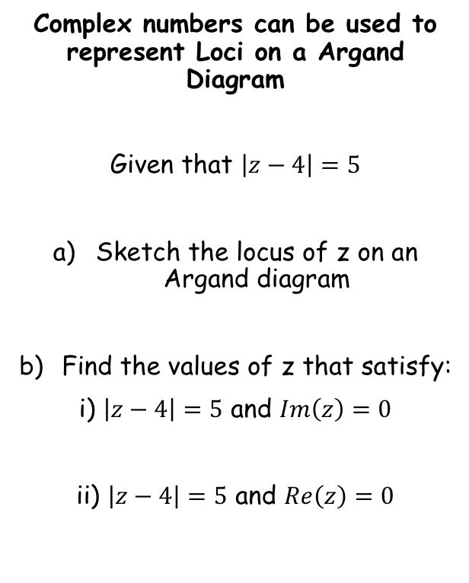






Argand Diagrams
The locus of points described by $\left|z−z_{1}\right|=r$ is a circle with centre $\left(x_{1},y_{1}\right)$ and radius $r$.
Complex numbers can be used to represent Loci on a Argand Diagram
Given that $\left|z−4\right|=5$
Sketch the locus of z on an Argand diagram
Find the values of z that satisfy:
i) $\left|z−4\right|=5$ and $Im\left(z\right)=0$
ii) $\left|z−4\right|=5$ and $Re\left(z\right)=0$
$$\left|z−4\right|=5$$
$$z_{1}=4$$
Radius = 5
Centre = (4,0)
In words, ‘The distance of the variable point $z$, from the fixed point $z_{1}$, is equal to 5’
$$Im$$
$$z=x+iy$$
$$z_{1}$$
$$Re$$
$$(4,0)$$
2E

Slide 5




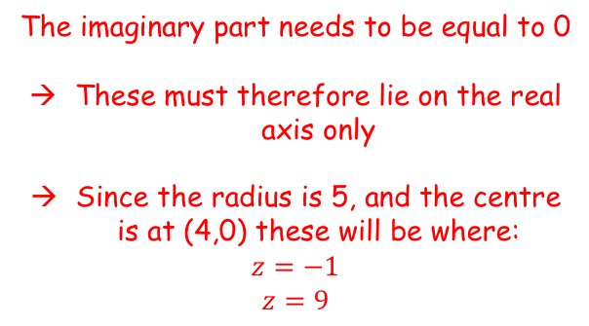
Argand Diagrams
The locus of points described by $\left|z−z_{1}\right|=r$ is a circle with centre $\left(x_{1},y_{1}\right)$ and radius $r$.
$$Im$$
Complex numbers can be used to represent Loci on a Argand Diagram
Given that $\left|z−4\right|=5$
Sketch the locus of z on an Argand diagram
Find the values of z that satisfy:
i) $\left|z−4\right|=5$ and $Im\left(z\right)=0$
ii) $\left|z−4\right|=5$ and $Re\left(z\right)=0$
$$z=x+iy$$
$$z_{1}$$
$$Re$$
$$(4,0)$$
The imaginary part needs to be equal to 0
These must therefore lie on the real axis only
Since the radius is 5, and the centre is at (4,0) these will be where:
$$z=−1$$
$$z=9$$
$$z=−1 z=9$$
2E

Slide 6
Argand Diagrams
The locus of points described by $\left|z−z_{1}\right|=r$ is a circle with centre $\left(x_{1},y_{1}\right)$ and radius $r$.
$$Im$$
Complex numbers can be used to represent Loci on a Argand Diagram
Given that $\left|z−4\right|=5$
Sketch the locus of z on an Argand diagram
Find the values of z that satisfy:
i) $\left|z−4\right|=5$ and $Im\left(z\right)=0$
ii) $\left|z−4\right|=5$ and $Re\left(z\right)=0$
$$z=x+iy$$
$$z_{1}$$
$$Re$$
$$(4,0)$$
The real part needs to be equal to 0
These must therefore lie on the imaginary axis only
We can use the equation of the circle to find these…
$$z=−1 z=9$$
2E

Slide 7






Argand Diagrams
The locus of points described by $\left|z−z_{1}\right|=r$ is a circle with centre $\left(x_{1},y_{1}\right)$ and radius $r$.
$$Im$$
Complex numbers can be used to represent Loci on a Argand Diagram
Given that $\left|z−4\right|=5$
Sketch the locus of z on an Argand diagram
Find the values of z that satisfy:
i) $\left|z−4\right|=5$ and $Im\left(z\right)=0$
ii) $\left|z−4\right|=5$ and $Re\left(z\right)=0$
$$z=x+iy$$
$$3$$
$$z_{1}$$
$$Re$$
$$(4,0)$$
$$−3$$
$${\left(x−4\right)}^{2}+y^{2}=25$$
Sub in x = 0
$${\left(−4\right)}^{2}+y^{2}=25$$
Calculate
$$z=−1 z=9$$
$$16+y^{2}=25$$
Subtract 16
$$y^{2}=9$$
$$z=3i or z=−3i$$
Square root
$$y=±3$$
2E

Slide 8



Argand Diagrams
The locus of points described by $\left|z−z_{1}\right|=r$ is a circle with centre $\left(x_{1},y_{1}\right)$ and radius $r$.
Im
Complex numbers can be used to represent Loci on a Argand Diagram
If:
Sketch the locus of P(x,y) which is represented by z on an Argand diagram
P(x,y)
(5,3)
$$\left|z−5−3i\right|=3$$
Re
$$\left|z−5−3i\right|=3$$
$$\left|z−(5+3i)\right|=3$$
So we want the locus where the distance between the variable point z and the fixed point (5,3) is equal to 3
Leave z as it is – this is the variable point
Put this part in a bracket
- This is the fixed point
This will be a circle of radius 3 units, centre (5,3)
2E

Slide 9




Argand Diagrams
The locus of points described by $\left|z−z_{1}\right|=r$ is a circle with centre $\left(x_{1},y_{1}\right)$ and radius $r$.
Im
Complex numbers can be used to represent Loci on a Argand Diagram
If:
Find the maximum value of argz in the interval (-π,π)
Sketch this on the diagram
We can use the ‘tangents to a circle’ rule
We can then find the angle in the lower triangle, and double it!
P(x,y)
(5,3)
$$\left|z−5−3i\right|=3$$
3
$$θ$$
Re
5
$$\tan^{−1}\left(\frac{3}{5}\right)$$
Calculate
$$=0.54 rad$$
Double
$$=1.08 rad$$
2E

Slide 10





Argand Diagrams
The locus of points described by $\left|z−z_{1}\right|=r$ is a circle with centre $\left(x_{1},y_{1}\right)$ and radius $r$.
Complex numbers can be used to represent Loci on a Argand Diagram
If:
Use an algebraic method to find a Cartesian equation of the locus of z
$$\left|z−5−3i\right|=3$$
Replace z with ‘x + iy’
$$\left|x+iy−5−3i\right|=3$$
$$\left|z−5−3i\right|=3$$
Group the real and imaginary terms
$$\left|\left(x−5\right)+i(y−3)\right|=3$$
Use the rule above to remove the modulus
$$\sqrt{{\left(x−5\right)}^{2}+{\left(y−3\right)}^{2}}=3$$
Square both sides
$${(x−5)}^{2}+{\left(y−3\right)}^{2}=9$$
You (hopefully) recognise that this is the equation of a circle, radius 3 and with centre (5,3)!
2E

Slide 11




Argand Diagrams
The locus of points described by $\left|z−z_{1}\right|=r$ is a circle with centre $\left(x_{1},y_{1}\right)$ and radius $r$.
y
Complex numbers can be used to represent Loci on a Argand Diagram
Given that the complex number z = x + iy satisfies the equation:
Find the minimum and maximum values of |z|
Start by drawing this on an Argand diagram
It is a circle, centre (12,5) radius 3 units
3
3
$$\left|z−12−5i\right|=3$$
(12,5)
$$\left|z−(12+5i)\right|=3$$
13
x
The smallest and largest values for |z| will be on the same straight line through the circle’s centre
You can mark the size of the radius on the diagram
Find the distance from (0,0) to (12,5), then add/subtract 3 to find the largest and smallest values
So the largest value of |z| will be 16 and the smallest will be 10
$$\sqrt{5^{2}+{12}^{2}}$$
$$=13$$
2E

Slide 12





Argand Diagrams
The locus of points described by $\left|z−z_{1}\right|=r$ is a circle with centre $\left(x_{1},y_{1}\right)$ and radius $r$.
The locus of points described by $\left|z−z_{1}\right|=\left|z−z_{2}\right|$ is the perpendicular bisector of the line segment joining $z_{1}$ and $z_{2}$
$$\left|z\right|$$
This is the distance of the variable point P(x,y) from the origin (0,0)
You can use complex numbers to represent a locus of points on an Argand diagram
Sketch the locus of P(x,y) which is represented by z on an Argand diagram, if:
We therefore need the set of points that are the same distance from (0,0) and (0,6)
This will be the bisector of the line joining the two co-ordinates
You can see that it is the equivalent of the line with equation y = 3 (z = 3i)
$$\left|z−6i\right|$$
This is the distance of the variable point P(x,y) from the fixed point (0,6)
$$\left|z−(6i)\right|$$
Im
$$\left|z\right|=\left|z−6i\right|$$
(0,6)
y = 3
Re
(0,0)
2E

Slide 13











Argand Diagrams
The locus of points described by $\left|z−z_{1}\right|=r$ is a circle with centre $\left(x_{1},y_{1}\right)$ and radius $r$.
The locus of points described by $\left|z−z_{1}\right|=\left|z−z_{2}\right|$ is the perpendicular bisector of the line segment joining $z_{1}$ and $z_{2}$
You can use complex numbers to represent a locus of points on an Argand diagram
Sketch the locus of P(x,y) which is represented by z on an Argand diagram, if:
Show that the locus is y = 3 using an algebraic method
$$\left|z\right|=\left|z−6i\right|$$
Replace z with x + iy
$$\left|x+iy\right|=\left|x+iy−6i\right|$$
Factorise the ‘i’ terms on the right side
$$\left|x+iy\right|=\left|x+i(y−6)\right|$$
Use the rule for moduli (to remove the moduli!)
$$\left|z\right|=\left|z−6i\right|$$
$$\sqrt{x^{2}+y^{2}}$$
$$=$$
$$\sqrt{x^{2}+{\left(y−6\right)}^{2}}$$
Square both sides
$$x^{2}+y^{2}=x^{2}+{\left(y−6\right)}^{2}$$
Expand the bracket
$$x^{2}+y^{2}=x^{2}+y^{2}−12y+36$$
Simplify
$$0=−12y+36$$
Add 12y
$$12y=36$$
Divide by 12
$$y=3$$
2E

Slide 14













Argand Diagrams
The locus of points described by $\left|z−z_{1}\right|=r$ is a circle with centre $\left(x_{1},y_{1}\right)$ and radius $r$.
The locus of points described by $\left|z−z_{1}\right|=\left|z−z_{2}\right|$ is the perpendicular bisector of the line segment joining $z_{1}$ and $z_{2}$
You can use complex numbers to represent a locus of points on an Argand diagram
Use an algebraic method to find the Cartesian equation of the locus of z if:
Represent the locus of z on a cartesian set of axes
$$\left|z−3\right|=\left|z+i\right|$$
Replace z with x + iy
$$\left|x+iy−3\right|=\left|x+iy+i\right|$$
Group real and imaginary parts
$$\left|\left(x−3\right)+iy\right|=\left|x+i(y+1)\right|$$
Use the rule for moduli (to remove the moduli!)
$$\left|z−3\right|=\left|z+i\right|$$
$$\sqrt{{\left(x−3\right)}^{2}+y^{2}}=\sqrt{x^{2}+{\left(y+1\right)}^{2}}$$
Square both sides
$$y=−3x+4$$
$${\left(x−3\right)}^{2}+y^{2}=x^{2}+{\left(y+1\right)}^{2}$$
Expand brackets
$$x^{2}−6x+9+y^{2}$$
$$=$$
$$x^{2}+y^{2}+2y+1$$
Simplify
$$−6x+9=2y+1$$
Subtract 1
$$−6x+8=2y$$
Divide by 2
$$−3x+4=y$$
2E

Slide 15
Argand Diagrams
The locus of points described by $\left|z−z_{1}\right|=r$ is a circle with centre $\left(x_{1},y_{1}\right)$ and radius $r$.
The locus of points described by $\left|z−z_{1}\right|=\left|z−z_{2}\right|$ is the perpendicular bisector of the line segment joining $z_{1}$ and $z_{2}$
You can use complex numbers to represent a locus of points on an Argand diagram
Use an algebraic method to find the Cartesian equation of the locus of z if:
Represent the locus of z on a cartesian set of axes
y
(0,4)
$$\left|z−3\right|=\left|z+i\right|$$
$$y=−3x+4$$
x
(3,0)
(0,-1)
$$\left|z−3\right|=\left|z+i\right|$$
y = -3x + 4
Distance of the variable point z from the fixed point (3,0)
Distance of the variable point x from the fixed point (0,-1)
2E

Slide 16



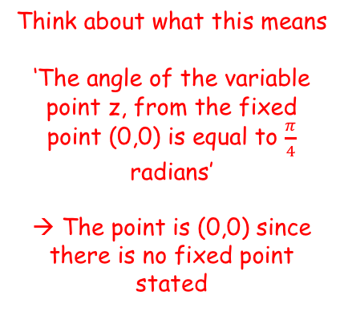
Argand Diagrams
The locus of points described by $\left|z−z_{1}\right|=r$ is a circle with centre $\left(x_{1},y_{1}\right)$ and radius $r$.
The locus of points described by $\left|z−z_{1}\right|=\left|z−z_{2}\right|$ is the perpendicular bisector of the line segment joining $z_{1}$ and $z_{2}$
y
You can use complex numbers to represent a locus of points on an Argand diagram
If:
Sketch the locus of P(x,y) which is represented by z on an Argand diagram. Then find the Cartesian equation of this locus algebraically.
→ The locus will be the set of points which start at (0,0) and make an argument of ^{π}/₄ with the positive x-axis
The line is not extended back downwards
→ It is known as a ‘half-line’
$$z$$
$$argz=\frac{π}{4}$$
$$\frac{π}{4}$$
x
Think about what this means
‘The angle of the variable point z, from the fixed point (0,0) is equal to $\frac{π}{4}$ radians’
→ The point is (0,0) since there is no fixed point stated
2E

Slide 17







Argand Diagrams
The locus of points described by $\left|z−z_{1}\right|=r$ is a circle with centre $\left(x_{1},y_{1}\right)$ and radius $r$.
The locus of points described by $\left|z−z_{1}\right|=\left|z−z_{2}\right|$ is the perpendicular bisector of the line segment joining $z_{1}$ and $z_{2}$
y
You can use complex numbers to represent a locus of points on an Argand diagram
If:
Sketch the locus of P(x,y) which is represented by z on an Argand diagram. Then find the Cartesian equation of this locus algebraically.
→ The locus will be the set of points which start at (0,0) and make an argument of ^{π}/₄ with the positive x-axis
y
$$\frac{π}{4}$$
x
x
$$argz=\frac{π}{4}$$
$$argz=\frac{π}{4}$$
Replace z with ‘x + iy’
$$arg(x+iy)=\frac{π}{4}$$
The value of the argument is tan⁻¹(^{opposite}/_{adjacent})
$$Tan^{−1}\left(\frac{y}{x}\right)=\frac{π}{4}$$
‘Normal tan’
$$\frac{y}{x}=Tan\left(\frac{π}{4}\right)$$
Calculate the tan part
$$\frac{y}{x}=1$$
Multiply by x
$$y=x$$
(x > 0)
2E

Slide 18


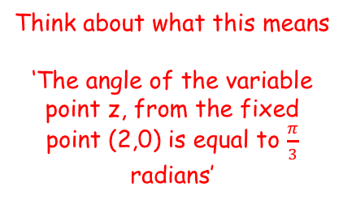
Argand Diagrams
The locus of points described by $\left|z−z_{1}\right|=r$ is a circle with centre $\left(x_{1},y_{1}\right)$ and radius $r$.
The locus of points described by $\left|z−z_{1}\right|=\left|z−z_{2}\right|$ is the perpendicular bisector of the line segment joining $z_{1}$ and $z_{2}$
y
You can use complex numbers to represent a locus of points on an Argand diagram
If:
Sketch the locus of P(x,y) which is represented by z on an Argand diagram. Then find the Cartesian equation of this locus algebraically.
The locus will be the set of values that, when we subtract 2 from them, make an angle of ^{π}/₃ with the origin
The locus must therefore start at (2,0) rather than (0,0)!
(2,0)
$$\frac{π}{3}$$
x
$$arg⁡(z−2)=\frac{π}{3}$$
Think about what this means
‘The angle of the variable point z, from the fixed point (2,0) is equal to $\frac{π}{3}$ radians’
2E

Slide 19






Argand Diagrams
The locus of points described by $\left|z−z_{1}\right|=r$ is a circle with centre $\left(x_{1},y_{1}\right)$ and radius $r$.
The locus of points described by $\left|z−z_{1}\right|=\left|z−z_{2}\right|$ is the perpendicular bisector of the line segment joining $z_{1}$ and $z_{2}$
y
You can use complex numbers to represent a locus of points on an Argand diagram
If:
Sketch the locus of P(x,y) which is represented by z on an Argand diagram. Then find the Cartesian equation of this locus algebraically.
The locus will be the set of values that, when we subtract 2 from them, make an angle of ^{π}/₃ with the origin
The locus must therefore start at (2,0) rather than (0,0)!
y
(2,0)
$$\frac{π}{3}$$
x
x - 2
$$arg⁡(z−2)=\frac{π}{3}$$
$$arg⁡(z−2)=\frac{π}{3}$$
Replace z with ‘x + iy’
$$arg(x+iy−2)=\frac{π}{3}$$
The value of the argument is tan⁻¹(^{opposite}/_{adjacent})
$$Tan^{−1}\left(\frac{y}{x−2}\right)=\frac{π}{3}$$
‘Normal tan’
$$\frac{y}{x−2}=Tan\left(\frac{π}{3}\right)$$
Calculate the tan part
$$\frac{y}{x−2}=\sqrt{3}$$
Multiply by (x – 2)
$$y=\sqrt{3}x−2\sqrt{3}$$
(x > 2)
2E

Slide 20



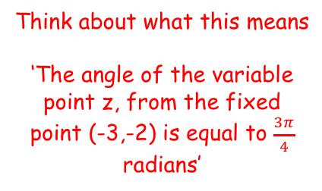
Argand Diagrams
The locus of points described by $\left|z−z_{1}\right|=r$ is a circle with centre $\left(x_{1},y_{1}\right)$ and radius $r$.
The locus of points described by $\left|z−z_{1}\right|=\left|z−z_{2}\right|$ is the perpendicular bisector of the line segment joining $z_{1}$ and $z_{2}$
y
You can use complex numbers to represent a locus of points on an Argand diagram
If:
Sketch the locus of z on an Argand diagram and use an algebraic method to find the equation of the line.
Start by writing the argument as a subtraction…
So the line will have to start at (-3,-2)
x
$$\frac{3π}{4}$$
$$arg⁡(z+3+2i)=\frac{3π}{4}$$
(-3,-2)
$$arg⁡(z−(−3−2i))=\frac{3π}{4}$$
Think about what this means
‘The angle of the variable point z, from the fixed point (-3,-2) is equal to $\frac{3π}{4}$ radians’
2E

Slide 21







Argand Diagrams
The locus of points described by $\left|z−z_{1}\right|=r$ is a circle with centre $\left(x_{1},y_{1}\right)$ and radius $r$.
The locus of points described by $\left|z−z_{1}\right|=\left|z−z_{2}\right|$ is the perpendicular bisector of the line segment joining $z_{1}$ and $z_{2}$
y
You can use complex numbers to represent a locus of points on an Argand diagram
If:
Sketch the locus of z on an Argand diagram and use an algebraic method to find the equation of the line.
Start by writing the argument as a subtraction…
So the line will have to start at (-3,-2)
y + 2
x
$$\frac{3π}{4}$$
$$arg⁡(z+3+2i)=\frac{3π}{4}$$
x + 3
(-3,-2)
$$arg⁡(z−(−3−2i))=\frac{3π}{4}$$
$$arg⁡(z+3+2i)=\frac{3π}{4}$$
Replace z with ‘x + iy’
$$arg(x+iy+3+2i)=\frac{3π}{4}$$
The value of the argument is tan⁻¹(^{opposite}/_{adjacent})
$$Tan^{−1}\left(\frac{y+2}{x+3}\right)=\frac{3π}{4}$$
‘Normal tan’
$$\frac{y+2}{x+3}=Tan\left(\frac{3π}{4}\right)$$
Calculate the tan part
$$\frac{y+2}{x+3}=−1$$
Multiply by (x + 3)
$$y+2=−x−3$$
(x < -3)
Subtract 2
$$y=−x−5$$
2E

Slide 22
Exercise 2E
Pearson Further Core Mathematics Year 1/AS
Complete before the lesson Q1-3 using Geogebra
In Class:
Green Q4-6
Amber Q7-11
Red Q12-19 & challenge

