Slide 1
Year 2 Pure Mathematics
Integration
- By parts
Chapter 11
(Part 6 of 11)

Slide 2
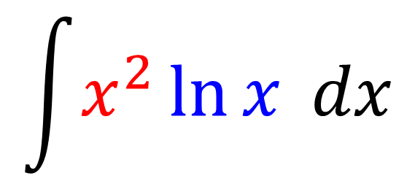
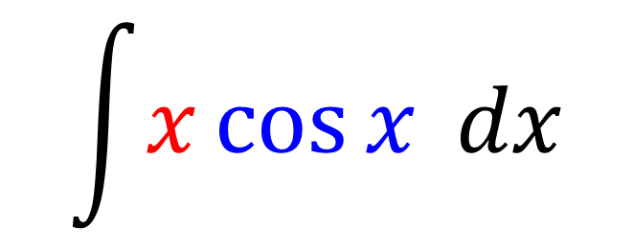
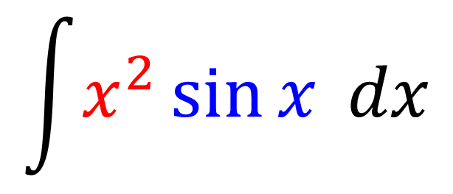
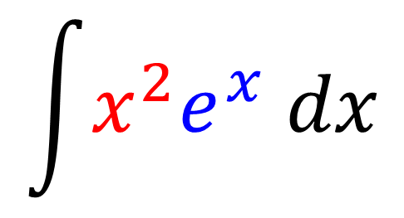
Integration by Parts
You ‘Integration by Parts’ when
integrating the product of two functions.
$$\int{x\cos{x} dx}$$
$$\int{x^{2}\ln{x} dx}$$
$$\int{x^{2}e^{x} dx}$$
$$\int{x^{2}\sin{x} dx}$$

Slide 3
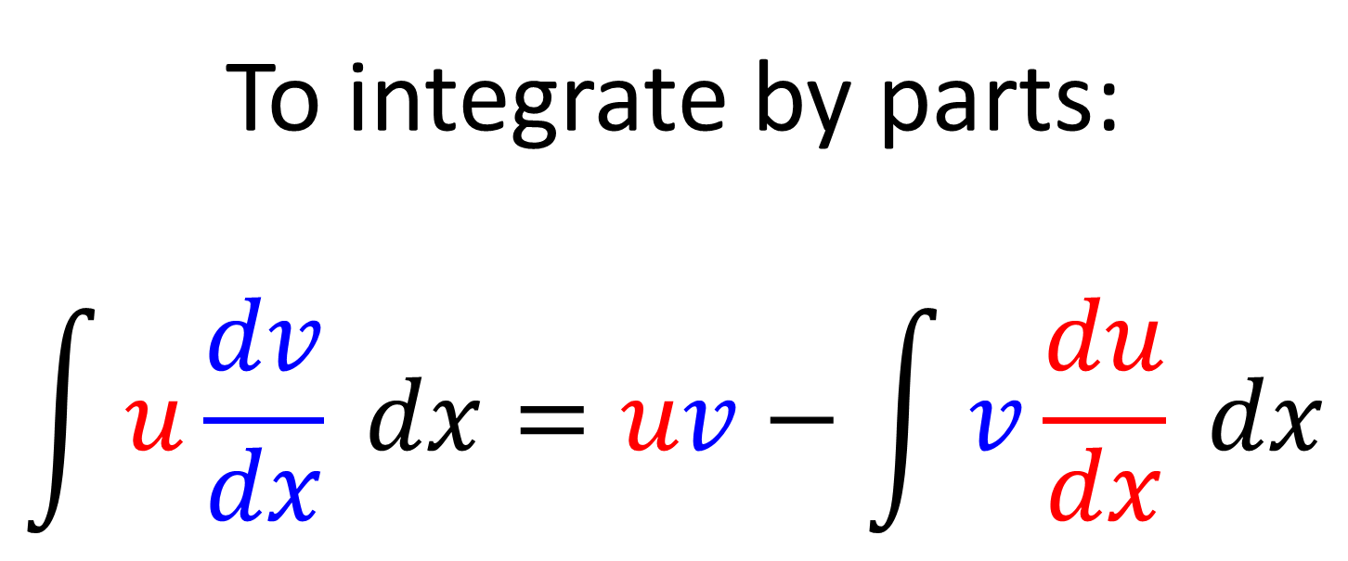
Integration by Parts
To integrate by parts:
$$\int{u\frac{dv}{dx}} dx=uv−\int{v\frac{du}{dx} dx}$$
Given in the formula booklet

Slide 4

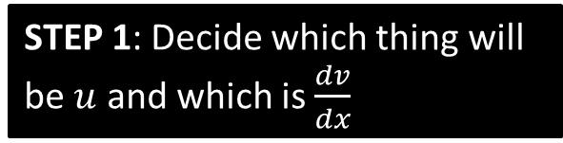
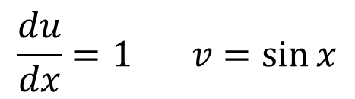
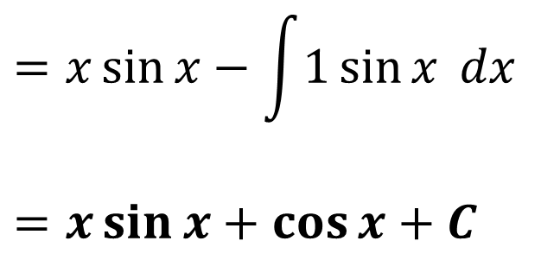
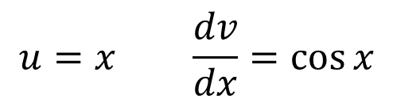
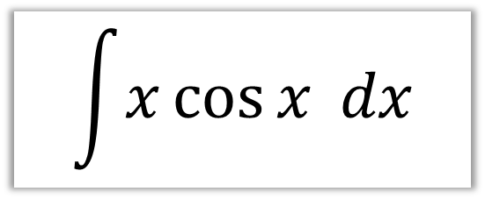
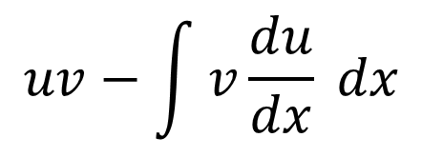

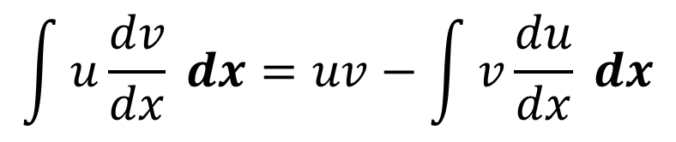
Integration by Parts
$$\int{x\cos{x} dx}$$
$$\int{u\frac{dv}{dx}} dx=uv−\int{v\frac{du}{dx} dx}$$
STEP 1: Decide which thing will be $u$ and which is $\frac{dv}{dx}$
STEP 3: Use the formula.
Song about LIATE help you decide u - Funny
$$uv−\int{v\frac{du}{dx} dx}$$
$$u=x \frac{dv}{dx}=\cos{x}$$
$u$ will always be the $x^{n}$ term
UNLESS one term is $\ln{x}$.
$$=x\sin{x}−\int{1\sin{x} dx}$$
$$=x\sin{x}+\cos{x}+C$$
STEP 2: Find $\frac{du}{dx}$ and $v$.
$$\frac{du}{dx}=1 v=\sin{x}$$

Slide 5
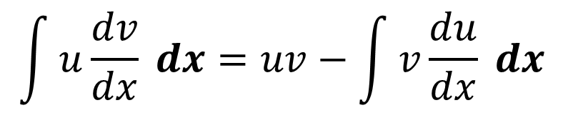
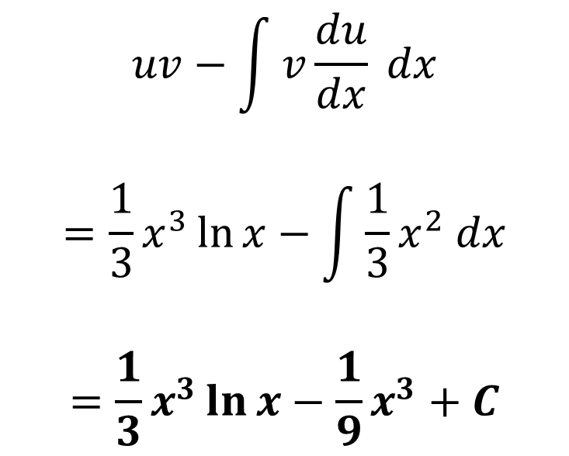
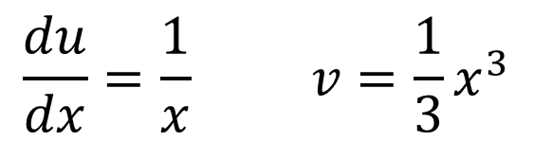
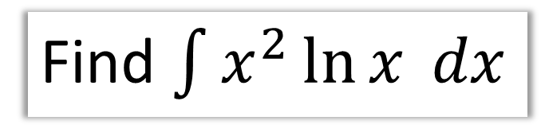
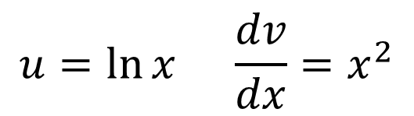

Integration by Parts
Find $\int{x^{2}\ln{x} dx}$
$$\int{u\frac{dv}{dx}} dx=uv−\int{v\frac{du}{dx} dx}$$
STEP 1: Decide which thing will be $u$ and which is $\frac{dv}{dx}$
STEP 3: Use the formula.
$$uv−\int{v\frac{du}{dx} dx}$$
$$=\frac{1}{3}x^{3}\ln{x}−\int{\frac{1}{3}x^{2} dx}$$
$$=\frac{1}{3}x^{3}\ln{x}−\frac{1}{9}x^{3}+C$$
$$u=\ln{x} \frac{dv}{dx}=x^{2}$$
STEP 2: Find $\frac{du}{dx}$ and $v$.
$$\frac{du}{dx}=\frac{1}{x} v=\frac{1}{3}x^{3}$$

Slide 6
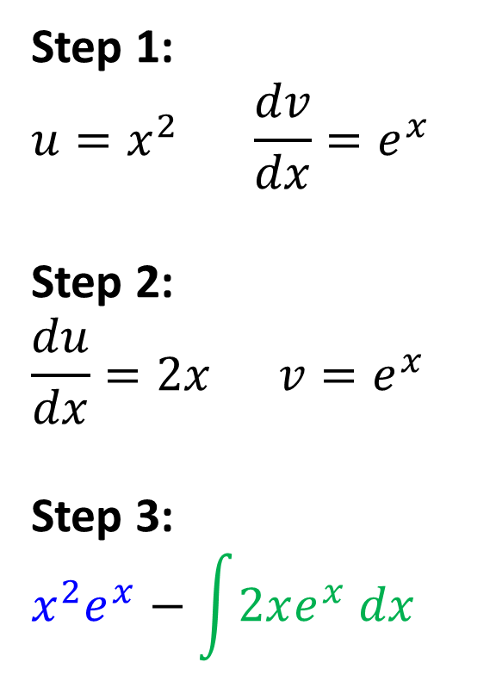
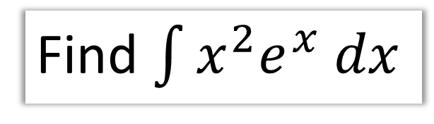
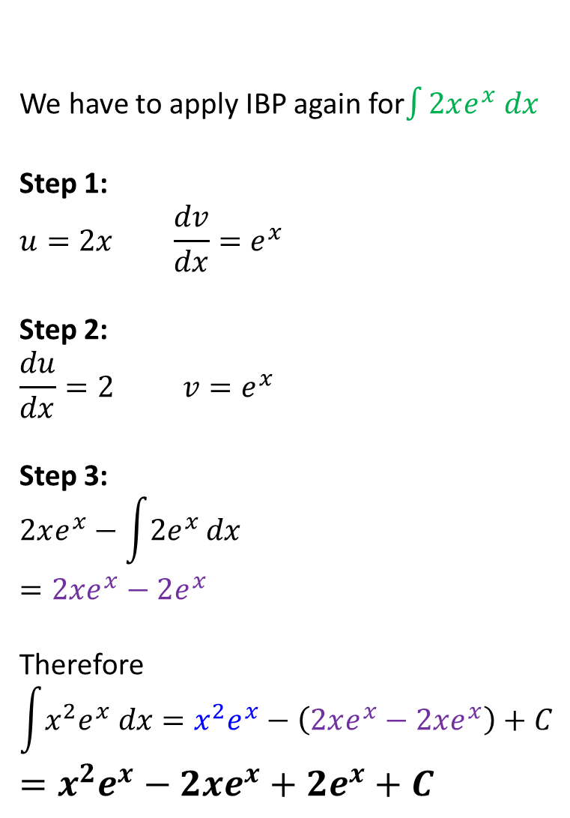
Integration by Parts - IBP twice!
We have to apply IBP again for$\int{2xe^{x} dx}$
Step 1:
$$u=2x \frac{dv}{dx}=e^{x}$$
Step 2:
$$\frac{du}{dx}=2 v=e^{x}$$
Step 3:
$$2xe^{x}−\int{2e^{x}}dx \\ =2xe^{x}−2e^{x}$$
Therefore
$$\int{x^{2}e^{x} dx}=x^{2}e^{x}−\left(2xe^{x}−2xe^{x}\right)+C \\ =x^{2}e^{x}−2xe^{x}+2e^{x}+C$$
Find $\int{x^{2}e^{x} dx}$
Step 1:
$$u=x^{2} \frac{dv}{dx}=e^{x}$$
Step 2:
$$\frac{du}{dx}=2x v=e^{x}$$
Step 3:
$$x^{2}e^{x}−\int{2xe^{x} dx}$$

Slide 7
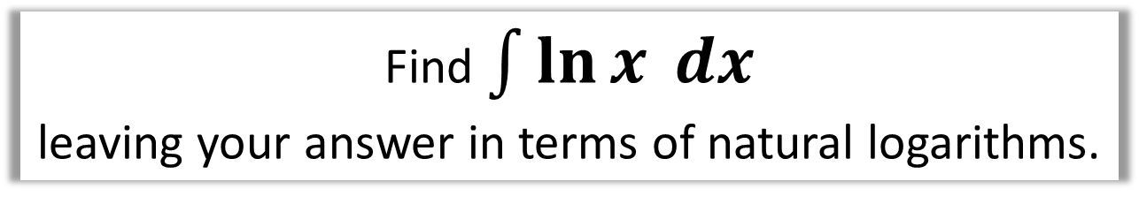
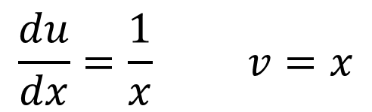
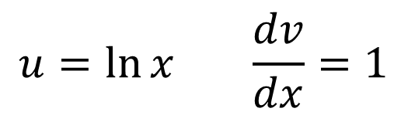
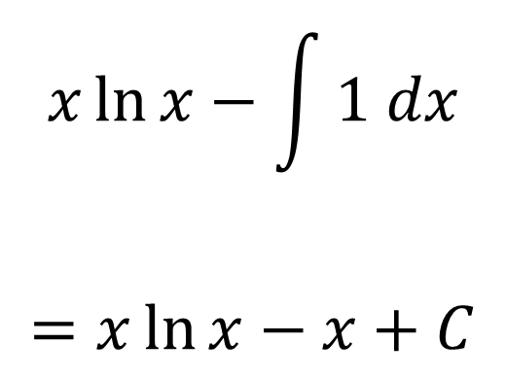
Integration by Parts - Integrating $\ln{x}$
Find $\int{\ln{x} dx}$
leaving your answer in terms of natural logarithms.
STEP 1:
STEP 3:
$$u=\ln{x} \frac{dv}{dx}=1$$
$$x\ln{x}−\int{1 dx}$$
$$=x\ln{x}−x+C$$
STEP 2:
$$\frac{du}{dx}=\frac{1}{x} v=x$$

Slide 8



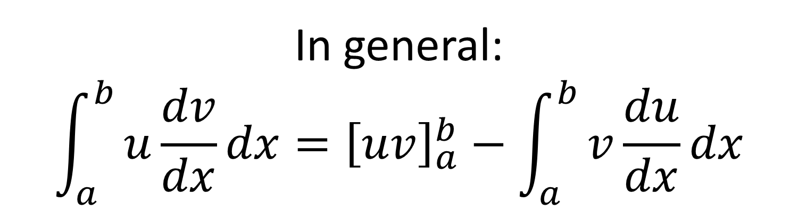



Integration by Parts - Definite Integration
$$y$$
$$?$$
$$Area=distance$$
$$a$$
$$x$$
$$b$$
In general:
$$\int_{a}^{b}{u\frac{dv}{dx}dx}={\left[uv\right]}_{a}^{b}−\int_{a}^{b}{v\frac{du}{dx}dx}$$

Slide 9
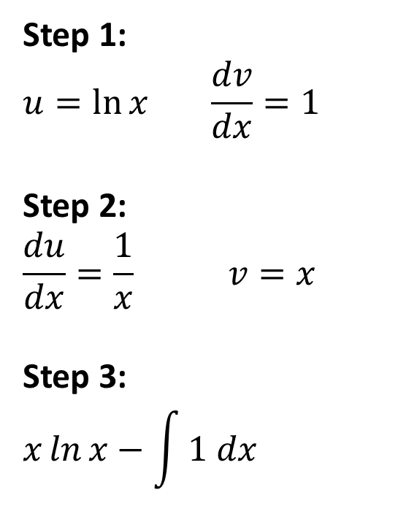

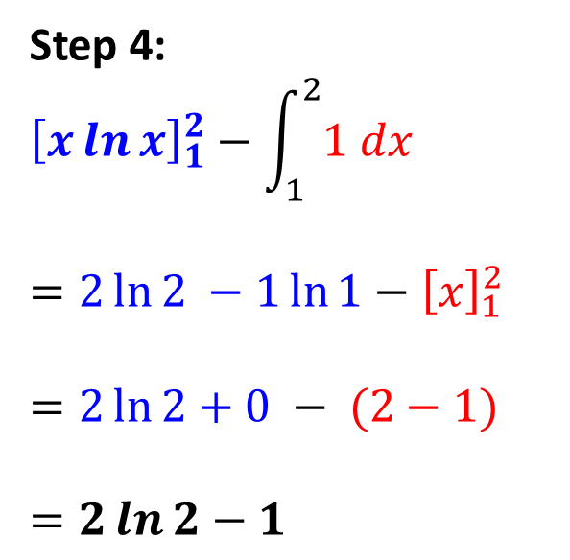
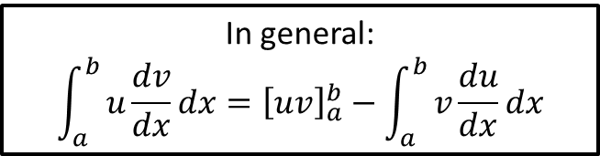
Integration by Parts - Definite Integration
Find $\int_{1}^{2}{\ln{x}dx}$
leaving your answer in terms of natural logarithms.
In general:
$$\int_{a}^{b}{u\frac{dv}{dx}dx}={\left[uv\right]}_{a}^{b}−\int_{a}^{b}{v\frac{du}{dx}dx}$$
Step 1:
$$u=\ln{x} \frac{dv}{dx}=1$$
Step 2:
$$\frac{du}{dx}=\frac{1}{x} v=x$$
Step 3:
$$x\ln{x}−\int{1 dx}$$
Step 4:
$${\left[x\ln{x}\right]}_{1}^{2}−\int_{1}^{2}{1 dx}$$
$$=2\ln{2 }−1\ln{1}−{\left[x\right]}_{1}^{2}$$
$$=2\ln{2+0 − (2−1)}$$
$$=2\ln{2}−1$$

Slide 10
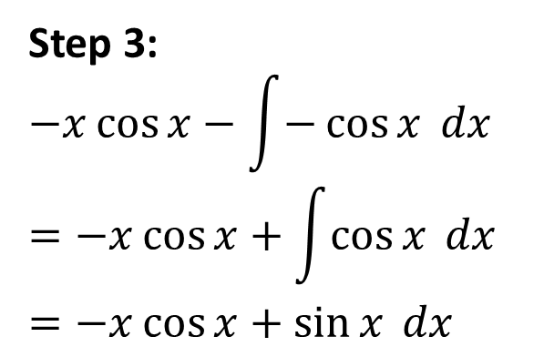
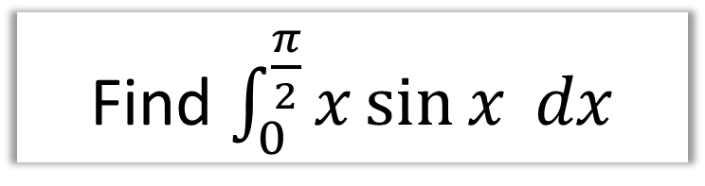
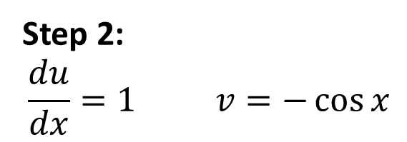
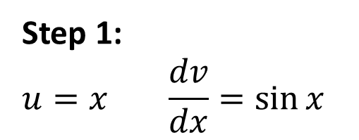
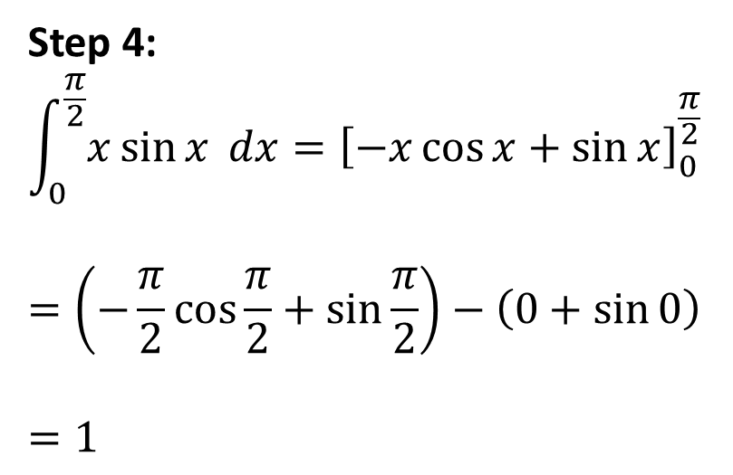
SKILL #6: Integration by Parts - Definite Integration
Find $\int_{0}^{\frac{π}{2}}{x\sin{x} dx}$
Step 1:
$$u=x \frac{dv}{dx}=\sin{x}$$
Step 4:
$$\int_{0}^{\frac{π}{2}}{x\sin{x} dx}={\left[−x\cos{x}+\sin{x}\right]}_{0}^{\frac{π}{2}}$$
$$=\left(−\frac{π}{2}\cos{\frac{π}{2}}+\sin{\frac{π}{2}}\right)−\left(0+\sin{0}\right)$$
$$=1$$
Step 2:
$$\frac{du}{dx}=1 v=−\cos{x}$$
Step 3:
$$−x\cos{x}−\int{−\cos{x} dx} \\ =−x\cos{x}+\int{\cos{x} dx} \\ =−x\cos{x}+\sin{x} dx$$

Slide 11
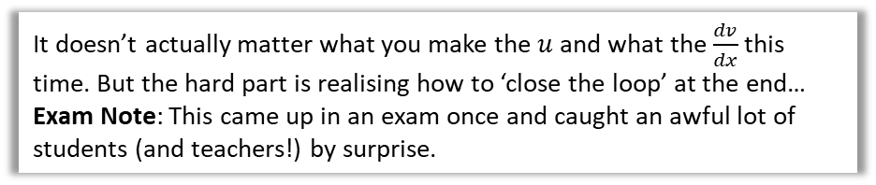
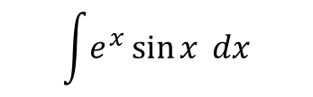
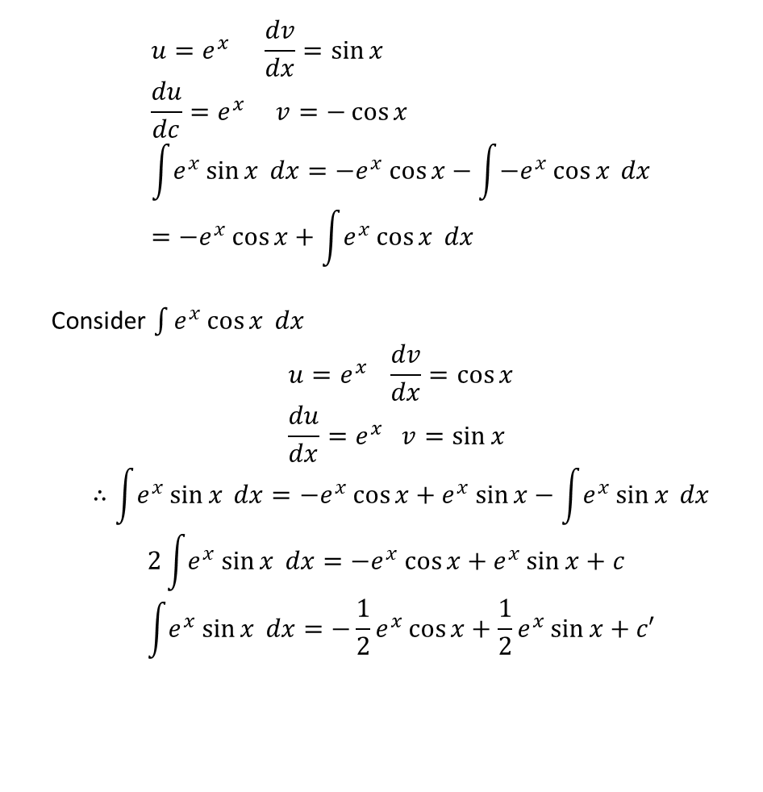
One final unusual one…
It doesn’t actually matter what you make the $u$ and what the $\frac{dv}{dx}$ this time. But the hard part is realising how to ‘close the loop’ at the end…
Exam Note: This came up in an exam once and caught an awful lot of students (and teachers!) by surprise.
$$\int{e^{x}\sin{x} dx}$$
$$u=e^{x} \frac{dv}{dx}=\sin{x} \\ \frac{du}{dc}=e^{x} v=−\cos{x} \\ \int{e^{x}\sin{x} dx}=−e^{x}\cos{x}−\int{−e^{x}\cos{x} dx} \\ =−e^{x}\cos{x}+\int{e^{x}\cos{x} dx}$$
Consider $\int{e^{x}\cos{x} dx}$
$$u=e^{x} \frac{dv}{dx}=\cos{x} \\ \frac{du}{dx}=e^{x} v=\sin{x}$$
$$∴\int{e^{x}\sin{x} dx}=−e^{x}\cos{x}+e^{x}\sin{x}−\int{e^{x}\sin{x} dx}$$
$$2\int{e^{x}}\sin{x} dx=−e^{x}\cos{x}+e^{x}\sin{x}+c \\ \int{e^{x}}\sin{x} dx=−\frac{1}{2}e^{x}\cos{x}+\frac{1}{2}e^{x}\sin{x}+c′$$
?
This is the surprising bit! Because we ended up with the original expression, we can ‘collect’ these integrals together!

Slide 12
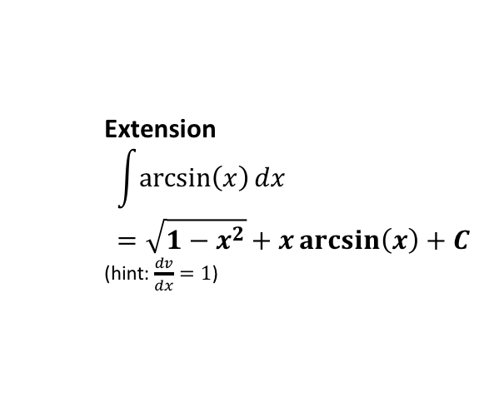
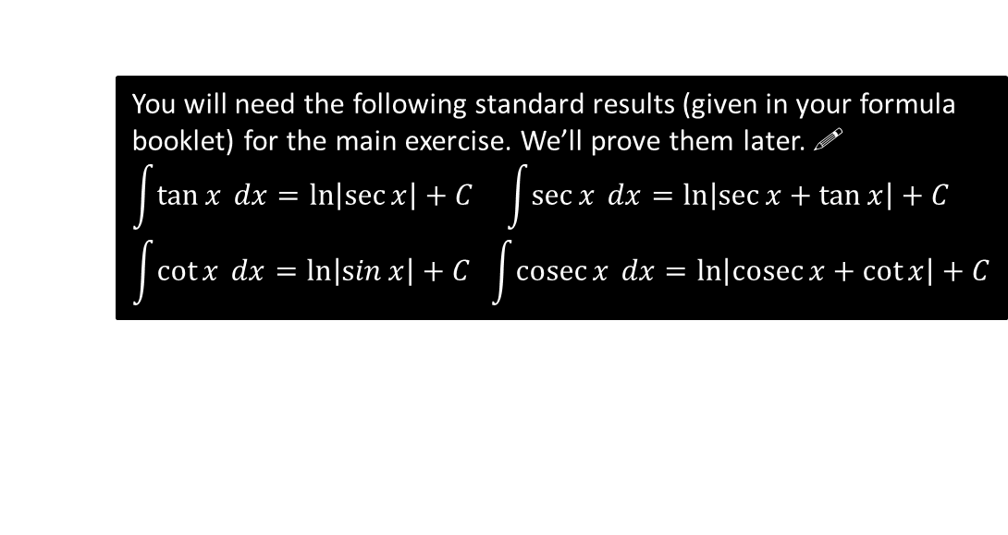
Exercise 11F
Pearson Pure Mathematics Year 2/AS
Page 306-307
Complete before the lesson Q1-2
In Class:
Green Q3-4
Amber Q5
Red Q6-7
Extension
$$\int{\arcsin\left(x\right)dx}=\sqrt{1−x^{2}}+x\arcsin\left(x\right)+C$$
(hint: $\frac{dv}{dx}=1$)
?
You will need the following standard results (given in your formula booklet) for the main exercise. We’ll prove them later. !
$$\int{\tan{x} dx}=\ln\left|\sec{x}\right|+C \int{\sec{x} dx}=\ln\left|\sec{x+\tan{x}}\right|+C \\ \int{\cot{x} dx}=\ln\left|\sin{x}\right|+C \int{\operatorname{cosec}{x} dx}=\ln\left|\operatorname{cosec}{x+\cot{x}}\right|+C$$

