Slide 1
Year 2 Applied Mathematics
Further Kinematics
- Variable Acceleration Vectors
Chapter 8
(Part 4 of 4)

Slide 2
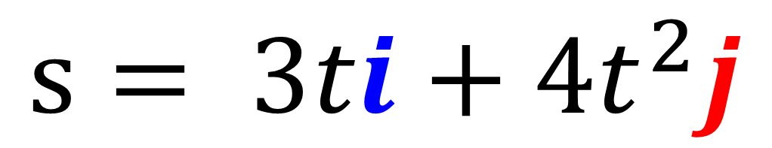

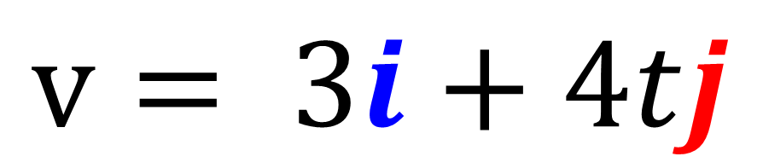
Differentiating Vectors
Differentiate the $i$ and $j$ components separately.
$$s= 3ti+4t^{2}j$$
$$v= 3i+4tj$$

Slide 3
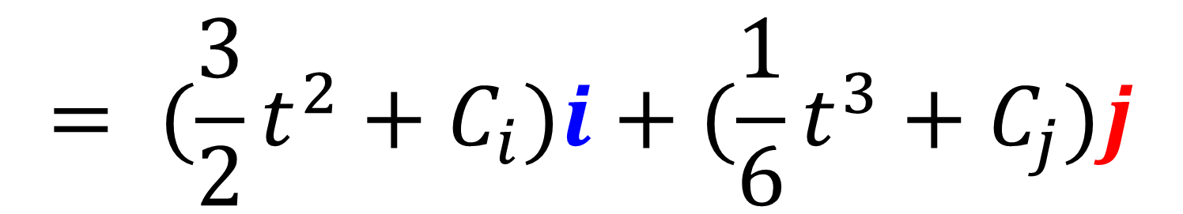

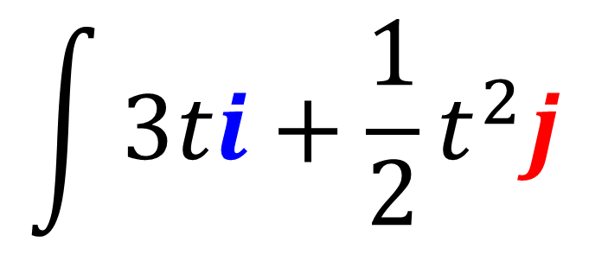
Integrating Vectors
Integrate the $i$ and $j$ components separately.
Both components will have their own C value.
$$\int{3ti+\frac{1}{2}t^{2}j}$$
$$= (\frac{3}{2}t^{2}+C_{i})i+(\frac{1}{6}t^{3}+C_{j})j$$

Slide 4
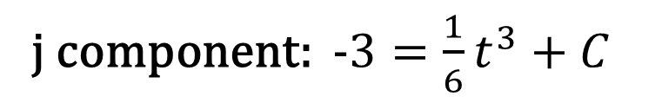
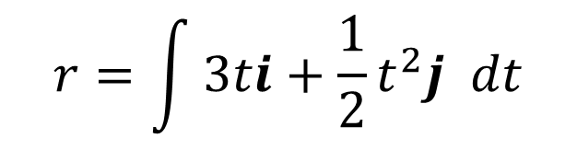
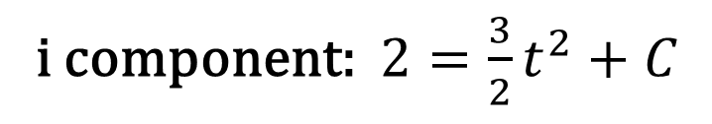
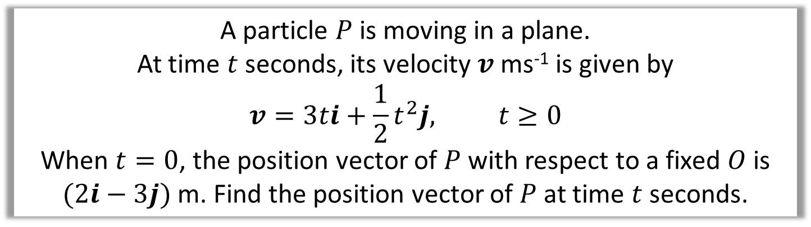
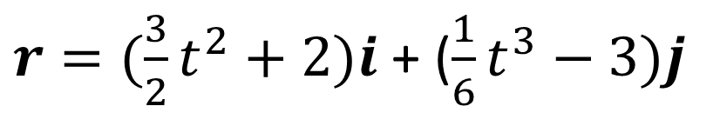
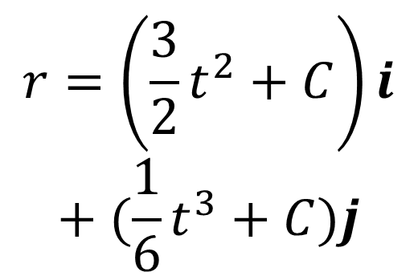
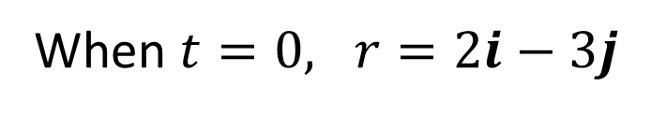
Integrating Vectors
A particle $P$ is moving in a plane.
At time $t$ seconds, its velocity $v$ ms⁻¹ is given by
$$v=3ti+\frac{1}{2}t^{2}j, t≥0$$
When $t=0$, the position vector of $P$ with respect to a fixed $O$ is $(2i−3j)$ m. Find the position vector of $P$ at time $t$ seconds.
$$r=\int{3ti+\frac{1}{2}t^{2}j dt}$$
When $t=0, r=2i−3j$
i component: $2=\frac{3}{2}t^{2}+C$
$$r=\left(\frac{3}{2}t^{2}+C\right)i$$
$$+ (\frac{1}{6}t^{3}+C)j$$
j component: $−3=\frac{1}{6}t^{3}+C$
$r=(\frac{3}{2}t^{2}+2)i$ + ($\frac{1}{6}t^{3}−3)j$

Slide 5
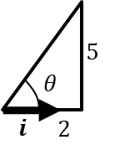
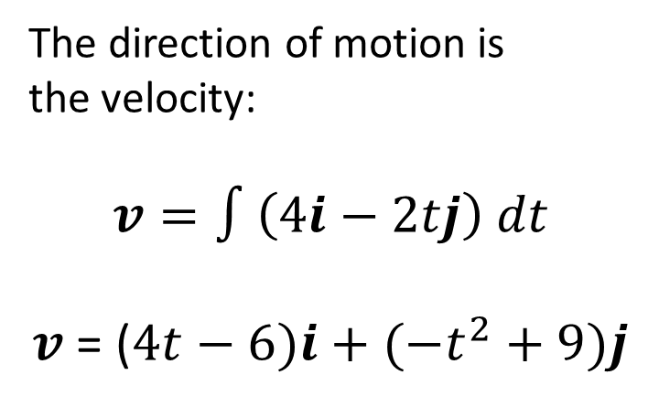
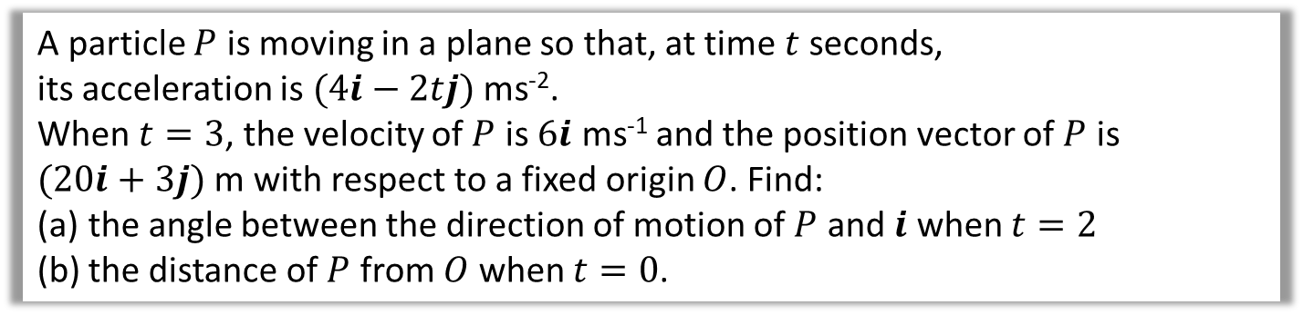
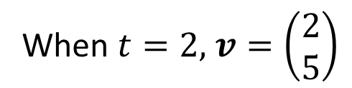
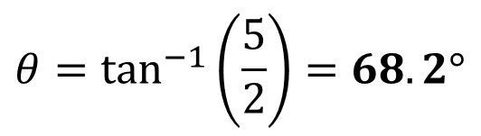
Integrating Vectors
A particle $P$ is moving in a plane so that, at time $t$ seconds,
its acceleration is $(4i−2tj)$ ms⁻².
When $t=3$, the velocity of $P$ is $6i$ ms⁻¹ and the position vector of $P$ is
$(20i+3j)$ m with respect to a fixed origin $O$. Find:
the angle between the direction of motion of $P$ and $i$ when $t=2$
the distance of $P$ from $O$ when $t=0$.
a
When $t=2,$ $v=\left(\begin{matrix}2 \\ 5\end{matrix}\right)$
The direction of motion is
the velocity:
$$v=∫\left(4i−2tj\right) dt$$
$v$ = ($4t−6)i+(−t^{2}+9)j$
$$θ=\tan^{−1}\left(\frac{5}{2}\right)=68.2°$$

Slide 6
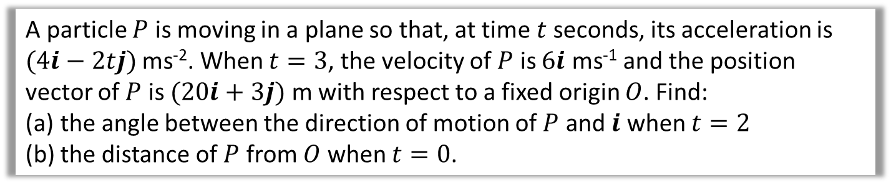
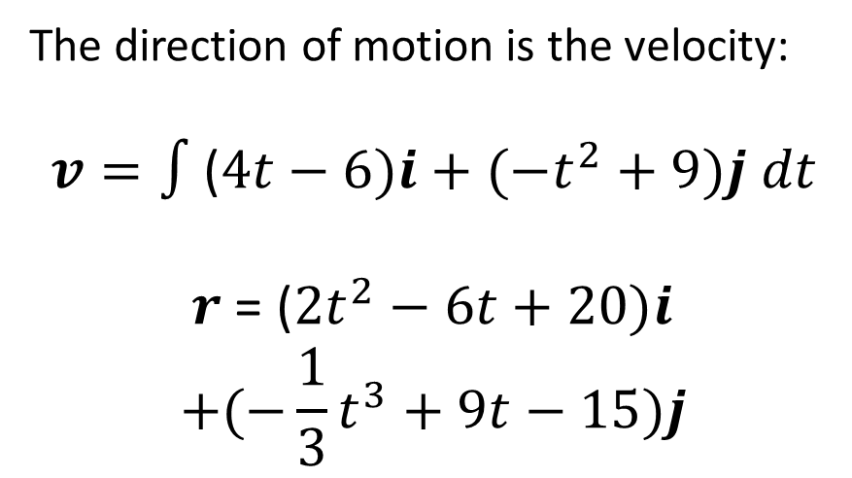
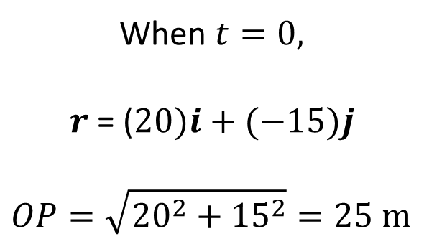
Integrating Vectors
A particle $P$ is moving in a plane so that, at time $t$ seconds, its acceleration is $(4i−2tj)$ ms⁻². When $t=3$, the velocity of $P$ is $6i$ ms⁻¹ and the position vector of $P$ is $(20i+3j)$ m with respect to a fixed origin $O$. Find:
the angle between the direction of motion of $P$ and $i$ when $t=2$
the distance of $P$ from $O$ when $t=0$.
b
The direction of motion is the velocity:
$$v=∫\text{(}4t−6)i+(−t^{2}+9)j dt$$
$r$ = ($2t^{2}−6t+20)i$
$$+(−\frac{1}{3}t^{3}+9t−15)j$$
When $t=0,$
$$r\text{ = (}20)i+(−15)j$$
$$OP=\sqrt{{20}^{2}+{15}^{2}}=25 m$$

Slide 7
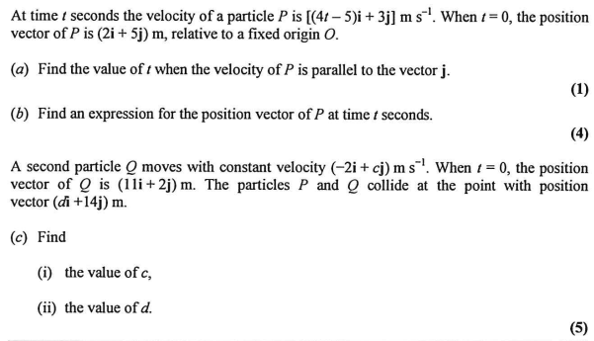
Variable Acceleration and Vectors – Exam Question

Slide 8
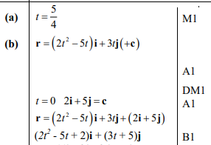
Variable Acceleration and Vectors – Exam Question Answers

Slide 9
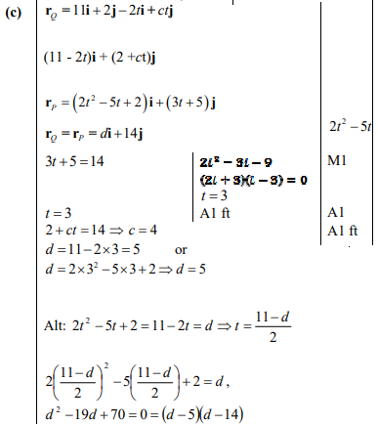
Variable Acceleration and Vectors – Exam Question Answers

Slide 10
Exercise 8D/E
Pearson Stats/Mechanics Year 2
Pages 175-176
Complete before the lesson Q1-2
In Class:
Green Q3-4
Amber Q5-7
Red Q8-10

