Slide 1
Year 2 Pure Mathematics
Integration
- By substitution
Chapter 11
(Part 5 of 11)

Slide 2
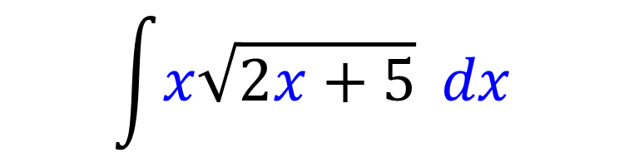
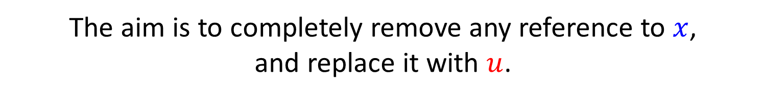
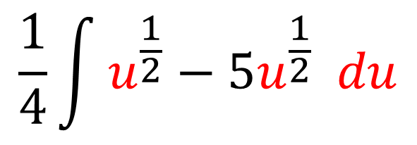
Integration by Substitution
For complicated expression,
we can make a substitution to turn it into an
equivalent integration that is simpler.
The aim is to completely remove any reference to $x$,
and replace it with $u$.
$$\int{x\sqrt{2x+5}} dx$$
$$\frac{1}{4}\int{u^{\frac{1}{2}}−5u^{\frac{1}{2}} du}$$
Now it is simpler to integrate.

Slide 3



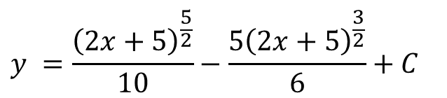
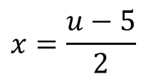
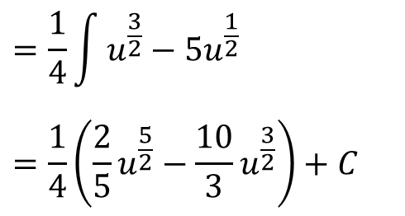
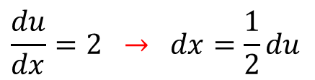
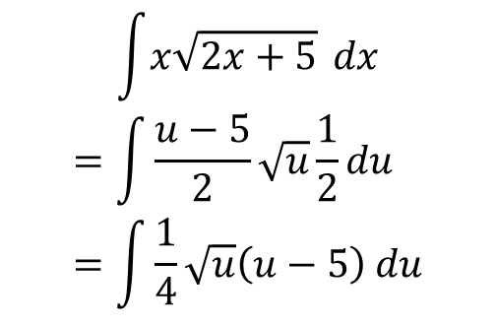
Integration by Substitution
Use the substitution $u=2x+5$ to find $\int{x\sqrt{2x+5}} dx$
STEP 1: Work out $x$ and $dx$
STEP 3: Integrate simplified expression.
$$\frac{du}{dx}=2 → dx=\frac{1}{2}du$$
$$=\frac{1}{4}\int{u^{\frac{3}{2}}−5u^{\frac{1}{2}}}$$
$$=\frac{1}{4}\left(\frac{2}{5}u^{\frac{5}{2}}−\frac{10}{3}u^{\frac{3}{2}}\right)+C$$
$$x=\frac{u−5}{2}$$
$$u=2x+5→$$
STEP 2: Substitute these into
original expression.
STEP 4: Write answer in terms of $x$.
$$\int{x\sqrt{2x+5}} dx$$
$$=\int{\frac{u−5}{2}\sqrt{u}\frac{1}{2}du}=\int{\frac{1}{4}\sqrt{u}\left(u−5\right) du}$$
$$y =\frac{{\left(2x+5\right)}^{\frac{5}{2}}}{10}−\frac{5{\left(2x+5\right)}^{\frac{3}{2}}}{6}+C$$

Slide 4
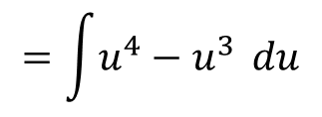
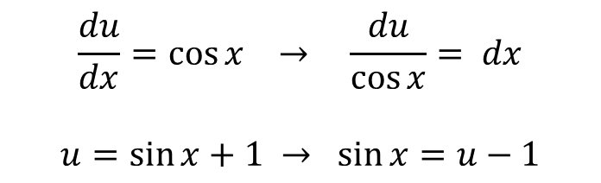
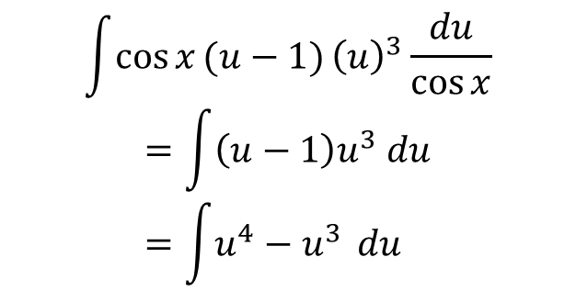
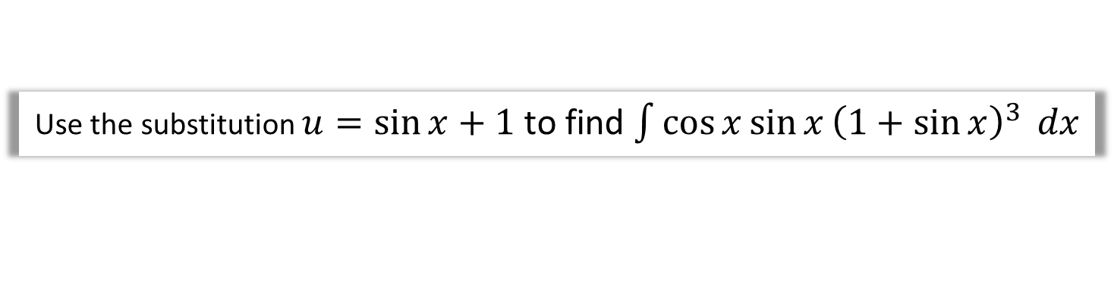
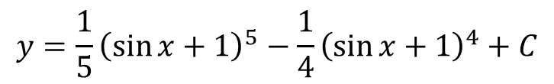
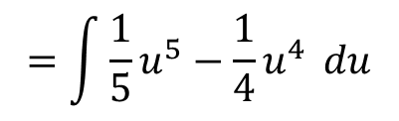
Integration by Substitution
Use the substitution $u=\sin{x}+1$ to find $\int{\cos{x}\sin{x}{\left(1+\sin{x}\right)}^{3}} dx$
STEP 1: Work out $x$ and $dx$
STEP 3: Integrate simplified expression.
$$=\int{u^{4}−u^{3}} du$$
$$\frac{du}{dx}=\cos{x} → \frac{du}{\cos{x}}= dx$$
$$u=\sin{x}+1 →\sin{x}=u−1$$
$$=\int{{\frac{1}{5}u}^{5}−{\frac{1}{4}u}^{4}} du$$
STEP 2: Substitute these into
original expression.
STEP 4: Write answer in terms of $x$.
$$\int{\cos{x}(u−1{)}{\left(u\right)}^{3}}\frac{du}{\cos{x}}$$
$$=\int{\left(u−1\right)u^{3} du} \\ =\int{u^{4}−u^{3}} du$$
$$y=\frac{1}{5}{\left(\sin{x}+1\right)}^{5}−\frac{1}{4}{\left(\sin{x}+1\right)}^{4}+C$$

Slide 5
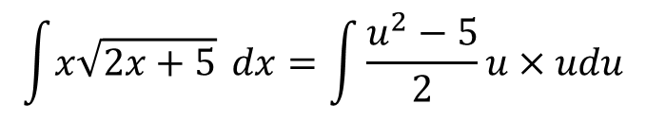
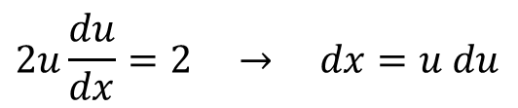
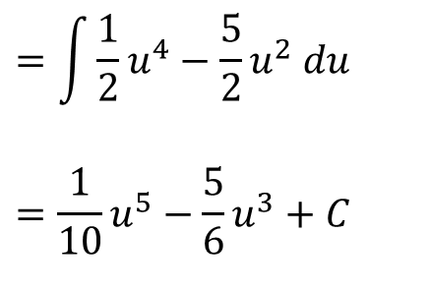
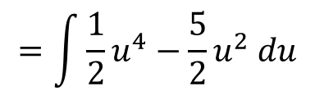
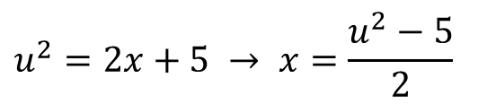
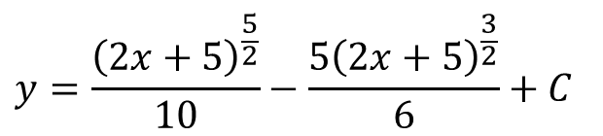
Integration by Substitution (and implicit)
Use the substitution $u^{2}=2x+5$ to find $\int{x\sqrt{2x+5}} dx$
STEP 1: Work out $x$ and $dx$
STEP 3: Integrate simplified expression.
$$2u\frac{du}{dx}=2 → dx=u du$$
$$=\int{\frac{1}{2}u^{4}−\frac{5}{2}u^{2} du}$$
$$=\frac{1}{10}u^{5}−\frac{5}{6}u^{3}+C$$
$$u^{2}=2x+5 → x=\frac{u^{2}−5}{2}$$
STEP 2: Substitute these into
original expression.
STEP 4: Write answer in terms of $x$.
$$y=\frac{{\left(2x+5\right)}^{\frac{5}{2}}}{10}−\frac{5{\left(2x+5\right)}^{\frac{3}{2}}}{6}+C$$
$$\int{x\sqrt{2x+5}} dx=\int{\frac{u^{2}−5}{2}u×udu}$$
$$=\int{\frac{1}{2}u^{4}−\frac{5}{2}u^{2} du}$$

Slide 6
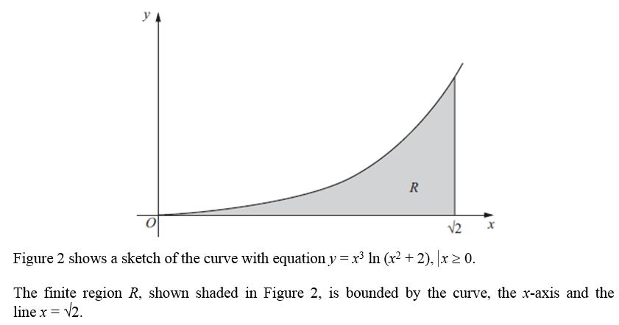
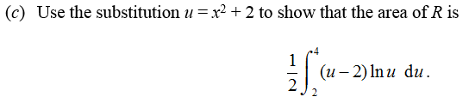

Test Your Understanding
Edexcel C4 June 2011 Q4
?
$$\frac{du}{dx}=2x → du=2x dx \\ x^{2}=u−2$$
When $x=\sqrt{2}$, $u={\left(\sqrt{2}\right)}^{2}+2=4$
When $x=0, u=0^{2}+2=2$
$$\int_{0}^{\sqrt{2}}{x^{2}\ln\left(x^{2}+2\right)x}dx=\int_{2}^{4}{\frac{1}{2}(u−2)\ln\left(u\right) du}$$

Slide 7
Exercise 11E
Pearson Pure Mathematics Year 2/AS
Page 306-307
Complete before the lesson Q1-2
In Class:
Green Q3-4
Amber Q5-6
Red Q7-9 & Challenge

