Slide 1
Year 2 Pure Mathematics
Functions and Graphs
- Modulus
Chapter 2
(Part 1 of 6)

Slide 2
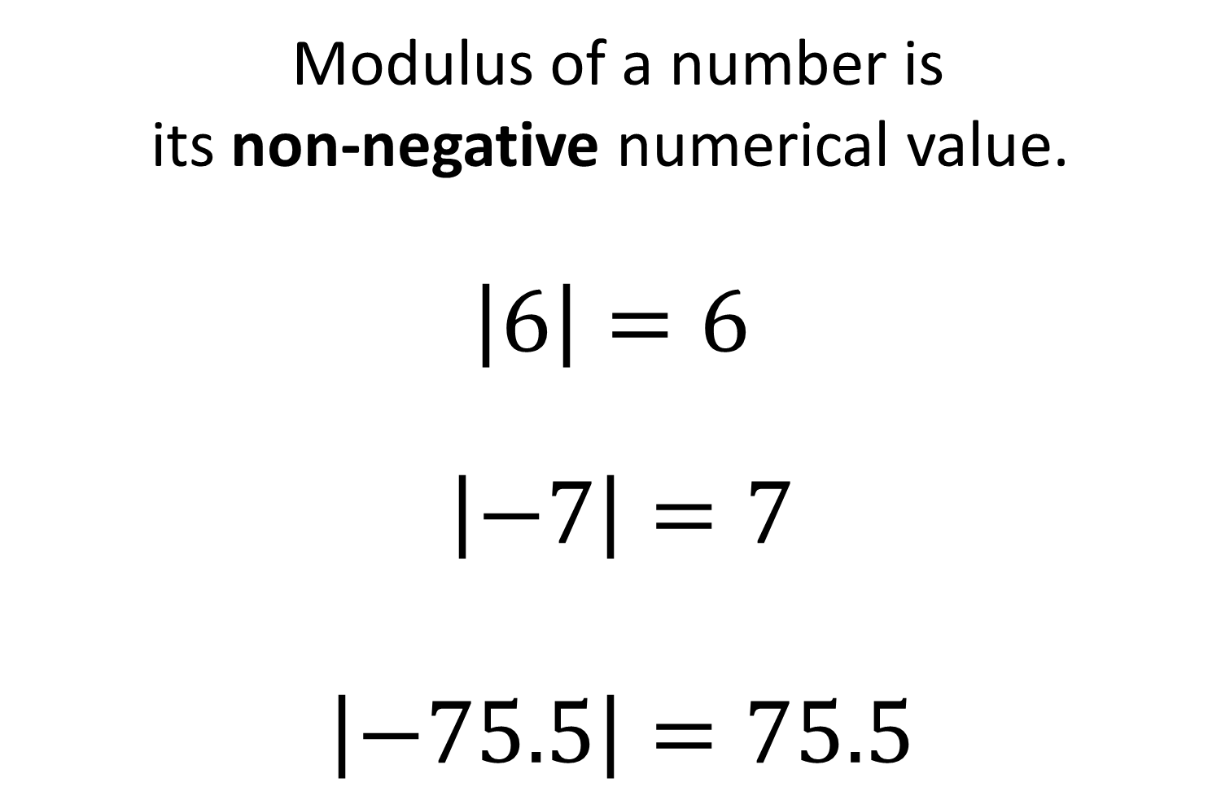
Modulus Function
Modulus of a number is
its non-negative numerical value.
$\left|6\right|=6$
$\left|−7\right|=7$
$\left|−75.5\right|=75.5$

Slide 3
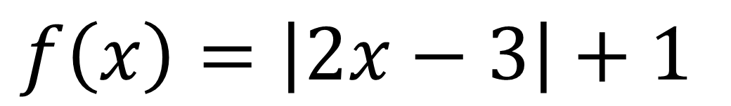
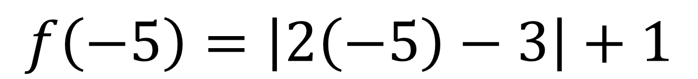
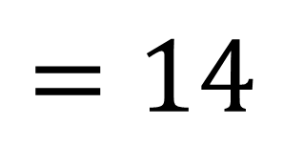
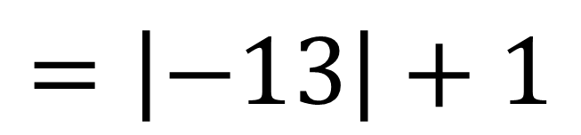
Modulus Function
Functions can contain a modulus.
$$f\left(x\right)=\left|2x−3\right|+1$$
$$f\left(−5\right)=\left|2\left(−5\right)−3\right|+1$$
$$=\left|−13\right|+1$$
$$=14$$

Slide 4
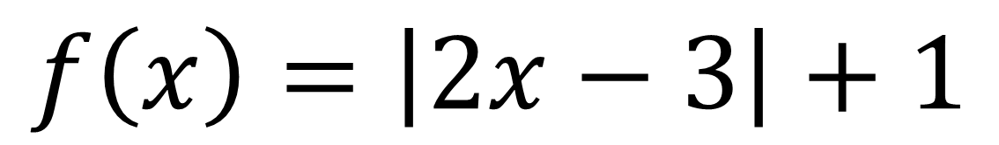
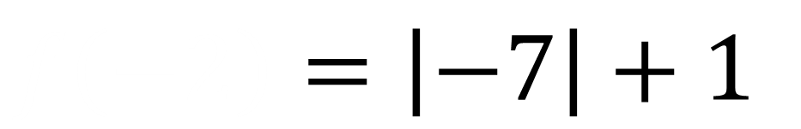
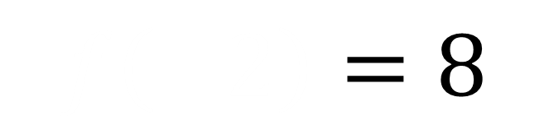
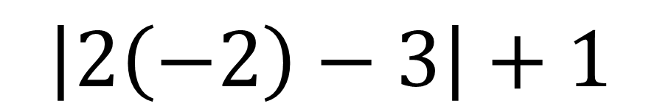
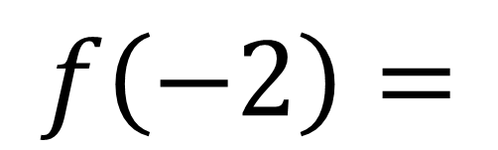
Modulus Function
$$f\left(x\right)=\left|2x−3\right|+1$$
$$f\left(−2\right)=$$
$$\left|2\left(−2\right)−3\right|+1$$
$$f\left(−2\right)=\left|−7\right|+1$$
$$f\left(−2\right)=8$$

Slide 5
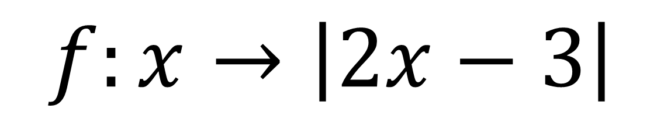
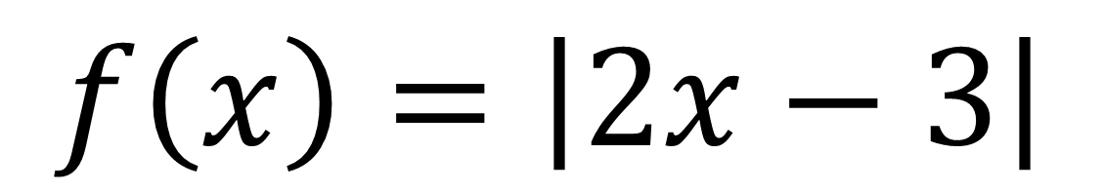
Modulus Function
Functions can also use the following notation.
$$f\left(x\right)=\left|2x−3\right|$$
$$f:x→\left|2x−3\right|$$

Slide 6

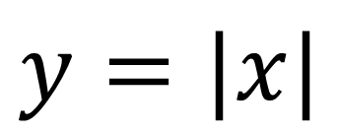

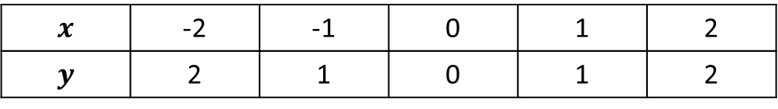



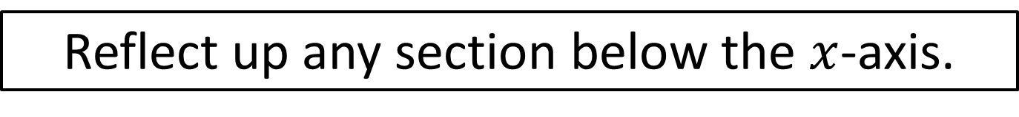
Modulus Graphs
$$y=|x|$$
$$x$$ | -2 | -1 | 0 | 1 | 2
$$y$$ | 2 | 1 | 0 | 1 | 2
$$(−2,2)$$
$$(2,2)$$
$$(−1,1)$$
$$(1,1)$$
$$(0,0)$$
Reflect up any section below the $x$-axis.

Slide 7
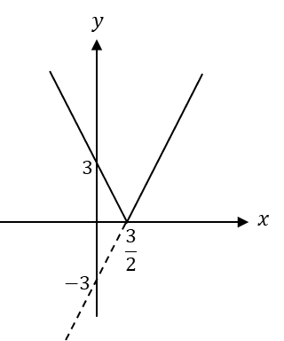
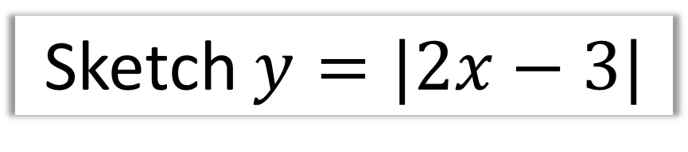
Modulus Graphs
Sketch $y=|2x−3|$
y = -2x + 3
y = 2x - 3

Slide 8
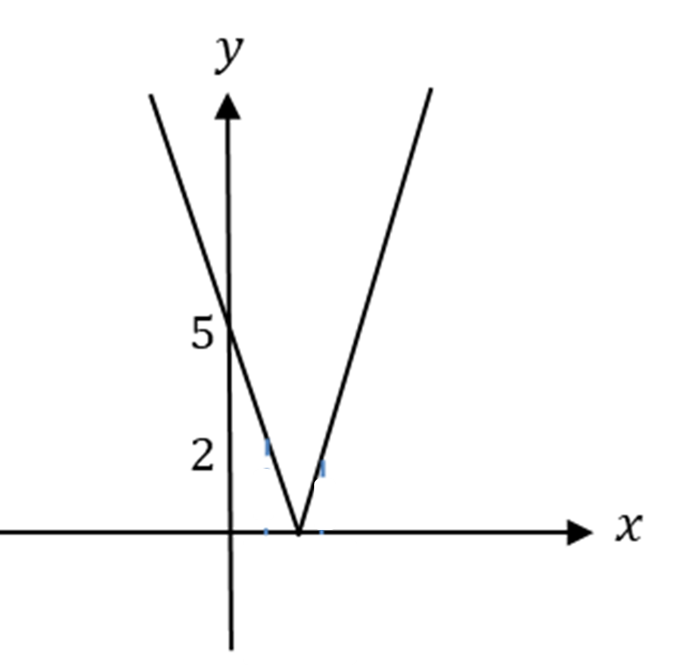
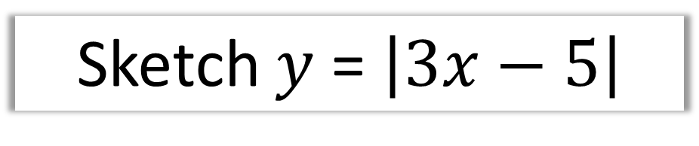
Modulus Graphs
Sketch $y$ = $\left|3x−5\right|$
y = -3x + 5
y = 3x - 5

Slide 9
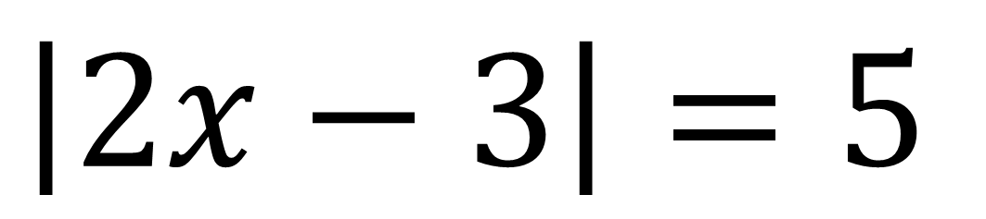
Solving Equations with Modulus
When solving equations
involving a modulus you will
need to sketch a graph.
$$\left|2x−3\right|=5$$

Slide 10
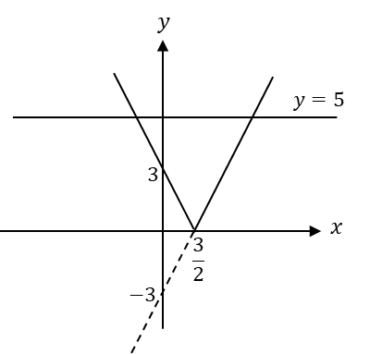
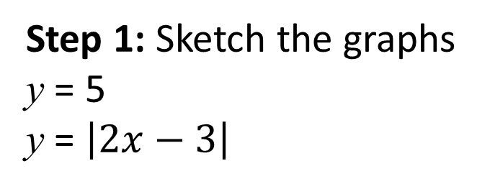
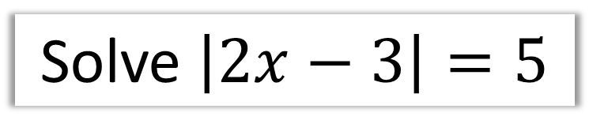
Solving Equations with Modulus
Solve $\left|2x−3\right|=5$
Step 1: Sketch the graphs
y = 5
y = $\left|2x−3\right|$
A
B

Slide 11
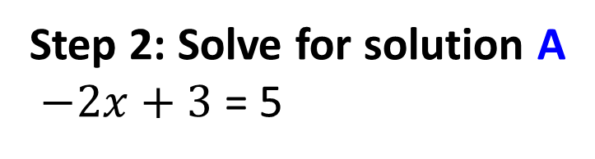
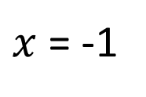
Solving Equations with Modulus
Solve $\left|2x−3\right|=5$
Step 2: Solve for solution A
$−2x+3$ = 5
$x$= -1
A
B

Slide 12
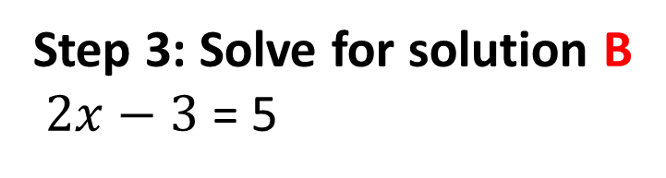
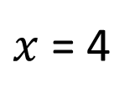
Solving Equations with Modulus
Solve $\left|2x−3\right|=5$
Step 3: Solve for solution B
$2x−3$ = 5
$x$= 4
A
B

Slide 13
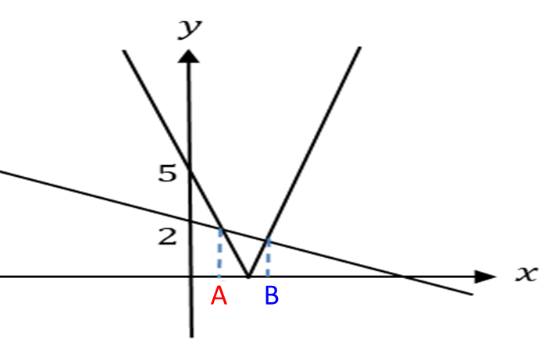
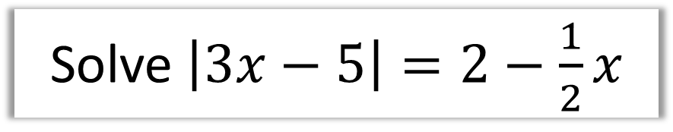

Solving Equations with Modulus
Solve $\left|3x−5\right|=2−\frac{1}{2}x$
Solution A:
$$5−3x=2−\frac{1}{2}x \\ x=\frac{6}{5}$$

Slide 14
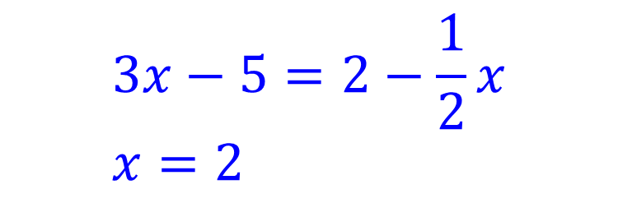
Solving Equations with Modulus
Solve $\left|3x−5\right|=2−\frac{1}{2}x$
Solution B:
$$3x−5=2−\frac{1}{2}x \\ x=2$$

Slide 15
Exercise 2A
Pearson Pure Mathematics Year 2/AS
Page 18
Complete before the lesson Q1-4
In Class:
Green Q5&6
Amber Q7-9
Red Q10-13 & Challenge

