Slide 1
Year 2 Pure Mathematics
Binomial Expansion
- Validity
Chapter 4
(Part 2 of 3)

Slide 2

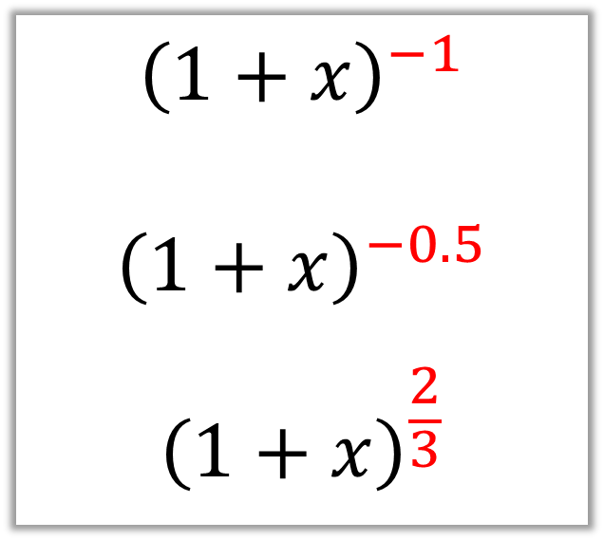
Binomial Expansion - Infinite expansions
$${\left(1+x\right)}^{−1}$$
$${\left(1+x\right)}^{−0.5}$$
$${\left(1+x\right)}^{\frac{2}{3}}$$
Binomial expansions, when $n$ is either
negative or fractions, are infinitely long.

Slide 3
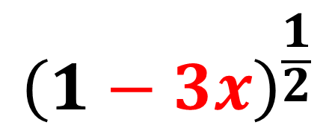
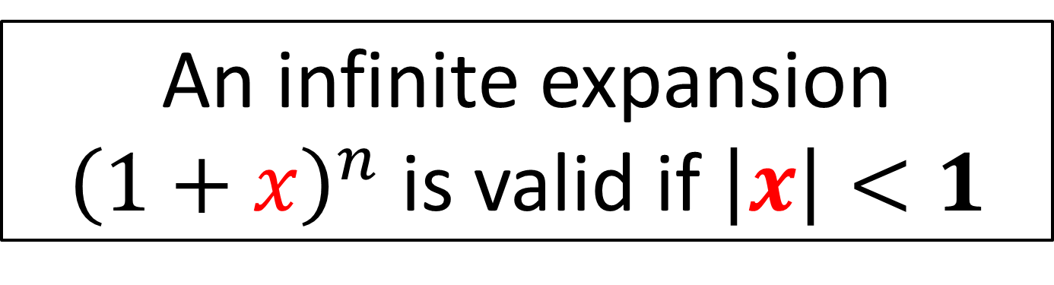
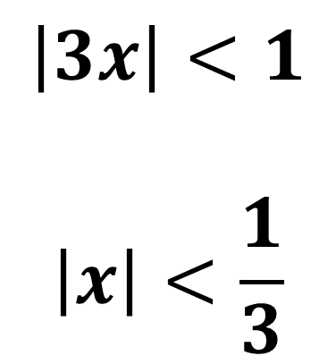
Binomial Expansion – Validity
An infinite expansion ${\left(1+x\right)}^{n}$ is valid if $\left|x\right|<1$
$${\left(1−3x\right)}^{\frac{1}{2}}$$
$$\left|3x\right|<1$$
$$\left|x\right|<\frac{1}{3}$$

Slide 4

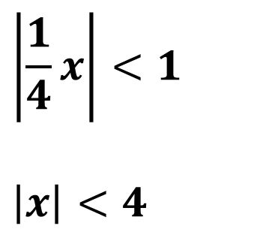


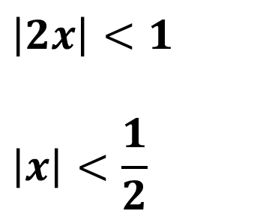

Binomial Expansion - Validity
Expansion of ${\left(1+2x\right)}^{−1}$ valid if:
$$\left|2x\right|<1$$
$$\left|x\right|<\frac{1}{2}$$
Expansion of ${\left(1−x\right)}^{−2}$ valid if:
$$|x|<1$$
Expansion of ${\left(1+\frac{1}{4}x\right)}^{\frac{1}{2}}$ valid if:
$$\left|\frac{1}{4}x\right|<1$$
$$\left|x\right|<4$$

Slide 5


Binomial Expansion - Infinite expansions
$$=1−x+x^{2}−x^{3}+x^{4}−x^{5}+x^{6}…$$
Let x = 0.4
1 term = 1
The result is converging on a single value.
2 terms = 1 – 0.4 = 0.6
3 terms = 1 – 0.4 + 0.4² = 0.76
4 terms = 1 – 0.4 + 0.4² – 0.4³ = 0.696
5 terms = 1 – 0.4 + 0.4² – 0.4³ + 0.4⁴ = 0.6704
6 terms = 1 – 0.4 + 0.4² – 0.4³ + 0.4⁴ - 0.4⁵ = 0.66016
$−1<x<1$
This converges, so expansion is valid.

Slide 6


Binomial Expansion - Infinite expansions
$$=1−x+x^{2}−x^{3}+x^{4}−x^{5}+x^{6}…$$
Let x = 1
1 term = 1
NOT converging on a single value,
so expansion
is not valid.
2 terms = 1 – 0 = 0
3 terms = 1 – 0 + 1² = 1
4 terms = 1 – 0 + 1² – 1³ = 0
5 terms = 1 – 0 + 1² – 1³ + 1⁴ = 1
6 terms = 1 – 0 + 1² – 1³ + 1⁴ - 1⁵ = 0
$x=1$
This does not converge so expansion is not valid.

Slide 7


Binomial Expansion - Infinite expansions
$$=1−x+x^{2}−x^{3}+x^{4}−x^{5}+x^{6}…$$
Let x = 2
1 term = 1
The results is diverging,
so expansion
is not valid.
2 terms = 1 – 2 = -1
3 terms = 1 – 2 + 2² = 1
4 terms = 1 – 2 + 2² – 2³ = -5
5 terms = 1 – 2 + 2² – 2³ + 2⁴ = 11
6 terms = 1 – 2 + 2² – 2³ + 2⁴ – 2⁵ = -21
$x>1$
This diverges, so expansion is not valid.

Slide 8
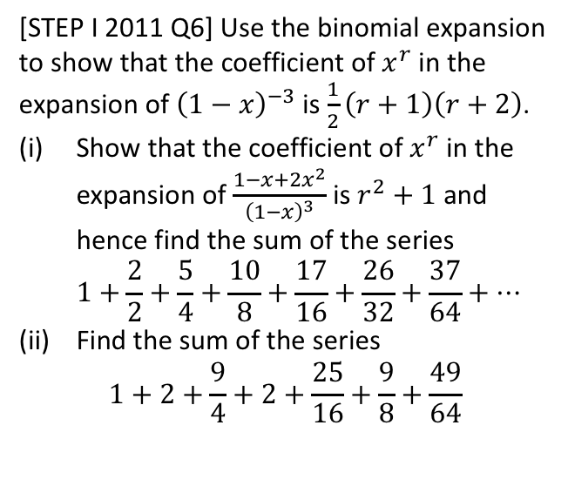
Exercise 4A
Pearson Pure Mathematics Year 2/AS
Pages 96-97
Complete before the lesson Q1 & 3
In Class:
Green Q4-6
Amber Q7-8
Red Q9 & Challenge
Extension
[STEP I 2011 Q6] Use the binomial expansion to show that the coefficient of $x^{r}$ in the expansion of ${\left(1−x\right)}^{−3}$ is $\frac{1}{2}\left(r+1\right)\left(r+2\right)$.
Show that the coefficient of $x^{r}$ in the expansion of $\frac{1−x+2x^{2}}{{\left(1−x\right)}^{3}}$ is $r^{2}+1$ and hence find the sum of the series
$1+\frac{2}{2}+\frac{5}{4}+\frac{10}{8}+\frac{17}{16}+\frac{26}{32}+\frac{37}{64}+…$
Find the sum of the series
$1+2+\frac{9}{4}+2+\frac{25}{16}+\frac{9}{8}+\frac{49}{64}$

