Slide 1
Year 1 Pure Mathematics
Representation of Data
– Box Plots and Outliers
Chapter 3
(Part 1 of 3)

Slide 2
Box Plots
Box Plots allow us to visually represent the spread of the data.
Minimum | Lower Quartile | Median | Upper Quartile | Maximum
3 | 15 | 17 | 22 | 27
range
IQR
0 5 10 15 20 25 30

Slide 3
Box Plots
The diameters of 11 different Roman coins are
measured in centimetres:
2.2 2.5 2.7 2.7 2.8 3.0 3.1 3.2 3.6 4.0 4.2
Determine the following information:
Minimum | Lower Quartile (Q1) | Median (Q2) | Upper Quartile (Q3) | Maximum
2.2
2.7
3.0
3.6
4.2
2.2 2.5 2.7 2.7 2.8 3.0 3.1 3.2 3.6 4.0 4.2

Slide 4
Box Plots
0 5 10 15 20 25 30
Age (years)
True or false:
“The right box represents more people than the left box.”
False
Each box represents 25% of people, i.e. the same number of people!
“The ages are more spread out above the median.”
True
The wider the box or whisker,
the more spread out the values are
within that 25% of the data

Slide 5
Box Plots - Outliers
An outlier is an extreme value.
Outliers
Outliers
0 5 10 15 20 25 30
There are different definitions for an outlier.
One common definition is:
Outliers happen when the data value is
1.5 IQRs below the LQ and above the UQ.

Slide 6
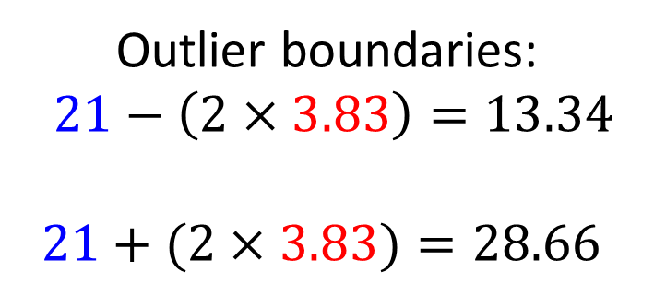
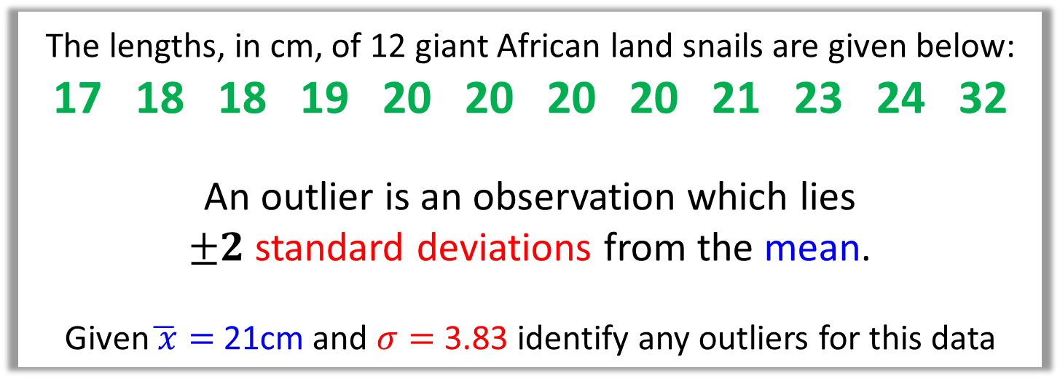
Box Plots - Outliers
The lengths, in cm, of 12 giant African land snails are given below: 17 18 18 19 20 20 20 20 21 23 24 32
An outlier is an observation which lies
$±2$ standard deviations from the mean.
Given$\overline{ x}=$ 21cm and $σ=$ 3.83 identify any outliers for this data
Outlier boundaries:
$21−\left(2×3.83\right)=13.34$
$$21+(2×3.83)=28.66$$
The only outlier is 32.

Slide 7
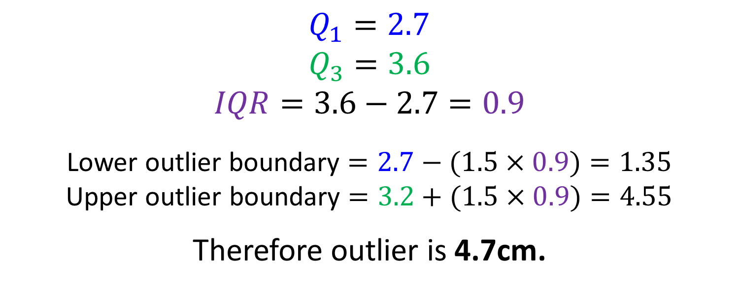
Box Plots - Outliers
The diameters of 11 different Roman coins are
measured in centimetres:
2.2 2.5 2.7 2.7 2.8 3.0 3.1 3.2 3.6 4.0 4.7
Determine the quartiles and hence any outliers.
(Outlier is when the data value is 1.5 IQRs beyond UQ and LQ)
$Q_{1}=2.7$
$$Q_{3}=3.6$$
$$IQR=3.6−2.7=0.9$$
Lower outlier boundary $=2.7−(1.5×0.9)=1.35$
Upper outlier boundary $=3.2+(1.5×0.9)=4.55$
Therefore outlier is 4.7cm.

Slide 8

Box Plot - Outliers
Smallest values | Largest values | Lower Quartile | Median | Upper Quartile
0, 3 | 21, 27 | 8 | 10 | 14
Given that the outlier boundaries are -1 and $23$
draw a box plot to represent the above data.
The Maximum Data Value (21)
Upper Outlier Boundary (23)
Use a cross for each outlier (27)
0 5 10 15 20 25 30

Slide 9
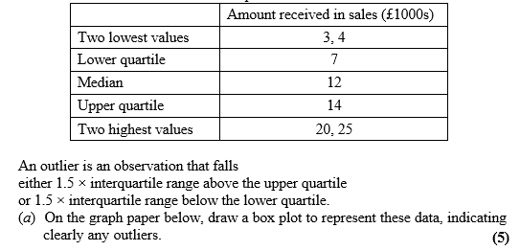
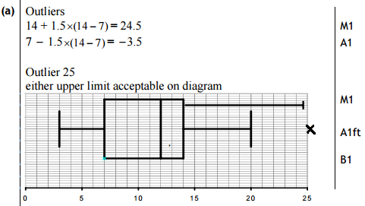
Box Plots – Exam Question

Slide 10
Comparing Box Plots
Box Plot comparing house prices of
Croydon and Kingston-upon-Thames:
Croydon
Kingston
£400k £450k £500k £550k £600k £650k £700k £750k
“Compare the prices of houses in Croydon with those in Kingston”. (2 marks)
For 1 mark, one of:
In interquartile range of house prices in Kingston is greater than Croydon.
The range of house prices in Kingston is greater than Croydon.
For 1 mark:
“The median house price in Kingston was greater than that in Croydon.”
Include some measure of location (median is best).
Include some measure of spread.

Slide 11
Exercise 3A/3B
Pearson Pure Mathematics Year 1/AS
Pages 42-43, 45
Complete before the lesson Ex3A Q1 & Ex3B Q1-2
In Class:
Green Ex3A Q2-4
Amber Ex3B Q3-4

