Slide 1

CorePure1 Chapter 3 ::
Series
jfrost@tiffin.kingston.sch.uk
www.drfrostmaths.com
@DrFrostMaths
Last modified: 14th September 2018

Slide 2








www.drfrostmaths.com
Everything is completely free.
Why not register?
Register now to interactively practise questions on this topic, including past paper questions and extension questions (including MAT + UKMT).
Teachers: you can create student accounts (or students can register themselves), to set work, monitor progress and even create worksheets.
With questions by:
Dashboard with points, trophies, notifications and student progress.
Questions organised by topic, difficulty and past paper.
Teaching videos with topic tests to check understanding.

Slide 3
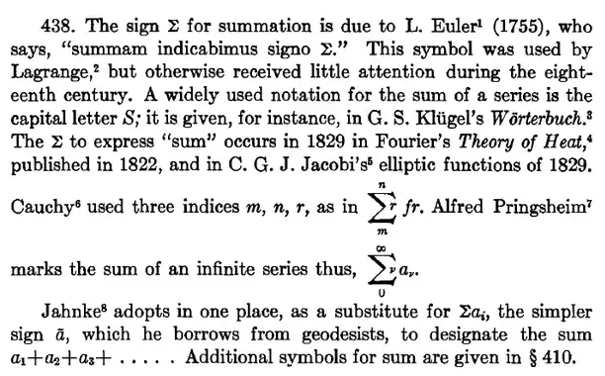
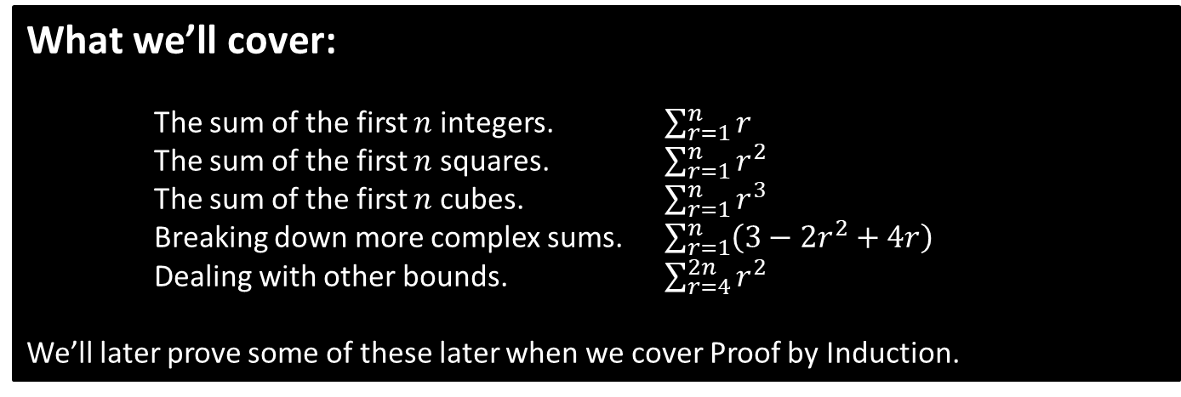
Chapter Overview
Recall that a series is a sum of (a finite or infinite number of) terms.
In Pure Year 1 we saw the $Σ$ symbol (“capital sigma”) indicates a summation.
What we’ll cover:
The sum of the first $n$ integers. $\sum_{r=1}^{n}{r}$
The sum of the first $n$ squares. $\sum_{r=1}^{n}{r^{2}}$
The sum of the first $n$ cubes. $\sum_{r=1}^{n}{r^{3}}$
Breaking down more complex sums. $\sum_{r=1}^{n}{\left(3−2r^{2}+4r\right)}$
Dealing with other bounds. $\sum_{r=4}^{2n}{r^{2}}$
We’ll later prove some of these later when we cover Proof by Induction.
From History of Mathematical Notations, Vol 2.

Slide 4
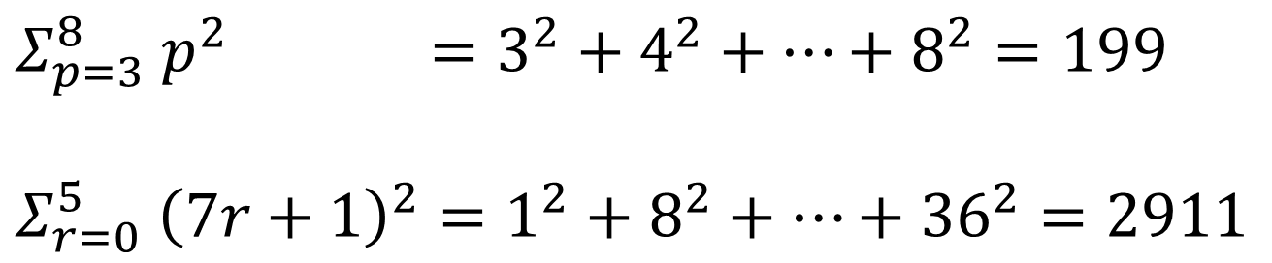
Recap
Determine the following results by explicitly writing out the elements in the sum:
?
$$Σ_{p=3}^{8} p^{2} =3^{2}+4^{2}+…+8^{2}=199$$
$$Σ_{r=0}^{5} {\left(7r+1\right)}^{2}=1^{2}+8^{2}+…+{36}^{2}=2911$$
?

Slide 5
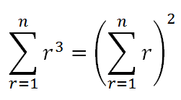

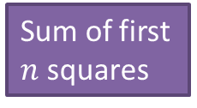


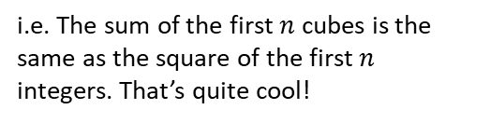
Sum of ones, integers, squares, cubes
These are the four essential formulae you need to learn for this chapter
(and that’s almost it!):
The last two are in the formula booklet, but you should memorise them anyway)
!
$$\sum_{r=1}^{n}{1=n} \\ \sum_{r=1}^{n}{r=\frac{1}{2}n\left(n+1\right)} \\ \sum_{r=1}^{n}{r^{2}=\frac{1}{6}n\left(n+1\right)\left(2n+1\right)} \\ \sum_{r=1}^{n}{r^{3}=\frac{1}{4}n^{2}{\left(n+1\right)}^{2}}$$
?
Sum of first $n$ integers
?
Sum of first $n$ squares
?
Sum of first $n$ cubes
?
Note that:
i.e. The sum of the first $n$ cubes is the same as the square of the first $n$ integers. That’s quite cool!

Slide 6
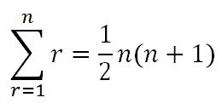
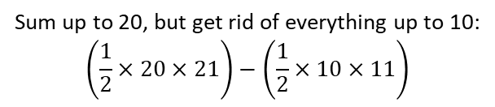
Quickfire Triangulars!
In your head if you can...
1 + 2 + 3 + ... + 10 = 55
1 + 2 + 3 + ... + 99 = 4950
11 + 12 + 13 + ... + 20 = 210 – 55 = 155
100 + 101 + 102 + ... + 200 = 20100 – 4950 = 15150
?
?
Sum up to 20, but get rid of everything up to 10:
$$\left(\frac{1}{2}×20×21\right)−\left(\frac{1}{2}×10×11\right)$$
?
?

Slide 7


Further Examples of Sum of Natural Numbers
Use the formulae to evaluate the following:
(Examples from textbook)
$$\sum_{r=1}^{4}{\left(2r−1\right)}=1+3+5+7=16$$
$$\sum_{r=1}^{50}{r}=\frac{1}{2}×50×51=1275$$
$$\sum_{r=25}^{50}{r}=\sum_{r=1}^{50}{r}−\sum_{r=1}^{24}{r}=1275−\left(\frac{1}{2}×20×21\right)=1065$$
Show that $\sum_{r=5}^{2N−1}{r}=2N^{2}−N−10$ (for $N≥3$)
$$=\sum_{r=1}^{2N−1}{r}−\sum_{r=1}^{4}{r}=\frac{1}{2}\left(2N−1\right)\left(2N\right)−\frac{1}{2}\left(4\right)\left(5\right) \\ =…=2N^{2}−N−10$$
?
There are sufficiently few terms that we can just list them.
?
?
Fro Tip: For summations where you subtract, ensure that you use one less than the lower limit.
?
We substitute $n$ for whatever the upper limit is, in this case, $2N−1$

Slide 8
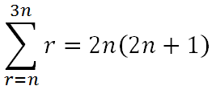
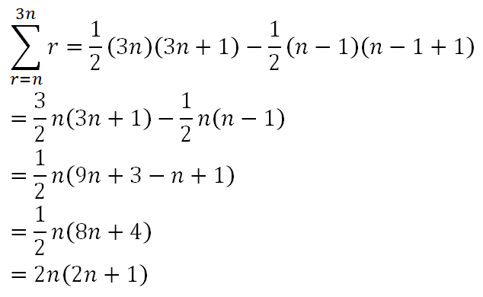
Test Your Understanding So Far
Fro Tip: After writing out your initial subtraction, DO NOT expand out – is there a common term you can factorise?
Show that
?

Slide 9
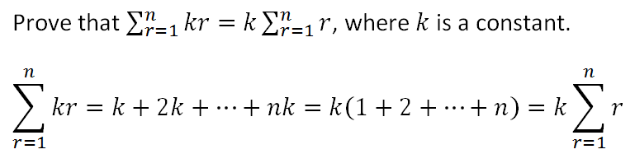

Breaking Up Summations
?
Examples:
?
$$\sum_{r=1}^{r}{3r}=3\sum_{r=1}^{r}{r}=\frac{3}{2}n\left(n+1\right) \\ \sum_{r=1}^{r}{4}=4n$$
?

Slide 10
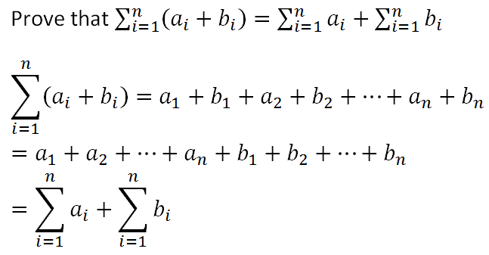
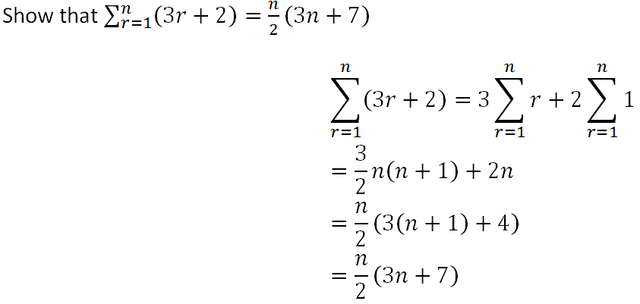

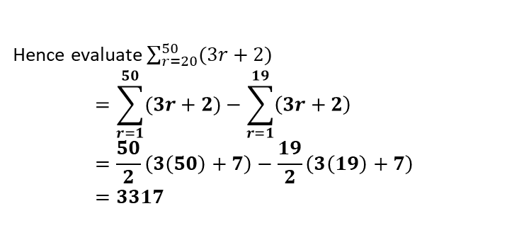
Breaking Up Summations
We can combine this property of summations with the previous one to break summations up:
?
$$\sum_{r=1}^{25}{(3r+1)}=3\sum_{r=1}^{25}{r}+\sum_{r=1}^{25}{1} \\ =\frac{3}{2}\left(25\right)\left(26\right)+25=1000$$
?
Further Examples:
Hence evaluate $\sum_{r=20}^{50}{(3r+2)}$
$$=\sum_{r=1}^{50}{(3r+2)}−\sum_{r=1}^{19}{\left(3r+2\right)} \\ =\frac{50}{2}\left(3\left(50\right)+7\right)−\frac{19}{2}\left(3\left(19\right)+7\right) \\ =3317$$
?
?

Slide 11
Exercise 3A
Pearson Core Pure Mathematics Book 1
Pages 46-47
Complete before the lesson Q1-3
In Class:
Green Q4-7
Amber Q8-11
Red Q12-14 & challenge

Slide 12
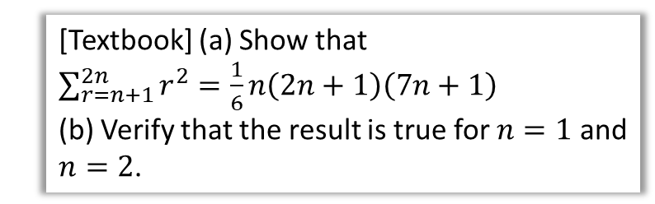
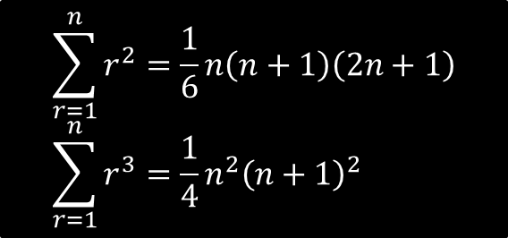

Sums of Squares and Cubes
$$\sum_{r=1}^{n}{r^{2}=\frac{1}{6}n\left(n+1\right)\left(2n+1\right)} \\ \sum_{r=1}^{n}{r^{3}=\frac{1}{4}n^{2}{\left(n+1\right)}^{2}}$$
[Textbook] (a) Show that $\sum_{r=n+1}^{2n}{r^{2}=\frac{1}{6}n\left(2n+1\right)\left(7n+1\right)}$
(b) Verify that the result is true for $n=1$ and $n=2$.
$$\sum_{r=n+1}^{2n}{r^{2}}=\sum_{r=1}^{2n}{r^{2}}−\sum_{r=1}^{n}{r^{2}} \\ =\frac{1}{6}\left(2n\right)\left(2n+1\right)\left(4n+1\right)−\frac{1}{6}n\left(n+1\right)\left(2n+1\right) \\ =\frac{1}{6}n\left(2n+1\right)\left(2\left(4n+1\right)−\left(n+1\right)\right) \\ =\frac{1}{6}n\left(2n+1\right)\left(7n+1\right)$$
When $n=1$:
$$2^{2}=\frac{1}{6}×3×8 \\ 4=4$$
When $n=2$:
$$3^{2}+4^{2}=\frac{2}{6}×5×15 \\ 15=15$$
Observation: The order of the polynomial for each formula is one more than the term being summed. So summing squares gives a cubic, summing cubes gives a quartic, and so on.
?
As before, DO NOT expand everything out: factorise any common terms.

Slide 13
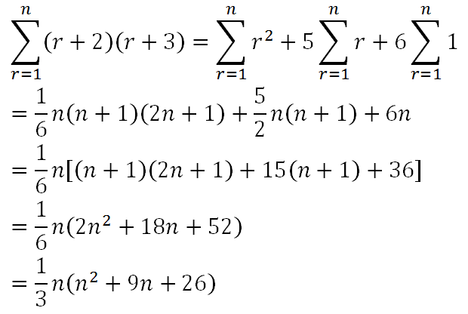
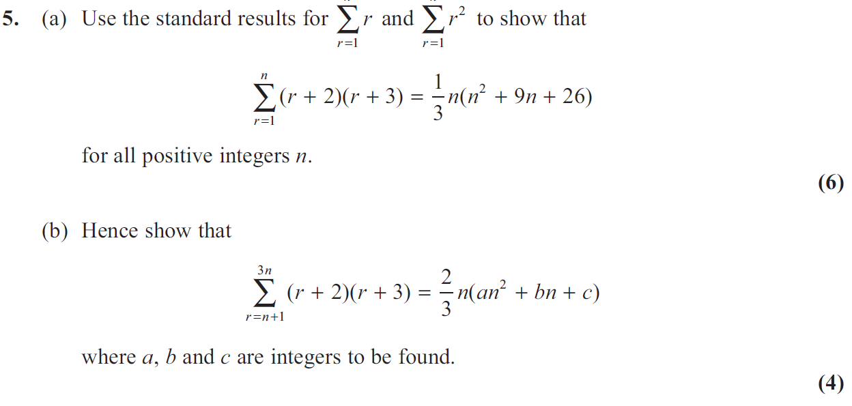
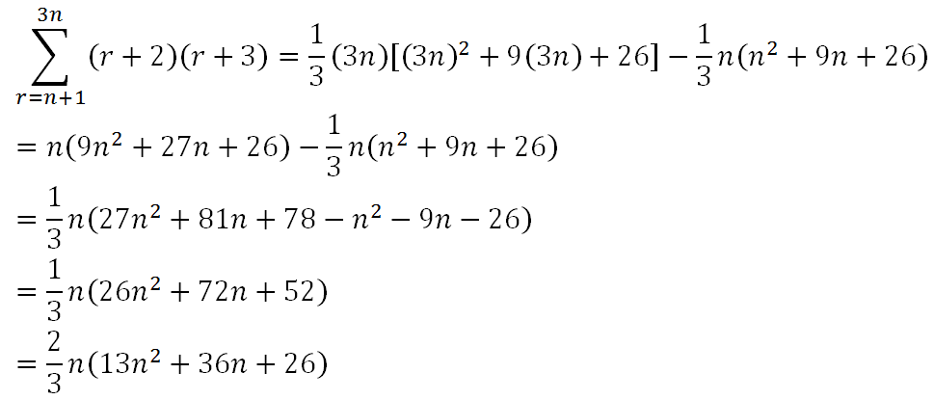
Test Your Understanding
Edexcel FP1(Old) June 2013
?
?

Slide 14
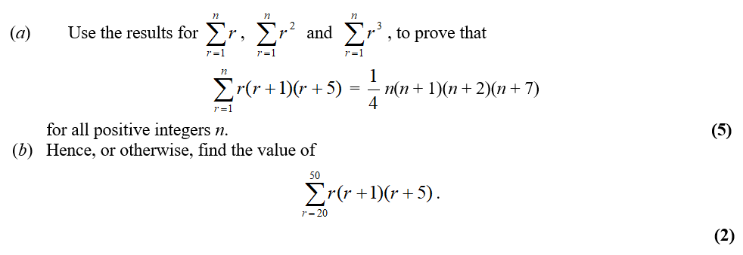
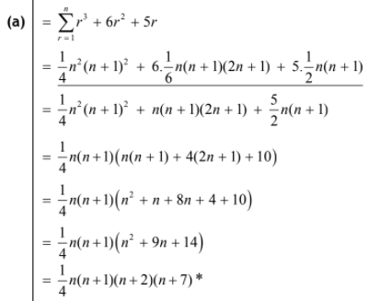
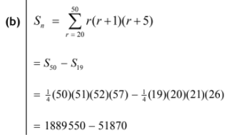
Harder Exam Question
Edexcel FP1(Old) Jan 2011 Q5
?
?

Slide 15
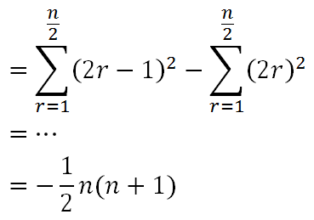

Exercise 3B
Pearson Core Pure Mathematics Book 1
Pages 46-47
Complete before the lesson Q1-2
In Class:
Green Q3-7
Amber Q8-11
Red Q12-14 & challenge & Ext
Bonus Frost Conundrum:
Given that $n$ is even, determine $1^{2}−2^{2}+3^{2}−4^{2}+5^{2}−…−n^{2}$
?
Alternatively, notice that each pair of terms is the difference of two squares. We thus get:
$$\left(3×−1\right)+\left(7×−1\right)+\left(11×−1\right)+…+\left(\left(2n−1\right)×−1\right) \\ =−1\left(3+7+11+…+\left[2n−1\right]\right)$$
The contents of the brackets are the sum of an arithmetic series (with $a=3, d=4,\frac{n}{2}$ terms), and we could get the same result.

