Slide 1
Year 2 Pure Mathematics
Sequences and Series
- Sum to Infinity
Chapter 3
(Part 5 of 7)

Slide 2
Divergent vs Convergent
1 + 2 + 4 + 8 + 16 + ...
Divergent – the sum tends towards infinity.
1 + 0.5 + 0.25 + 0.125 + ...
Convergent – the sum tends towards 2.

Slide 3
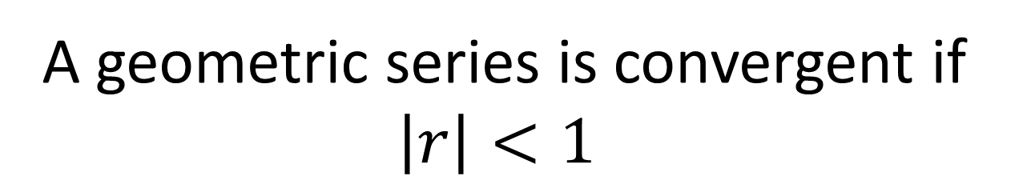
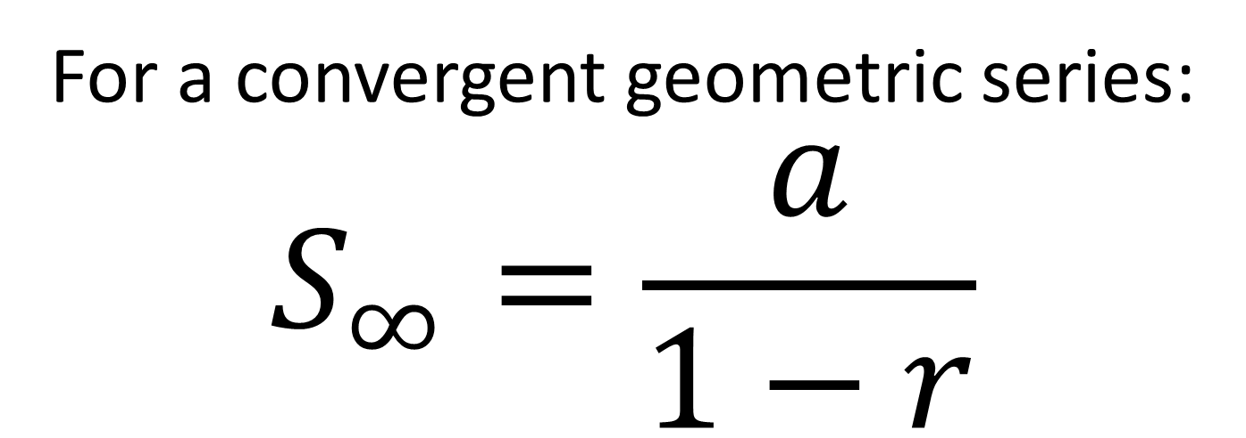
Sum to Infinity
A geometric series is convergent if $\left|r\right|<1$
For a convergent geometric series:
$$S_{∞}=\frac{a}{1−r}$$

Slide 4
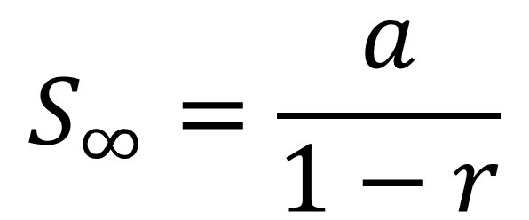

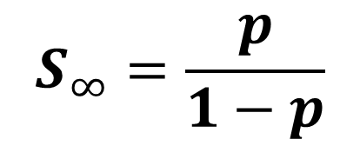
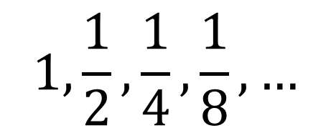
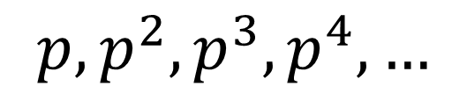
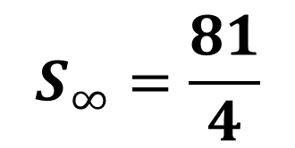
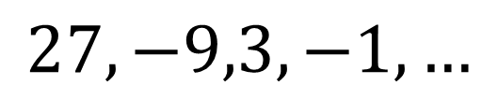
Sum to Infinity
$$S_{∞}=\frac{a}{1−r}$$
$$1,\frac{1}{2},\frac{1}{4},\frac{1}{8},…$$
$$S_{∞}=2$$
$$S_{∞}=\frac{81}{4}$$
$$27,−9,3,−1,…$$
$$p, p^{2},p^{3},p^{4},…$$
$$S_{∞}=\frac{p}{1−p}$$

Slide 5
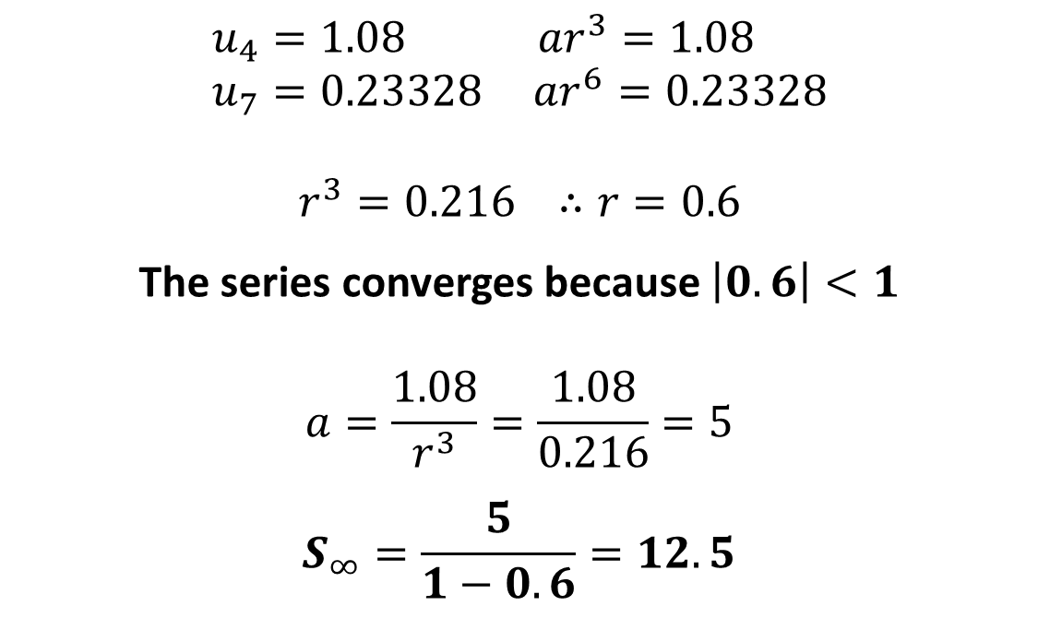
Sum to Infinity
The fourth term of a geometric series is 1.08 and the seventh term is 0.23328.
Show that this series is convergent.
Find the sum to infinity of this series.
$$u_{4}=1.08 ar^{3}=1.08 \\ u_{7}=0.23328 ar^{6}=0.23328$$
$$r^{3}=0.216 ∴r=0.6$$
The series converges because $\left|0.6\right|<1$
$$a=\frac{1.08}{r^{3}}=\frac{1.08}{0.216}=5$$
$$S_{∞}=\frac{5}{1−0.6}=12.5$$

Slide 6
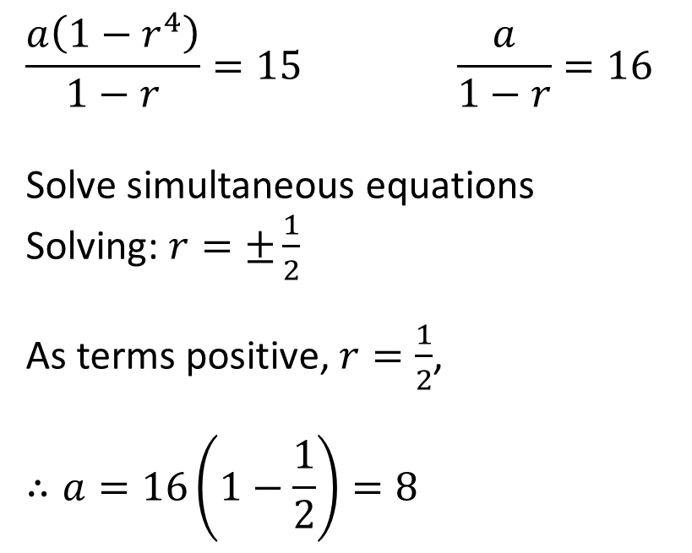
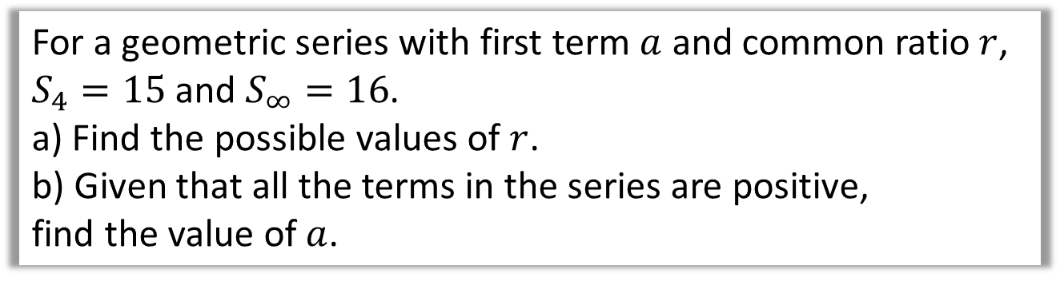
Sum to Infinity
For a geometric series with first term $a$ and common ratio $r$,
$S_{4}=15$ and $S_{∞}=16$.
a) Find the possible values of $r$.
b) Given that all the terms in the series are positive,
find the value of $a$.
$$\frac{a\left(1−r^{4}\right)}{1−r}=15 \frac{a}{1−r}=16$$
Solve simultaneous equations
Solving: $r=±\frac{1}{2}$
As terms positive, $r=\frac{1}{2}$,
$$∴a=16\left(1−\frac{1}{2}\right)=8$$

Slide 7
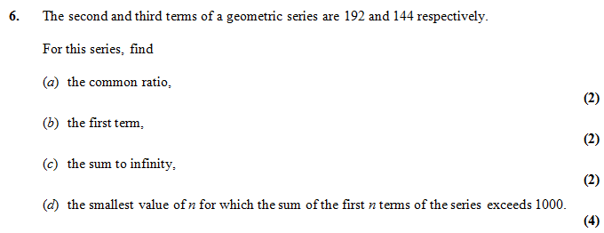

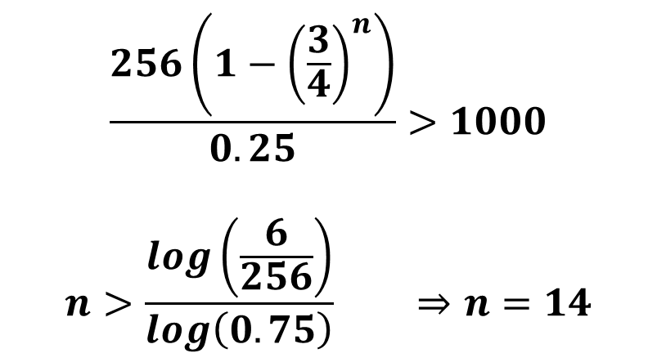


Sum to Infinity – Exam Question
$$r=\frac{3}{4}$$
$$a=256$$
$$S_{∞}=1024$$
$$\frac{256\left(1−{\left(\frac{3}{4}\right)}^{n}\right)}{0.25}>1000$$
$$n>\frac{log\left(\frac{6}{256}\right)}{log\left(0.75\right)} ⇒n=14$$

Slide 8




Test Your Understanding
Edexcel C2 May 2011 Q6
?
$$r=\frac{3}{4}$$
?
$$a=256$$
?
$$S_{∞}=1024$$
?
$$\frac{256\left(1−{\left(\frac{3}{4}\right)}^{n}\right)}{0.25}>1000$$
$$n>\frac{log\left(\frac{6}{256}\right)}{log\left(0.75\right)} ⇒n=14$$

Slide 9


Exercise 3E
Pearson Pure Mathematics Year 2/AS
Pages 75-76
Complete before the lesson Q1-5
In Class:
Green Q6-7
Amber Q8-9
Red Q10-11 & Challenge & Ext
Extension
[MAT 2006 1H] How many solutions does the equation
$$2=\sin{x}+\sin^{2}{x}+\sin^{3}{x}+\sin^{4}{x}+…$$
have in the range $0≤x<2π$
RHS is geometric series. $a=\sin{x}, r=\sin{x}$.
$$2=\frac{\sin{x}}{1−\sin{x}} → 2−2\sin{x}=\sin{x} \\ \sin{x}=\frac{2}{3}$$
By considering the graph of sin for $0≤x<2π$, this has 2 solutions.
[Frost] Determine the value of $x$ where:
$$x=\frac{1}{1}+\frac{2}{2}+\frac{3}{4}+\frac{4}{8}+\frac{5}{16}+\frac{6}{32}+…$$
(Hint: Use an approach similar to proof of geometric $S_{n}$ formula)
Doubling:
$$2x=2+\frac{1}{1}+\frac{1}{2}+\frac{1}{4}+\frac{1}{8}+…$$
Subtracting the two equations:
$$x=2+\frac{1}{1}+\frac{1}{2}+\frac{1}{4}+\frac{1}{8}+… \\ =2+2=4$$
?
?

