Slide 1
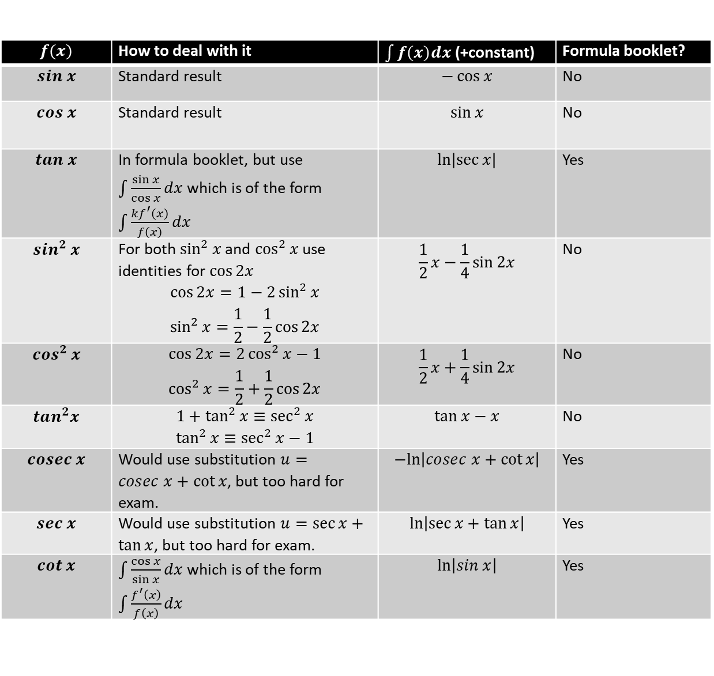
Summary of Functions
$$f(x)$$ | How to deal with it | $\int{f\left(x\right)dx}$ (+constant) | Formula booklet?
$$sin x$$ | Standard result | $$−\cos{x}$$ | No
$$cos x$$ | Standard result | $$\sin{x}$$ | No
$$tan x$$ | In formula booklet, but use $\int{\frac{\sin{x}}{\cos{x}}dx}$ which is of the form $\int{\frac{kf^{′}\left(x\right)}{f\left(x\right)}}dx$ | $$\ln\left|\sec{x}\right|$$ | Yes
$$sin^{2} x$$ | For both $\sin^{2}{x}$and $\cos^{2}{x}$ use identities for $\cos{2x}$ $$\cos{2x}=1−2\sin^{2}{x} \\ \sin^{2}{x}=\frac{1}{2}−\frac{1}{2}\cos{2x}$$ | $$\frac{1}{2}x−\frac{1}{4}\sin{2x}$$ | No
$$cos^{2} x$$ | $$\cos{2x}=2\cos^{2}{x}−1 \\ \cos^{2}{x}=\frac{1}{2}+\frac{1}{2}\cos{2x}$$ | $$\frac{1}{2}x+\frac{1}{4}\sin{2x}$$ | No
$$tan^{2}x$$ | $$1+\tan^{2}{x}≡\sec^{2}{x} \\ \tan^{2}{x}≡\sec^{2}{x}−1$$ | $$\tan{x}−x$$ | No
$$cosec x$$ | Would use substitution $u=cosec x+\cot{x}$, but too hard for exam. | $$−ln\left|cosec x+\cot{x}\right|$$ | Yes
$$sec x$$ | Would use substitution $u=\sec{x}+\tan{x}$, but too hard for exam. | $$\ln\left|\sec{x}+\tan{x}\right|$$ | Yes
$$cot x$$ | $\int{\frac{\cos{x}}{\sin{x}}dx}$ which is of the form $\int{\frac{f^{′}\left(x\right)}{f\left(x\right)}}dx$ | $$\ln\left|\sin{x}\right|$$ | Yes
?
?
?
?
?
?
?
?
?

Slide 2
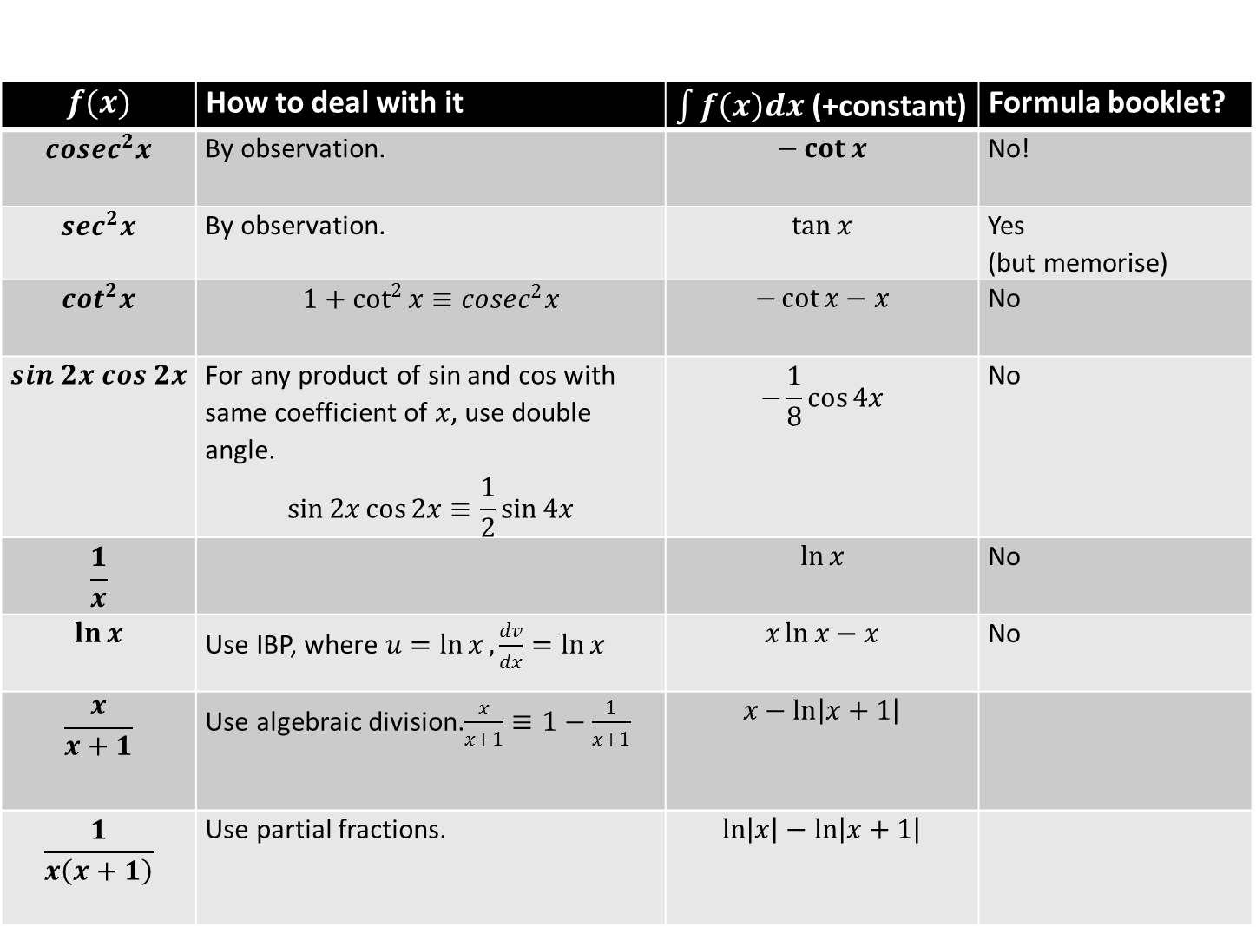
Summary of Functions
$$f(x)$$ | How to deal with it | $\int{f\left(x\right)dx}$ (+constant) | Formula booklet?
$$cosec^{2}x$$ | By observation. | $$−\cot{x}$$ | No!
$$sec^{2}x$$ | By observation. | $$\tan{x}$$ | Yes (but memorise)
$$cot^{2}x$$ | $$1+\cot^{2}{x}≡cosec^{2}x$$ | $$−\cot{x}−x$$ | No
$$sin 2x cos 2x$$ | For any product of sin and cos with same coefficient of $x$, use double angle. $$\sin{2x}\cos{2x}≡\frac{1}{2}\sin{4x}$$ | $$−\frac{1}{8}\cos{4x}$$ | No
$$\frac{1}{x}$$ |  | $$\ln{x}$$ | No
$$\ln{x}$$ | Use IBP, where $u=\ln{x},\frac{dv}{dx}=\ln{x}$ | $$x\ln{x}−x$$ | No
$$\frac{x}{x+1}$$ | Use algebraic division.$\frac{x}{x+1}≡1−\frac{1}{x+1}$ | $$x−\ln\left|x+1\right|$$
$$\frac{1}{x\left(x+1\right)}$$ | Use partial fractions. | $$\ln\left|x\right|−\ln\left|x+1\right|$$
?
?
?
?
?
?
?
?

Slide 3
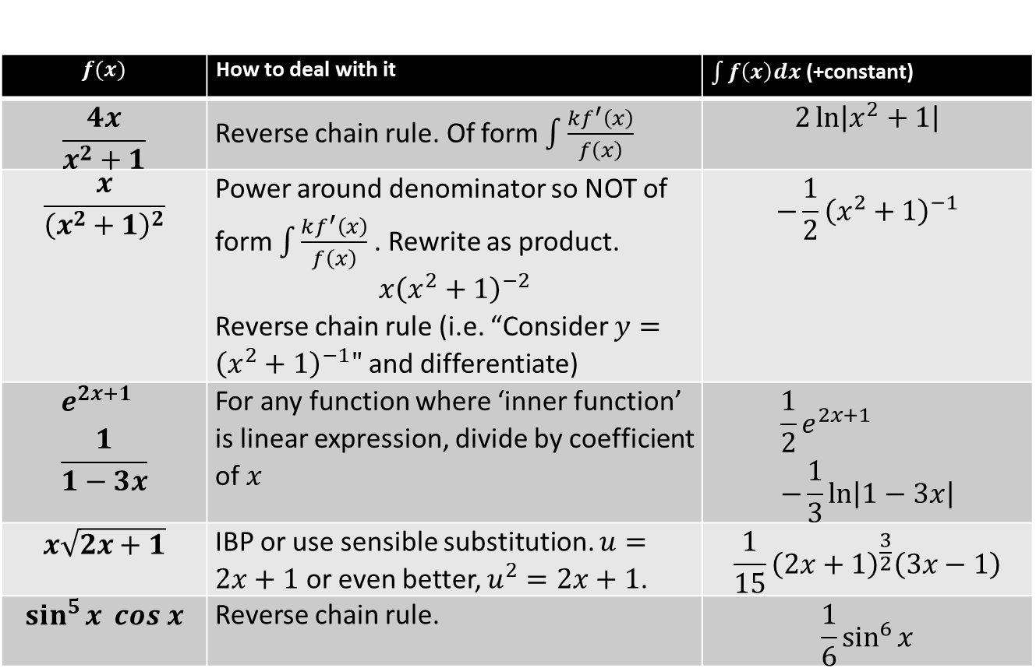
Summary of Functions
$$f(x)$$ | How to deal with it | $\int{f\left(x\right)dx}$ (+constant)
$$\frac{4x}{x^{2}+1}$$ | Reverse chain rule. Of form $\int{\frac{kf^{′}\left(x\right)}{f\left(x\right)}}$ | $$2\ln\left|x^{2}+1\right|$$
$$\frac{x}{{\left(x^{2}+1\right)}^{2}}$$ | Power around denominator so NOT of form $\int{\frac{kf^{′}\left(x\right)}{f\left(x\right)}}$ . Rewrite as product. $$x{\left(x^{2}+1\right)}^{−2}$$ Reverse chain rule (i.e. “Consider $y={\left(x^{2}+1\right)}^{−1}"$ and differentiate) | $$−\frac{1}{2}{\left(x^{2}+1\right)}^{−1}$$
$$e^{2x+1} \\ \frac{1}{1−3x}$$ | For any function where ‘inner function’ is linear expression, divide by coefficient of $x$ | $$\frac{1}{2}e^{2x+1} \\ −\frac{1}{3}\ln\left|1−3x\right|$$
$$x\sqrt{2x+1}$$ | IBP or use sensible substitution. $u=2x+1$ or even better, $u^{2}=2x+1$. | $$\frac{1}{15}{\left(2x+1\right)}^{\frac{3}{2}}\left(3x−1\right)$$
$$\sin^{5}{x} cos x$$ | Reverse chain rule. | $$\frac{1}{6}\sin^{6}{x}$$
?
?
?
?
?

