Slide 1

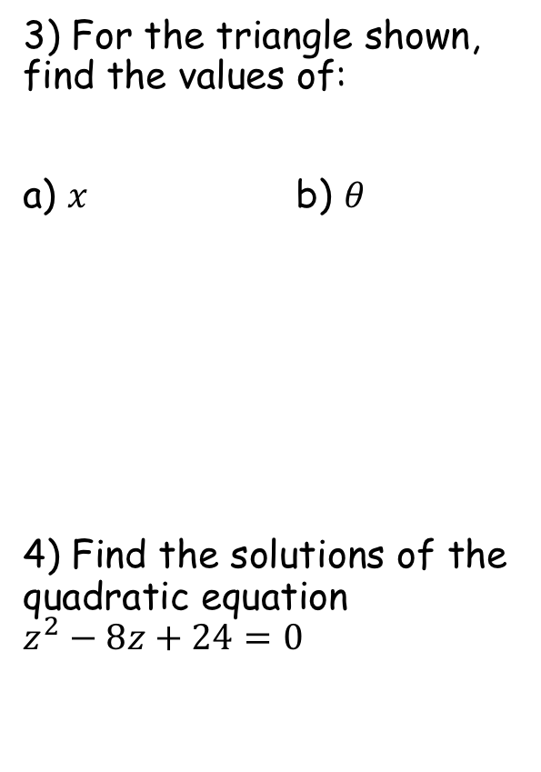


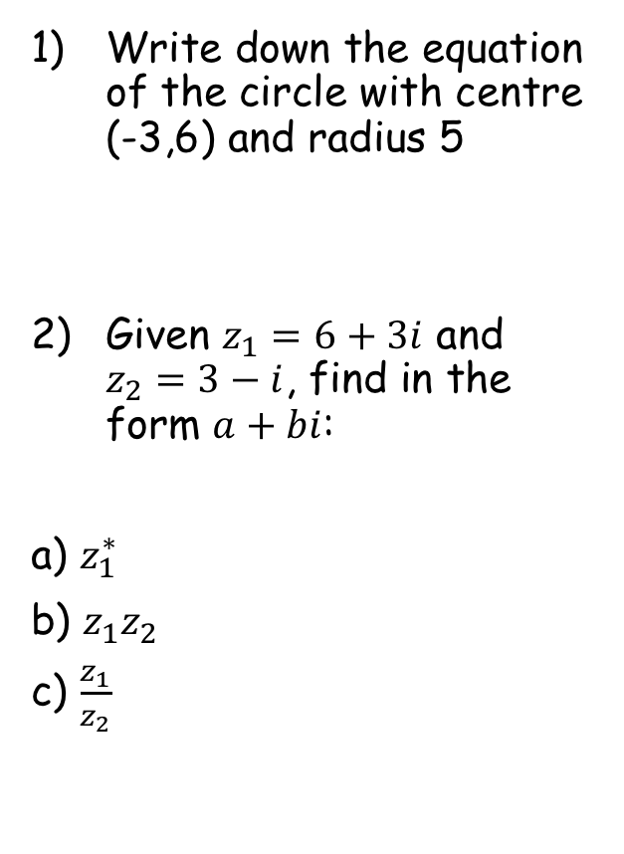





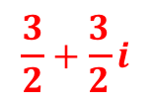
Prior Knowledge Check
Write down the equation of the circle with centre (-3,6) and radius 5
Given $z_{1}=6+3i$ and $z_{2}=3−i$, find in the form $a+bi$:
a) $z_{1}^{∗}$
b) $z_{1}z_{2}$
c) $\frac{z_{1}}{z_{2}}$
3) For the triangle shown, find the values of:
a) $x$ b) $θ$
4) Find the solutions of the quadratic equation $z^{2}−8z+24=0$
$${\left(x+3\right)}^{2}+{\left(y−6\right)}^{2}=25$$
5cm
$$67.4$$
$$θ$$
12cm
$$x$$
$$13$$
$$6−3i$$
$$21+3i$$
$$\frac{3}{2}+\frac{3}{2}i$$
$$4±2i\sqrt{2}$$

Slide 2
Argand Diagrams
You can represent complex numbers using an Argand diagram.
A grid where values for x and y can be plotted is known as a Cartesian set of axes (after Rene Descartes)
An Argand diagram is very similar, but the x-axis represents real numbers and the y-axis represents imaginary numbers.
These are named after Jean-Robert Argand (1768–1822), although they were first described by Norwegian-Danish land surveyor and mathematician Caspar Wessel
Complex numbers can be plotted on an Argand diagram, by considering the real and imaginary parts as coordinates
2A

Slide 3









Argand Diagrams
y (Imaginary)
z₁
You can represent complex numbers using an Argand diagram.
5i
√29
Represent the following complex numbers on an Argand diagram:
Find the magnitude of |OA|, |OB| and |OC|, where O is the origin of the Argand diagram, and A, B and C are z₁, z₂ and z₃ respectively
→ You can use Pythagoras’ Theorem to find the magnitude of the distances
5
z₃
√17
1
2
$$z_{1}=2+5i$$
x (Real)
-5
4
3
5
$$z_{2}=3−4i$$
4
5
$$z_{3}=−4+i$$
z₂
-5i
$$\left|OA\right|=\sqrt{2^{2}+5^{2}}$$
$$\left|OA\right|=\sqrt{29}$$
$$\left|OC\right|=\sqrt{4^{2}+1^{2}}$$
$$\left|OB\right|=\sqrt{3^{2}+4^{2}}$$
$$\left|OC\right|=\sqrt{17}$$
$$\left|OB\right|=5$$
2A

Slide 4





Argand Diagrams
You can represent complex numbers using an Argand diagram.
y (Imaginary)
10i
Show z₁, z₂ and z₁ + z₂ on an Argand diagram
$$z_{1}=4+i$$
$$z_{2}=3+3i$$
z₁+z₂
z₂
z₁
x (Real)
-10
10
$$z_{1}+z_{2}$$
$$\left(4+i\right)+(3+3i)$$
$$=7+4i$$
-10i
Notice that vector z₁ + z₂ is effectively the diagonal of a parallelogram
2A

Slide 5





Argand Diagrams
y (Imaginary)
z₁
You can represent complex numbers using an Argand diagram.
5i
z₁-z₂
z₂
$$z_{1}=2+5i$$
$$z_{2}=4+2i$$
Show z₁, z₂ and z₁ - z₂ on an Argand diagram
x (Real)
-5
5
$$z_{1}−z_{2}$$
-z₂
$$\left(2+5i\right)−(4+2i)$$
$$=−2+3i$$
-5i
Vector z₁ – z₂ is still the diagram of a parallelogram
→ One side is z₁ and the other side is –z₂ (shown on the diagram)
2A

Slide 6
Argand Diagrams
You can find the value of r, the modulus of a complex number z, and the value of θ, which is the argument of z
The modulus of a complex number is its magnitude – you have already seen how to calculate it by using Pythagoras’ Theorem
It is usually represented by the letter r
The argument of a complex number is the angle it makes with the positive real axis
The argument is usually measured in radians
It will be negative if the complex number is plotted below the horizontal axis
2B

Slide 7






Argand Diagrams
You can find the value of r, the modulus of a complex number z, and the value of θ, which is the argument of z
Find, to two decimal places, the modulus and argument of z = 4 + 5i
Use Pythagoras’ Theorem to find r
$$r=\sqrt{4^{2}+5^{2}}$$
Calculate
$$r=\sqrt{41}$$
Work out as a decimal (if needed)
$$r=6.40 (2dp)$$
y (Imaginary)
z
5i
Use Trigonometry to find arg z
5
$$Tanθ=\frac{O}{A}$$
Sub in values
θ
$$Tanθ=\frac{5}{4}$$
x (Real)
-5
4
5
Calculate in radians
$$θ=0.90 radians (2dp)$$
-5i
2B

Slide 8







Argand Diagrams
You can find the value of r, the modulus of a complex number z, and the value of θ, which is the argument of z
Find, to two decimal places, the modulus and argument of z = -2 + 4i
Use Pythagoras’ Theorem to find r
$$r=\sqrt{2^{2}+4^{2}}$$
Calculate
$$r=\sqrt{20}$$
Work out as a decimal (if needed)
$$r=4.47 (2dp)$$
y (Imaginary)
5i
z
Use Trigonometry to find arg z
$$Tanθ=\frac{O}{A}$$
4
Sub in values
θ
2.03
$$Tanθ=\frac{4}{2}$$
x (Real)
-5
2
5
Calculate in radians
$$θ=1.11 radians (2dp)$$
Subtract from π to find the required angle (remember π radians = 180°)
$$π−1.11=2.03 radians$$
$$\arg{z}=2.03$$
-5i
2B

Slide 9









Argand Diagrams
Use Pythagoras’ Theorem to find r
You can find the value of r, the modulus of a complex number z, and the value of θ, which is the argument of z
Find, to two decimal places, the modulus and argument of z = -3 - 3i
$$r=\sqrt{3^{2}+3^{2}}$$
Calculate
$$r=\sqrt{18}$$
Work out as a decimal (if needed)
$$r=4.24 (2dp)$$
y (Imaginary)
5i
Use Trigonometry to find arg z
$$Tanθ=\frac{O}{A}$$
Sub in values
$$Tanθ=\frac{3}{3}$$
3
Calculate in radians
x (Real)
-5
θ
$$\frac{3π}{4}$$
5
$$θ=\frac{π}{4} radians (2dp)$$
Subtract from π to find the required angle (remember π radians = 180°)
3
$$π−\frac{π}{4}=\frac{3π}{4}radians$$
z
As the angle is below the x-axis, its written as negative
$$\arg{z}=−\frac{3π}{4}$$
-5i
2B

Slide 10








Argand Diagrams
y (Imaginary)
You can find the modulus-argument form of the complex number z
You have seen up to this point that a complex number z will usually be written in the form:
The modulus-argument form is an alternative way of writing a complex number, and it includes the modulus of the number as well as its argument.
The modulus-argument form looks like this:
r is the modulus of the number
θ is the argument of the number
z
Hyp
r
rsinθ
Opp
θ
$$z=x+iy$$
x (Real)
rcosθ
Adj
By GCSE Trigonometry:
$$z=r(cosθ+isinθ)$$
O
$$Opp=Hyp×Sinθ$$
$$=rsinθ$$
S
H
A
$$Adj=Hyp×Cosθ$$
$$=rcosθ$$
C
H
$$z=rcosθ+irsinθ$$
$$z=r(cosθ+isinθ)$$
Factorise
2C

Slide 11










Argand Diagrams
$$z=r(cosθ+isinθ)$$
y (Imaginary)
You can find the modulus-argument form of the complex number z
Express the numbers following numbers in the modulus argument form:
z₁
3
√3
$$z_{1}=1+i\sqrt{3}$$
θ
x (Real)
θ
1
$$z_{2}=−3−3i$$
3
$$z_{1}=2\left(cos\frac{π}{3}+isin\frac{π}{3}\right)$$
z₂
Modulus for z₁
Argument for z₁
$$\sqrt{1^{2}+{\sqrt{3}}^{2}}$$
$$Tan^{−1}\left(\frac{\sqrt{3}}{1}\right)$$
$$=2$$
$$=\frac{π}{3}$$
$$z_{1}=r(cosθ+isinθ)$$
$$z_{1}=2\left(cos\frac{π}{3}+isin\frac{π}{3}\right)$$
2C

Slide 12









Argand Diagrams
$$z=r(cosθ+isinθ)$$
y (Imaginary)
You can find the modulus-argument form of the complex number z
Express the numbers following numbers in the modulus argument form:
z₁
3
√3
$$z_{1}=1+i\sqrt{3}$$
θ
x (Real)
θ
1
$$z_{2}=−3−3i$$
3
$$z_{1}=2\left(cos\frac{π}{3}+isin\frac{π}{3}\right)$$
z₂
$$z_{2}=3\sqrt{2}\left(cos\left(−\frac{3π}{4}\right)+isin\left(−\frac{3π}{4}\right)\right)$$
Modulus for z₂
Argument for z₂
$$\sqrt{3^{2}+3^{2}}$$
$$Tan^{−1}\left(\frac{3}{3}\right)$$
Remember the angle you actually want!
$$=\sqrt{18}$$
$$=\frac{π}{4}$$
$$=−\frac{3π}{4}$$
$$=3\sqrt{2}$$
$$z_{2}=r(cosθ+isinθ)$$
$$z_{2}=3\sqrt{2}\left(cos\left(−\frac{3π}{4}\right)+isin\left(−\frac{3π}{4}\right)\right)$$
2C

Slide 13
Exercise 2C
Pearson Further Core Mathematics Year 1/AS
Complete before the lesson Q1&3
In Class:
Green Q2&4
Amber Q5
Red Q6

