Slide 1
Year 1 Pure Mathematics
Circles
- Circumcircle
Chapter 6
(Part 4 of 5)

Slide 2
Triangles in Circles
The triangle inscribes the circle.
If the circumscribing shape is a circle,
it is known as the circumcircle of the triangle.
The centre of a circumcircle is known
as the circumcentre.

Slide 3


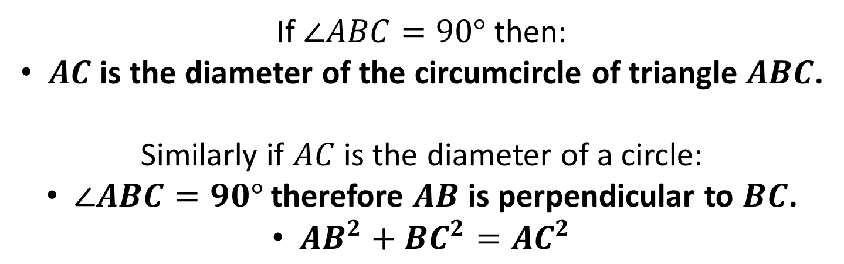

Triangles in Circles
$$B$$
$$C$$
$$A$$
If $∠ABC=90°$ then:
$AC$ is the diameter of the circumcircle of triangle $ABC$.
Similarly if $AC$ is the diameter of a circle:
$∠ABC=90°$ therefore $AB$ is perpendicular to $BC$.
$AB^{2}+BC^{2}=AC^{2}$

Slide 4
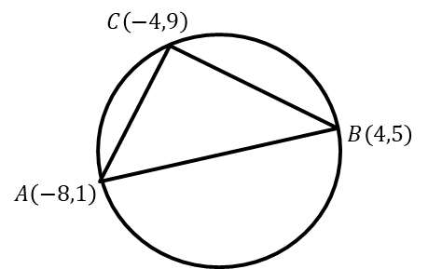
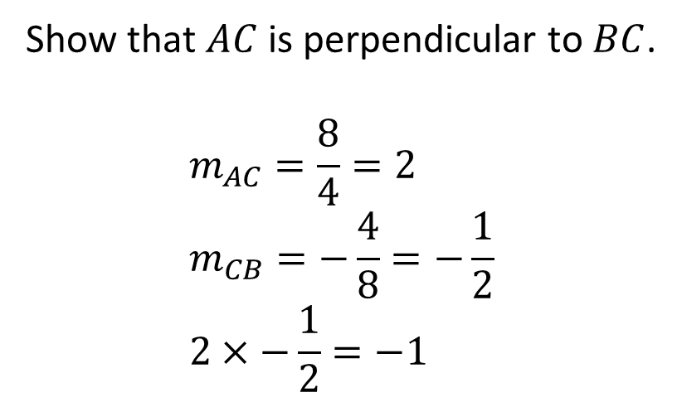
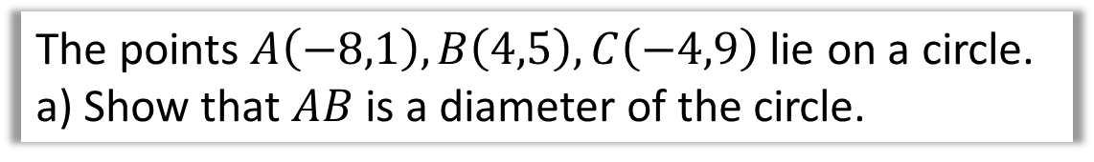
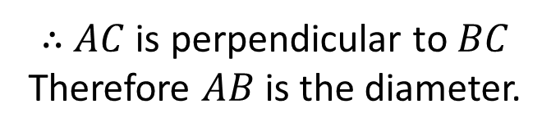
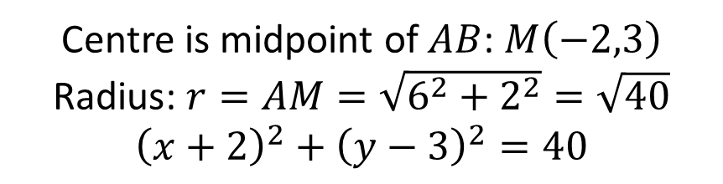
Triangles in Circles
The points $A\left(−8,1\right), B\left(4,5\right),C\left(−4,9\right)$ lie on a circle.
a) Show that $AB$ is a diameter of the circle.
Show that $AC$ is perpendicular to $BC$.
$$m_{AC}=\frac{8}{4}=2 \\ m_{CB}=−\frac{4}{8}=−\frac{1}{2} \\ 2×−\frac{1}{2}=−1$$
$∴$ $AC$ is perpendicular to $BC$
Therefore $AB$ is the diameter.
b) Hence find the equation of the circle.
Centre is midpoint of $AB$: $M\left(−2,3\right)$
Radius: $r=AM=\sqrt{6^{2}+2^{2}}=\sqrt{40}$
$${\left(x+2\right)}^{2}+{\left(y−3\right)}^{2}=40$$

Slide 5
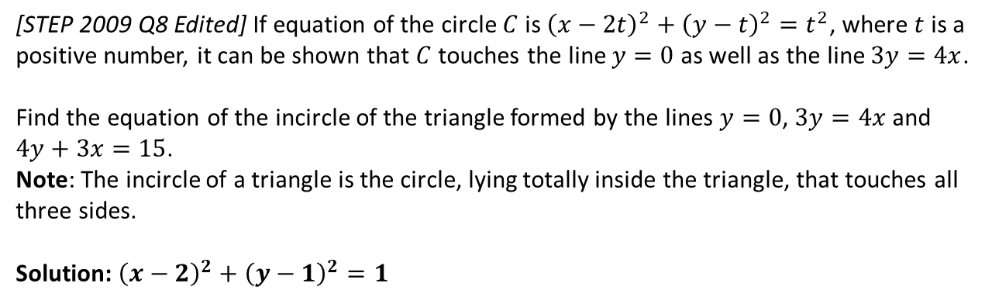
Exercise 6F
Pearson Pure Mathematics Year 1/AS
Pages 131-132
Extension:
1
[STEP 2009 Q8 Edited] If equation of the circle $C$ is ${\left(x−2t\right)}^{2}+{\left(y−t\right)}^{2}=t^{2}$, where $t$ is a positive number, it can be shown that $C$ touches the line $y=0$ as well as the line $3y=4x$.
Find the equation of the incircle of the triangle formed by the lines $y=0$, $3y=4x$ and $4y+3x=15$.
Note: The incircle of a triangle is the circle, lying totally inside the triangle, that touches all three sides.
Solution: ${\left(x−2\right)}^{2}+{\left(y−1\right)}^{2}=1$
?
Complete before the lesson Q1-2
Green Q3-4
Amber Q5-6
Red Q7-9 & Ext

