Slide 1
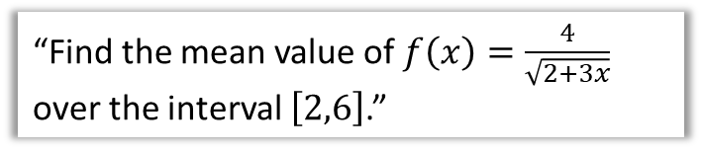
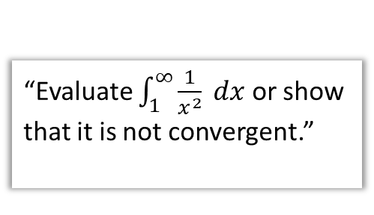
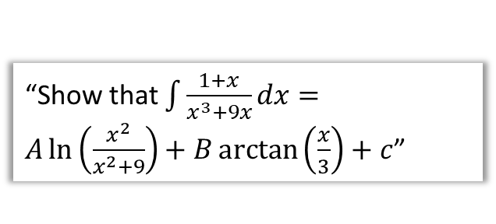
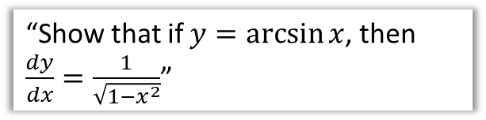
Chapter Overview
In this chapter, we explore a variety of new techniques for integration, as well as how integration can be applied.
1:: Improper Integrals
2:: Mean value of a function
“Evaluate $\int_{1}^{∞}{\frac{1}{x^{2}} dx}$ or show that it is not convergent.”
“Find the mean value of $f\left(x\right)=\frac{4}{\sqrt{2+3x}}$ over the interval $\left[2,6\right]$.”
3:: Differentiating and integrating inverse trigonometric functions
4:: Integrating using partial fractions.
“Show that $\int{\frac{1+x}{x^{3}+9x}}dx=A\ln\left(\frac{x^{2}}{x^{2}+9}\right)+B\arctan\left(\frac{x}{3}\right)+c$”
“Show that if $y=\arcsin{x}$, then $\frac{dy}{dx}=\frac{1}{\sqrt{1−x^{2}}}$”

Slide 2










Improper Integrals
STARTER 1: Determine $\int_{−1}^{1}{\frac{1}{x^{2}} dx}$. Is there an issue?
?
$$\int_{−1}^{1}{\frac{1}{x^{2}} dx}=\int_{−1}^{1}{x^{−2} dx}={\left[−x^{−1}\right]}_{−1}^{1} \\ =\left(−\frac{1}{1}\right)−\left(−\frac{1}{−1}\right)=−1− +1=−2$$
What’s odd is the we ended up with a negative value. But the whole graph is above the $x$ axis! The problem is related to integrating over a discontinuity, i.e. the function is not defined for the entire interval $[−1,1]$, notably where $x=0$. We will see when this causes and issue and when it does not.
We say the definite integral does not exist.
$$y$$
$$x$$
$$−1$$
$$1$$
STARTER 2: Determine $\int_{1}^{∞}{\frac{1}{x^{2}} dx}$. Is there an issue?
?
(Note: the below is seriously dodgy maths as we’re not allowed to use $∞$ in calculations – we’ll look at the proper way to write this in a sec)
$${\left[−x^{−1}\right]}_{1}^{∞}=\left(−\frac{1}{∞}\right)−\left(−\frac{1}{1}\right)=0+1=1$$
Although the graph is extending to infinity, the area is finite because the $y$ values converge towards 0. The result is therefore valid this time. This is an example of an improper integral and because the value converged, we say the definite integral exists.
$$y$$
$$x$$
$$1$$

Slide 3


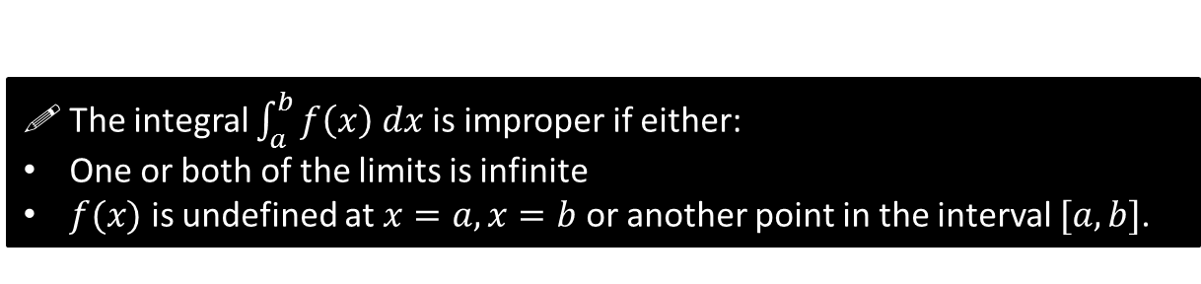



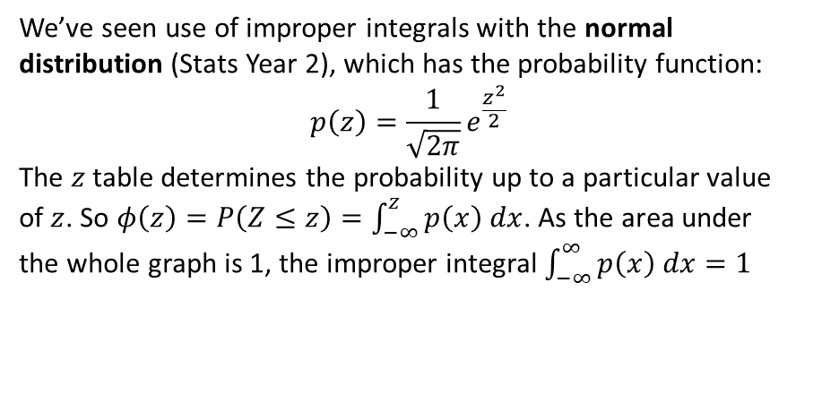

Improper Integrals
STARTER 3: Determine $\int_{0}^{1}{\frac{1}{\sqrt{x}} dx}$. Is there an issue?
$$y$$
?
$$\int_{0}^{1}{\frac{1}{\sqrt{x}} dx}=\int_{−1}^{1}{x^{−\frac{1}{2}} dx}={\left[2\sqrt{x}\right]}_{0}^{1} \\ =2\sqrt{1}−2\sqrt{0}=2$$
This is similar to the second example. Although $y→∞$ as $x→0$ (and not defined when $x=0$), the area is convergent and therefore finite. The result of 2 is therefore valid.
$$x$$
$$1$$
! The integral $\int_{a}^{b}{f\left(x\right) dx}$ is improper if either:
One or both of the limits is infinite
$f(x)$ is undefined at $x=a, x=b$ or another point in the interval $[a,b]$.
We’ve seen use of improper integrals with the normal distribution (Stats Year 2), which has the probability function:
$$p\left(z\right)=\frac{1}{\sqrt{2π}}e^{\frac{z^{2}}{2}}$$
The $z$ table determines the probability up to a particular value of $z$. So $φ\left(z\right)=P\left(Z≤z\right)=\int_{−∞}^{z}{p\left(x\right) dx}$. As the area under the whole graph is 1, the improper integral $\int_{−∞}^{∞}{p\left(x\right) dx}=1$
$$p(z)$$
$$z$$

Slide 4

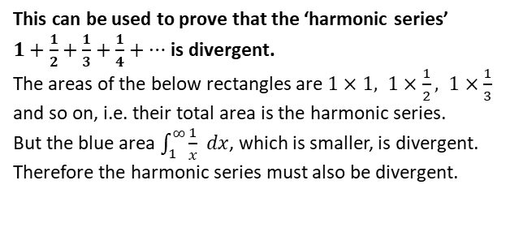

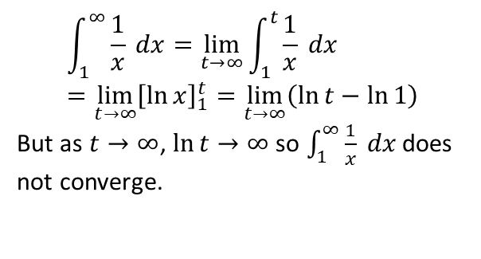

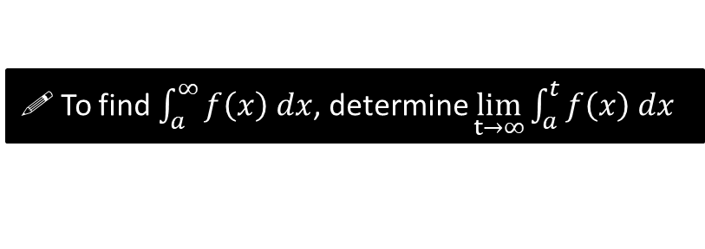
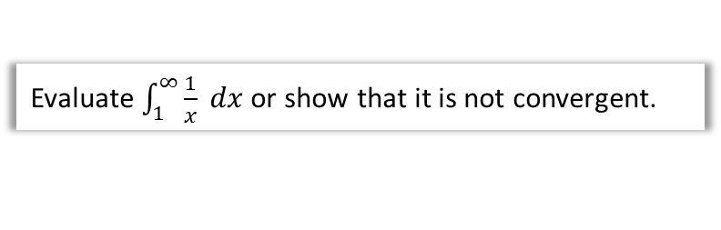

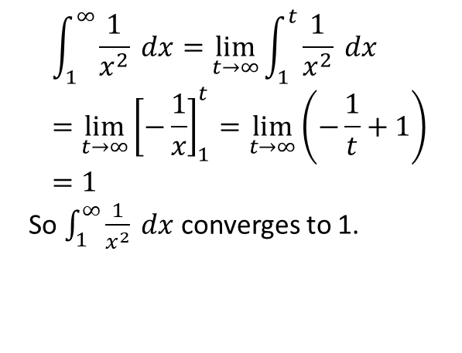



Examples
! To find $\int_{a}^{∞}{f\left(x\right) dx}$, determine $\lim_{t→∞}\int_{a}^{t}{f\left(x\right) dx}$
As mentioned, we can’t use $∞$ in calculations directly. We can make use of the $lim$ function we saw in differentiation by first principles.
Evaluate $\int_{1}^{∞}{\frac{1}{x^{2}} dx}$ or show that it is not convergent.
Evaluate $\int_{1}^{∞}{\frac{1}{x} dx}$ or show that it is not convergent.
?
$$\int_{1}^{∞}{\frac{1}{x} dx}=\lim_{t→∞}{\int_{1}^{t}{\frac{1}{x} dx}} \\ =\lim_{t→∞}{{\left[\ln{x}\right]}_{1}^{t}}=\lim_{t→∞}\left(\ln{t}−\ln{1}\right)$$
But as $t→∞$, $\ln{t}→∞$ so $\int_{1}^{∞}{\frac{1}{x} dx}$ does not converge.
?
$$\int_{1}^{∞}{\frac{1}{x^{2}} dx}=\lim_{t→∞}{\int_{1}^{t}{\frac{1}{x^{2}} dx}} \\ =\lim_{t→∞}{{\left[−\frac{1}{x}\right]}_{1}^{t}}=\lim_{t→∞}\left(−\frac{1}{t}+1\right) \\ =1$$
So $\int_{1}^{∞}{\frac{1}{x^{2}} dx}$ converges to 1.
Just For Your Interest
This can be used to prove that the ‘harmonic series’
$1+\frac{1}{2}+\frac{1}{3}+\frac{1}{4}+…$ is divergent.
The areas of the below rectangles are $1×1, 1×\frac{1}{2}, 1×\frac{1}{3}$ and so on, i.e. their total area is the harmonic series.
But the blue area $\int_{1}^{∞}{\frac{1}{x} dx}$, which is smaller, is divergent. Therefore the harmonic series must also be divergent.
$$y$$
$$1$$
$$2$$
$$3$$
$$4$$
$$x$$

Slide 5

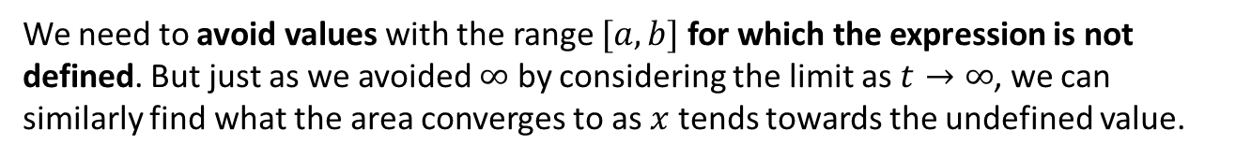

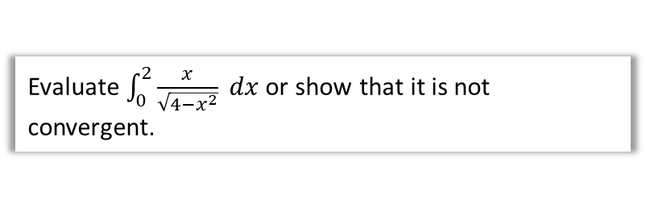
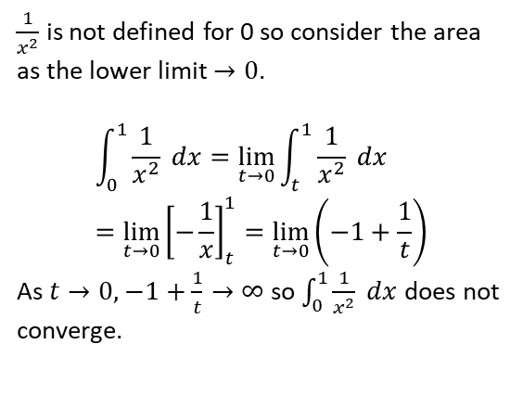
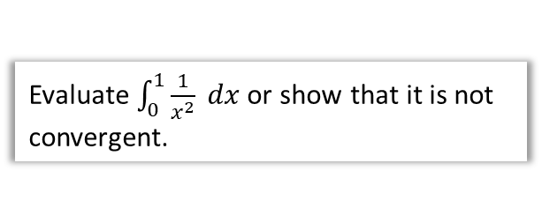
When $f(x)$ not defined for some value
We need to avoid values with the range $[a,b]$ for which the expression is not defined. But just as we avoided $∞$ by considering the limit as $t→∞$, we can similarly find what the area converges to as $x$ tends towards the undefined value.
Evaluate $\int_{0}^{1}{\frac{1}{x^{2}} dx}$ or show that it is not convergent.
Evaluate $\int_{0}^{2}{\frac{x}{\sqrt{4−x^{2}}} dx}$ or show that it is not convergent.
?
?
$\frac{1}{x^{2}}$ is not defined for 0 so consider the area as the lower limit $→0$.
$$\int_{0}^{1}{\frac{1}{x^{2}} dx}=\lim_{t→0}{\int_{t}^{1}{\frac{1}{x^{2}} dx}} \\ =\lim_{t→0}{{\left[−\frac{1}{x}\right]}_{t}^{1}}=\lim_{t→0}\left(−1+\frac{1}{t}\right)$$
As $t→0,$ $−1+\frac{1}{t}→∞$ so $\int_{0}^{1}{\frac{1}{x^{2}} dx}$ does not converge.
$$\int_{0}^{2}{\frac{x}{\sqrt{4−x^{2}}} dx}=\int_{0}^{2}{x{\left(4−x^{2}\right)}^{−\frac{1}{2}} dx}$$
Try $y={\left(4−x^{2}\right)}^{\frac{1}{2}} → \frac{dy}{dx}=−x{\left(4−x^{2}\right)}^{−\frac{1}{2}}$
$$∴\int_{0}^{2}{x{\left(4−x^{2}\right)}^{−\frac{1}{2}} dx}=\lim_{t→2}{\int_{0}^{t}{x{\left(4−x^{2}\right)}^{−\frac{1}{2}} dx}}$$
$$=\lim_{t→2}{{\left[−\sqrt{4−x^{2}}\right]}_{0}^{t}}=\lim_{t→2}\left(−\sqrt{4−t^{2}}+2\right)=2$$
So $\int_{0}^{2}{\frac{x}{\sqrt{4−x^{2}}} dx}$ converges to 2.
“Consider and scale” method
Undefined when $x=2$

Slide 6
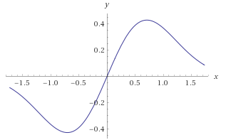






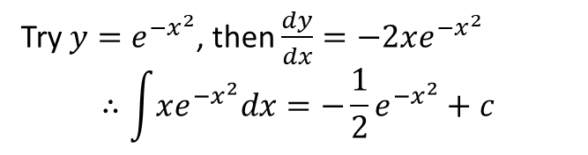
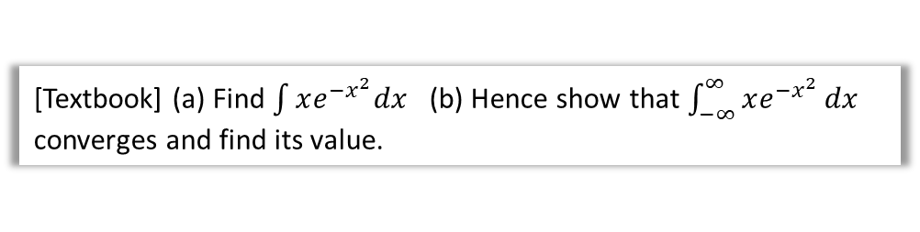



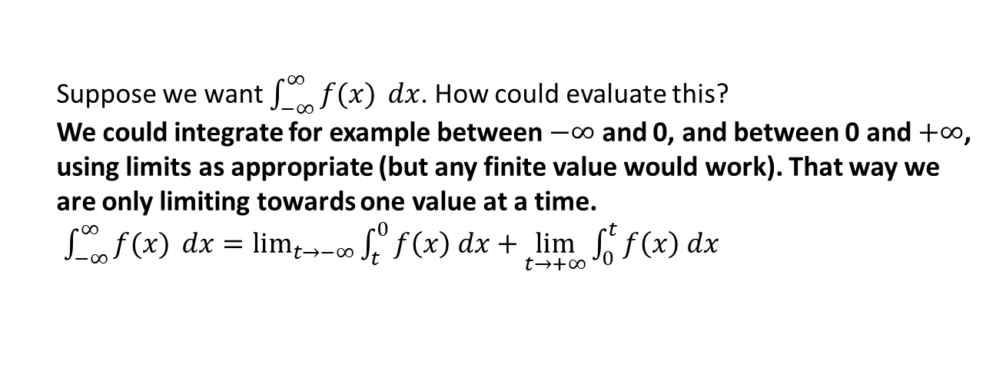




When integrating between $−∞$ and $∞$
desired range of limits
$$−∞$$
$$−2$$
$$−1$$
$$0$$
$$1$$
$$2$$
$$3$$
$$4$$
$$5$$
$$6$$
$$7$$
$$+∞$$
Suppose we want $\int_{−∞}^{∞}{f(x)} dx$. How could evaluate this?
We could integrate for example between $−∞$ and 0, and between 0 and $+∞$, using limits as appropriate (but any finite value would work). That way we are only limiting towards one value at a time.
$\int_{−∞}^{∞}{f(x)} dx=\lim_{t→−∞}{\int_{t}^{0}{f\left(x\right) dx}}+\lim_{t→+∞}{\int_{0}^{t}{f\left(x\right) dx}}$
?
[Textbook] (a) Find $\int{xe^{−x^{2}}dx}$ (b) Hence show that $\int_{−∞}^{∞}{xe^{−x^{2}}}dx$ converges and find its value.
b
$$\int_{−∞}^{∞}{xe^{−x^{2}}}dx=\int_{−∞}^{0}{xe^{−x^{2}}}dx+\int_{0}^{∞}{xe^{−x^{2}}}dx \\ =\lim_{t→−∞}{{\left[−\frac{1}{2}e^{−x^{2}}\right]}_{t}^{0}}+\lim_{t→∞}{{\left[−\frac{1}{2}e^{−x^{2}}\right]}_{0}^{t}} \\ =… \\ =−\frac{1}{2}+\frac{1}{2}=0$$
a
?
?
Try $y=e^{−x^{2}}$, then $\frac{dy}{dx}=−2xe^{−x^{2}}$
$$∴\int{xe^{−x^{2}}dx}=−\frac{1}{2}e^{−x^{2}}+c$$

Slide 7
Exercise 3A
Pearson Core Pure Year 2
Pages 56-58
Complete before the lesson Q1-3
In Class:
Green Q4-6
Amber Q7-10
Red Q11-15 & Challenge

Slide 8

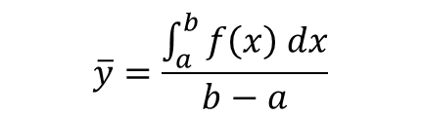


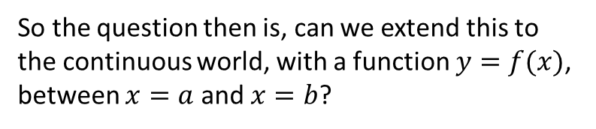
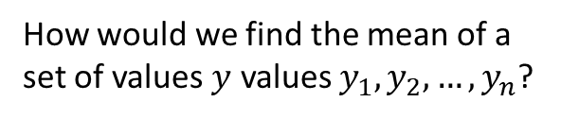
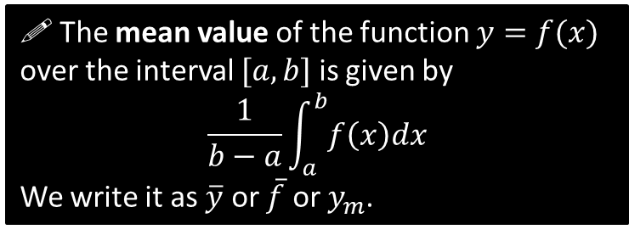



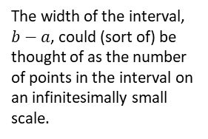



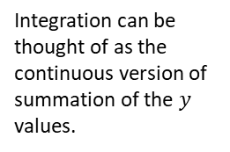
The Mean Value of a Function
How would we find the mean of a set of values $y$ values $y_{1}, y_{2},…,y_{n}$?
So the question then is, can we extend this to the continuous world, with a function $y=f(x)$, between $x=a$ and $x=b$?
$$y_{4}$$
$$\overline{y}$$
$$y_{2}$$
$$y_{3}$$
$$\overline{y}$$
$$y_{1}$$
?
$$\overline{y}=\frac{y_{1}+y_{2}+…+y_{n}}{n}$$
continuous equivalent?
$$a$$
$$b$$
Integration can be thought of as the continuous version of summation of the $y$ values.
?
continuous equivalent?
$$\overline{y}=\frac{\int_{a}^{b}{f\left(x\right) dx}}{b−a}$$
?
The width of the interval, $b−a$, could (sort of) be thought of as the number of points in the interval on an infinitesimally small scale.
! The mean value of the function $y=f(x)$ over the interval $[a,b]$ is given by
$$\frac{1}{b−a}\int_{a}^{b}{f\left(x\right)dx}$$
We write it as $\overline{y}$ or $\overline{f}$ or $y_{m}$.

Slide 9

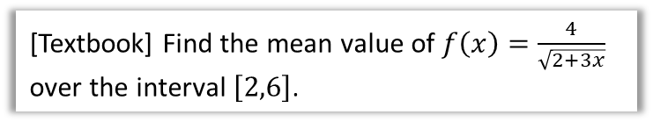
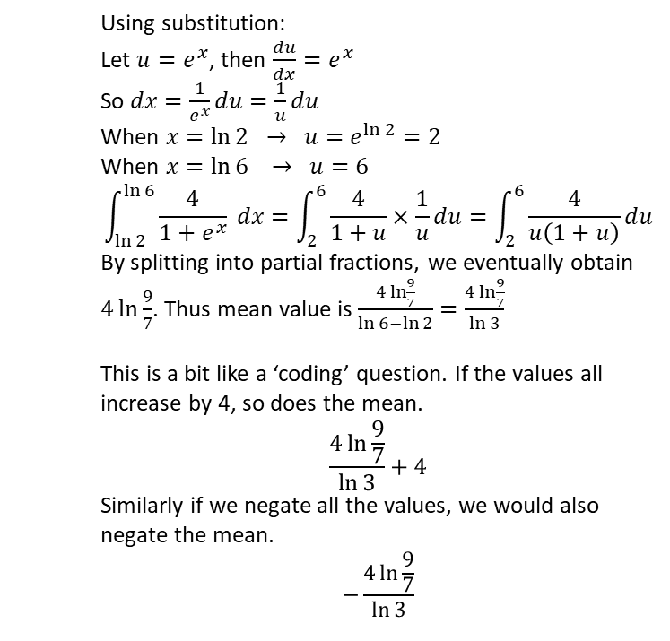
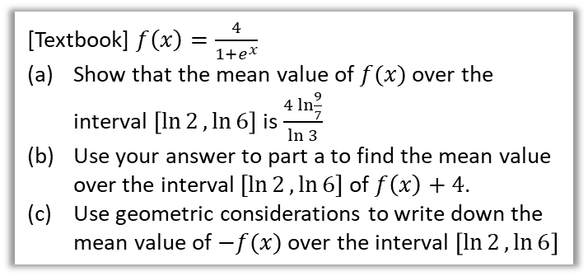
Examples
[Textbook] Find the mean value of $f\left(x\right)=\frac{4}{\sqrt{2+3x}}$ over the interval $\left[2,6\right]$.
[Textbook] $f\left(x\right)=\frac{4}{1+e^{x}}$
Show that the mean value of $f(x)$ over the interval $\left[\ln{2},\ln{6}\right]$ is $\frac{4\ln{\frac{9}{7}}}{\ln{3}}$
Use your answer to part a to find the mean value over the interval $[\ln{2},\ln{6}]$ of $f\left(x\right)+4$.
Use geometric considerations to write down the mean value of $−f(x)$ over the interval $\left[\ln{2},\ln{6}\right]$
?
$$\int_{2}^{6}{\frac{4}{\sqrt{2+3x}} dx}=4\int_{2}^{6}{{\left(2+3x\right)}^{−\frac{1}{2}}dx} \\ =\frac{8}{3}{\left[{\left(2+3x\right)}^{\frac{1}{2}}\right]}_{2}^{6} \\ =\frac{16}{3}\left(\sqrt{5}−\sqrt{2}\right)$$
So mean value is $\frac{\frac{16}{3}\left(\sqrt{5}−\sqrt{2}\right)}{6−2}=\frac{4}{3}\left(\sqrt{5}−\sqrt{2}\right)$
Using substitution:
Let $u=e^{x}$, then $\frac{du}{dx}=e^{x}$
So $dx=\frac{1}{e^{x}}du=\frac{1}{u}du$
When $x=\ln{2} → u=e^{\ln{2}}=2$
When $x=\ln{6} → u=6$
$$\int_{\ln{2}}^{\ln{6}}{\frac{4}{1+e^{x}}} dx=\int_{2}^{6}{\frac{4}{1+u}×\frac{1}{u}du}=\int_{2}^{6}{\frac{4}{u\left(1+u\right)}du}$$
By splitting into partial fractions, we eventually obtain $4\ln{\frac{9}{7}}$. Thus mean value is $\frac{4\ln{\frac{9}{7}}}{\ln{6}−\ln{2}}=\frac{4\ln{\frac{9}{7}}}{\ln{3}}$
This is a bit like a ‘coding’ question. If the values all increase by 4, so does the mean.
$$\frac{4\ln{\frac{9}{7}}}{\ln{3}}+4$$
Similarly if we negate all the values, we would also negate the mean.
$$−\frac{4\ln{\frac{9}{7}}}{\ln{3}}$$
a
?
b
?
c
?

Slide 10

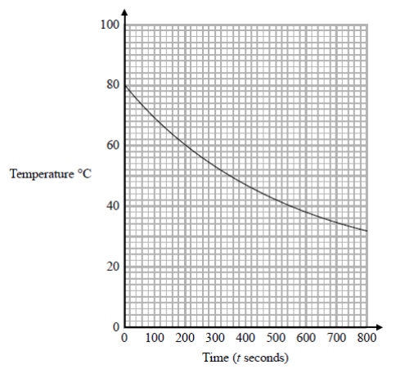



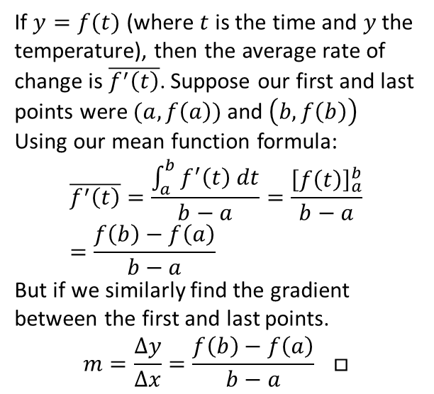
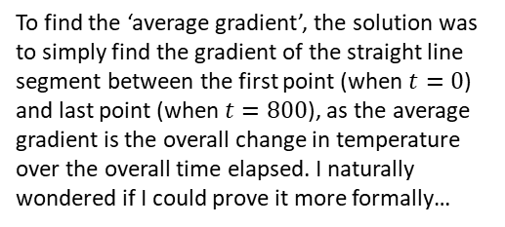
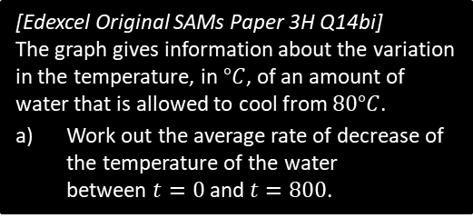
Just for your interest…
Why does the gradient of the line segment between the first and last point of a function give you the average gradient of the function?
When helping some GCSE students revise, I came across this question:
$$\left(a,f\left(a\right)\right)$$
[Edexcel Original SAMs Paper 3H Q14bi]
The graph gives information about the variation in the temperature, in $°C$, of an amount of water that is allowed to cool from $80°C$.
Work out the average rate of decrease of the temperature of the water between $t=0$ and $t=800$.
$$\left(b,f\left(b\right)\right)$$
If $y=f(t)$ (where $t$ is the time and $y$ the temperature), then the average rate of change is $\overline{f^{′}\left(t\right)}$. Suppose our first and last points were $(a,f\left(a\right))$ and $\left(b,f\left(b\right)\right)$
Using our mean function formula:
$$\overline{f^{′}\left(t\right)}=\frac{\int_{a}^{b}{f^{′}\left(t\right) dt}}{b−a}=\frac{{\left[f\left(t\right)\right]}_{a}^{b}}{b−a} \\ =\frac{f\left(b\right)−f\left(a\right)}{b−a}$$
But if we similarly find the gradient between the first and last points.
$$m=\frac{Δy}{Δx}=\frac{f\left(b\right)−f\left(a\right)}{b−a} □$$
To find the ‘average gradient’, the solution was to simply find the gradient of the straight line segment between the first point (when $t=0$) and last point (when $t=800$), as the average gradient is the overall change in temperature over the overall time elapsed. I naturally wondered if I could prove it more formally…
ME-WOW!

Slide 11
Exercise 3B
Pearson Core Pure Year 2
Pages 61-62
Complete before the lesson Q1-3
In Class:
Green Q4-6
Amber Q7-9
Red Q10-14

Slide 12



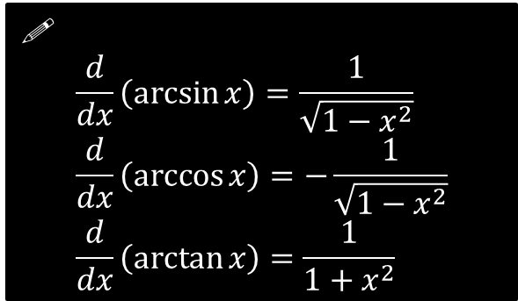

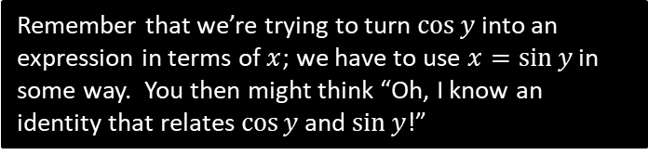
Differentiating inverse trigonometric functions
Show that if $y=\arcsin{x}$, then $\frac{dy}{dx}=\frac{1}{\sqrt{1−x^{2}}}$
?
$$y=\arcsin{x} \\ x=\sin{y} \\ \frac{dx}{dy}=\cos{y} \\ \frac{dy}{dx}=\frac{1}{\cos{y}}$$
We know that $sin^{2}y+cos^{2}y≡1$
$$=\frac{1}{\sqrt{1−\sin^{2}{y}}}=\frac{1}{\sqrt{1−x^{2}}}$$
Remember that we’re trying to turn $\cos{y}$ into an expression in terms of $x$; we have to use $x=\sin{y}$ in some way. You then might think “Oh, I know an identity that relates $\cos{y}$ and $\sin{y}$!”
!
$$\frac{d}{dx}\left(\arcsin{x}\right)=\frac{1}{\sqrt{1−x^{2}}} \\ \frac{d}{dx}\left(\arccos{x}\right)=−\frac{1}{\sqrt{1−x^{2}}} \\ \frac{d}{dx}\left(\arctan{x}\right)=\frac{1}{1+x^{2}}$$
Given that $y=\arcsin{x^{2}}$ find $\frac{dy}{dx}$
?
Using the chain rule:
$$\frac{dy}{dx}=\frac{1}{\sqrt{1−{\left(x^{2}\right)}^{2}}}×2x \\ =\frac{2x}{\sqrt{1−x^{4}}}$$
(Teacher Note: Those with the original print versions of the new A Level Pure Year 2 textbooks will actually find this material there: it has since been moved to this module)

Slide 13

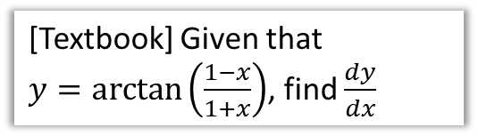

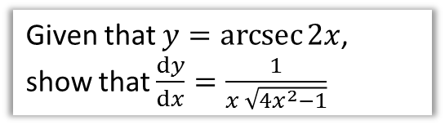
Test Your Understanding
[Textbook] Given that
$y=\arctan\left(\frac{1−x}{1+x}\right)$, find $\frac{dy}{dx}$
Given that $y=\operatorname{arcsec}{2x}$, show that $\frac{dy}{dx}=\frac{1}{x \sqrt{4x^{2}−1}}$
?
(Let’s use the ‘full’ Chain Rule method this time)
Let $u=\frac{1−x}{1+x}$
$$\frac{du}{dx}=…=−\frac{2}{{\left(1+x\right)}^{2}}$$
$$y=\arctan{u} \\ ∴\frac{dy}{du}=\frac{1}{1+u^{2}}$$
By the Chain Rule:
$$\frac{dy}{dx}=\frac{dy}{du}×\frac{du}{dx} \\ =\frac{1}{1+u^{2}}×\left(−\frac{2}{{\left(1+x\right)}^{2}}\right) \\ =… \\ =−\frac{1}{1+x^{2}}$$
?
$$\sec{y}=2x \\ \sec{y}\tan{y}\frac{dy}{dx}=2 \\ \frac{dy}{dx}=\frac{2}{\sec{y}\tan{y}} \\ \frac{dy}{dx}=\frac{2}{\sec{y} \sqrt{\sec^{2}{y}−1}} \\ \frac{dy}{dx}=\frac{2}{2x \sqrt{4x^{2}−1}}=\frac{1}{x \sqrt{4x^{2}−1}}$$

Slide 14
Exercise 3C
Pearson Core Pure Year 2
Pages 61-62
Complete before the lesson Q1
In Class:
Green Q2-4
Amber Q5-6
Red Q7-11

Slide 15
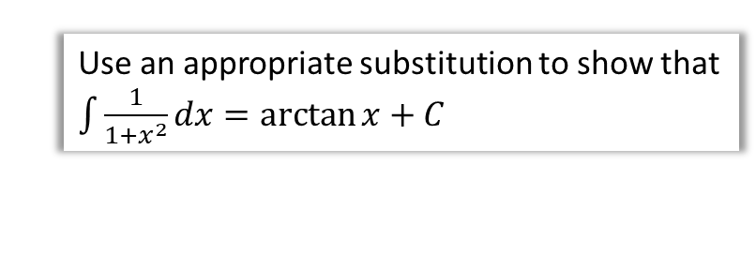

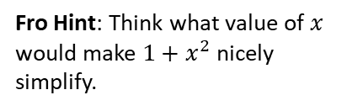

Integrating with inverse trigonometric functions
Use an appropriate substitution to show that $\int{\frac{1}{1+x^{2}}dx}=\arctan{x}+C$
?
Fro Hint: Think what value of $x$ would make $1+x^{2}$ nicely simplify.
$$x=\tan{θ}$$
?
$$\frac{dx}{dθ}=\sec^{2}{θ} → dx=\sec^{2}{θ}dθ \\ \int{\frac{1}{1+x^{2}}dx}=\int{\frac{1}{1+\tan^{2}{θ}}\sec^{2}{θ}dθ} \\ =\int{1 dθ} \\ =θ+C \\ =\arctan{x}+C$$

Slide 16



Dealing with $1/(a^{2}−x^{2})$ , $1/\sqrt{a^{2}−x^{2}}$, ….
From earlier:
$$\int{\frac{1}{\sqrt{1−x^{2}}} dx}=\arcsin\left(x\right)+C, \left|x\right|<a \\ \int{\frac{1}{1+x^{2}} dx}=\arctan\left(x\right)+C$$
Show that $\int{\frac{1}{\sqrt{a^{2}−x^{2}}}dx}=\arcsin\left(\frac{x}{a}\right)+c$ where $a$ is a positive constant and $\left|x\right|<a$.
?
$$\int{\frac{1}{\sqrt{a^{2}−x^{2}}}dx}=\int{\frac{1}{\sqrt{a^{2}\left(1−\frac{x^{2}}{a^{2}}\right)}}dx}=\int{\frac{1}{a\sqrt{1−\frac{x^{2}}{a^{2}}}}dx}=$$
$$=\frac{1}{a}\int{\frac{1}{\sqrt{1−\left(\frac{x}{a}\right)}} dx}$$
This looks like a standard result from above. Letting $u=\frac{x}{a}$ (note $dx=a du$)
$$=\frac{1}{a}\int{\frac{1}{\sqrt{1−u}} du}=\arcsin{(u)}+c \\ =\arcsin\left(\frac{x}{a}\right)+c$$

Slide 17



Example
! Standard results: (in formula booklet)
$$\int{\frac{1}{\sqrt{a^{2}−x^{2}}} dx}=\arcsin\left(\frac{x}{a}\right)+C, \left|x\right|<a \\ \int{\frac{1}{a^{2}+x^{2}} dx}=\frac{1}{a}\arctan\left(\frac{x}{a}\right)+C$$
[Textbook] Find $\int{\frac{4}{5+x^{2}}dx}$
?
$$\int{\frac{4}{5+x^{2}}dx}=4\int{\frac{1}{5+x^{2}}dx} \\ =\frac{4}{\sqrt{5}}\arctan\left(\frac{x}{\sqrt{5}}\right)+c$$

Slide 18





Dealing with $1/(a^{2}−b^{2}x^{2})$ , ….
Standard results: (in formula booklet)
$$\int{\frac{1}{\sqrt{a^{2}−x^{2}}} dx}=\arcsin\left(\frac{x}{a}\right)+C, \left|x\right|<a \\ \int{\frac{1}{a^{2}+x^{2}} dx}=\frac{1}{a}\arctan\left(\frac{x}{a}\right)+C$$
Find $\int{\frac{1}{25+9x^{2}}dx}$
Find $\int_{−\frac{\sqrt{3}}{4}}^{\frac{\sqrt{3}}{4}}{\frac{1}{\sqrt{3−4x^{2}}}}dx$
?
$$=\frac{1}{9}\int{\frac{1}{\frac{25}{9}+x^{2}} dx} \\ =\frac{1}{9}×\frac{1}{\left(\frac{5}{3}\right)}artan\left(\frac{x}{\left(\frac{5}{3}\right)}\right)+C \\ =\frac{1}{15}\arctan\left(\frac{3x}{5}\right)+C$$
$$=\int_{−\frac{\sqrt{3}}{4}}^{\frac{\sqrt{3}}{4}}{\frac{1}{\sqrt{4}\sqrt{\frac{3}{4}−x^{2}}}}dx \\ =\frac{1}{2}{\left[\arcsin\left(\frac{2x}{\sqrt{3}}\right)\right]}_{−\frac{\sqrt{3}}{4}}^{\frac{\sqrt{3}}{4}} \\ =\frac{π}{12}−\left(−\frac{π}{12}\right)=\frac{π}{6}$$
?

Slide 19




Final example
Standard results: (in formula booklet)
$$\int{\frac{1}{\sqrt{a^{2}−x^{2}}} dx}=\arcsin\left(\frac{x}{a}\right)+C, \left|x\right|<a \\ \int{\frac{1}{a^{2}+x^{2}} dx}=\frac{1}{a}\arctan\left(\frac{x}{a}\right)+C$$
Fro Tip: If you have multiple terms being added/subtracted in the numerator, split up the fraction.
Find $\int{\frac{x+4}{\sqrt{1−4x^{2}}}dx}$
?
$$\int{\frac{x+4}{\sqrt{1−4x^{2}}}dx}=\int{\frac{x}{\sqrt{1−4x^{2}}}dx}+4\int{\frac{1}{\sqrt{1−4x^{2}}}dx}$$
Deal with each in turn:
$$\int{\frac{x}{\sqrt{1−4x^{2}}}dx}=\int{x {\left(1−4x^{2}\right)}^{−\frac{1}{2}} dx} \\ =−\frac{1}{4}\sqrt{1−4x^{2}}+c$$
$$4\int{\frac{1}{\sqrt{1−4x^{2}}}dx}=4\int{\frac{1}{\sqrt{4\left(\frac{1}{4}−x^{2}\right)}}dx} \\ =2\int{\frac{1}{\sqrt{\frac{1}{4}−x^{2}}}dx}=2\arcsin{2x}+c$$
$$∴\int{\frac{x+4}{\sqrt{1−4x^{2}}}dx}=−\frac{1}{4}\sqrt{1−4x^{2}}+2\arcsin{2x}+c$$
$$a=\frac{1}{2}$$

Slide 20
Exercise 3D
Pearson Core Pure Year 2
Pages 67-69
Complete before the lesson Q1-3
In Class:
Green Q4-7
Amber Q8-11
Red Q12-14 & Challenge

Slide 21



Solving using partial fractions
We have already seen in Pure Year 2 how we can use partial fractions to integrate. We can use this to further expand our repertoire of integration techniques for expressions of the form $\frac{1}{a^{2}±x^{2}}$ and $\frac{1}{\sqrt{a^{2}±x^{2}}}$
Prove that $\int{\frac{1}{a^{2}−x^{2}} dx}=\frac{1}{2a}\ln\left|\frac{a+x}{a−x}\right|+c$
?
$$\frac{1}{a^{2}−x^{2}}≡\frac{1}{\left(a+x\right)\left(a−x\right)}≡\frac{A}{a+x}+\frac{B}{a−x} \\ 1≡A\left(a−x\right)+B(a+x)$$
If $x=a$ $⇒ 1=2aB → B=\frac{1}{2a}$
If $x=−a ⇒ 1=2aA → A=\frac{1}{2a}$
$$∴\int{\frac{1}{a^{2}−x^{2}} dx}=\frac{1}{2a}\int{\frac{1}{a+x}+\frac{1}{a−x} dx} \\ =\frac{1}{2a}\left(\ln\left|a+x\right|−\ln\left|a−x\right|\right) \\ =\frac{1}{2a}\ln\left|\frac{a+x}{a−x}\right|+c$$

Slide 22



Partial Fractions involving Quadratic Factors
When you write as partial fractions, ensure you have the most general possible non-top heavy fraction, i.e. the ‘order’ (i.e. maximum power) of the numerator is one less than the denominator.
$$\frac{1}{x(x^{2}+1)}≡\frac{A}{x}+\frac{Bx+C}{x^{2}+1}$$
[Textbook] Show that $\int{\frac{1+x}{x^{3}+9x}}dx=A\ln\left(\frac{x^{2}}{x^{2}+9}\right)+B\arctan\left(\frac{x}{3}\right)+c$, where $A$ and $B$ are constants to be found.
?
$$\int{\frac{1+x}{x^{3}+9x}}dx=\int{\frac{1+x}{x\left(x^{2}+9\right)}}dx=\frac{A}{x}+\frac{Bx+C}{x^{2}+9}$$
$$1+x≡A\left(x^{2}+9\right)+x\left(Bx+C\right) \\ … \\ A=\frac{1}{9}, B=−\frac{1}{9}, C=1$$
$$\int{\frac{1+x}{x^{3}+9x}}dx=\frac{1}{9}\int{\frac{1}{x} dx}−\frac{1}{9}\int{\frac{x}{x^{2}+9} dx}+\int{\frac{1}{x^{2}+9} dx} \\ =\frac{1}{9}\ln{x}−\frac{1}{18}\ln\left(x^{2}+9\right)+\frac{1}{3}\arctan\left(\frac{x}{3}\right)+c \\ =\frac{1}{18}\ln\left(\frac{x^{2}}{x^{2}+9}\right)+\frac{1}{3}\arctan\left(\frac{x}{3}\right)+c$$

Slide 23



Test Your Understanding
If the fraction is top-heavy, you’ll have a quotient. As per Pure Year 2, if the order of numerator and denominator is the same, you’ll need an extra constant term. If the power is 1 greater in the numerator, you’ll need a quotient of $Ax+B$, and so on.
$$\frac{4x^{2}+x}{x^{2}+x}=\frac{4x^{2}+x}{x\left(x+1\right)}=A+\frac{B}{x}+\frac{C}{x+1}$$
[Textbook] (a) Express $\frac{x^{4}+x}{x^{4}+5x^{2}+6}$ as partial fractions.
(b) Hence find $\int{\frac{x^{4}+x}{x^{4}+5x^{2}+6}} dx$.
$$\frac{x^{4}+x}{x^{4}+5x^{2}+6}=A+\frac{Bx+C}{x^{2}+2}+\frac{Dx+E}{x^{2}+3} \\ A=1, B=1, C=4, D=−1, E=−9$$
$$\frac{x^{4}+x}{x^{4}+5x^{2}+6}=1+\frac{x+4}{x^{2}+2}−\frac{x+9}{x^{2}+3}$$
$$\int{1+\frac{x+4}{x^{2}+2}−\frac{x+9}{x^{2}+3} dx}=\int{1+\frac{x}{x^{2}+2}+\frac{4}{x^{2}+2}−\frac{x}{x^{2}+3}−\frac{9}{x^{2}+3}} dx \\ =… \\ =x+\frac{1}{2}\ln\left|\frac{x^{2}+2}{x^{2}+3}\right|+2\sqrt{2}\arctan\left(\frac{x}{\sqrt{2}}\right)−3\sqrt{3}\arctan\left(\frac{x}{\sqrt{3}}\right)+c$$
a
?
b
?

Slide 24
Exercise 3E
Pearson Core Pure Year 2
Pages 72-73
Complete before the lesson Q1-2
In Class:
Green Q3-5
Amber Q6-7
Red Q8-12 & Challenge

