Slide 1
Year 1 Applied Mathematics
Forces and Motions
- Scale Plans and Lifts
Chapter 10
(Part 4 of 4)

Slide 2
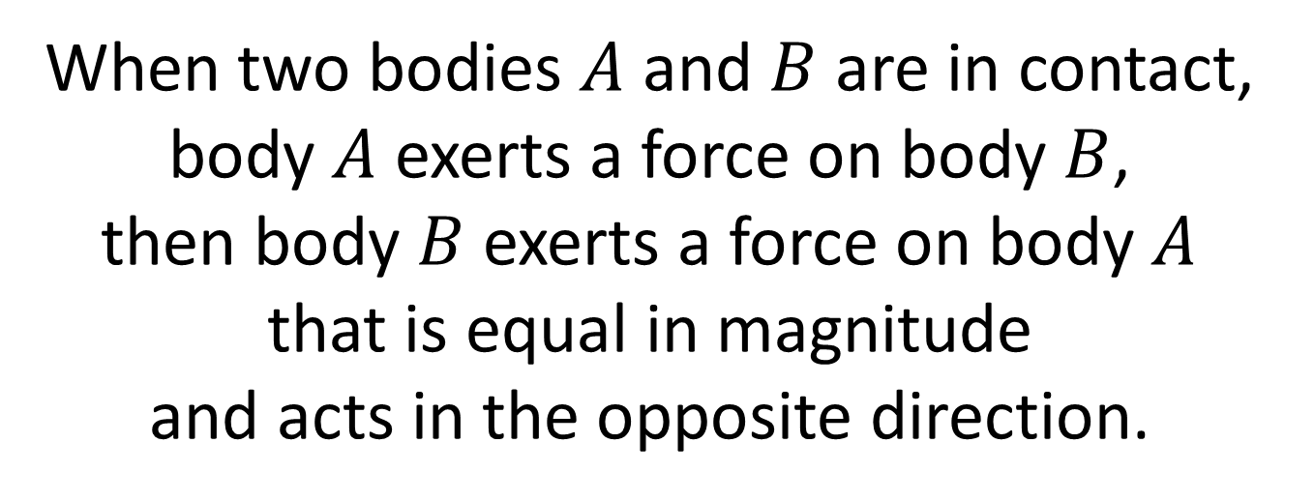
Scales Plan and Lifts
Newton’s 3rd Law:
For every action there is an
equal and opposite reaction.
When two bodies $A$ and $B$ are in contact,
body $A$ exerts a force on body $B$,
then body $B$ exerts a force on body $A$
that is equal in magnitude
and acts in the opposite direction.

Slide 3




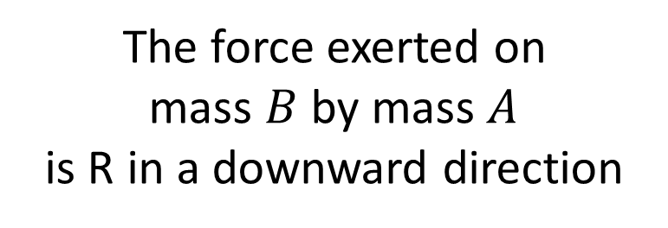
Scales Plan and Lifts
Newton’s 3rd Law:
For every action there is an equal and opposite reaction.
The force exerted on
mass $B$ by mass $A$
is R in a downward direction
$$a$$
A
$$R$$
$$R$$
B
A
B
$$W$$

Slide 4
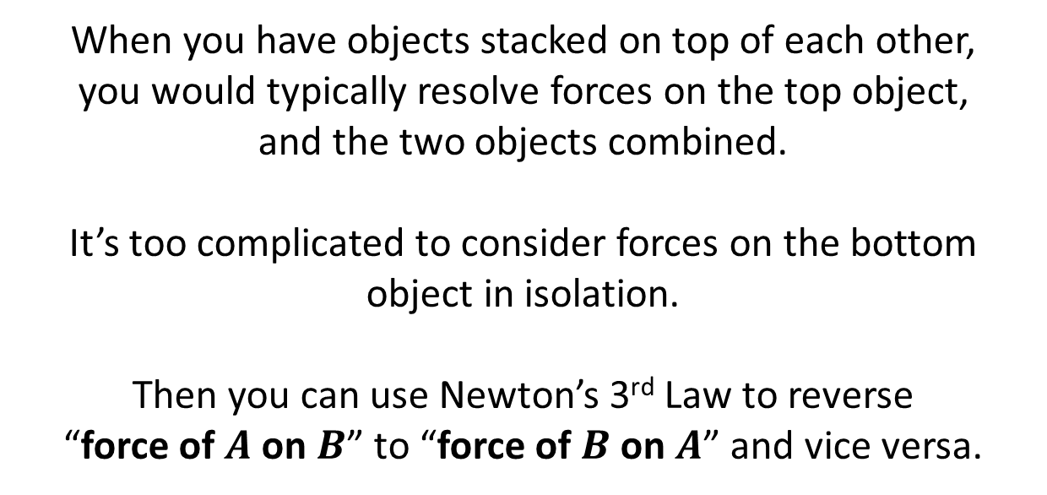
Scales Plan and Lifts
A
A
A + B
B
When you have objects stacked on top of each other,
you would typically resolve forces on the top object,
and the two objects combined.
It’s too complicated to consider forces on the bottom object in isolation.
Then you can use Newton’s 3rd Law to reverse
“force of $A$ on $B$” to “force of $B$ on $A$” and vice versa.

Slide 5
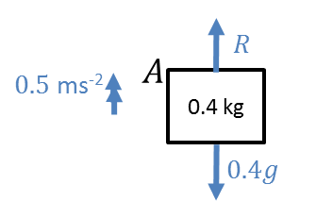



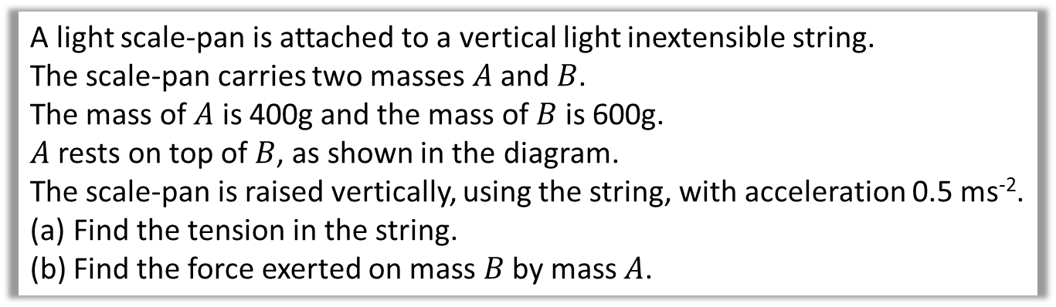

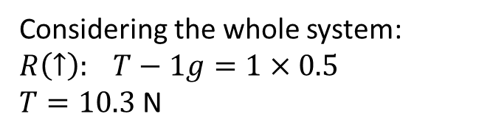

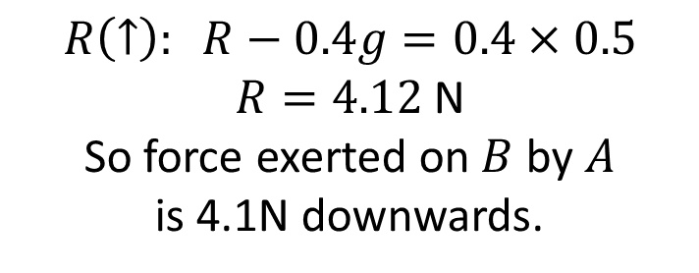
Scales Plan and Lifts
A light scale-pan is attached to a vertical light inextensible string.
The scale-pan carries two masses $A$ and $B$.
The mass of $A$ is 400g and the mass of $B$ is 600g.
$A$ rests on top of $B$, as shown in the diagram.
The scale-pan is raised vertically, using the string, with acceleration 0.5 ms⁻².
Find the tension in the string.
Find the force exerted on mass $B$ by mass $A$.
a
Considering the whole system:
$$R\left(↑\right): T−1g=1×0.5$$
$T=10.3$ N
b
$$T$$
$$R\left(↑\right): R−0.4g=0.4×0.5$$
$R=4.12$ N
So force exerted on $B$ by $A$
is 4.1N downwards.
$$A$$
0.4 kg
$1$kg
0.6 kg
$$1g$$
$$B$$

Slide 6
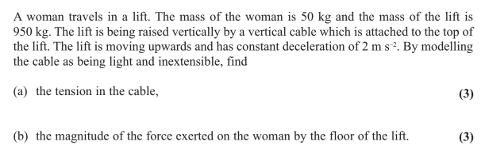
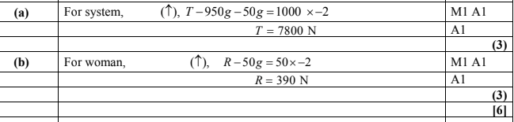
Scales Plan and Lifts

Slide 7
Exercise 10F
Pearson Stats/Mechanics Year 1
Pages 175-177
Complete before the lesson Q1
In Class:
Green Q2
Red Q3-5

