Slide 1



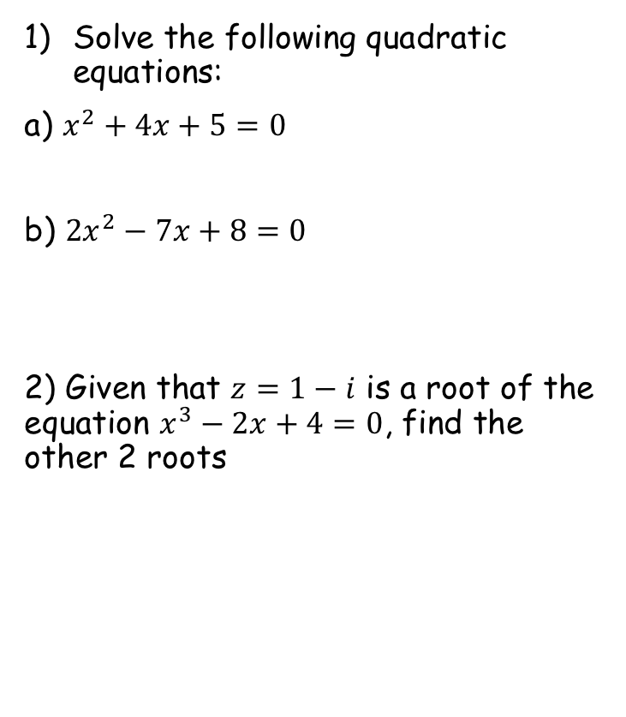

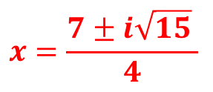


Prior Knowledge Check
Solve the following quadratic equations:
a) $x^{2}+4x+5=0$
b) ${2x}^{2}−7x+8=0$
2) Given that $z=1−i$ is a root of the equation $x^{3}−2x+4=0$, find the other 2 roots
3) $f\left(x\right)=x^{2}−2x−3$. Find the roots of:
a) $f\left(x\right)=0$
b) $f\left(x−5\right)=0$
c) $f\left(2x\right)=0$
$$x=2±i$$
$−1$and$3$
$$x=\frac{7±i\sqrt{15} }{4}$$
$4$ and$8$
$−\frac{1}{2}$ and $\frac{3}{2}$
$z=1+i$ and $z=2$

Slide 2
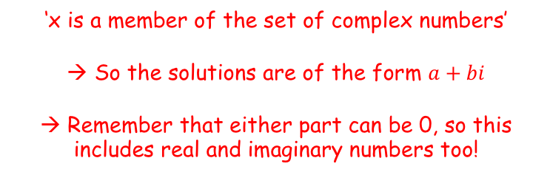
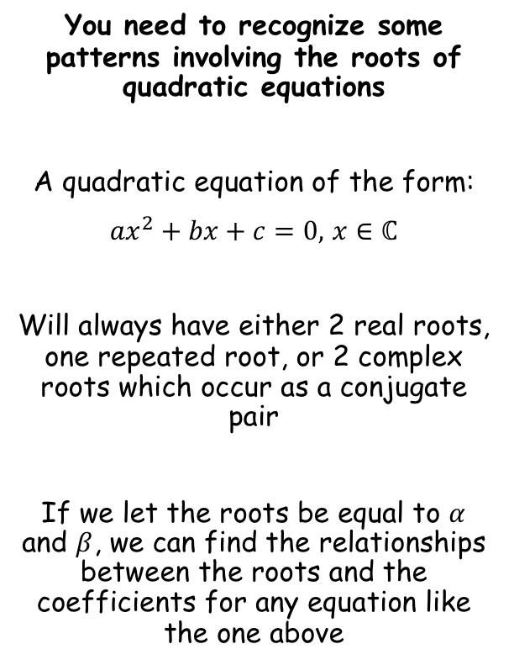
Roots of Polynomials
You need to recognize some patterns involving the roots of quadratic equations
A quadratic equation of the form:
${ax}^{2}+bx+c=0,$ $x∈ℂ$
Will always have either 2 real roots, one repeated root, or 2 complex roots which occur as a conjugate pair
If we let the roots be equal to $α$ and $β$, we can find the relationships between the roots and the coefficients for any equation like the one above
‘x is a member of the set of complex numbers’
→ So the solutions are of the form $a+bi$
→ Remember that either part can be 0, so this includes real and imaginary numbers too!
4A

Slide 3
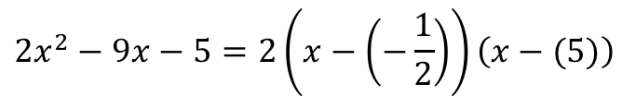

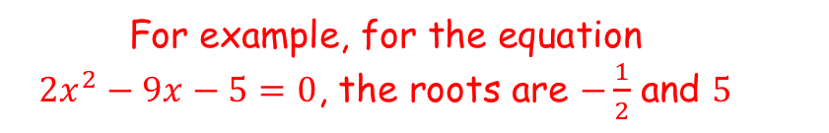
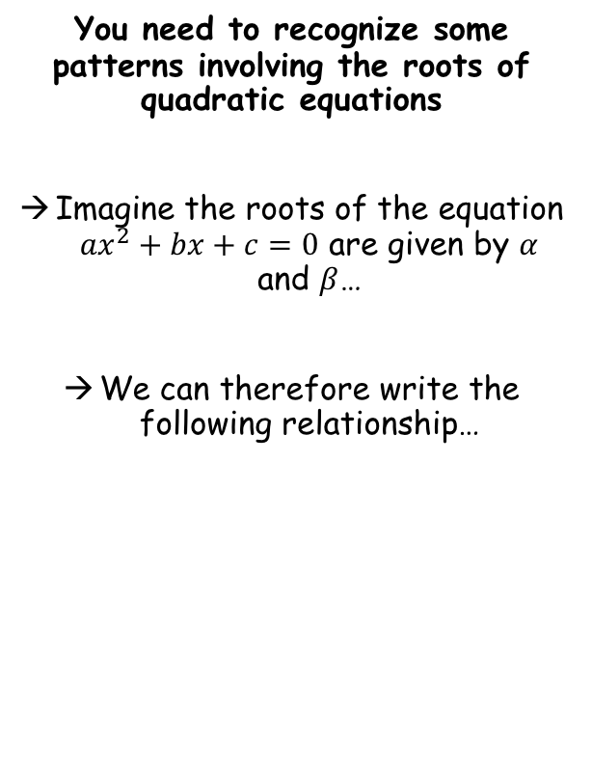

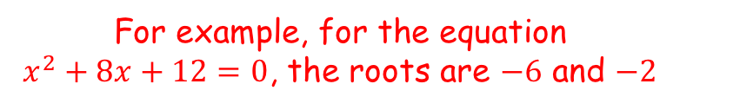
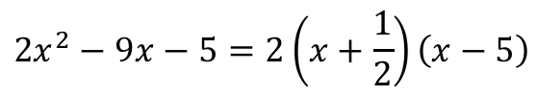
Roots of Polynomials
You need to recognize some patterns involving the roots of quadratic equations
Imagine the roots of the equation ${ax}^{2}+bx+c=0$ are given by $α$ and $β$…
We can therefore write the following relationship…
$${ax}^{2}+bx+c=a(x−α)(x−β)$$
For example, for the equation $x^{2}+8x+12=0$, the roots are $−6$ and $−2$
$$x^{2}+8x+12= (x−(−6))(x−(−2))$$
$$x^{2}+8x+12= (x+6)(x+2)$$
For example, for the equation ${2x}^{2}−9x−5=0$, the roots are $−\frac{1}{2}$ and $5$
$${2x}^{2}−9x−5=2\left(x−\left(−\frac{1}{2}\right)\right)\left(x−(5)\right)$$
$${2x}^{2}−9x−5=2\left(x+\frac{1}{2}\right)\left(x−5\right)$$
4A

Slide 4











Roots of Polynomials
You need to recognize some patterns involving the roots of quadratic equations
If the roots of the equation ${ax}^{2}+bx+c=0$ are given by $α$ and $β$…
$${ax}^{2}+bx+c=a(x−α)(x−β)$$
Multiply out the brackets
$${ax}^{2}+bx+c=a\left(x^{2}−αx−βx+αβ\right)$$
Group like terms
$${ax}^{2}+bx+c=a\left(x^{2}−(α+β)x+αβ\right)$$
Divide by $a$
$${ax}^{2}+bx+c=a(x−α)(x−β)$$
$$x^{2}+\frac{b}{a}x+\frac{c}{a}=x^{2}−(α+β)x+αβ$$
Compare coefficients of $x$
Compare constants
$$\frac{b}{a}=−(α+β)$$
$$\frac{c}{a}=αβ$$
$$−\frac{b}{a}=α+β$$
→ The sum of the roots is $−\frac{b}{a}$
→ The product of the roots is $\frac{c}{a}$
4A

Slide 5





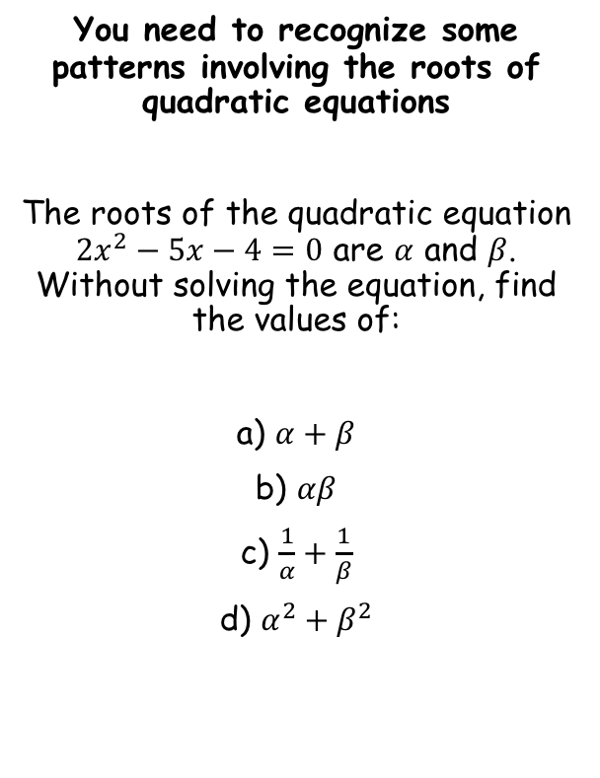

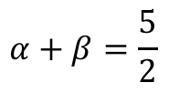

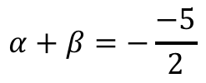


Roots of Polynomials
$$α+β=−\frac{b}{a}$$
$$αβ=\frac{c}{a}$$
You need to recognize some patterns involving the roots of quadratic equations
The roots of the quadratic equation ${2x}^{2}−5x−4=0$ are $α$ and $β$. Without solving the equation, find the values of:
a) $α+β$
b) $αβ$
c) $\frac{1}{α}+\frac{1}{β}$
d) $α^{2}+β^{2}$
$${2x}^{2}−5x−4=0$$
$$a=2$$
Summarise a, b and c first!
$$b=−5$$
$$c=−4$$
Then, write out the relationship that you will use
$$α+β=−\frac{b}{a}$$
$$\frac{5}{2}$$
Sub in $b$ and $a$
$$α+β=−\frac{−5}{2}$$
Simplify
$$α+β=\frac{5}{2}$$
4A

Slide 6





Roots of Polynomials
$$α+β=−\frac{b}{a}$$
$$αβ=\frac{c}{a}$$
You need to recognize some patterns involving the roots of quadratic equations
The roots of the quadratic equation ${2x}^{2}−5x−4=0$ are $α$ and $β$. Without solving the equation, find the values of:
a) $α+β$
b) $αβ$
c) $\frac{1}{α}+\frac{1}{β}$
d) $α^{2}+β^{2}$
$${2x}^{2}−5x−4=0$$
$$a=2$$
Summarise a, b and c first!
$$b=−5$$
$$c=−4$$
Then, write out the relationship that you will use
$$αβ=\frac{c}{a}$$
$$\frac{5}{2}$$
Sub in $c$ and $a$
$$αβ=\frac{−4}{2}$$
$$−2$$
Simplify
$$αβ=−2$$
4A

Slide 7
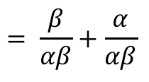
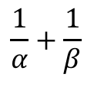

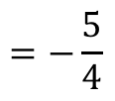
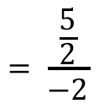

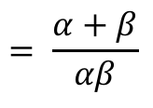
Roots of Polynomials
$$α+β=−\frac{b}{a}$$
$$αβ=\frac{c}{a}$$
You need to recognize some patterns involving the roots of quadratic equations
The roots of the quadratic equation ${2x}^{2}−5x−4=0$ are $α$ and $β$. Without solving the equation, find the values of:
a) $α+β$
b) $αβ$
c) $\frac{1}{α}+\frac{1}{β}$
d) $α^{2}+β^{2}$
$${2x}^{2}−5x−4=0$$
$$a=2$$
Summarise a, b and c first!
$$b=−5$$
$$c=−4$$
Sometimes you will need to find a way to rewrite the relationship so that is uses $α+β$ and $αβ$
$$\frac{1}{α}+\frac{1}{β}$$
Rewrite with common denominators
$$\frac{5}{2}$$
$$= \frac{β}{αβ}+\frac{α}{αβ}$$
$$−2$$
Group up
$$−\frac{5}{4}$$
$$= \frac{α+β}{αβ}$$
Replace using a) and b)
$$= \frac{\frac{5}{2}}{−2}$$
Simplify
$$=−\frac{5}{4}$$
4A

Slide 8


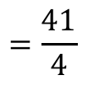
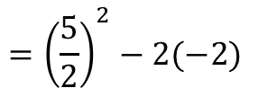
Roots of Polynomials
$$α+β=−\frac{b}{a}$$
$$αβ=\frac{c}{a}$$
You need to recognize some patterns involving the roots of quadratic equations
The roots of the quadratic equation ${2x}^{2}−5x−4=0$ are $α$ and $β$. Without solving the equation, find the values of:
a) $α+β$
b) $αβ$
c) $\frac{1}{α}+\frac{1}{β}$
d) $α^{2}+β^{2}$
$${2x}^{2}−5x−4=0$$
$$a=2$$
Summarise a, b and c first!
$$b=−5$$
$$c=−4$$
Sometimes you will need to find a way to rewrite the relationship so that is uses $α+β$ and $αβ$
$$α^{2}+β^{2}$$
Rewrite using a squared bracket
$$\frac{5}{2}$$
$$={\left(α+β\right)}^{2}−2αβ$$
$$−2$$
Sub in values and replace
$$−\frac{5}{4}$$
$$={\left(\frac{5}{2}\right)}^{2}−2(−2)$$
Calculate
$$=\frac{41}{4}$$
4A

Slide 9


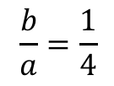
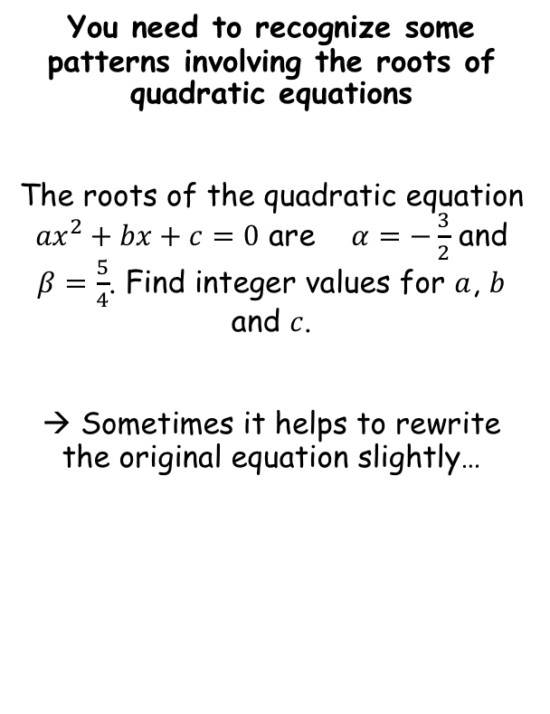



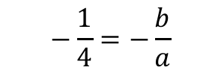
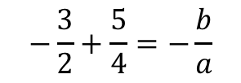
Roots of Polynomials
$$α+β=−\frac{b}{a}$$
$$αβ=\frac{c}{a}$$
You need to recognize some patterns involving the roots of quadratic equations
The roots of the quadratic equation ${ax}^{2}+bx+c=0$ are $α=−\frac{3}{2}$ and $β=\frac{5}{4}$. Find integer values for $a$, $b$ and $c$.
→ Sometimes it helps to rewrite the original equation slightly…
$$\frac{b}{a}=\frac{1}{4}$$
In this question you have to use the relationships ‘backwards’…
$$α+β=−\frac{b}{a}$$
Sub in the roots
$$−\frac{3}{2}+\frac{5}{4}=−\frac{b}{a}$$
Add the fractions
$$−\frac{1}{4}=−\frac{b}{a}$$
$${ax}^{2}+bx+c=0$$
Multiply by -1
Divide by $a$
$$\frac{1}{4}=\frac{b}{a}$$
$$x^{2}+\frac{b}{a}x+\frac{c}{a}=0$$
4A

Slide 10

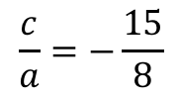
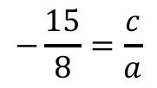
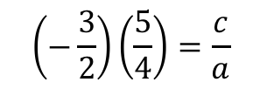
Roots of Polynomials
$$α+β=−\frac{b}{a}$$
$$αβ=\frac{c}{a}$$
You need to recognize some patterns involving the roots of quadratic equations
The roots of the quadratic equation ${ax}^{2}+bx+c=0$ are $α=−\frac{3}{2}$ and $β=\frac{5}{4}$. Find integer values for $a$, $b$ and $c$.
→ Sometimes it helps to rewrite the original equation slightly…
$$\frac{b}{a}=\frac{1}{4}$$
$$\frac{c}{a}=−\frac{15}{8}$$
In this question you have to use the relationships ‘backwards’…
$$αβ=\frac{c}{a}$$
Sub in the roots
$$\left(−\frac{3}{2}\right)\left(\frac{5}{4}\right)=\frac{c}{a}$$
Calculate
$$−\frac{15}{8}=\frac{c}{a}$$
$${ax}^{2}+bx+c=0$$
Divide by $a$
$$x^{2}+\frac{b}{a}x+\frac{c}{a}=0$$
4A

Slide 11


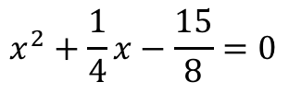

Roots of Polynomials
$$α+β=−\frac{b}{a}$$
$$αβ=\frac{c}{a}$$
You need to recognize some patterns involving the roots of quadratic equations
The roots of the quadratic equation ${ax}^{2}+bx+c=0$ are $α=−\frac{3}{2}$ and $β=\frac{5}{4}$. Find integer values for $a$, $b$ and $c$.
→ Sometimes it helps to rewrite the original equation slightly…
$$\frac{b}{a}=\frac{1}{4}$$
$$\frac{c}{a}=−\frac{15}{8}$$
Now we can replace these in the rearranged equation below…
$$x^{2}+\frac{b}{a}x+\frac{c}{a}=0$$
Sub in the values above…
$$x^{2}+\frac{1}{4}x−\frac{15}{8}=0$$
Multiply all by 8
$${ax}^{2}+bx+c=0$$
$${8x}^{2}+2x−15=0$$
Divide by $a$
$a=8$, $b=2$, $c=−15$
$$x^{2}+\frac{b}{a}x+\frac{c}{a}=0$$
4A

Slide 12
Exercise 4A
Pearson Further Core Mathematics Year 1/AS
Complete before the lesson Q1-4
In Class:
Green Q5-7
Amber Q8-10
Red Q11-13

