Slide 1
Year 1 Applied Mathematics
Hypothesis Testing
- Probability of the Sample
Chapter 7
(Part 2 of 5)

Slide 2
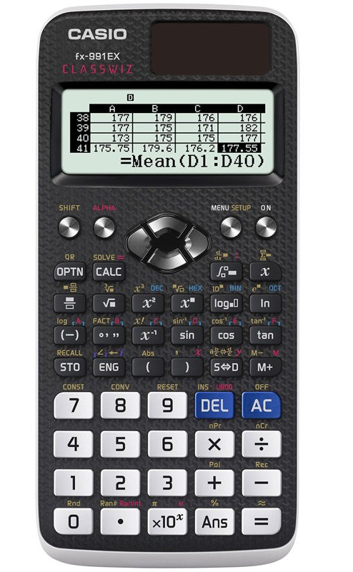

Probability of the sample
Calculating Binomial Cumulative Distribution
Menu
7
Down Button
1
2
5 heads from 8 tosses
X = 5
N = 8
P = 0.5
X = outcomes
N = total trials/sample size
P = probability of success
$$P\left(X≤5\right)=0.855$$

Slide 3
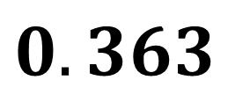
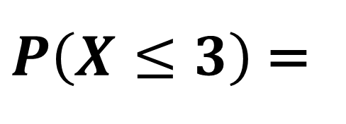
Probability of the sample
John believes a coin maybe biased towards tails.
He tosses the coin 8 times and counts 3 heads.
What is the probability of getting 3 or less heads?
Using your calculator:
Binomial CD
X = 3
N = 8
P = 0.5
$P\left(X≤3\right)$ =
$$0.363$$

Slide 4
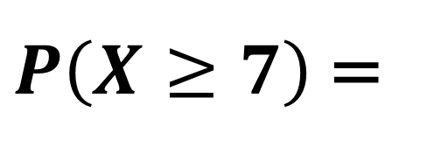
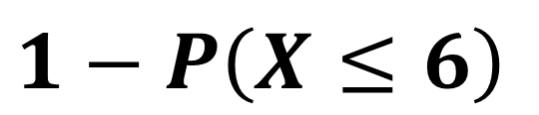
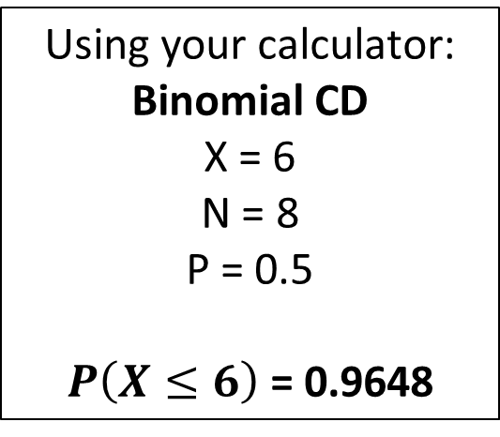
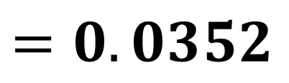
Probability of the sample
John believes a coin maybe biased towards heads.
He tosses the coin 8 times and counts 7 heads.
What is the probability of getting 7 or more heads?
Using your calculator:
Binomial CD
X = 6
N = 8
P = 0.5
$P\left(X≤6\right)$ = 0.9648
$P\left(X≥7\right)$ =
$$1−P\left(X≤6\right)$$
$$=0.0352$$

Slide 5
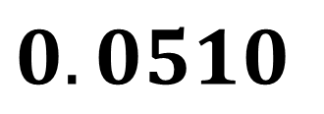
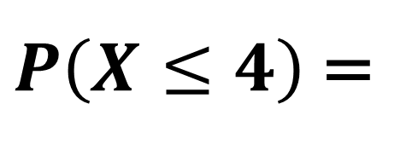
Probability of the sample
An election candidate believes she has the support of 40% of the residents in a particular town. A researcher wants to test whether the candidate is over-estimating her support. After asking 20 residents, 4 of them gave their support to the candidate.
What is the probability of 4 or less residents giving their support?
Using your calculator:
Binomial CD
X = 4
N = 20
P = 0.4
$P\left(X≤4\right)$ =
$$0.0510$$

Slide 6
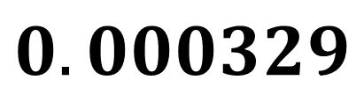
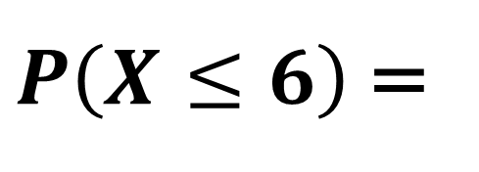
Probability of the sample
In the UK, 5% of students normally turn up late to school each day.
Mr Hameed wishes to determine if Piffin School has a problem with attendance. One morning Mr Hameed observed 6 out of 20 students arriving late.
What is the probability of 6 or more students being late?
Using your calculator:
Binomial CD
X = 6
N = 20
P = 0.05
$P\left(X≤6\right)$ =
$$0.000329$$

Slide 7
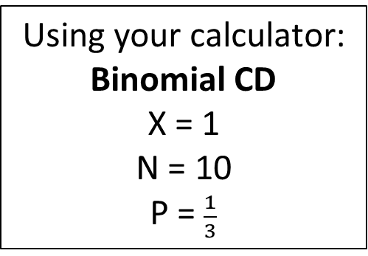
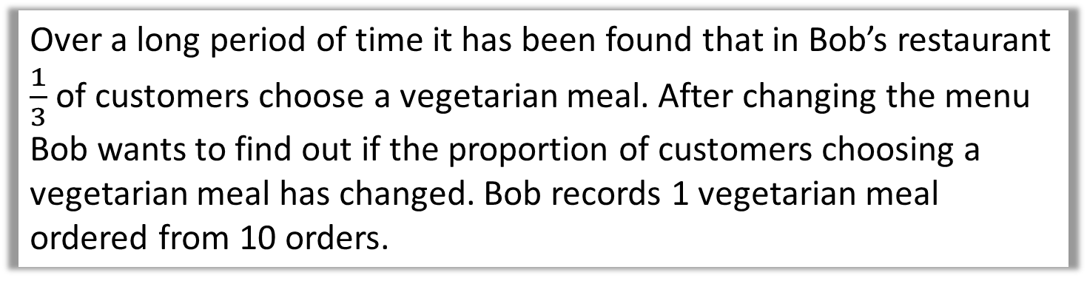
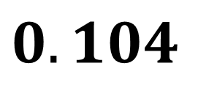
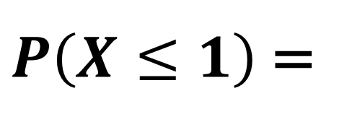
Probability of the sample
Over a long period of time it has been found that in Bob’s restaurant $\frac{1}{3}$ of customers choose a vegetarian meal. After changing the menu Bob wants to find out if the proportion of customers choosing a vegetarian meal has changed. Bob records 1 vegetarian meal ordered from 10 orders.
What is the probability of 1 or less meals are vegetarian?
Using your calculator:
Binomial CD
X = 1
N = 10
P = $\frac{1}{3}$
$P\left(X≤1\right)$ =
$$0.104$$

