Slide 1
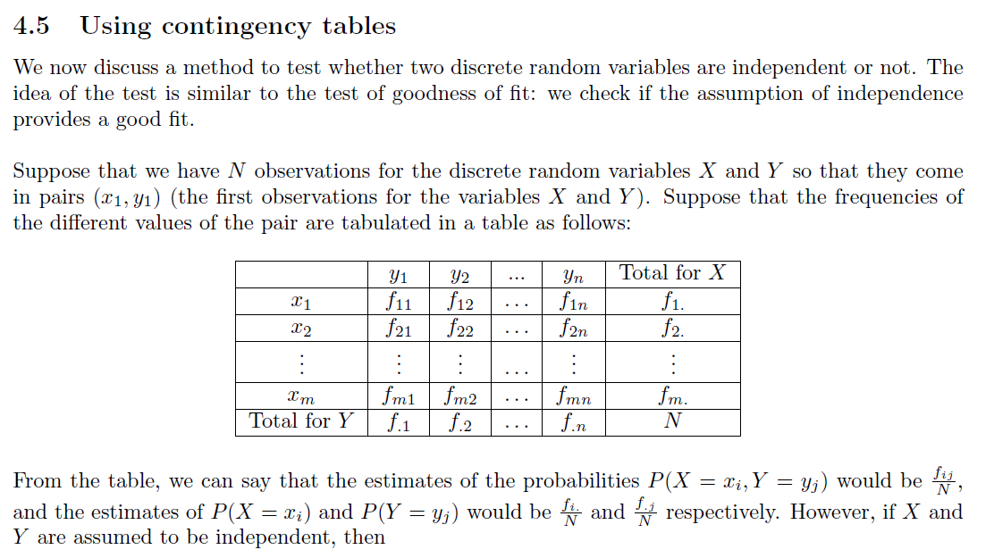

Slide 2
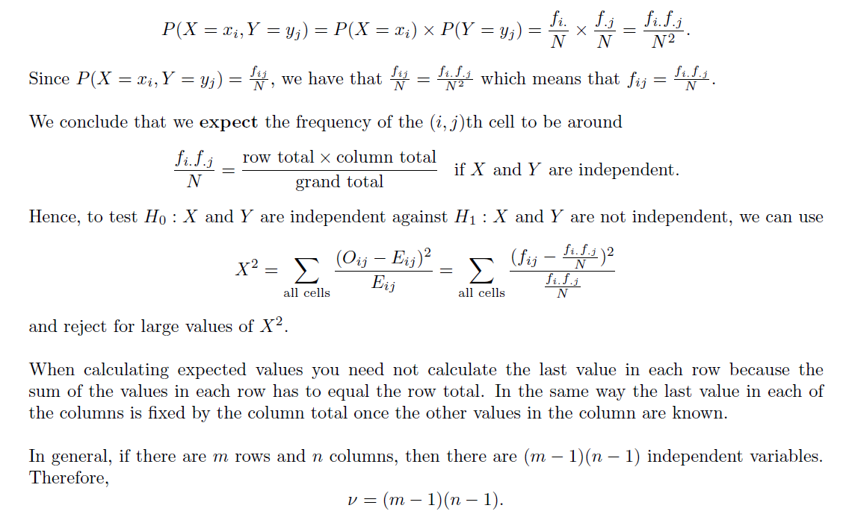

Slide 3
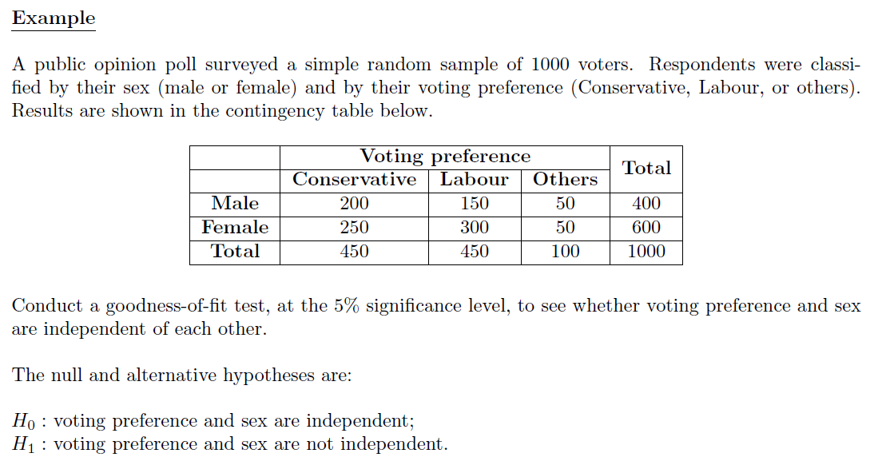

Slide 4
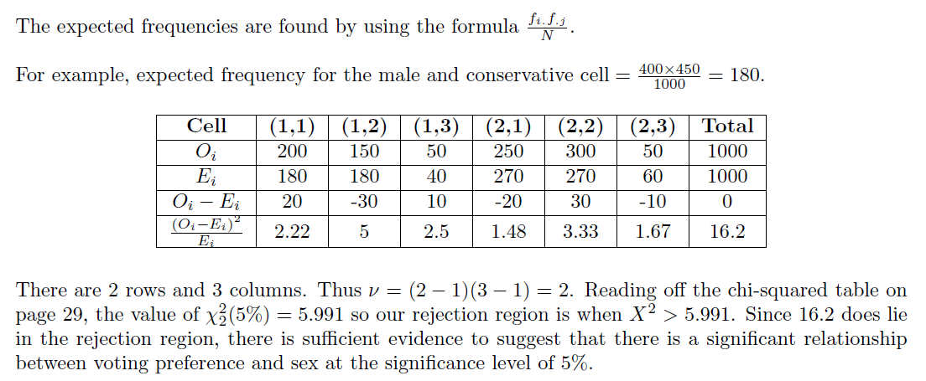

Slide 5
Exercise 6E
Pearson Further Statistics 1
Pages 116-119
Complete before the lesson Q1-2
In Class:
Green Q3-4
Amber Q5-8
Red Q9-12

