Slide 1
Year 1 Pure Mathematics
Differentiation
2nd Derivative
Chapter 12
(Part 3 of 6)

Slide 2
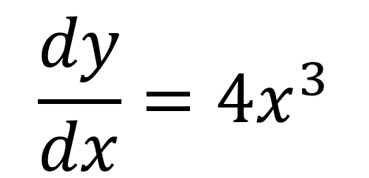
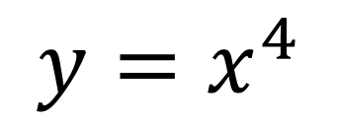
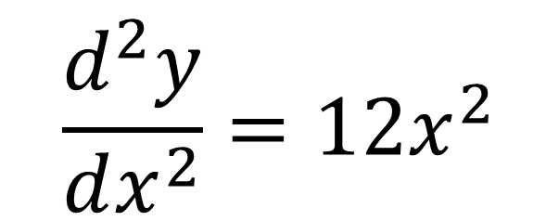
Second Order Derivatives
$$y=x^{4}$$
$$\frac{dy}{dx}=4x^{3}$$
First Derivative
$$\frac{d^{2}y}{dx^{2}}=12x^{2}$$
Second Derivative

Slide 3
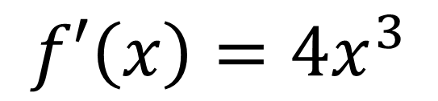
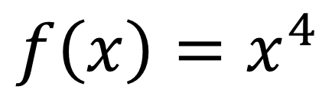
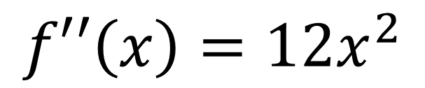
Second Order Derivatives
$$f\left(x\right)=x^{4}$$
$$f′\left(x\right)=4x^{3}$$
First Derivative
$$f′′\left(x\right)=12x^{2}$$
Second Derivative

Slide 4
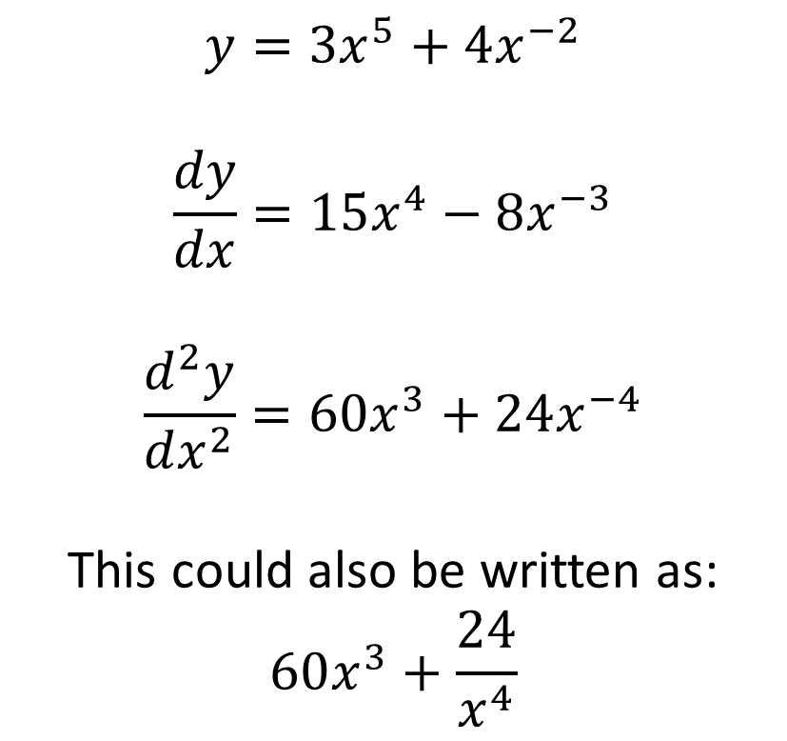
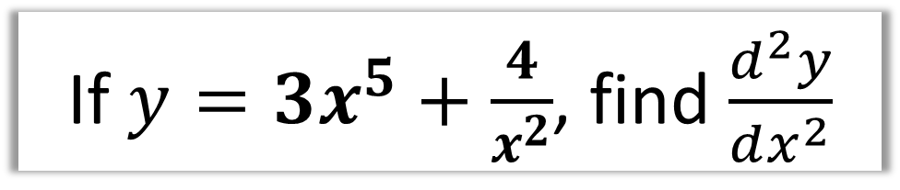
Second Order Derivatives
If $y=3x^{5}+\frac{4}{x^{2}}$, find $\frac{d^{2}y}{dx^{2}}$
$$y=3x^{5}+4x^{−2}$$
$$\frac{dy}{dx}=15x^{4}−8x^{−3}$$
$$\frac{d^{2}y}{dx^{2}}=60x^{3}+24x^{−4}$$
This could also be written as:
$$60x^{3}+\frac{24}{x^{4}}$$

Slide 5
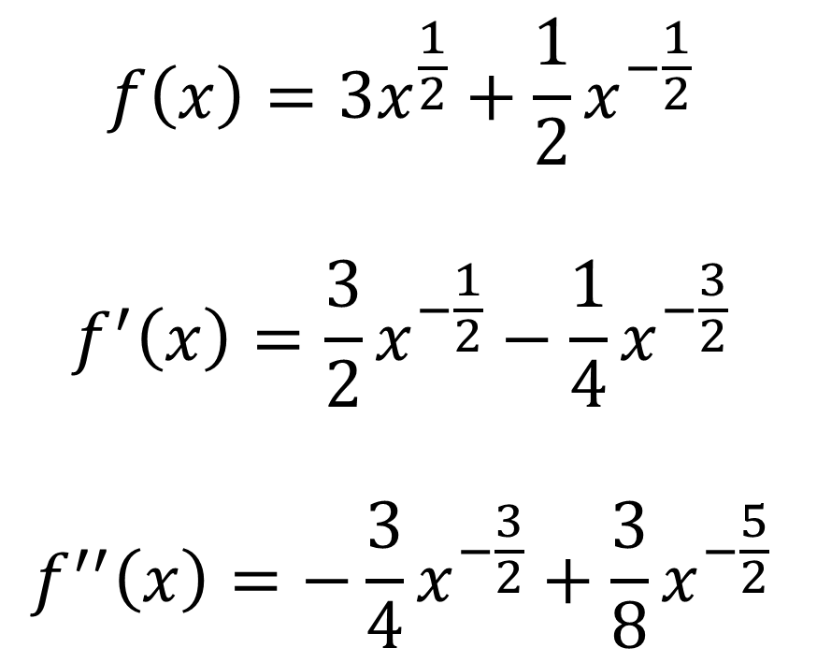
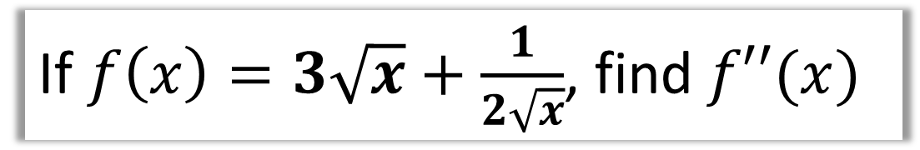
Second Order Derivatives
If $f\left(x\right)=3\sqrt{x}+\frac{1}{2\sqrt{x}}$, find $f′′(x)$
$$f\left(x\right)=3x^{\frac{1}{2}}+\frac{1}{2}x^{−\frac{1}{2}}$$
$$f^{′}\left(x\right)=\frac{3}{2}x^{−\frac{1}{2}}−\frac{1}{4}x^{−\frac{3}{2}}$$
$$f^{′′}\left(x\right)=−\frac{3}{4}x^{−\frac{3}{2}}+\frac{3}{8}x^{−\frac{5}{2}}$$

Slide 6


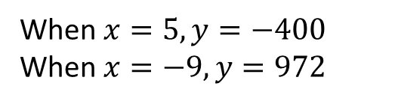
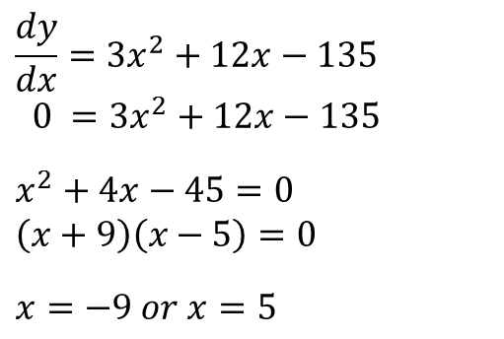


Stationary/Turning Points
A stationary point is where the gradient is 0.
Local maximum
$$f^{′}\left(x\right)=0$$
Local minimum
$$f^{′}\left(x\right)=0$$
Find the coordinates of the turning points of $y=x^{3}+6x^{2}−135x$
$$\frac{dy}{dx}=3x^{2}+12x−135$$
$$0 =3x^{2}+12x−135$$
$$x^{2}+4x−45=0 \\ \left(x+9\right)\left(x−5\right)=0$$
$$x=−9 or x=5$$
When $x=5, y=−400$
When $x=−9, y=972$
$$(−9 ,972)$$
$$\left(5 ,−400\right)$$

Slide 7
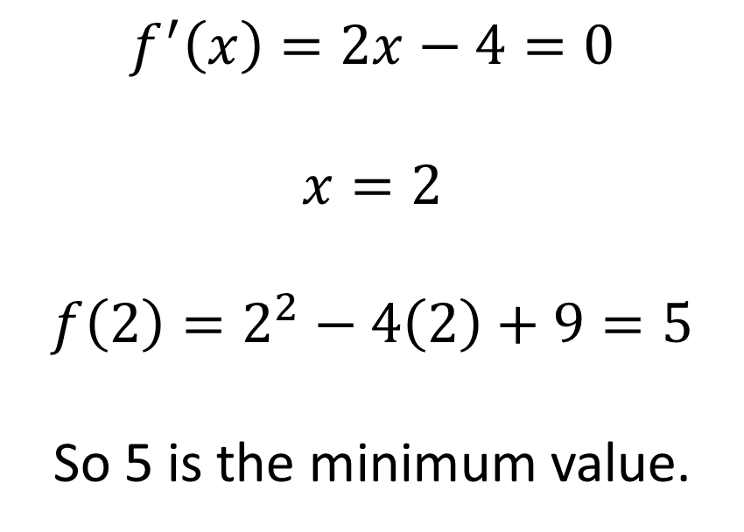
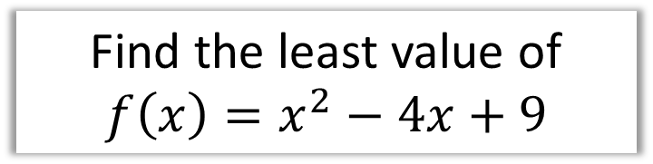
Stationary/Turning Points
Find the least value of
$$f\left(x\right)=x^{2}−4x+9$$
$$f^{′}\left(x\right)=2x−4=0$$
$$x=2$$
$$f\left(2\right)=2^{2}−4\left(2\right)+9=5$$
So 5 is the minimum value.

Slide 8


Stationary/Turning Points
Find the turning point of
$$y=\sqrt{x}−x$$
$$y=x^{\frac{1}{2}}−x$$
$$\frac{dy}{dx}=\frac{1}{2}x^{−\frac{1}{2}}−1$$
$\frac{1}{2}x^{−\frac{1}{2}}−1=0$
$$x=\frac{1}{4}$$
When $x=\frac{1}{4}$,
$$y=\sqrt{\frac{1}{4}}−\frac{1}{4}=\frac{1}{4}$$
So turning point is $\left(\frac{1}{4},\frac{1}{4}\right)$

Slide 9

Points of Inflection
There’s a third type of stationary point!
$$f^{′}\left(x\right)=0$$
A point of inflection is where the curve changes from convex to concave (or vice versa).
concave
convex

Slide 10
How do we tell what type of stationary point?
Look at gradient just before and just after point.
Local Maximum
Gradient just before | Gradient at maximum | Gradient just after
+ve | 0 | +ve
Point of Inflection
Gradient just before | Gradient at inflection | Gradient just after
+ve | 0 | +ve
Local Minimum
Gradient just before | Gradient at minimum | Gradient just after
-ve | 0 | +ve

Slide 11
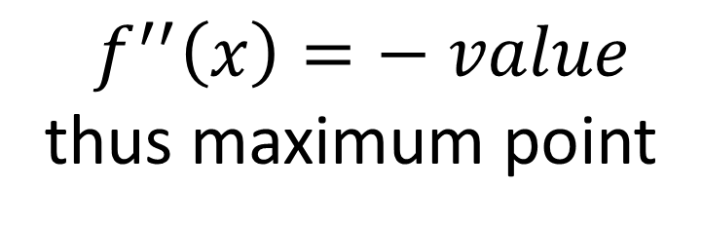
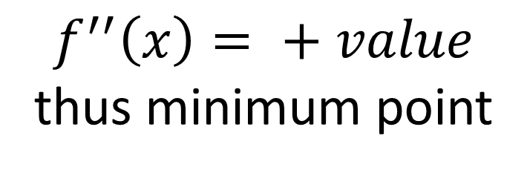
How do we tell what type of stationary point?
The second derivative tells us
the rate at what the gradient is changing.
Thus if the second derivative is positive,
the gradient is increasing.
$$f^{′′}\left(x\right)= + value$$
thus minimum point
If the second derivative is negative,
the gradient is decreasing.
$$f^{′′}\left(x\right)=− value$$
thus maximum point

Slide 12
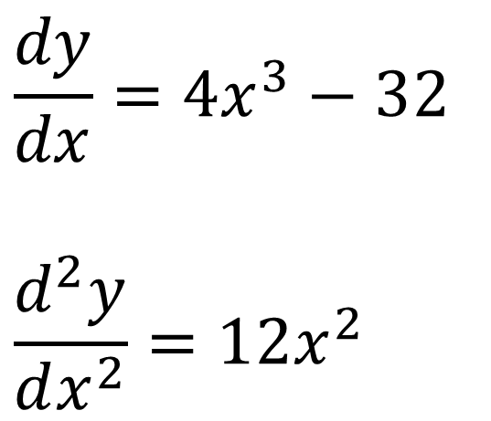
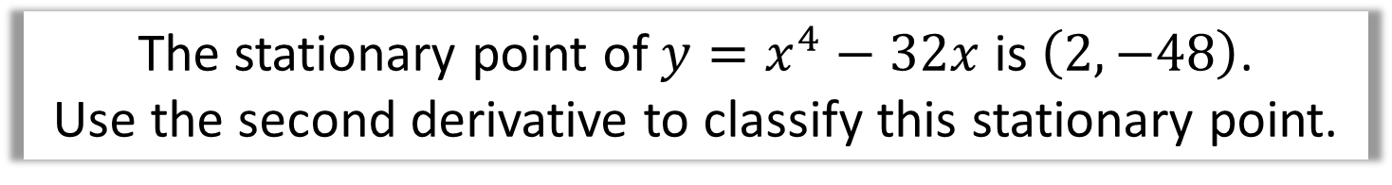
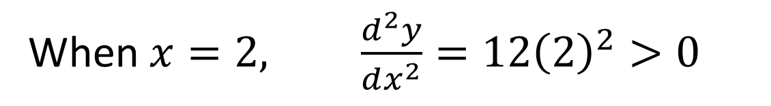
How do we tell what type of stationary point?
The stationary point of $y=x^{4}−32x$ is $\left(2,−48\right)$.
Use the second derivative to classify this stationary point.
$$\frac{dy}{dx}=4x^{3}−32$$
$$\frac{d^{2}y}{dx^{2}}=12x^{2}$$
When $x=2, \frac{d^{2}y}{dx^{2}}=12{\left(2\right)}^{2}>0$
Therefore the stationary point is a minimum point.

Slide 13
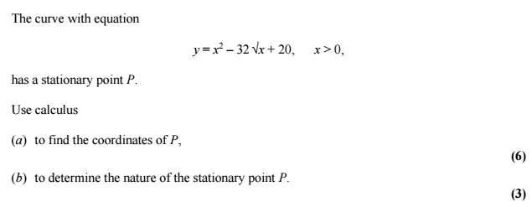
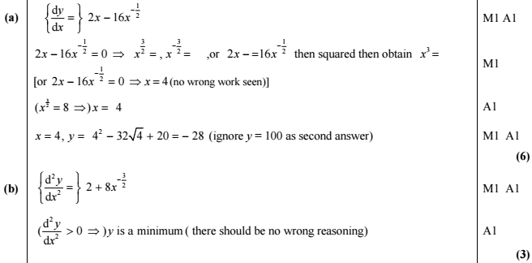
Stationary/Turning Points

Slide 14
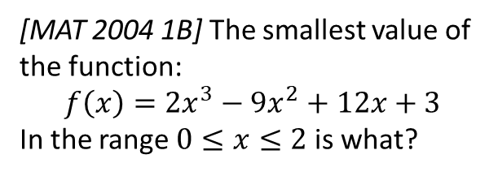
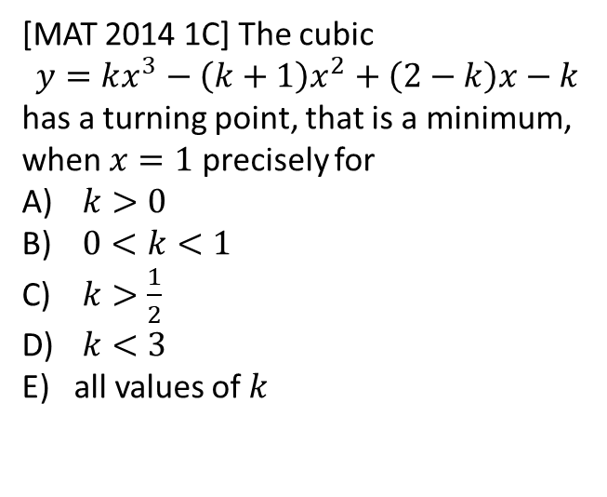
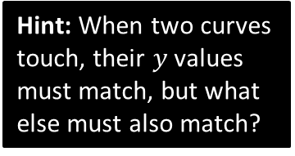
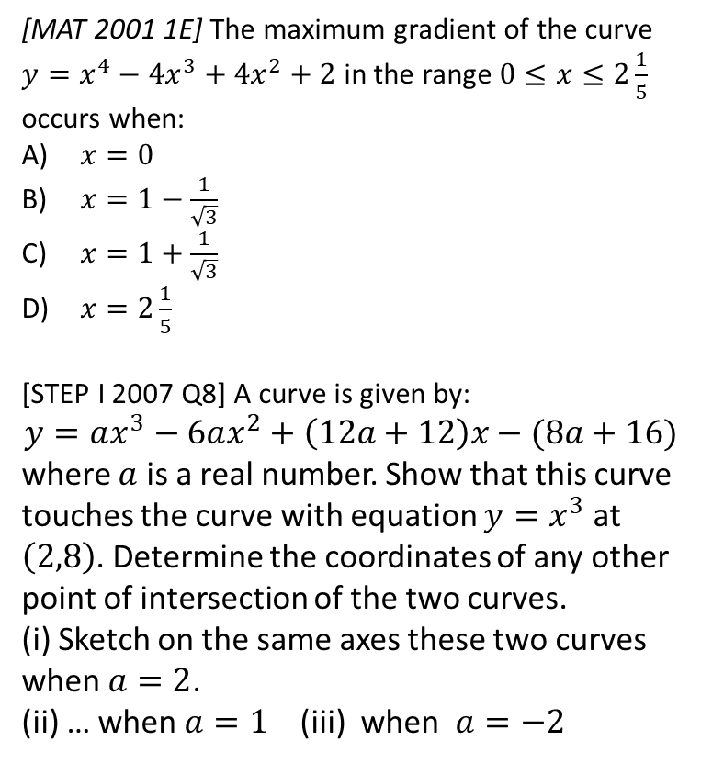
Exercise 12I
Complete before the lesson Q1
Green Q2
Amber Q3
Red
Pearson Pure Mathematics
Page 276
Extension
3
[MAT 2001 1E] The maximum gradient of the curve $y=x^{4}−4x^{3}+4x^{2}+2$ in the range $0≤x≤2\frac{1}{5}$ occurs when:
$x=0$
$x=1−\frac{1}{\sqrt{3}}$
$x=1+\frac{1}{\sqrt{3}}$
$x=2\frac{1}{5}$
[STEP I 2007 Q8] A curve is given by:
$$y=ax^{3}−6ax^{2}+\left(12a+12\right)x−(8a+16)$$
where $a$ is a real number. Show that this curve touches the curve with equation $y=x^{3}$ at $\left(2,8\right)$. Determine the coordinates of any other point of intersection of the two curves.
(i) Sketch on the same axes these two curves when $a=2$.
(ii) … when $a=1$ (iii) when $a=−2$
1
[MAT 2014 1C] The cubic
$$y=kx^{3}−\left(k+1\right)x^{2}+\left(2−k\right)x−k$$
has a turning point, that is a minimum, when $x=1$ precisely for
$k>0$
$0<k<1$
$k>\frac{1}{2}$
$k<3$
all values of $k$
Hint: When two curves touch, their $y$ values must match, but what else must also match?
4
2
[MAT 2004 1B] The smallest value of the function:
$$f\left(x\right)=2x^{3}−9x^{2}+12x+3$$
In the range $0≤x≤2$ is what?

