Slide 1
Year 1 Pure Mathematics
Circles
- Intersecting Lines
Chapter 6
(Part 4 of 5)

Slide 2
Intersections of Lines and Circles
How many times can a straight intersect a circle?
2 intersections
1 intersections
0 intersections

Slide 3
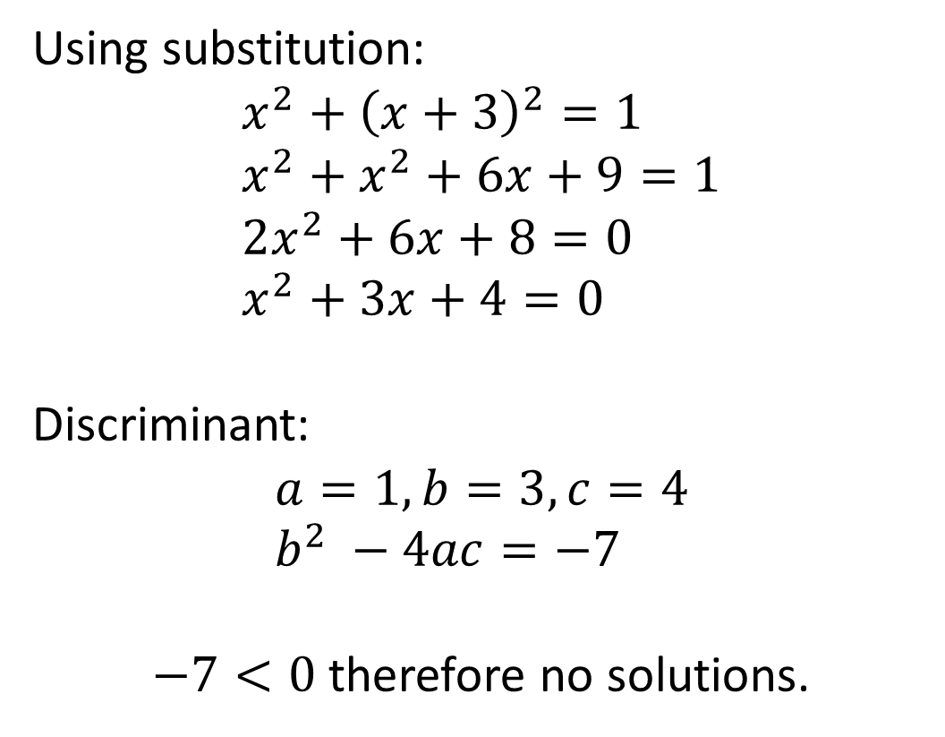
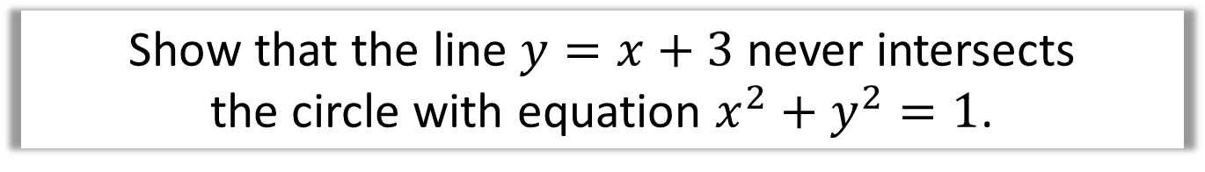
Intersections of Lines and Circles
Show that the line $y=x+3$ never intersects
the circle with equation $x^{2}+y^{2}=1$.
Using substitution:
$$x^{2}+{\left(x+3\right)}^{2}=1 \\ x^{2}+x^{2}+6x+9=1 \\ 2x^{2}+6x+8=0 \\ x^{2}+3x+4=0$$
Discriminant:
$$a=1, b=3, c=4 \\ b^{2} −4ac=−7$$
$−7<0$ therefore no solutions.

Slide 4
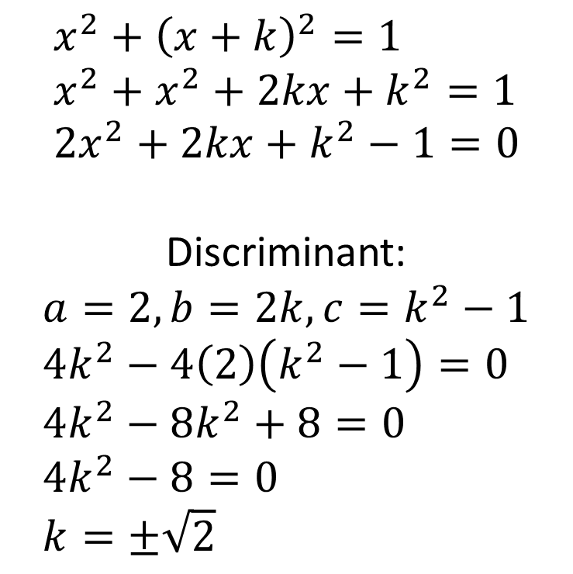
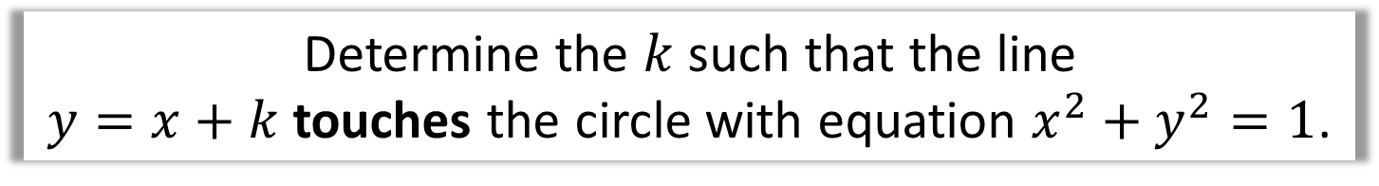
Intersections of Lines and Circles
Determine the $k$ such that the line
$y=x+k$ touches the circle with equation $x^{2}+y^{2}=1$.
$$x^{2}+{\left(x+k\right)}^{2}=1 \\ x^{2}+x^{2}+2kx+k^{2}=1 \\ 2x^{2}+2kx+k^{2}−1=0$$
Discriminant:
$$a=2, b=2k, c=k^{2}−1 \\ 4k^{2}−4\left(2\right)\left(k^{2}−1\right)=0 \\ 4k^{2}−8k^{2}+8=0 \\ 4k^{2}−8=0 \\ k=±\sqrt{2}$$

Slide 5
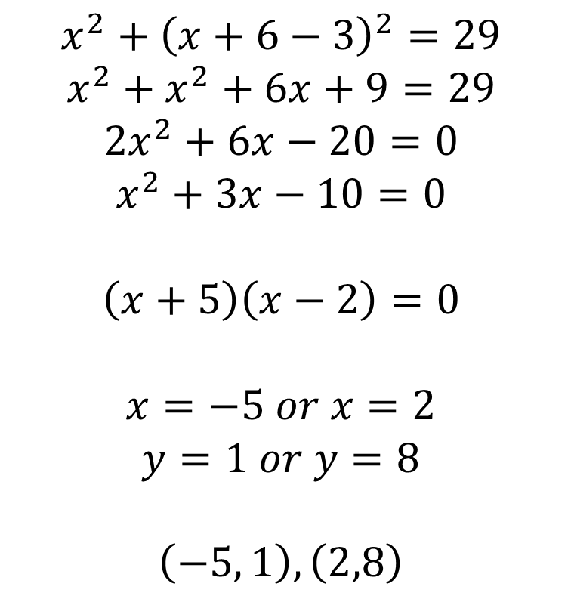

Intersections of Lines and Circles
Find the points of intersection where the line
$y=x+6$ meets $x^{2}+{\left(y−3\right)}^{2}=29$.
$$x^{2}+{\left(x+6−3\right)}^{2}=29 \\ x^{2}+x^{2}+6x+9=29 \\ 2x^{2}+6x−20=0 \\ x^{2}+3x−10=0$$
$$\left(x+5\right)\left(x−2\right)=0$$
$$x=−5 or x=2 \\ y=1 or y=8$$
$$\left(−5, 1\right), \left(2,8\right)$$

Slide 6
Tangents, Chords, Perpendicular Bisectors
tangent
perpendicular bisector
radius
chord
The tangent is
perpendicular to the radius (at the point of intersection).
The perpendicular bisector
of any chord passes through
the centre of the circle.

Slide 7
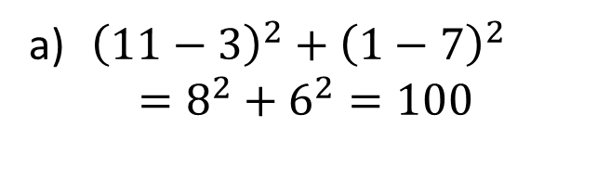
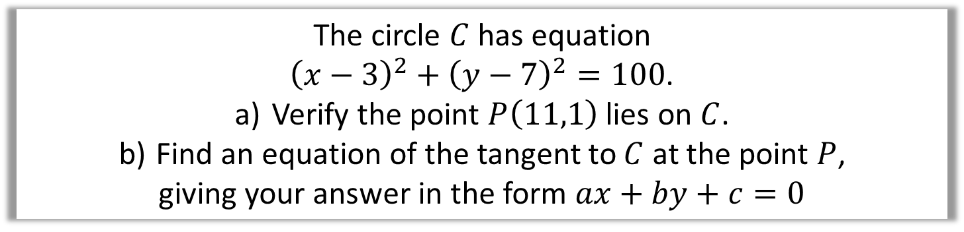
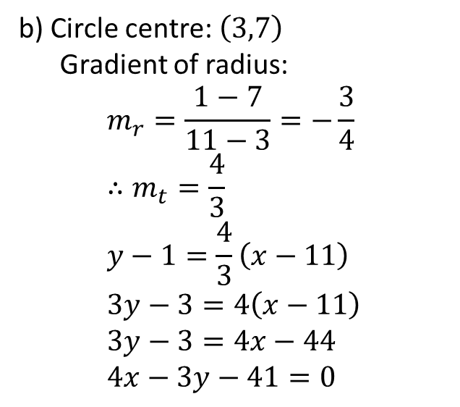
Tangents, Chords, Perpendicular Bisectors
The circle $C$ has equation
${\left(x−3\right)}^{2}+{\left(y−7\right)}^{2}=100$.
Verify the point $P\left(11,1\right)$ lies on $C$.
Find an equation of the tangent to $C$ at the point $P$,
giving your answer in the form $ax+by+c=0$
${\left(11−3\right)}^{2}+{\left(1−7\right)}^{2}$
$=8^{2}+6^{2}=100$
b) Circle centre: $\left(3,7\right)$
Gradient of radius:
$$m_{r}=\frac{1−7}{11−3}=−\frac{3}{4} \\ ∴m_{t}=\frac{4}{3} \\ y−1=\frac{4}{3}\left(x−11\right) \\ 3y−3=4\left(x−11\right) \\ 3y−3=4x−44 \\ 4x−3y−41=0$$

Slide 8
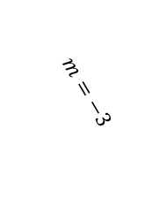
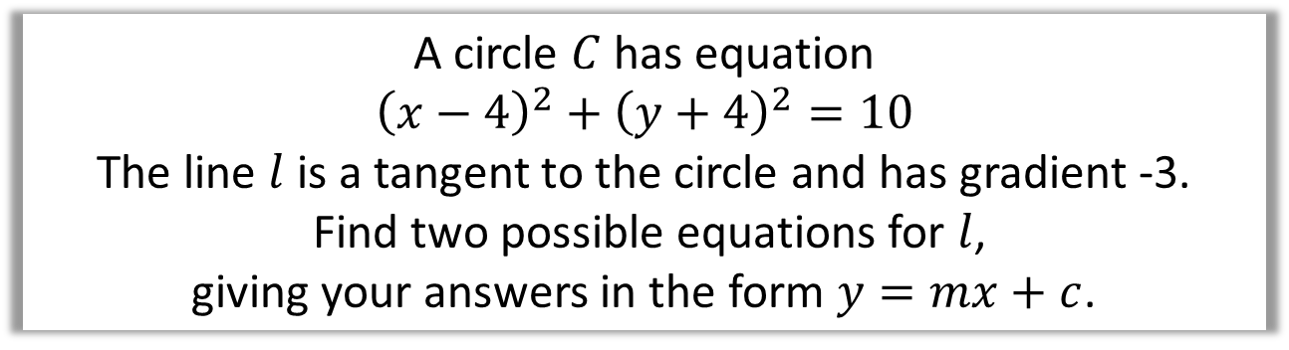
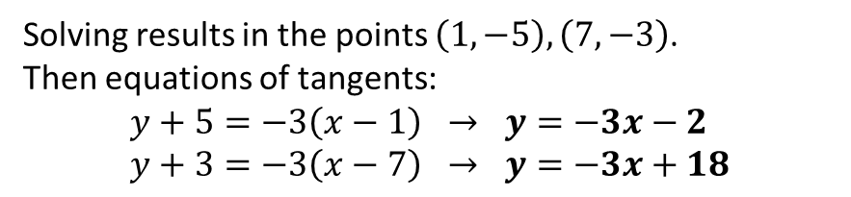
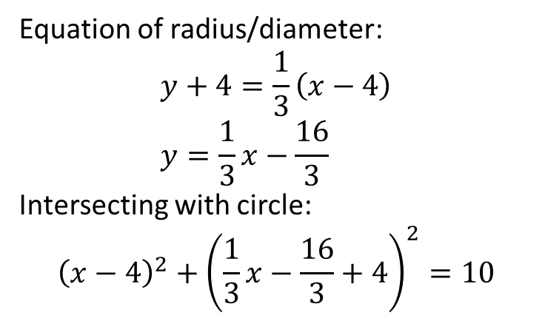

Tangents, Chords, Perpendicular Bisectors
A circle $C$ has equation
$${\left(x−4\right)}^{2}+{\left(y+4\right)}^{2}=10$$
The line $l$ is a tangent to the circle and has gradient -3.
Find two possible equations for $l$,
giving your answers in the form $y=mx+c$.
Equation of radius/diameter:
$$y+4=\frac{1}{3}\left(x−4\right) \\ y=\frac{1}{3}x−\frac{16}{3}$$
Intersecting with circle:
$${\left(x−4\right)}^{2}+{\left(\frac{1}{3}x−\frac{16}{3}+4\right)}^{2}=10$$
$$m=−3$$
$$\left(4,−4\right)$$
Solving results in the points $\left(1,−5\right), \left(7,−3\right)$.
Then equations of tangents:
$$y+5=−3\left(x−1\right) → y=−3x−2 \\ y+3=−3\left(x−7\right) → y=−3x+18$$

Slide 9
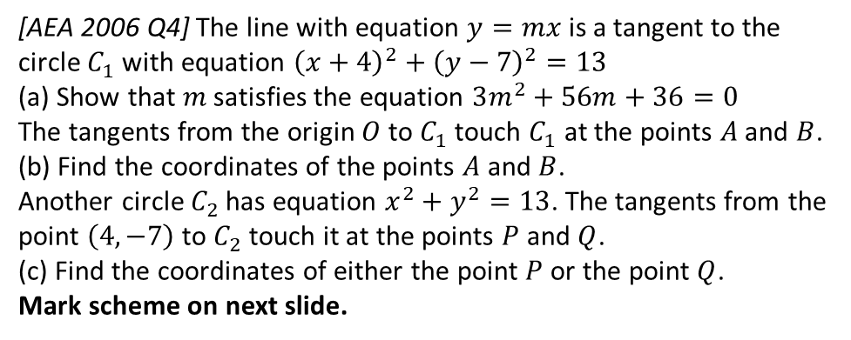

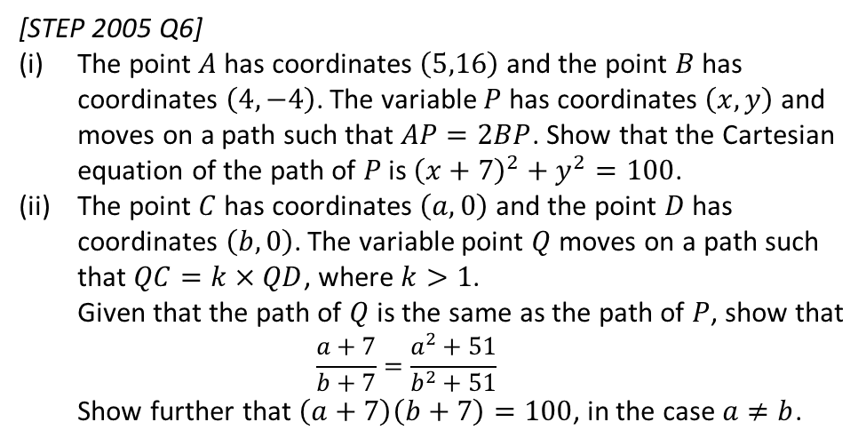
Exercise 6E
Complete before the lesson Q1-3
Green Q4-6
Amber Q7-9
Red Q10-11 & Challenge & Ext
Pearson Pure Mathematics Year 1/AS Pages 126-128
Extension:
2
[AEA 2006 Q4] The line with equation $y=mx$ is a tangent to the circle $C_{1}$ with equation ${\left(x+4\right)}^{2}+{\left(y−7\right)}^{2}=13$
(a) Show that $m$ satisfies the equation $3m^{2}+56m+36=0$
The tangents from the origin $O$ to $C_{1}$ touch $C_{1}$ at the points $A$ and $B$.
(b) Find the coordinates of the points $A$ and $B$.
Another circle $C_{2}$ has equation $x^{2}+y^{2}=13$. The tangents from the point $\left(4,−7\right)$ to $C_{2}$ touch it at the points $P$ and $Q$.
(c) Find the coordinates of either the point $P$ or the point $Q$.
Mark scheme on next slide.
1
[MAT 2012 1A] Which of the following lines is a tangent to the circle with equation
$x^{2}+y^{2}=4$?
$x+y=2$
$y=x−2\sqrt{2}$
$x=\sqrt{2}$
$y=\sqrt{2}−x$
Solution: B. Note that we could avoid using algebra by using a suitable diagram and simple use of Pythagoras to get the $y$-intercept.
(This is not a tangent/chord question but is worthwhile regardless!)
3
[STEP 2005 Q6]
The point $A$ has coordinates $\left(5,16\right)$ and the point $B$ has coordinates $\left(4,−4\right)$. The variable $P$ has coordinates $\left(x,y\right)$ and moves on a path such that $AP=2BP$. Show that the Cartesian equation of the path of $P$ is ${\left(x+7\right)}^{2}+y^{2}=100$.
The point $C$ has coordinates $\left(a,0\right)$ and the point $D$ has coordinates $\left(b,0\right)$. The variable point $Q$ moves on a path such that $QC=k×QD$, where $k>1$.
Given that the path of $Q$ is the same as the path of $P$, show that
$\frac{a+7}{b+7}=\frac{a^{2}+51}{b^{2}+51}$
Show further that $\left(a+7\right)\left(b+7\right)=100$, in the case $a≠b$.
?
Mark scheme on next slide.

