Slide 1


Matrices
$$\left|\begin{matrix}a & b & c \\ d & e & f \\ g & h & i\end{matrix}\right|=a\left|\begin{matrix}e & f \\ h & i\end{matrix}\right|−b\left|\begin{matrix}d & f \\ g & i\end{matrix}\right|+c\left|\begin{matrix}d & e \\ g & h\end{matrix}\right|$$
$$\left|\begin{matrix}a & b \\ c & d\end{matrix}\right|=ad−bc$$
You need to be able to find the inverse of a 3x3 Matrix
This consists of a number of steps. Although your calculator can do this, if the Matrix contains unknowns then you will need to follow the steps…
You also need to know some key definitions which we will see as we go through the steps…
6E

Slide 2
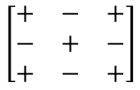
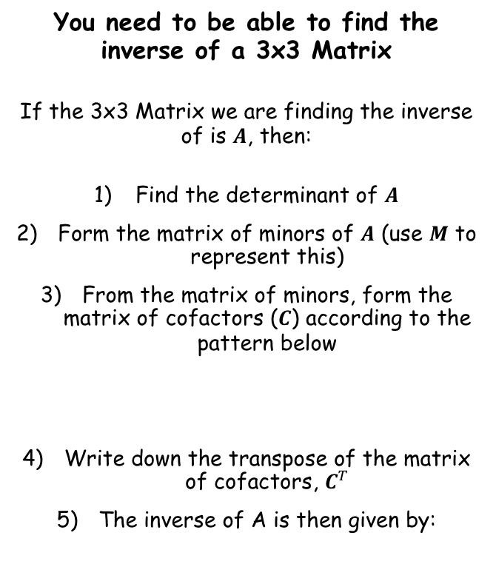
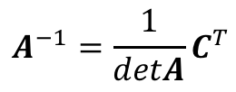
Matrices
$$\left|\begin{matrix}a & b & c \\ d & e & f \\ g & h & i\end{matrix}\right|=a\left|\begin{matrix}e & f \\ h & i\end{matrix}\right|−b\left|\begin{matrix}d & f \\ g & i\end{matrix}\right|+c\left|\begin{matrix}d & e \\ g & h\end{matrix}\right|$$
$$\left|\begin{matrix}a & b \\ c & d\end{matrix}\right|=ad−bc$$
You need to be able to find the inverse of a 3x3 Matrix
If the 3x3 Matrix we are finding the inverse of is $A$, then:
Find the determinant of $A$
Form the matrix of minors of $A$ (use $M$ to represent this)
From the matrix of minors, form the matrix of cofactors ($C$) according to the pattern below
Write down the transpose of the matrix of cofactors, $C^{T}$
The inverse of A is then given by:
$$\left[\begin{matrix}+ & − & + \\ − & + & − \\ + & − & +\end{matrix}\right]$$
$$A^{−1}=\frac{1}{detA}C^{T}$$
6E

Slide 3




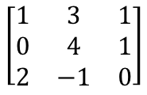


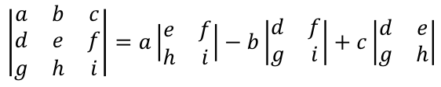
Matrices
$$\left|\begin{matrix}a & b & c \\ d & e & f \\ g & h & i\end{matrix}\right|=a\left|\begin{matrix}e & f \\ h & i\end{matrix}\right|−b\left|\begin{matrix}d & f \\ g & i\end{matrix}\right|+c\left|\begin{matrix}d & e \\ g & h\end{matrix}\right|$$
$$\left|\begin{matrix}a & b \\ c & d\end{matrix}\right|=ad−bc$$
You need to be able to find the inverse of a 3x3 Matrix
If the 3x3 Matrix we are finding the inverse of is $A$, then:
Find the determinant of $A$
Form the matrix of minors of $A$ (use $M$ to represent this)
From the matrix of minors, form the matrix of cofactors ($C$) according to the pattern below
Write down the transpose of the matrix of cofactors, $C^{T}$
The inverse of A is then given by:
$$\left[\begin{matrix}1 & 3 & 1 \\ 0 & 4 & 1 \\ 2 & −1 & 0\end{matrix}\right]$$
Given that the Matrix $A=$
, find $A^{−1}$
$$\left|\begin{matrix}a & b & c \\ d & e & f \\ g & h & i\end{matrix}\right|=a\left|\begin{matrix}e & f \\ h & i\end{matrix}\right|−b\left|\begin{matrix}d & f \\ g & i\end{matrix}\right|+c\left|\begin{matrix}d & e \\ g & h\end{matrix}\right|$$
$$detA=−1$$
Replace values
$$=1\left|\begin{matrix}4 & 1 \\ −1 & 0\end{matrix}\right|−3\left|\begin{matrix}0 & 1 \\ 2 & 0\end{matrix}\right|+1\left|\begin{matrix}0 & 4 \\ 2 & −1\end{matrix}\right|$$
Calculate each determinant
$$=1\left(0+1\right)−3\left(0−2\right)+1(0−8)$$
$$\left[\begin{matrix}+ & − & + \\ − & + & − \\ + & − & +\end{matrix}\right]$$
Calculate
$$=−1$$
$$A^{−1}=\frac{1}{detA}C^{T}$$
6E

Slide 4


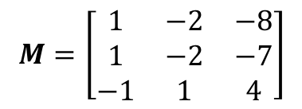








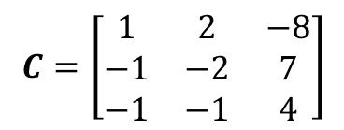
Matrices
$$\left|\begin{matrix}a & b & c \\ d & e & f \\ g & h & i\end{matrix}\right|=a\left|\begin{matrix}e & f \\ h & i\end{matrix}\right|−b\left|\begin{matrix}d & f \\ g & i\end{matrix}\right|+c\left|\begin{matrix}d & e \\ g & h\end{matrix}\right|$$
$$\left|\begin{matrix}a & b \\ c & d\end{matrix}\right|=ad−bc$$
You need to be able to find the inverse of a 3x3 Matrix
If the 3x3 Matrix we are finding the inverse of is $A$, then:
Find the determinant of $A$
Form the matrix of minors of $A$ (use $M$ to represent this)
From the matrix of minors, form the matrix of cofactors ($C$) according to the pattern below
Write down the transpose of the matrix of cofactors, $C^{T}$
The inverse of A is then given by:
$$\left[\begin{matrix}1 & 3 & 1 \\ 0 & 4 & 1 \\ 2 & −1 & 0\end{matrix}\right]$$
Given that the Matrix $A=$
, find $A^{−1}$
$$\left|\begin{matrix}4 & 1 \\ −1 & 0\end{matrix}\right|$$
$$\left|\begin{matrix}0 & 1 \\ 2 & 0\end{matrix}\right|$$
$$\left|\begin{matrix}0 & 4 \\ 2 & −1\end{matrix}\right|$$
$$detA=−1$$
$$\left|\begin{matrix}3 & 1 \\ −1 & 0\end{matrix}\right|$$
$$\left|\begin{matrix}1 & 1 \\ 2 & 0\end{matrix}\right|$$
$$\left|\begin{matrix}1 & 3 \\ 2 & −1\end{matrix}\right|$$
$$\left|\begin{matrix}3 & 1 \\ 4 & 1\end{matrix}\right|$$
$$\left|\begin{matrix}1 & 1 \\ 0 & 1\end{matrix}\right|$$
$$\left|\begin{matrix}1 & 3 \\ 0 & 4\end{matrix}\right|$$
Calculate determinants
$$M=\left[\begin{matrix}1 & −2 & −8 \\ 1 & −2 & −7 \\ −1 & 1 & 4\end{matrix}\right]$$
$$\left[\begin{matrix}+ & − & + \\ − & + & − \\ + & − & +\end{matrix}\right]$$
Form the matrix of cofactors
$$C=\left[\begin{matrix}1 & 2 & −8 \\ −1 & −2 & 7 \\ −1 & −1 & 4\end{matrix}\right]$$
$$A^{−1}=\frac{1}{detA}C^{T}$$
6E

Slide 5
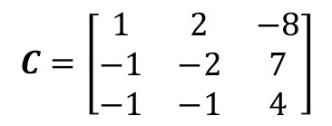

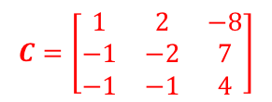


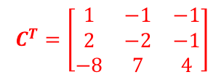
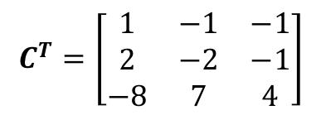
Matrices
$$\left|\begin{matrix}a & b & c \\ d & e & f \\ g & h & i\end{matrix}\right|=a\left|\begin{matrix}e & f \\ h & i\end{matrix}\right|−b\left|\begin{matrix}d & f \\ g & i\end{matrix}\right|+c\left|\begin{matrix}d & e \\ g & h\end{matrix}\right|$$
$$\left|\begin{matrix}a & b \\ c & d\end{matrix}\right|=ad−bc$$
You need to be able to find the inverse of a 3x3 Matrix
If the 3x3 Matrix we are finding the inverse of is $A$, then:
Find the determinant of $A$
Form the matrix of minors of $A$ (use $M$ to represent this)
From the matrix of minors, form the matrix of cofactors ($C$) according to the pattern below
Write down the transpose of the matrix of cofactors, $C^{T}$
The inverse of A is then given by:
$$\left[\begin{matrix}1 & 3 & 1 \\ 0 & 4 & 1 \\ 2 & −1 & 0\end{matrix}\right]$$
Given that the Matrix $A=$
, find $A^{−1}$
$$detA=−1$$
$$C=\left[\begin{matrix}1 & 2 & −8 \\ −1 & −2 & 7 \\ −1 & −1 & 4\end{matrix}\right]$$
Write down the transpose by swapping rows and columns
$$C^{T}=\left[\begin{matrix}1 & −1 & −1 \\ 2 & −2 & −1 \\ −8 & 7 & 4\end{matrix}\right]$$
$$C=\left[\begin{matrix}1 & 2 & −8 \\ −1 & −2 & 7 \\ −1 & −1 & 4\end{matrix}\right]$$
$$C^{T}=\left[\begin{matrix}1 & −1 & −1 \\ 2 & −2 & −1 \\ −8 & 7 & 4\end{matrix}\right]$$
$$\left[\begin{matrix}+ & − & + \\ − & + & − \\ + & − & +\end{matrix}\right]$$
The transpose of a Matrix is created by interchanging the rows and columns
$$\left[\begin{matrix}1 & 4 \\ 2 & 3\end{matrix}\right]$$
$$\left[\begin{matrix}1 & 2 \\ 4 & 3\end{matrix}\right]$$
$$A^{−1}=\frac{1}{detA}C^{T}$$
The transpose of Matrix $M$ is written as $M^{T}$
6E

Slide 6
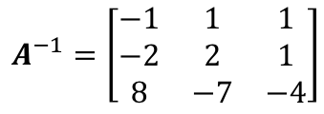
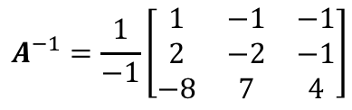

Matrices
$$\left|\begin{matrix}a & b & c \\ d & e & f \\ g & h & i\end{matrix}\right|=a\left|\begin{matrix}e & f \\ h & i\end{matrix}\right|−b\left|\begin{matrix}d & f \\ g & i\end{matrix}\right|+c\left|\begin{matrix}d & e \\ g & h\end{matrix}\right|$$
$$\left|\begin{matrix}a & b \\ c & d\end{matrix}\right|=ad−bc$$
You need to be able to find the inverse of a 3x3 Matrix
If the 3x3 Matrix we are finding the inverse of is $A$, then:
Find the determinant of $A$
Form the matrix of minors of $A$ (use $M$ to represent this)
From the matrix of minors, form the matrix of cofactors ($C$) according to the pattern below
Write down the transpose of the matrix of cofactors, $C^{T}$
The inverse of A is then given by:
$$\left[\begin{matrix}1 & 3 & 1 \\ 0 & 4 & 1 \\ 2 & −1 & 0\end{matrix}\right]$$
Given that the Matrix $A=$
, find $A^{−1}$
$$detA=−1$$
$$A^{−1}=\frac{1}{detA}C^{T}$$
Replace both
$$A^{−1}=\frac{1}{−1}\left[\begin{matrix}1 & −1 & −1 \\ 2 & −2 & −1 \\ −8 & 7 & 4\end{matrix}\right]$$
Multiply by the fraction value outside
$$A^{−1}=\left[\begin{matrix}−1 & 1 & 1 \\ −2 & 2 & 1 \\ 8 & −7 & −4\end{matrix}\right]$$
$$C^{T}=\left[\begin{matrix}1 & −1 & −1 \\ 2 & −2 & −1 \\ −8 & 7 & 4\end{matrix}\right]$$
$$\left[\begin{matrix}+ & − & + \\ − & + & − \\ + & − & +\end{matrix}\right]$$
Remember that although your calculator can do this, you need to know the steps if you get an algebraic version
(see example 18 in the textbook!)
$$A^{−1}=\frac{1}{detA}C^{T}$$
6E

Slide 7













Matrices
$$\left|\begin{matrix}a & b & c \\ d & e & f \\ g & h & i\end{matrix}\right|=a\left|\begin{matrix}e & f \\ h & i\end{matrix}\right|−b\left|\begin{matrix}d & f \\ g & i\end{matrix}\right|+c\left|\begin{matrix}d & e \\ g & h\end{matrix}\right|$$
$${\left(PQ\right)}^{−1}={Q^{−1}P}^{−1}$$
$$\left|\begin{matrix}a & b \\ c & d\end{matrix}\right|=ad−bc$$
You need to be able to find the inverse of a 3x3 Matrix
The matrices $P$ and $Q$ are non-singular. Prove that ${\left(PQ\right)}^{−1}=Q^{−1}P^{−1}$.
Start by letting $C={\left(PQ\right)}^{−1}$
$$C={\left(PQ\right)}^{−1}$$
Multiply both sides by $PQ$ (at the start)
$$(PQ)C=(PQ){\left(PQ\right)}^{−1}$$
The right hand side is the identity matrix
$$PQC=I$$
Multiply both sides by $P^{−1}$ at the start
$$P^{−1}PQC=P^{−1}I$$
There will be some terms which we can eliminate
$$QC=P^{−1}$$
Multiply both sides by $Q^{−1}$ at the start
$$Q^{−1}QC={Q^{−1}P}^{−1}$$
We can simplify
$$C={Q^{−1}P}^{−1}$$
Replace C with the initial assumption
$${\left(PQ\right)}^{−1}={Q^{−1}P}^{−1}$$
This is a useful result that you should learn!
6E

Slide 8


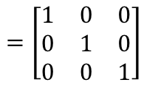
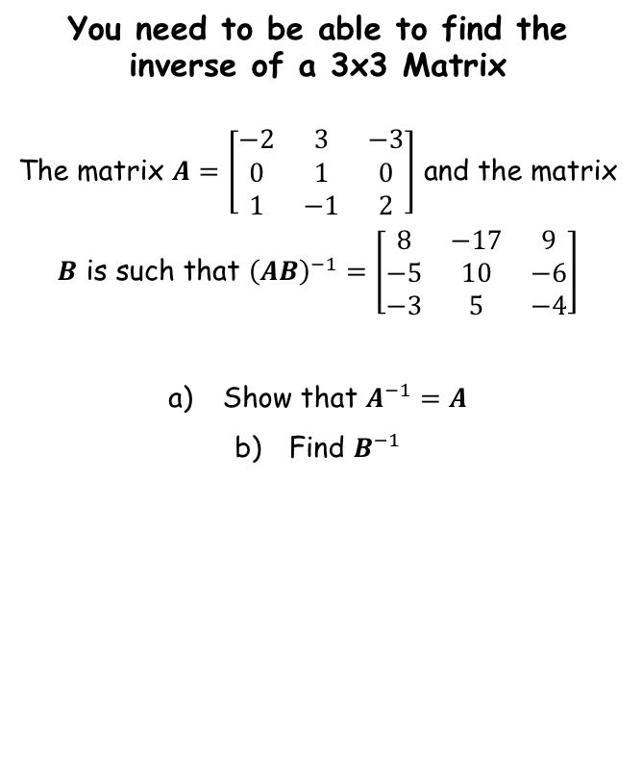

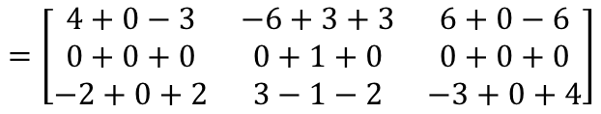

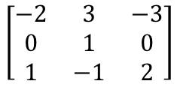
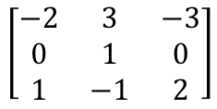
Matrices
$$\left|\begin{matrix}a & b & c \\ d & e & f \\ g & h & i\end{matrix}\right|=a\left|\begin{matrix}e & f \\ h & i\end{matrix}\right|−b\left|\begin{matrix}d & f \\ g & i\end{matrix}\right|+c\left|\begin{matrix}d & e \\ g & h\end{matrix}\right|$$
$${\left(PQ\right)}^{−1}={Q^{−1}P}^{−1}$$
$$\left|\begin{matrix}a & b \\ c & d\end{matrix}\right|=ad−bc$$
You need to be able to find the inverse of a 3x3 Matrix
The matrix $A=\left[\begin{matrix}−2 & 3 & −3 \\ 0 & 1 & 0 \\ 1 & −1 & 2\end{matrix}\right]$ and the matrix
$B$ is such that ${\left(AB\right)}^{−1}=\left[\begin{matrix}8 & −17 & 9 \\ −5 & 10 & −6 \\ −3 & 5 & −4\end{matrix}\right]$
Show that $A^{−1}=A$
Find $B^{−1}$
$$A^{−1}=A$$
Multiply both sides by A at the start
$${AA}^{−1}=AA$$
Rewrite both sides
$$I=A^{2}$$
So we can prove the initial statement by showing that $A^{2}=I$
$$\left[\begin{matrix}−2 & 3 & −3 \\ 0 & 1 & 0 \\ 1 & −1 & 2\end{matrix}\right]$$
$$\left[\begin{matrix}−2 & 3 & −3 \\ 0 & 1 & 0 \\ 1 & −1 & 2\end{matrix}\right]$$
Calculate each part
$$=\left[\begin{matrix}4+0−3 & −6+3+3 & 6+0−6 \\ 0+0+0 & 0+1+0 & 0+0+0 \\ −2+0+2 & 3−1−2 & −3+0+4\end{matrix}\right]$$
Simplify
$$=\left[\begin{matrix}1 & 0 & 0 \\ 0 & 1 & 0 \\ 0 & 0 & 1\end{matrix}\right]$$
6E

Slide 9
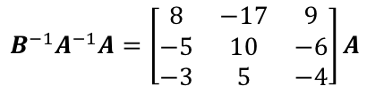
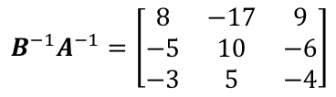
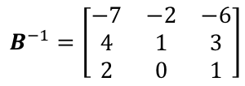
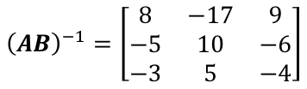

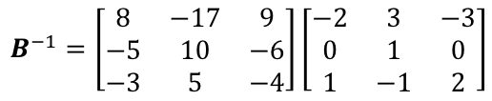
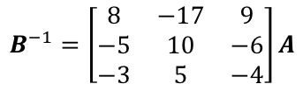
Matrices
$$\left|\begin{matrix}a & b & c \\ d & e & f \\ g & h & i\end{matrix}\right|=a\left|\begin{matrix}e & f \\ h & i\end{matrix}\right|−b\left|\begin{matrix}d & f \\ g & i\end{matrix}\right|+c\left|\begin{matrix}d & e \\ g & h\end{matrix}\right|$$
$${\left(PQ\right)}^{−1}={Q^{−1}P}^{−1}$$
$$\left|\begin{matrix}a & b \\ c & d\end{matrix}\right|=ad−bc$$
You need to be able to find the inverse of a 3x3 Matrix
The matrix $A=\left[\begin{matrix}−2 & 3 & −3 \\ 0 & 1 & 0 \\ 1 & −1 & 2\end{matrix}\right]$ and the matrix
$B$ is such that ${\left(AB\right)}^{−1}=\left[\begin{matrix}8 & −17 & 9 \\ −5 & 10 & −6 \\ −3 & 5 & −4\end{matrix}\right]$
Show that $A^{−1}=A$
Find $B^{−1}$
$${\left(AB\right)}^{−1}=\left[\begin{matrix}8 & −17 & 9 \\ −5 & 10 & −6 \\ −3 & 5 & −4\end{matrix}\right]$$
You can use the result above to rewrite the left side
$$B^{−1}A^{−1}=\left[\begin{matrix}8 & −17 & 9 \\ −5 & 10 & −6 \\ −3 & 5 & −4\end{matrix}\right]$$
Multiply by $A$ at the ends
$$B^{−1}A^{−1}A=\left[\begin{matrix}8 & −17 & 9 \\ −5 & 10 & −6 \\ −3 & 5 & −4\end{matrix}\right]A$$
We can simplify the left side
$$B^{−1}=\left[\begin{matrix}8 & −17 & 9 \\ −5 & 10 & −6 \\ −3 & 5 & −4\end{matrix}\right]A$$
Write in Matrix A
$$B^{−1}=\left[\begin{matrix}8 & −17 & 9 \\ −5 & 10 & −6 \\ −3 & 5 & −4\end{matrix}\right]\left[\begin{matrix}−2 & 3 & −3 \\ 0 & 1 & 0 \\ 1 & −1 & 2\end{matrix}\right]$$
You can do the multiplication
$$B^{−1}=\left[\begin{matrix}−7 & −2 & −6 \\ 4 & 1 & 3 \\ 2 & 0 & 1\end{matrix}\right]$$
6E

Slide 10
Exercise 6E
Pearson Further Core Mathematics Year 1/AS
Complete before the lesson Q1-3
In Class:
Green Q4&5
Amber Q6-8
Red Q9-10

