Slide 1
Year 1 Pure Mathematics
Straight Line Graphs
- Area of Shapes
Chapter 5
(Part 4 of 5)

Slide 2




Area of Shapes
$$y$$
8
Height
$$x$$
$$O$$
$$10$$
Base

Slide 3


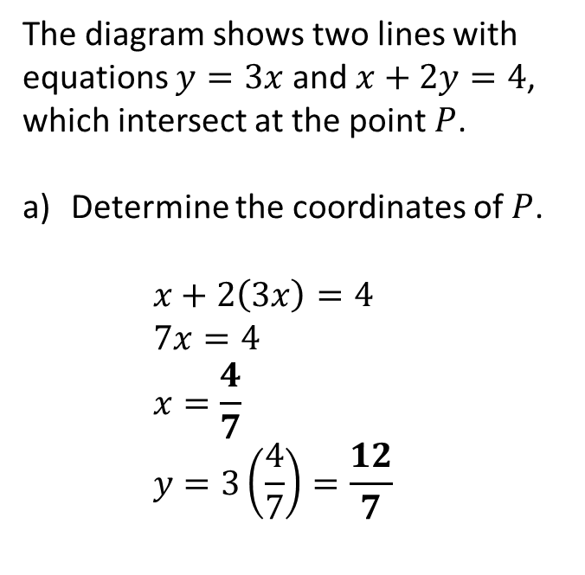
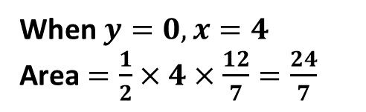

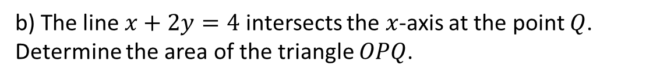

Area of Shapes
The diagram shows two lines with equations $y=3x$ and $x+2y=4$, which intersect at the point $P$.
Determine the coordinates of $P$.
$x+2\left(3x\right)=4$
$7x=4$
$x=\frac{4}{7}$
$y=3\left(\frac{4}{7}\right)=\frac{12}{7}$
$$y$$
$$y=3x$$
$$P$$
$$x+2y=4$$
$$x$$
$$O$$
$$Q$$
b) The line $x+2y=4$ intersects the $x$-axis at the point $Q$.
Determine the area of the triangle $OPQ$.
When $y=0, x=4$
Area $=\frac{1}{2}×4×\frac{12}{7}=\frac{24}{7}$

Slide 4



Area of Shapes
$$y$$
$$7$$
Base
$$4$$
Height
$$x$$
$$O$$
$$6$$

Slide 5


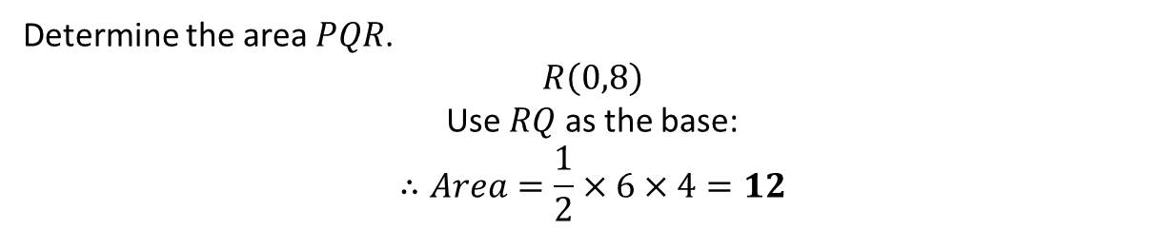



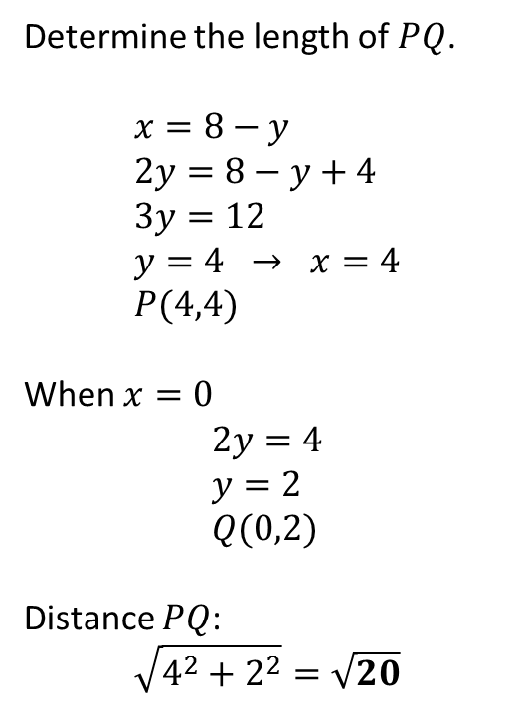
Area of Shapes
a
Determine the length of $PQ$.
$$x=8−y \\ 2y=8−y+4 \\ 3y=12 \\ y=4 → x=4 \\ P(4,4)$$
When $x=0$
$$2y=4 \\ y=2 \\ Q(0,2)$$
Distance $PQ$:
$$\sqrt{4^{2}+2^{2}}=\sqrt{20}$$
$$y$$
$$2y=x+4$$
$$R$$
$$P$$
$$Q$$
$$x+y=8$$
$$x$$
$$O$$
b
Determine the area $PQR$.
$$R\left(0,8\right)$$
Use $RQ$ as the base:
$$∴Area=\frac{1}{2}×6×4=12$$

Slide 6






Area of Shapes
$$y$$
$$8$$
Height
Base
$$O$$
$$x$$
$$12$$
$$−3$$

Slide 7






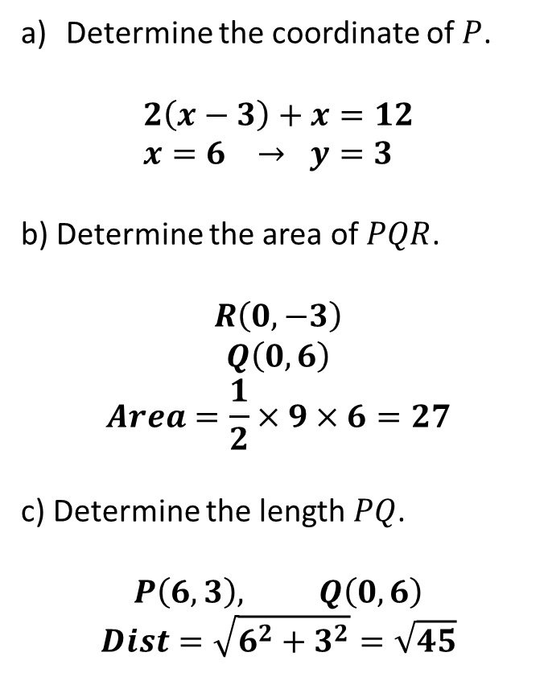
Area of Shapes
$$y$$
Determine the coordinate of $P$.
$$2\left(x−3\right)+x=12 \\ x=6 → y=3$$
b) Determine the area of $PQR$.
$$R\left(0,−3\right) \\ Q\left(0,6\right) \\ Area=\frac{1}{2}×9×6=27$$
c) Determine the length $PQ$.
$$P\left(6,3\right), Q\left(0,6\right) \\ Dist=\sqrt{6^{2}+3^{2}}=\sqrt{45}$$
$$Q$$
$$2y+x=12$$
$$y=x−3$$
$$P$$
$$O$$
$$x$$
$$R$$

Slide 8
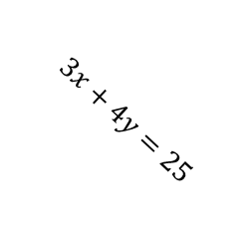


Exercise 5G
Complete before the lesson Q1-3
Green Q4-7
Amber Q8-10
Red Q11-12 & Ext
Pearson Pure Mathematics Year 1/AS Page 102-103
Extension Problems
1
[MAT 2001 1C]
The shortest distance from the origin to the line $3x+4y=25$ is what?
Gradient of $3x+4y=25$ is $−\frac{3}{4}$. Therefore gradient of line going through origin and closest point is $\frac{4}{3}$ (see diagram). This line therefore has equation $y=\frac{4}{3}x$
Solving two equations simultaneously, we get point of intersection $A(3,4)$.
Therefore distance $OA=\sqrt{3^{2}+4^{2}}=5$.
?
$$3x+4y=25$$
$$\left(0,0\right)$$

