Slide 1
Year 2 Pure Mathematics
Sequences and Series
- Recurrence Relations
Chapter 3
(Part 7 of 7)

Slide 2
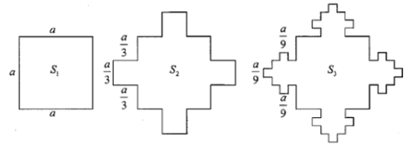
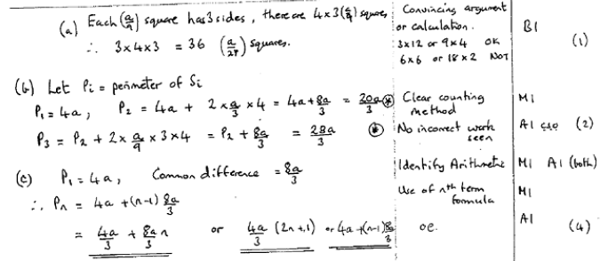
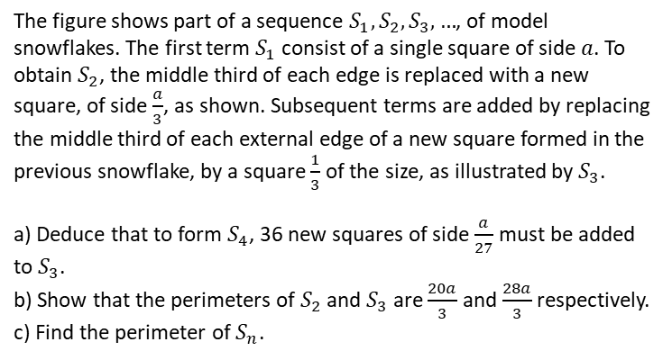
Exercise 3I
Pearson Pure Mathematics Year 2/AS
Pages 84-86
Extension
The figure shows part of a sequence $S_{1}, S_{2}, S_{3},…$, of model snowflakes. The first term $S_{1}$ consist of a single square of side $a$. To obtain $S_{2}$, the middle third of each edge is replaced with a new square, of side $\frac{a}{3}$, as shown. Subsequent terms are added by replacing the middle third of each external edge of a new square formed in the previous snowflake, by a square $\frac{1}{3}$ of the size, as illustrated by $S_{3}$.
a) Deduce that to form $S_{4}$, 36 new squares of side $\frac{a}{27}$ must be added to $S_{3}$.
b) Show that the perimeters of $S_{2}$ and $S_{3}$ are $\frac{20a}{3}$ and $\frac{28a}{3}$ respectively.
c) Find the perimeter of $S_{n}$.
1
[AEA 2007 Q5]
Complete Q1-4
In Class:
Green Q5-6
Amber Q7-9
Red Q10-16
?

