Slide 1
Year 1 Pure Mathematics
Binomial Expansion
- Coefficients
Chapter 8
(Part 2 of 3)

Slide 2


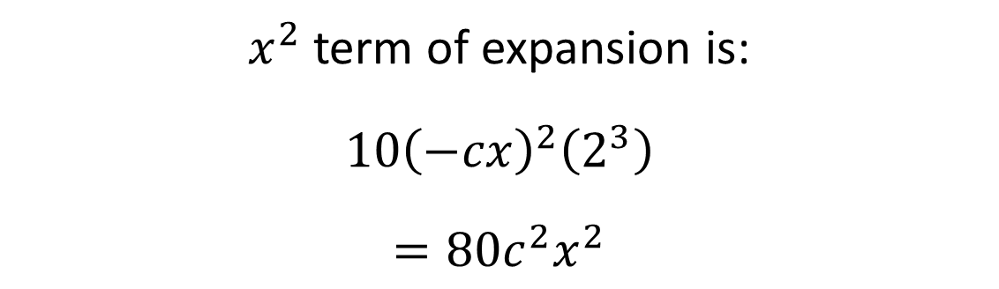
Binomial Expansion - Coefficients
The coefficient of $x^{2}$ in the expansion of ${\left(2−cx\right)}^{5}$ is 720.
Find the possible value(s) of the constant $c$.
$x^{2}$ term of expansion is:
$$10{\left(−cx\right)}^{2}\left(2^{3}\right)$$
$$={80c}^{2}x^{2}$$
Hence:
$$80c^{2}=720$$
$$c^{2}=9$$
$$c=±3$$

Slide 3
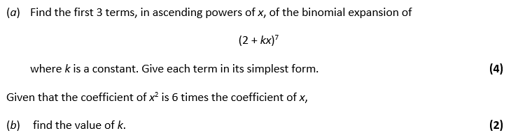
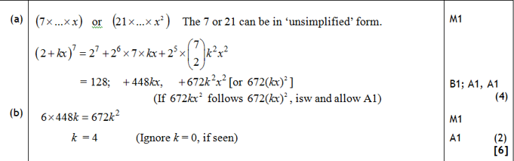
Binomial Expansion - Coefficients

Slide 4
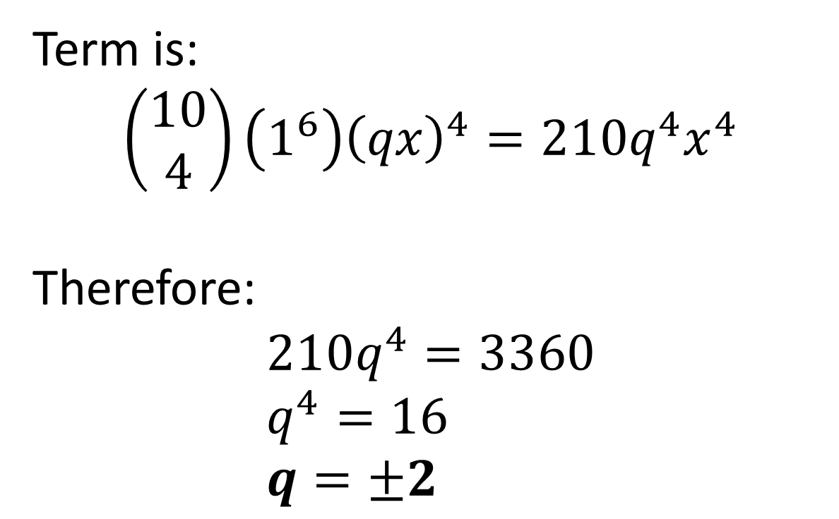
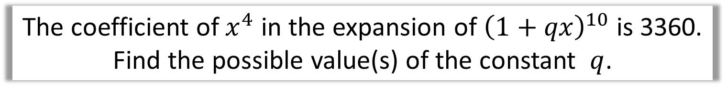
Binomial Expansion - Coefficients
The coefficient of $x^{4}$ in the expansion of ${\left(1+qx\right)}^{10}$ is 3360. Find the possible value(s) of the constant $q$.
Term is:
$$\left(\begin{matrix}10 \\ 4\end{matrix}\right)\left(1^{6}\right){\left(qx\right)}^{4}=210q^{4}x^{4}$$
Therefore:
$$210q^{4}=3360 \\ q^{4}=16 \\ q=±2$$

Slide 5
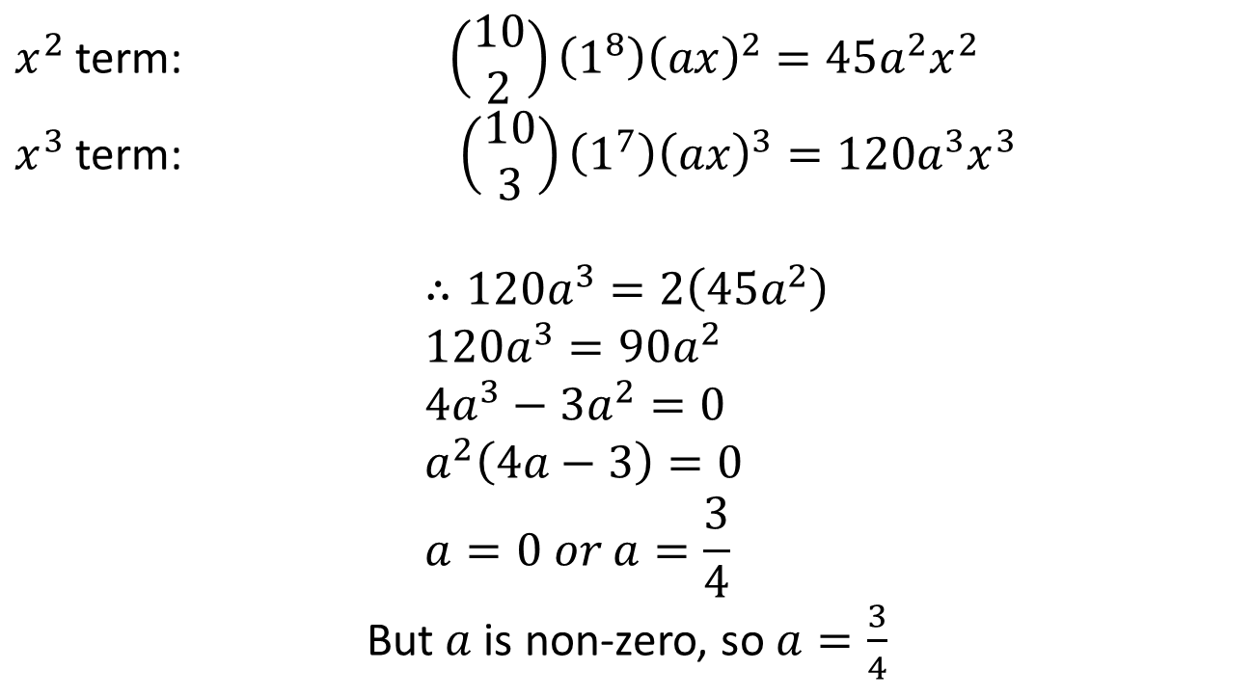
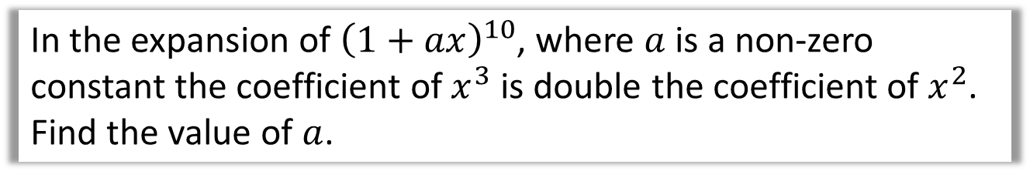
Binomial Expansion - Coefficients
In the expansion of ${\left(1+ax\right)}^{10}$, where $a$ is a non-zero constant the coefficient of $x^{3}$ is double the coefficient of $x^{2}$. Find the value of $a$.
$x^{2}$ term: $\left(\begin{matrix}10 \\ 2\end{matrix}\right)\left(1^{8}\right){\left(ax\right)}^{2}=45a^{2}x^{2}$
$x^{3}$ term: $\left(\begin{matrix}10 \\ 3\end{matrix}\right)\left(1^{7}\right){\left(ax\right)}^{3}=120a^{3}x^{3}$
$$∴120a^{3}=2\left(45a^{2}\right) \\ 120a^{3}=90a^{2} \\ 4a^{3}−3a^{2}=0 \\ a^{2}\left(4a−3\right)=0 \\ a=0 or a=\frac{3}{4}$$
But $a$ is non-zero, so $a=\frac{3}{4}$

Slide 6
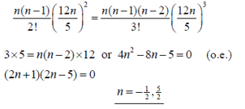
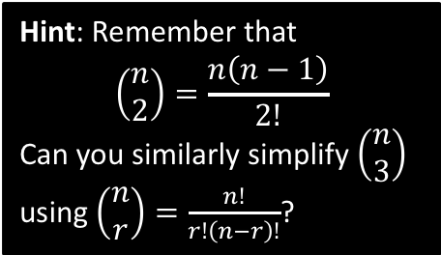
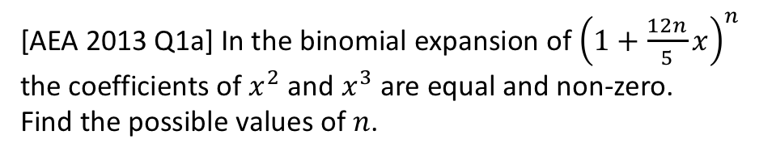
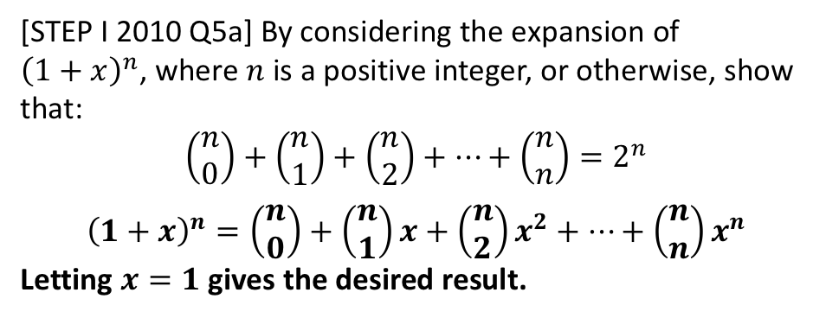
Exercise 8C
Complete before the lesson Q1&3
Green Q4
Amber Q5-7
Red Challenge
Pearson Pure Mathematics
Page 164
Extension
[AEA 2013 Q1a] In the binomial expansion of ${\left(1+\frac{12n}{5}x\right)}^{n}$ the coefficients of $x^{2}$ and $x^{3}$ are equal and non-zero.
Find the possible values of $n$.
Hint: Remember that
$$\left(\begin{matrix}n \\ 2\end{matrix}\right)=\frac{n\left(n−1\right)}{2!}$$
Can you similarly simplify $\left(\begin{matrix}n \\ 3\end{matrix}\right)$ using $\left(\begin{matrix}n \\ r\end{matrix}\right)=\frac{n!}{r!\left(n−r\right)!}$?
1
?
Froflection: This means that the sum of each row in Pascal’s Triangle gives successive powers of 2. Safe!
2
[STEP I 2010 Q5a] By considering the expansion of ${\left(1+x\right)}^{n}$, where $n$ is a positive integer, or otherwise, show that:
$$\left(\begin{matrix}n \\ 0\end{matrix}\right)+\left(\begin{matrix}n \\ 1\end{matrix}\right)+\left(\begin{matrix}n \\ 2\end{matrix}\right)+…+\left(\begin{matrix}n \\ n\end{matrix}\right)=2^{n}$$
$${\left(1+x\right)}^{n}=\left(\begin{matrix}n \\ 0\end{matrix}\right)+\left(\begin{matrix}n \\ 1\end{matrix}\right)x+\left(\begin{matrix}n \\ 2\end{matrix}\right)x^{2}+…+\left(\begin{matrix}n \\ n\end{matrix}\right)x^{n}$$
Letting $x=1$ gives the desired result.
?

Slide 7


Exercise 8D
Complete before the lesson Q1-2
Green Q3-4
Amber Q5-6
Red Q7-10 & Challenge
Pearson Pure Mathematics
Pages 166-167
Extension
2
[STEP I 2013 Q6] By considering the coefficient of $x^{r}$ in the series for $\left(1+x\right){\left(1+x\right)}^{n}$, or otherwise, obtain the following relation between binomial coefficients:
$$\left(\begin{matrix}n \\ r\end{matrix}\right)+\left(\begin{matrix}n \\ r−1\end{matrix}\right)=\left(\begin{matrix}n+1 \\ r\end{matrix}\right)$$
Noting that $\left(1+x\right){\left(1+x\right)}^{n}={\left(1+x\right)}^{n+1}$, the $x^{r}$ term is $\left(\begin{matrix}n+1 \\ r\end{matrix}\right)x^{r}$.
But the $x^{r}$ term could be obtained either by 1 in the first bracket multiplied by $x^{r}$ term in the second, giving $1×\left(\begin{matrix}n \\ r\end{matrix}\right)x^{r}$, or the $x$ in the first bracket multiplied by the $x^{r−1}$ term in the second, $x×\left(\begin{matrix}n \\ r−1\end{matrix}\right)x^{r−1}=\left(\begin{matrix}n \\ r−1\end{matrix}\right)x^{r}$. Thus comparing coefficients:
$$\left(\begin{matrix}n \\ r\end{matrix}\right)+\left(\begin{matrix}n \\ r−1\end{matrix}\right)=\left(\begin{matrix}n+1 \\ r\end{matrix}\right)$$
1
[MAT 2014 1G] Let $n$ be a positive integer. The coefficient of $x^{3}y^{5}$ in the expansion of ${\left(1+xy+y^{2}\right)}^{n}$ equals:
$n$
$2^{n}$
$\left(\begin{matrix}n \\ 3\end{matrix}\right)\left(\begin{matrix}n \\ 5\end{matrix}\right)$
$4\left(\begin{matrix}n \\ 4\end{matrix}\right)$
$\left(\begin{matrix}n \\ 8\end{matrix}\right)$
Try to imagine $n$ brackets written out. To get $x^{3}y^{5}$, we must have chosen $xy$ from 3 brackets, $y^{2}$ from one and 1 from the remaining brackets. That’s $\left(\begin{matrix}n \\ 3\end{matrix}\right)$ choices for the $xy$ term, and $n−3$ choices for the $y^{2}$ term.
Using the definition of the choose function, you can show that $4\left(\begin{matrix}n \\ 4\end{matrix}\right)=\left(n−3\right)\left(\begin{matrix}n \\ 3\end{matrix}\right)$
?
?

