Slide 1
Year 2 Applied Mathematics
Application of Forces
- Statics Rigid Bodies
Chapter 7
(Part 3 of 5)

Slide 2
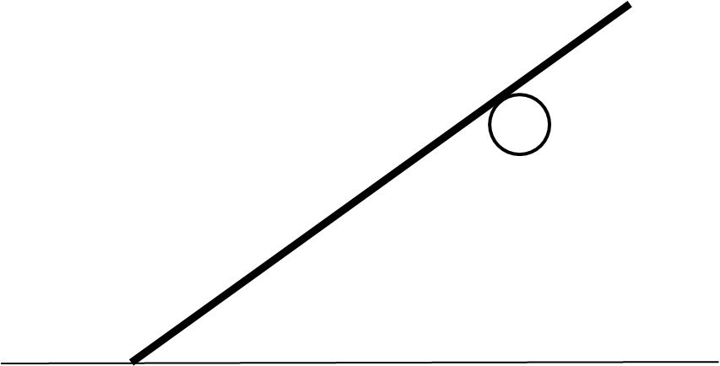
Static rigid bodies – Ladders and a Peg
Forces acting on the ladder/rod.
Reaction to peg (P)
Reaction to ground (R)
Weight (mg)
ϴ
Friction (F)

Slide 3
Static rigid bodies – Ladders and a Peg
Resolving perpendicular to the ladder/rod.
P
R cos ϴ
mg cos ϴ
ϴ
F sin ϴ

Slide 4
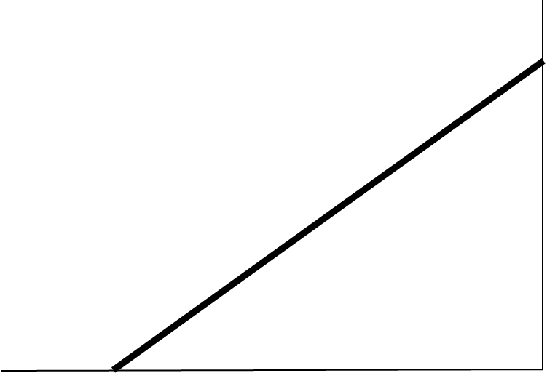
Static rigid bodies – Ladders and a Wall (Smooth)
Forces acting on the ladder and smooth wall.
Reaction to the wall (W)
Reaction to ground (R)
Weight (mg)
ϴ
Friction (F)

Slide 5
Static rigid bodies – Ladders and a Wall (Smooth)
Resolving perpendicular to the ladder.
w sin ϴ
R cos ϴ
mg cos ϴ
ϴ
F sin ϴ

Slide 6
Static rigid bodies – Ladders and a Wall (Rough)
Forces acting on the ladder and smooth wall.
Friction (Z)
Reaction to the wall (W)
Reaction to ground (R)
Weight (mg)
ϴ
Friction (F)

Slide 7
Static rigid bodies – Ladders and a Wall (Rough)
Z cos ϴ
Resolving perpendicular to the ladder.
w sin ϴ
R cos ϴ
mg cos ϴ
ϴ
F sin ϴ

Slide 8
Static rigid bodies
To solve this static problems
set up equations using:
=
Vertical forces
=
Horizontal forces
=
CW
ACW
Moments

Slide 9
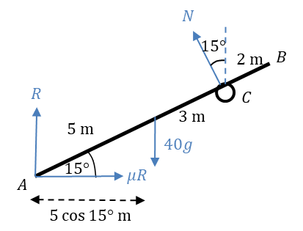
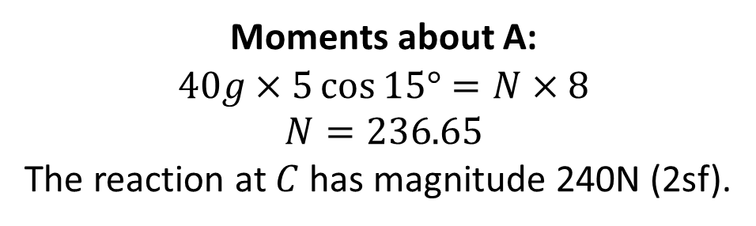
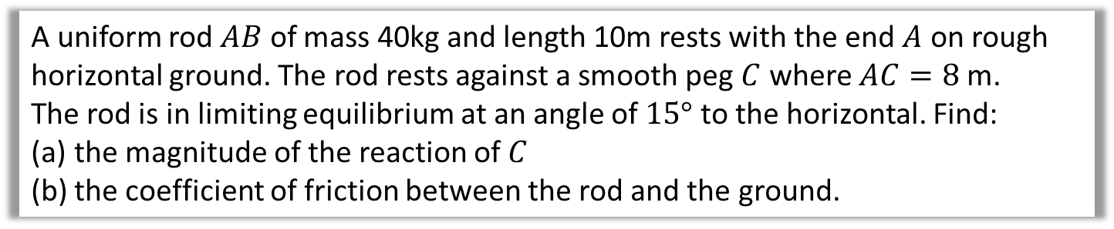
Static rigid bodies – Exam Questions with a Peg
A uniform rod $AB$ of mass 40kg and length 10m rests with the end $A$ on rough horizontal ground. The rod rests against a smooth peg $C$ where $AC=8$ m.
The rod is in limiting equilibrium at an angle of $15°$ to the horizontal. Find:
the magnitude of the reaction of $C$
the coefficient of friction between the rod and the ground.
Moments about A:
$$40g×5\cos{15°}=N×8 \\ N=236.65$$
The reaction at $C$ has magnitude 240N (2sf).
a

Slide 10
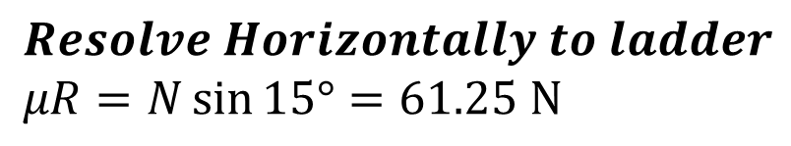
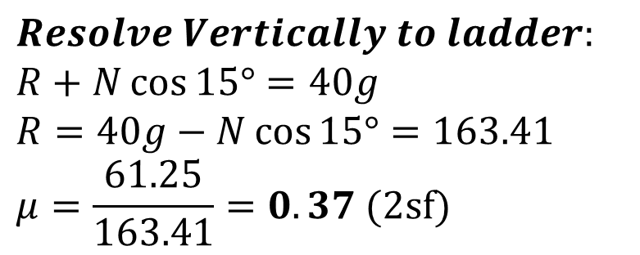
Static rigid bodies – Exam Questions with a Peg
A uniform rod $AB$ of mass 40kg and length 10m rests with the end $A$ on rough horizontal ground. The rod rests against a smooth peg $C$ where $AC=8$ m.
The rod is in limiting equilibrium at an angle of $15°$ to the horizontal. Find:
the magnitude of the reaction of $C$
the coefficient of friction between the rod and the ground.
b
$$Resolve Horizontally to ladder$$
$$μR=N\sin{15°}=61.25 N$$
$$Resolve Vertically to ladder:$$
$$R+N\cos{15°}=40g \\ R=40g−N\cos{15°}=163.41 \\ μ=\frac{61.25}{163.41}=0.37 (2sf)$$

Slide 11
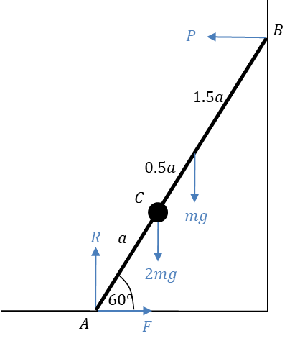
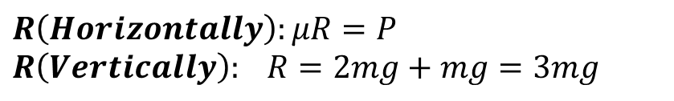
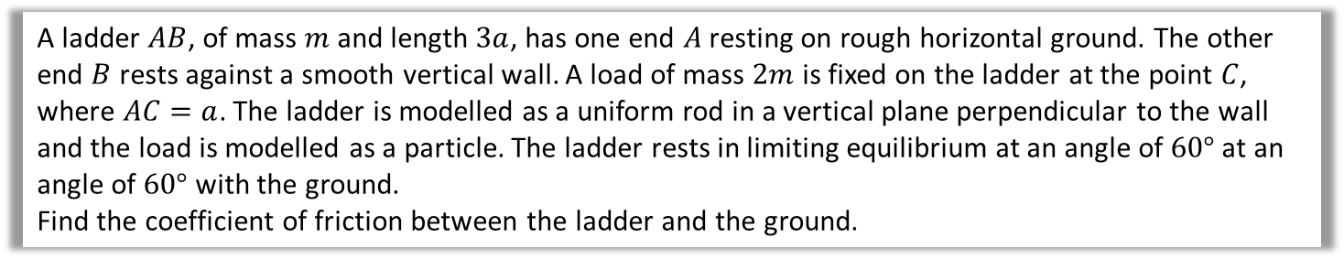
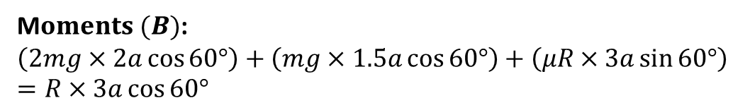
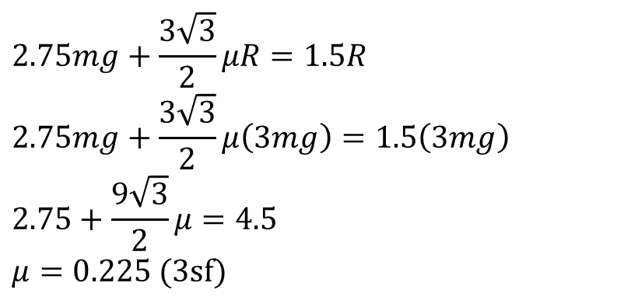
Static rigid bodies – Exam Question with smooth wall
A ladder $AB$, of mass $m$ and length $3a$, has one end $A$ resting on rough horizontal ground. The other end $B$ rests against a smooth vertical wall. A load of mass $2m$ is fixed on the ladder at the point $C$, where $AC=a$. The ladder is modelled as a uniform rod in a vertical plane perpendicular to the wall and the load is modelled as a particle. The ladder rests in limiting equilibrium at an angle of $60°$ at an angle of $60°$ with the ground.
Find the coefficient of friction between the ladder and the ground.
$$R\left(Horizontally\right):μR=P \\ R\left(Vertically\right): R=2mg+mg=3mg$$
M$oments (B)$:
$$\left(2mg×2a\cos{60°}\right)+\left(mg×1.5a\cos{60°}\right)+\left(μR×3a\sin{60°}\right)=R×3a\cos{60°}$$
$$2.75mg+\frac{3\sqrt{3}}{2}μR=1.5R$$
$$2.75mg+\frac{3\sqrt{3}}{2}μ\left(3mg\right)=1.5\left(3mg\right) \\ 2.75+\frac{9\sqrt{3}}{2}μ=4.5 \\ μ=0.225 (3sf)$$

Slide 12
Exercise 7D
Pearson Stats/Mechanics Year 2
Pages 144-146
Complete before the lesson Q1
In Class:
Green Q2-3
Amber Q4-7
Red Q8-13

