Slide 1
Year 1 Pure Mathematics
Data Collection
– Non-random Sampling
Chapter 1
(Part 2 of 4)

Slide 2
Sampling - Quota and Opportunity
Consider the following scenario:
You wish to conduct a survey in the UK
on whether being left-handed affects IQ.
We need to choose people to assess.
Why would random sampling be problematic?
Because you don’t know the sampling frame,
i.e. don’t have a list of all left-handed
(and non-left-handed) people in the UK.

Slide 3

Sampling - Quota
Quota Sampling
Set a quota for the number of pieces of data
you want from each strata.
Keep collecting data until you have your quota.

Slide 4
Sampling - Quota
 | Advantages | Disadvantages
Quota Sampling | Small sample can be representative of population | Bias can be introduced
 | Quick and Easy | Population need to be divided into groups
 | Inexpensive | Non-responses are not recorded

Slide 5

Sampling - Quota and Opportunity
Opportunity Sampling
Opportunity sampling is
where you find people at the time
the survey is being carried out
(e.g. exit polls at polling stations).

Slide 6
Sampling - Opportunity
 | Advantages | Disadvantages
Opportunity Sampling | Easy to carry out | Sample not likely to represent the population
 | Inexpensive | Highly dependent on the researcher.

Slide 7
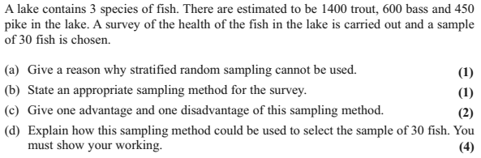
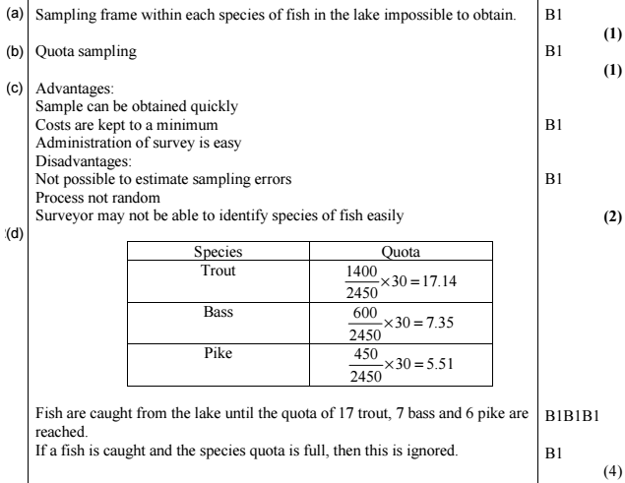

Sampling – Exam Question

Slide 8
Name That Sampling Method
Simple Random Sampling
Systematic Sampling
Stratified Sampling
Quota
Sampling
Opportunity
Sampling
Suggest a suitable sampling method.
“You wish to test lightbulbs
produced by a factory
in a daily batch.”
Probably systematic sampling, as the method of choosing items is simpler than simple random sampling (where it would be time-consuming to find specifically chosen random light bulbs). Sampling frame is known.
“You wish to survey consumers opinion on your new drink
FizzGuzz released in the UK.”
Quota sampling or opportunity sampling. We’d realistically not have access to the sampling frame (i.e. a list of all UK residents).
“You wish to determine
students’ favourite TV programmes in your school,
that is fairly representative
of each year group.”
Stratified sampling. We (probably) have access to the sampling frame (i.e. a list of all students). Stratified sampling ensures that each stratum (year group) is proportionately represented.

Slide 9
Exercise 1C
Pearson Statistics & Mechanics Year 1/AS
Pages 8-9
Complete before the lesson Q1-2
In Class:
Green Q3-6

