Slide 1
Year 2 Pure Mathematics
Radians
– Arc Lengths
Chapter 5
(Part 2 of 5)

Slide 2




Radians - Arc length
$$l$$
$$r$$
$$θ$$
Calculating Arc length using radians:
$$l=rθ$$

Slide 3
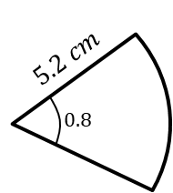
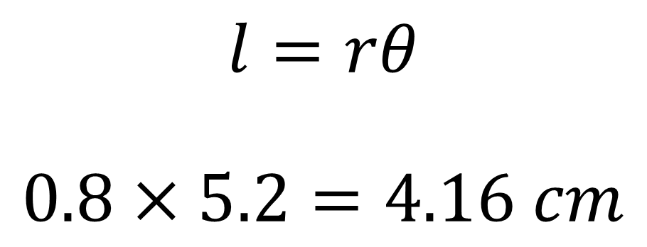
Radians - Arc length
Find the length of the arc
$$l=rθ$$
$$0.8×5.2=4.16 cm$$

Slide 4
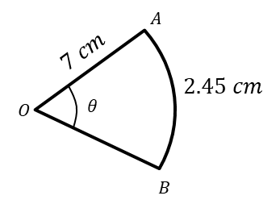
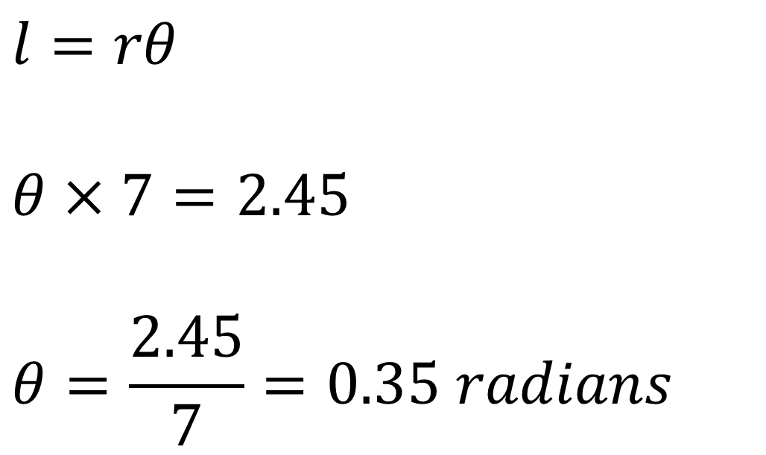

Radians - Arc length
Find the angle $∠AOB$
$$l=rθ$$
$$θ×7=2.45$$
$$θ=\frac{2.45}{7}=0.35 radians$$

Slide 5
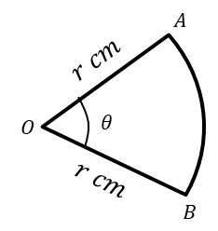
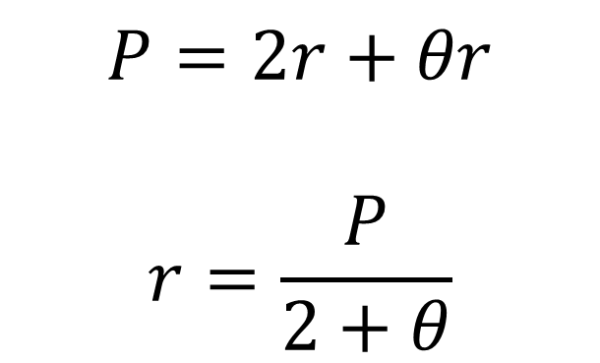

Radians - Arc length
The perimeter of the sector $AOB$ is $P$ cm. Express $r$ in terms of $P$ and $θ.$
$$P=2r+θr$$
$$r=\frac{P}{2+θ}$$

Slide 6
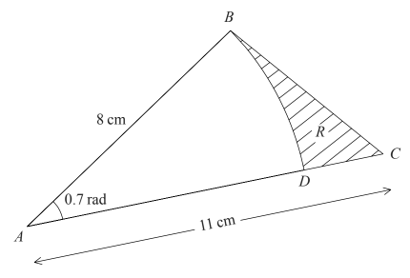
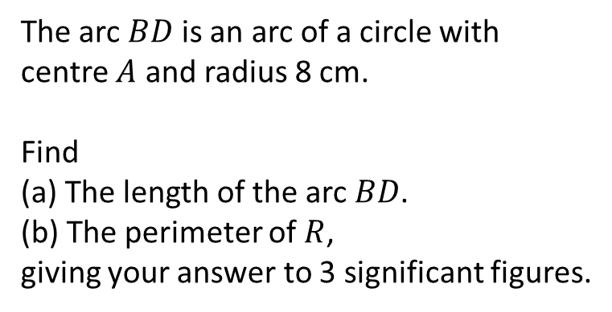
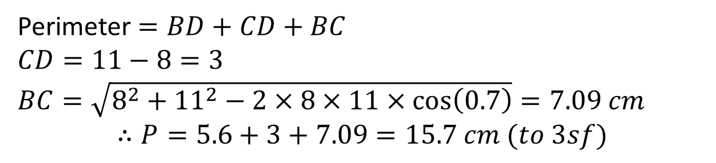
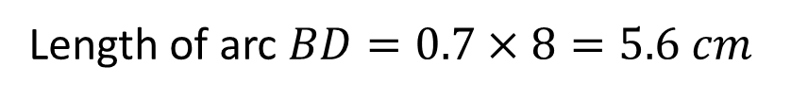
Radians - Arc length
The arc $BD$ is an arc of a circle with centre $A$ and radius 8 cm.
Find
(a) The length of the arc $BD$.
(b) The perimeter of $R$,
giving your answer to 3 significant figures.
a
Length of arc $BD=0.7×8=5.6 cm$
b
Perimeter $=BD+CD+BC$
$CD=11−8=3$
$BC=\sqrt{8^{2}+{11}^{2}−2×8×11×\cos\left(0.7\right)}=7.09 cm$
$$∴P=5.6+3+7.09=15.7 cm (to 3sf)$$

Slide 7
Exercises 5C
Pearson Pure Mathematics Year 2/AS
Pages 120-122
Note: Q10 is based on a past paper question so is worth doing.
Complete before the lesson Q1
In Class:
Green Q2-5
Amber Q6-9
Red Q10-14

