Slide 1
Year 1 Pure Mathematics
Trigonometric Ratios
Trigonometric Waves
Chapter 9
(Part 2 of 2)

Slide 2
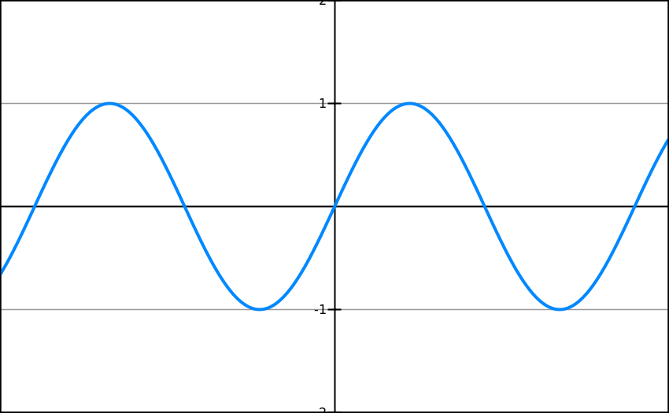
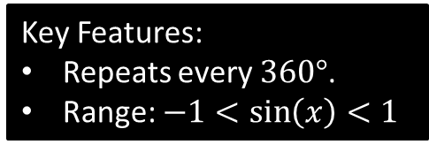
Sin Graph
What does y = sin x it look like?
Key Features:
Repeats every $360°$.
Range: $−1<\sin\left(x\right)<1$
-360
-270
-180
-90
90
180
270
360

Slide 3
Sin Graph
Suppose we know that sin(30) = 0.5.
By thinking about symmetry in the graph, how could we work out:
-360
-270
-180
-90
90
180
270
360
-0.5
0.5
-0.5
sin(-30) =
sin(150) =
sin(210) =

Slide 4
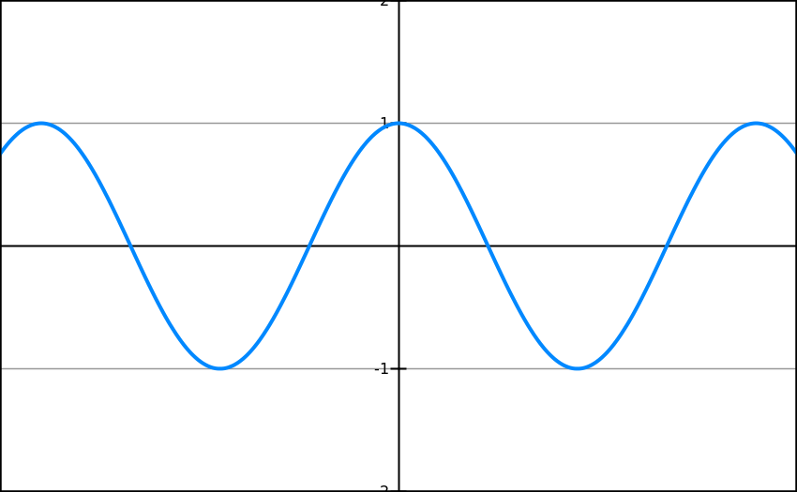
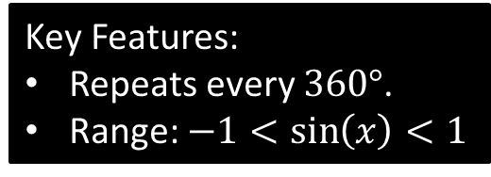
Cos Graph
What does y = cos x it look like?
Key Features:
Repeats every $360°$.
Range: $−1<\sin\left(x\right)<1$
-360
-270
-180
-90
90
180
270
360

Slide 5
Cos Graph
Suppose we know that cos(60) = 0.5.
By thinking about symmetry in the graph, how could we work out:
-360
-270
-180
-90
90
180
270
360
0.5
cos(-60) =
-0.5
cos(120) =
cos(240) =
-0.5

Slide 6
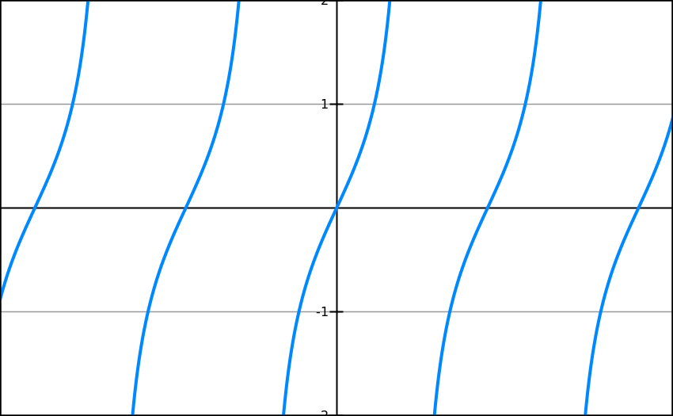
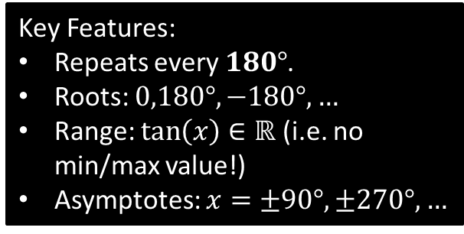
Tan Graph
What does y = tan x it look like?
-360
-270
-180
-90
90
180
270
360
Key Features:
Repeats every $180°$.
Roots: $0,180°,−180°, …$
Range: $\tan\left(x\right)∈ℝ$ (i.e. no min/max value!)
Asymptotes: $x=±90°, ±270°,…$

Slide 7





Tan Graph
Suppose we know that $\tan\left(30°\right)=\frac{1}{\sqrt{3}}$.
By thinking about symmetry in the graph, how could we work out:
-360
-270
-180
-90
90
180
270
360
$$\tan\left(150°\right)=−\frac{1}{\sqrt{3}}$$
$$−\frac{1}{\sqrt{3}}$$
$$−\frac{1}{\sqrt{3}}$$
$$\tan\left(−30°\right)=−\frac{1}{\sqrt{3}}$$

Slide 8
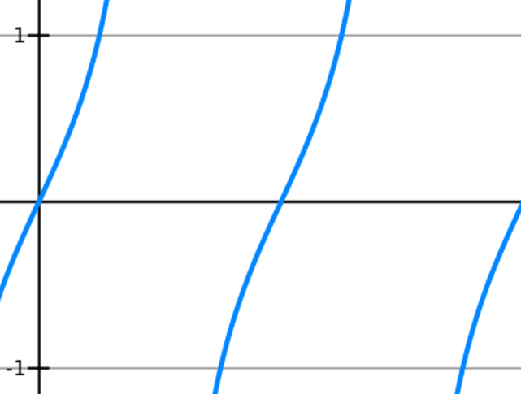
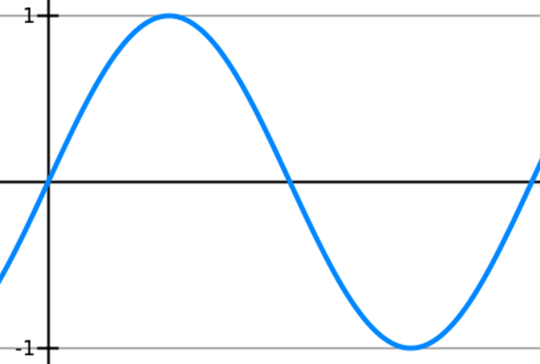
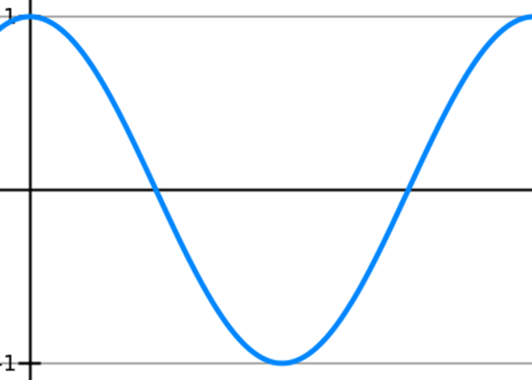



Transforming Trigonometric Graphs
When transforming graphs
always think about the basic
sin, cos and tan waves
as your starting position.
90˚
180˚
270˚
360˚
180˚
360˚
$$y=\cos{x}$$
180˚
360˚
$$y=\sin{x}$$
$$y=\tan{x}$$

Slide 9
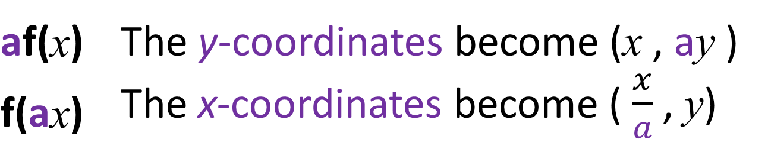
Transforming Trigonometric Graphs
f(x) + a |  | The graph moves up
f(x) - a |  | The graph moves down
f(x + a) |  | The graph moves left
f(x – a) |  | The graph moves right
af(x) | The y-coordinates become (x , ay )
f(ax) | The x-coordinates become ( $\frac{x}{a}$ , y)
-f(x) | The graph is reflected in the x axis
f(-x) | The graph is reflected in the y axis

Slide 10



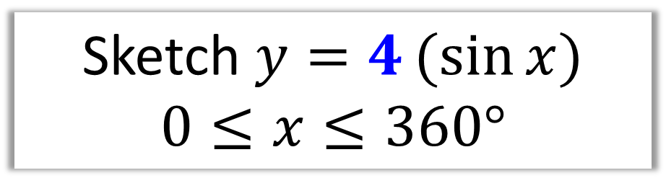






Transforming Trigonometric Graphs
Sketch $y=4(sin{x)}$
$$0≤x≤360°$$
$$y$$
$$×4$$
$$4$$
$$x$$
$$90°$$
$$180°$$
$$270°$$
$$360°$$
$$−4$$

Slide 11

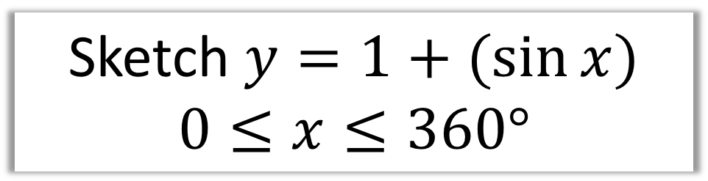




Transforming Trigonometric Graphs
Sketch $y=1+(sin{x)}$
$$0≤x≤360°$$
$$y$$
$$2$$
$$+ 1$$
$$1$$
$$0$$
$$x$$
$$90°$$
$$180°$$
$$270°$$
$$360°$$

Slide 12
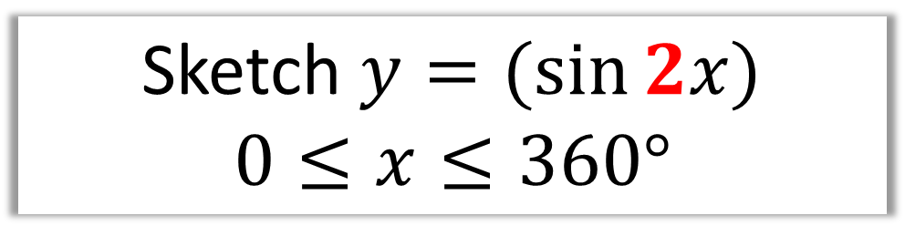


Transforming Trigonometric Graphs
Sketch $y=(sin{2x)}$
$$0≤x≤360°$$
$$y$$
2 cycles completed in 360˚
$$1$$
$$x$$
$$90°$$
$$180°$$
$$270°$$
$$360°$$
$$−1$$

Slide 13




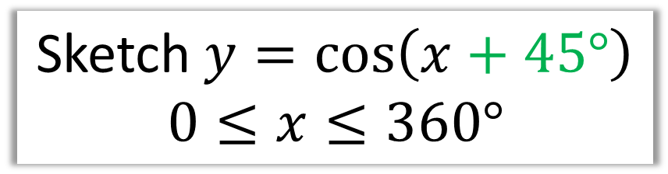






Transforming Trigonometric Graphs
Sketch $y=\cos\left(x+45°\right)$
$$0≤x≤360°$$
$$y$$
$$45°$$
$$1$$
$$x$$
$$−90°$$
$$90°$$
$$180°$$
$$270°$$
$$360°$$
$$−1$$

Slide 14


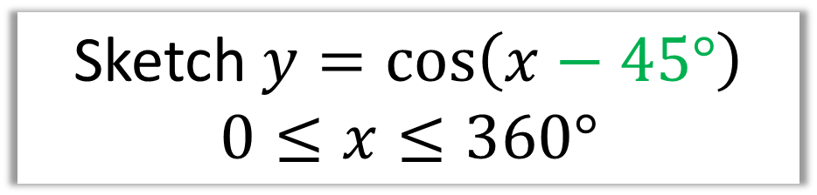





Transforming Trigonometric Graphs
Sketch $y=\cos\left(x−45°\right)$
$$0≤x≤360°$$
$$y$$
$$45°$$
$$1$$
$$x$$
$$−90°$$
$$90°$$
$$180°$$
$$270°$$
$$360°$$
$$−1$$

Slide 15
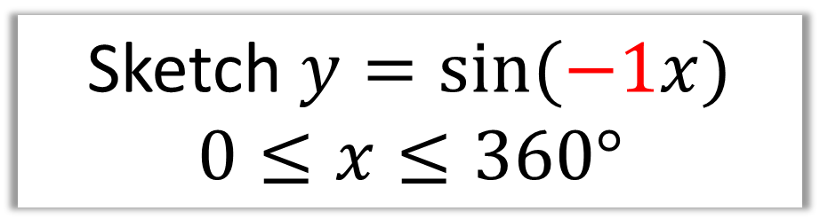




Transforming Trigonometric Graphs
Sketch $y=\sin{(−1x)}$
$$0≤x≤360°$$
$$y$$
Reflects in the $x$ axis
$$1$$
$$x$$
$$90°$$
$$180°$$
$$270°$$
$$360°$$
$$−1$$

Slide 16
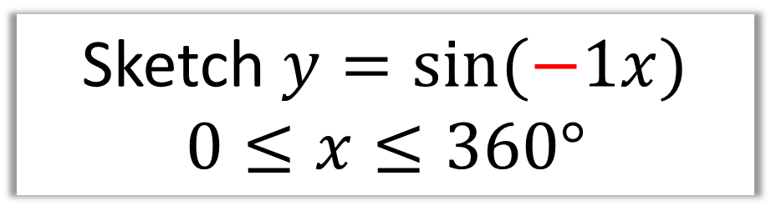

Transforming Trigonometric Graphs
Sketch $y=\sin{(−1x)}$
$$0≤x≤360°$$
$$y$$
Reflects in the $x$ axis
$$1$$
$$x$$
$$90°$$
$$180°$$
$$270°$$
$$360°$$
$$−1$$

Slide 17



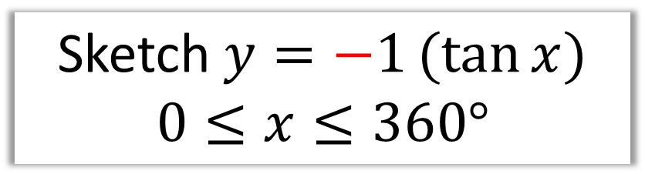




Transforming Trigonometric Graphs
Sketch $y=−1(tan{x)}$
$$0≤x≤360°$$
Reflects in the $y$ axis
$$y$$
$$x$$
$$90°$$
$$180°$$
$$270°$$
$$360°$$

Slide 18
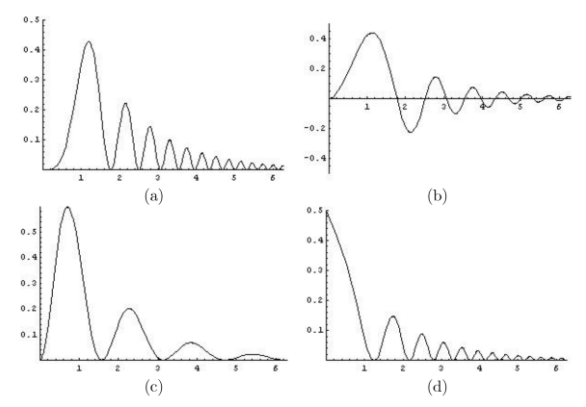
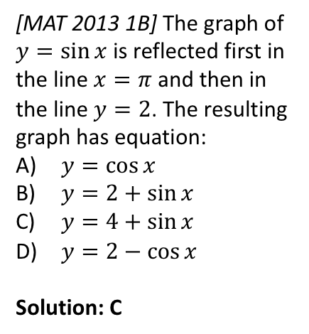
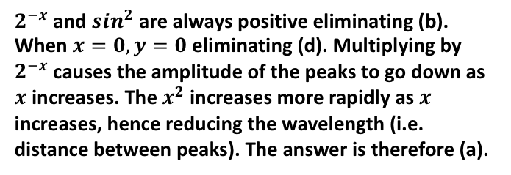
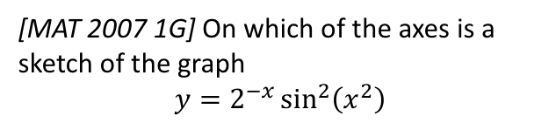
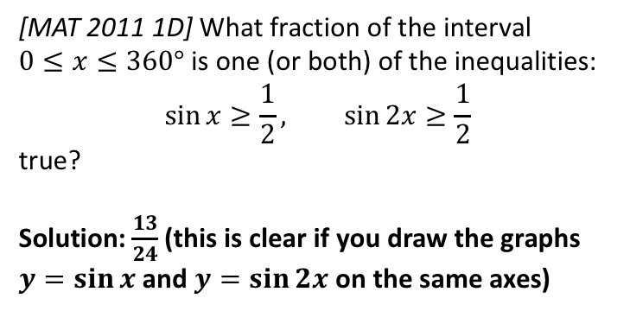
Exercise 9F/9G
Complete before the lesson Ex9F
Green Ex9G Q1-3
Amber Ex9G Q4-5
Red Ex9G Q6-9
Pearson Pure Mathematics
Pages 194, 197-198
Extension
1
[MAT 2013 1B] The graph of $y=\sin{x}$ is reflected first in the line $x=π$ and then in the line $y=2$. The resulting graph has equation:
$y=\cos{x}$
$y=2+\sin{x}$
$y=4+\sin{x}$
$y=2−\cos{x}$
Solution: C
3
[MAT 2007 1G] On which of the axes is a sketch of the graph
$$y=2^{−x}\sin^{2}\left(x^{2}\right)$$
?
2
[MAT 2011 1D] What fraction of the interval
$0≤x≤360°$ is one (or both) of the inequalities:
$$\sin{x}≥\frac{1}{2}, \sin{2x}≥\frac{1}{2}$$
true?
Solution: $\frac{13}{24}$ (this is clear if you draw the graphs $y=\sin{x}$ and $y=\sin{2x}$ on the same axes)
$2^{−x}$ and $s{in}^{2}$ are always positive eliminating (b). When $x=0, y=0$ eliminating (d). Multiplying by $2^{−x}$ causes the amplitude of the peaks to go down as $x$ increases. The $x^{2}$ increases more rapidly as $x$ increases, hence reducing the wavelength (i.e. distance between peaks). The answer is therefore (a).
?
?

