Slide 1
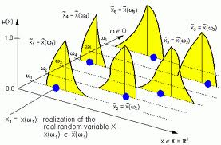
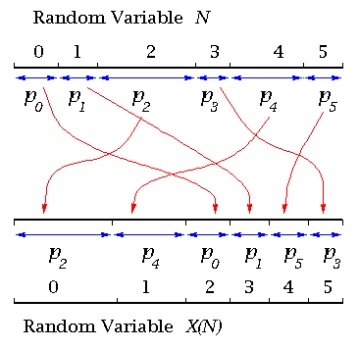
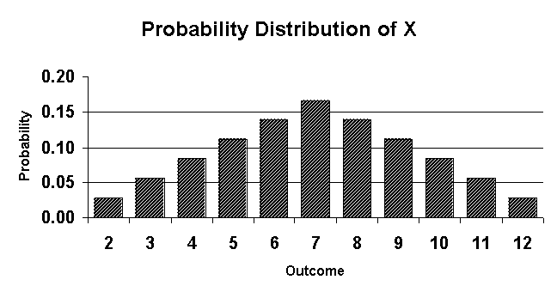
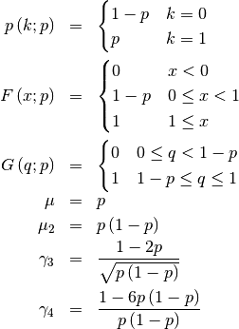
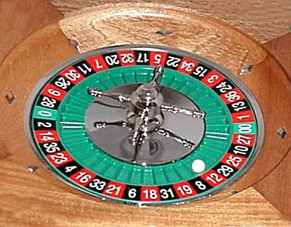
Discrete Random Variables

Slide 2
Exercise 1D
Pearson Pure Mathematics Year 1/AS
Pages 13-14
Complete before the lesson Q1
In Class:
Green Q2
Amber Q3-4
Red Q5-6

