Slide 1
Year 1 Pure Mathematics
Forces and Friction
– Inclined Slope
Chapter 5
(Part 2 of 3)

Slide 2

Inclined Slopes
For problems involving inclined planes, resolve forces parallel and perpendicular to the slope.
$$15°$$

Slide 3

Inclined Slopes
There is a reaction to the slope.
R
10kg
$$15°$$

Slide 4




Inclined Slopes
The mass of a particle on a slope…
10kg
$$15°$$
...has a parallel component and a perpendicular component.
10kg
$$10g\cos{15}$$
$$15°$$
$$10g\sin{15}$$

Slide 5
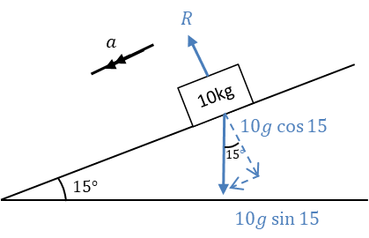
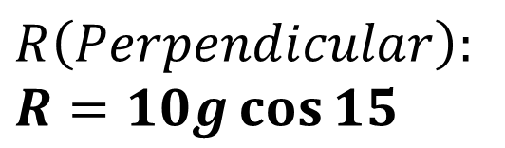
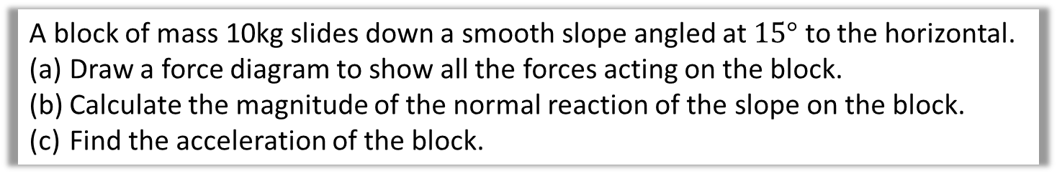
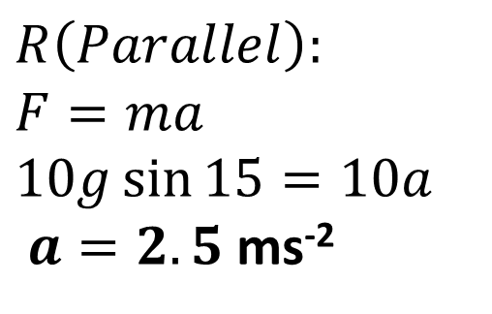
Inclined Slopes
A block of mass 10kg slides down a smooth slope angled at $15°$ to the horizontal.
Draw a force diagram to show all the forces acting on the block.
Calculate the magnitude of the normal reaction of the slope on the block.
Find the acceleration of the block.
$$R\left(Perpendicular\right):$$
$$R=10g\cos{15}$$
$$R\left(Parallel\right):$$
$$F=ma \\ 10g\sin{15}=10a$$
$a=2.5$ms⁻²

Slide 6
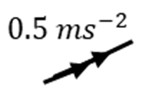
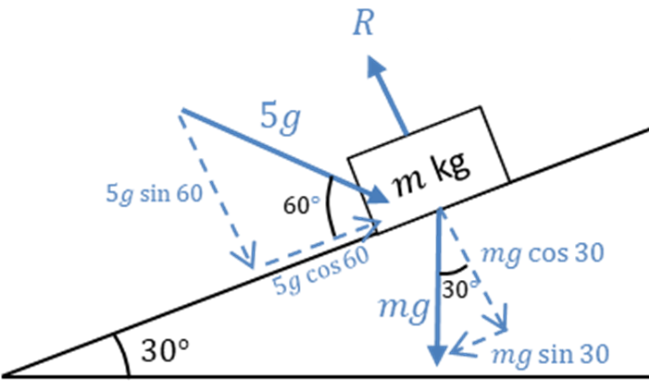
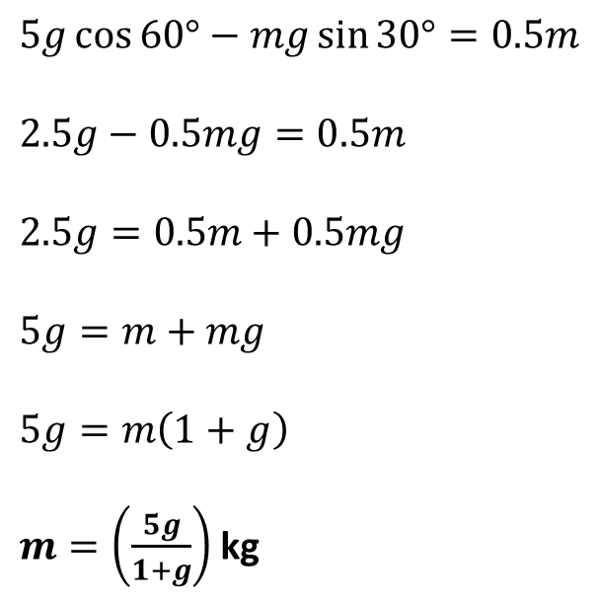
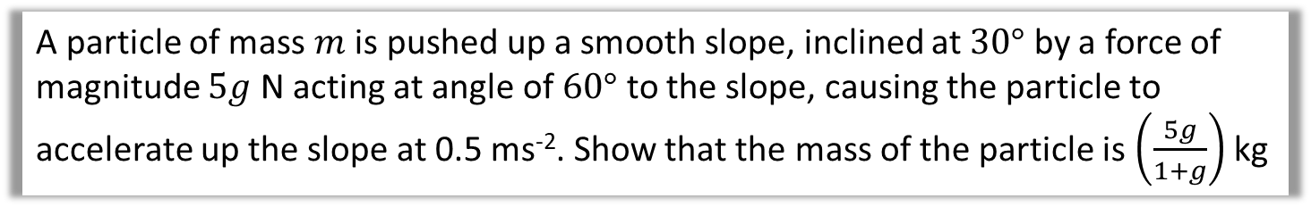
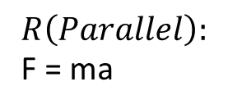
Inclined Slope - External force
A particle of mass $m$ is pushed up a smooth slope, inclined at $30°$ by a force of magnitude $5g$ N acting at angle of $60°$ to the slope, causing the particle to accelerate up the slope at 0.5 ms⁻². Show that the mass of the particle is $\left(\frac{5g}{1+g}\right)$ kg
$$R\left(Parallel\right):$$
F = ma
$$5g\cos{60°}−mg\sin{30°}=0.5m$$
$$2.5g−0.5mg=0.5m$$
$$2.5g=0.5m+0.5mg$$
$$5g=m+mg$$
$$5g=m\left(1+g\right)$$
$m=\left(\frac{5g}{1+g}\right)$ kg

Slide 7
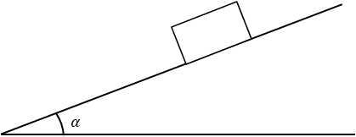
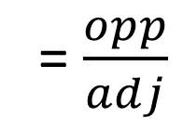
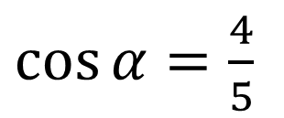
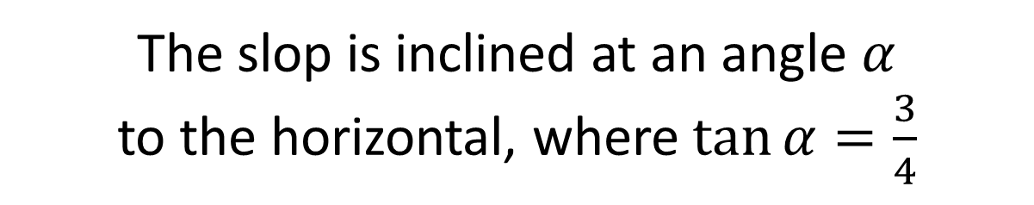
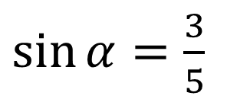


Inclined Slope – Calculating with angles
The slop is inclined at an angle $α$
to the horizontal, where $\tan{α}=\frac{3}{4}$
$\sin{α}=\frac{3}{5}$
5
$\tan{α}=\frac{3}{4}$ = $\frac{opp}{adj}$
= $\frac{opp}{adj}$
3
$$α$$
4
$\cos{α}=\frac{4}{5}$

Slide 8
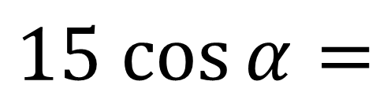

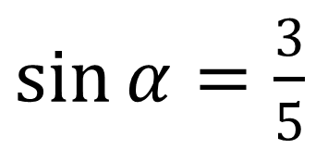

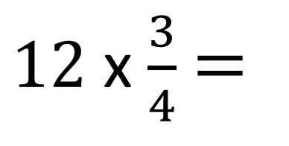
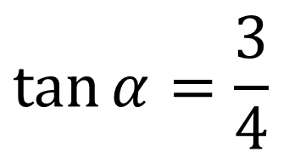
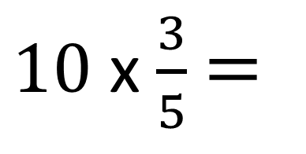
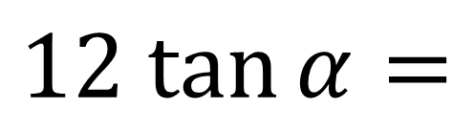
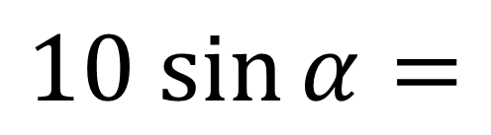

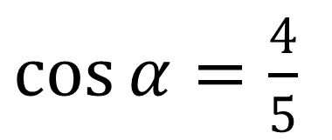
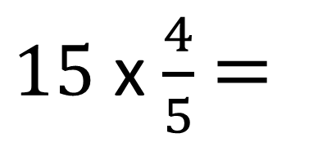
Inclined Slope – Calculating with angles
$\sin{α}=\frac{3}{5}$
$\cos{α}=\frac{4}{5}$
$$\tan{α}=\frac{3}{4}$$
$$10 sin{α}=$$
$10$ x $\frac{3}{5}$ $=$
$$6$$
$$15 cos{α}=$$
$15$ x $\frac{4}{5}$ $=$
$$12$$
$$12 tan{α}=$$
$12$ x $\frac{3}{4}$ $=$
$$9$$

Slide 9
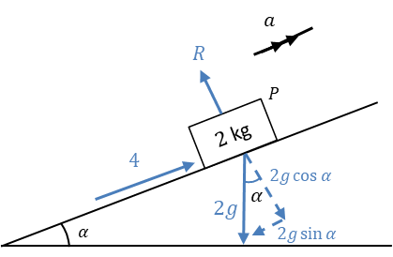
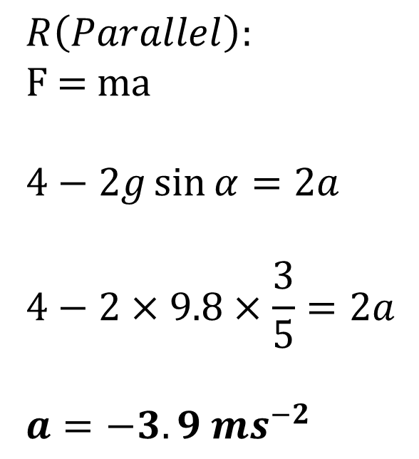
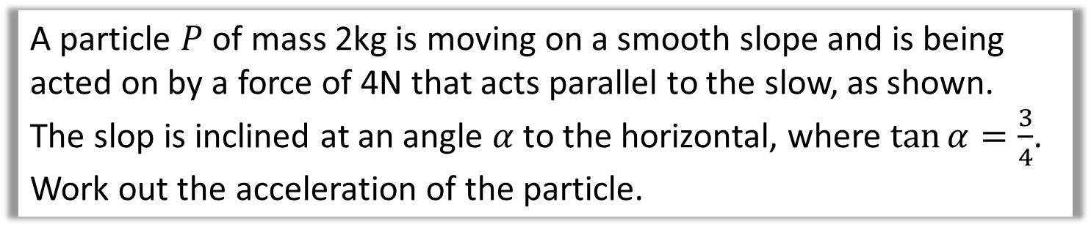
Inclined Slope – Calculating with angles
A particle $P$ of mass 2kg is moving on a smooth slope and is being acted on by a force of 4N that acts parallel to the slow, as shown.
The slop is inclined at an angle $α$ to the horizontal, where $\tan{α}=\frac{3}{4}$. Work out the acceleration of the particle.
$$R\left(Parallel\right):$$
F = ma
$$4−2g\sin{α}=2a$$
$$4−2×9.8×\frac{3}{5}=2a$$
$$a=−3.9 ms^{−2}$$

Slide 10
Exercise 5B
Pearson Stats/Mechanics Year 2
Pages 98-99
Complete before the lesson Q1&3
In Class:
Green Q4-5
Amber Q6-7
Red Q8 & Challenge

