Slide 1
Year 2 Pure Mathematics
Sequences and Series
- Recurrence Relations
Chapter 3
(Part 7 of 7)

Slide 2
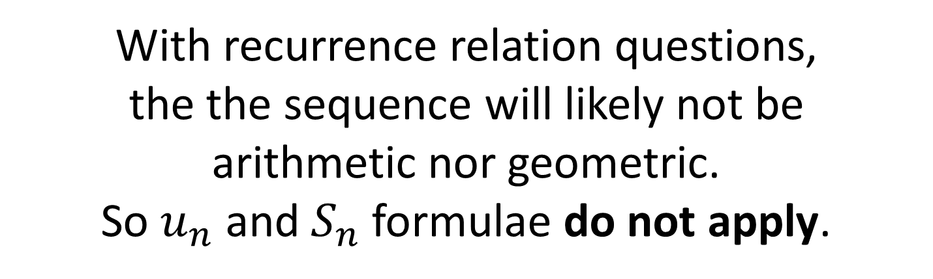
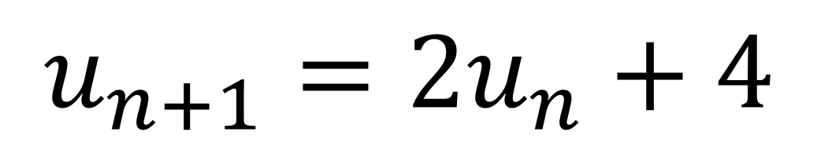
Recurrence Relations
A recurrence formula will only get you the next term in the sequence.
$$u_{n+1}=2u_{n}+4$$
With recurrence relation questions,
the the sequence will likely not be
arithmetic nor geometric.
So $u_{n}$ and $S_{n}$ formulae do not apply.

Slide 3
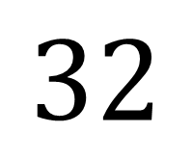
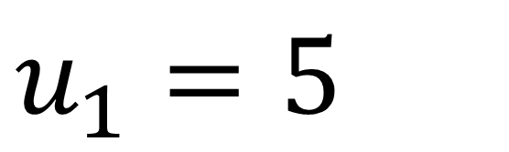
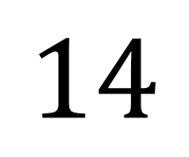
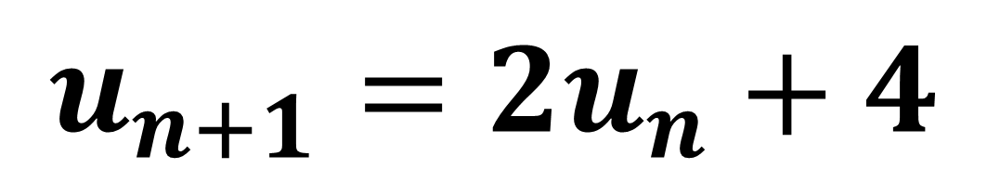
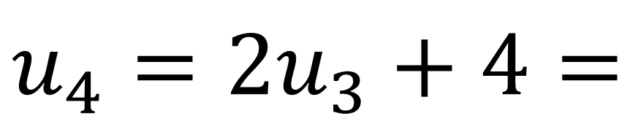
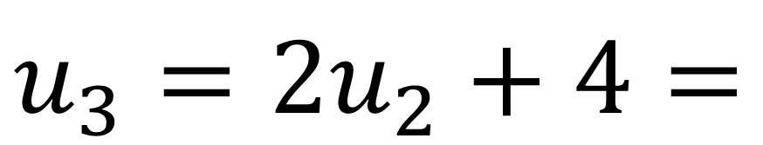
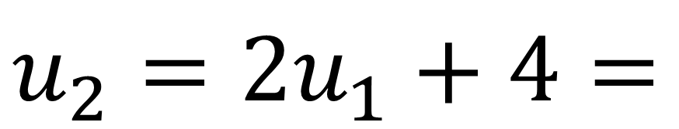
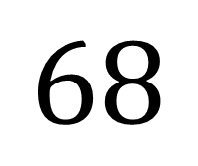
Recurrence Relations
$$u_{n+1}=2u_{n}+4$$
$$u_{1}=5$$
$$u_{2}=2u_{1}+4=$$
$$14$$
$$u_{3}=2u_{2}+4=$$
$$32$$
$$u_{4}=2u_{3}+4=$$
$$68$$

Slide 4
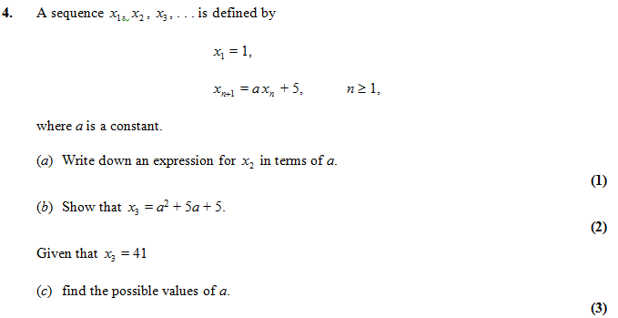



Recurrence Relations – Exam Question
$$x_{2}=a+5$$
$$x_{3}=a\left(a+5\right)+5=…$$
$$a^{2}+5a+5=41 \\ a^{2}+5a−36=0 \\ \left(a+9\right)\left(a−4\right)=0 \\ a=−9 or 4$$

Slide 5
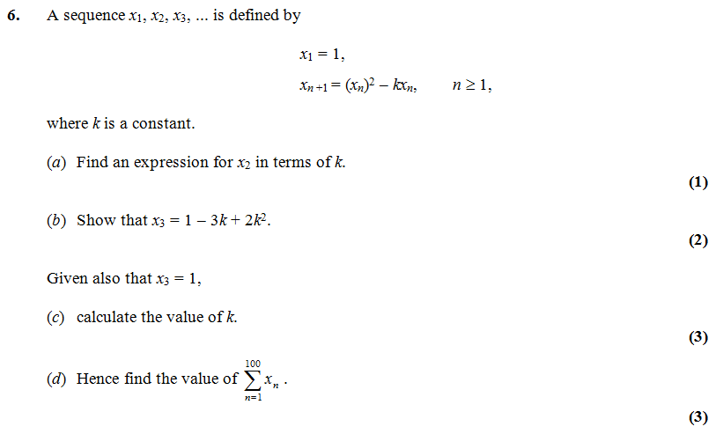


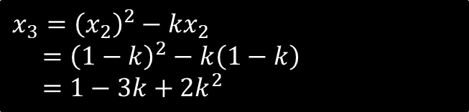

Recurrence Relations – Exam Question
$$x_{2}={\left(x_{1}\right)}^{2}−kx_{1}=1−k$$
$$x_{3}={\left(x_{2}\right)}^{2}−kx_{2} \\ ={\left(1−k\right)}^{2}−k\left(1−k\right) \\ =1−3k+2k^{2}$$
$$k=\frac{3}{2}$$
$$=1+\left(−\frac{1}{2}\right)+1+\left(−\frac{1}{2}\right)+… \\ =50×\left(1−\frac{1}{2}\right)=25$$

Slide 6
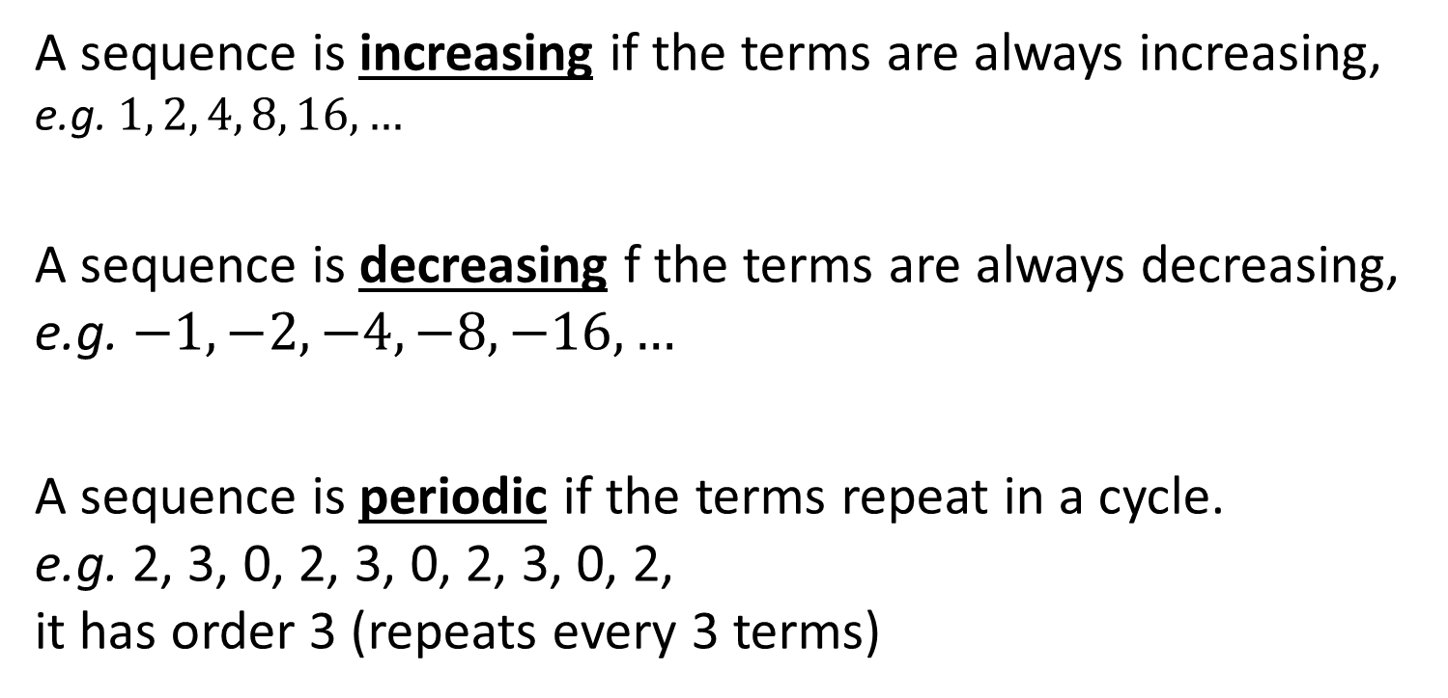
Increasing, decreasing and periodic sequences
A sequence is increasing if the terms are always increasing,
e.g. $1, 2, 4, 8, 16, …$
A sequence is decreasing f the terms are always decreasing,
e.g. $−1, −2, −4, −8, −16, …$
A sequence is periodic if the terms repeat in a cycle.
e.g. 2, 3, 0, 2, 3, 0, 2, 3, 0, 2,
it has order 3 (repeats every 3 terms)

Slide 7

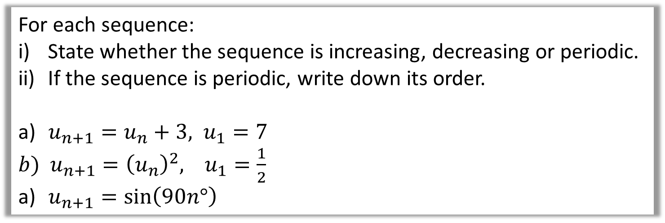
Increasing, decreasing and periodic sequences
For each sequence:
State whether the sequence is increasing, decreasing or periodic.
If the sequence is periodic, write down its order.
$u_{n+1}=u_{n}+3, u_{1}=7$
$b) u_{n+1}={\left(u_{n}\right)}^{2}, u_{1}=\frac{1}{2}$.
$u_{n+1}=\sin\left(90n°\right)$
a) Terms: 7, 10, 13,…. Increasing.
b) Terms: $\frac{1}{2},\frac{1}{4},\frac{1}{8},\frac{1}{16},…$. Decreasing
c) Terms: 1, 0, -1, 0, 1, 0, … Periodic, order 4.

Slide 8
Exercise 3H. - NB Skipped 3G
Pearson Pure Mathematics Year 2/AS
Pages 82-83
Complete before the lesson Q1-2
In Class:
Green Q3-4
Amber Q5
Red Challenge

