Slide 1

Further Mechanics 1 :
Work, Energy and Power
Mr Ingall
(the boss of www.drfrostmaths.com)
Still to do:
Add bad joke to keep Frosty happy
Last modified: 10th January 2019

Slide 2

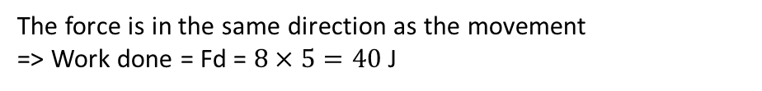
What do we understand by Work?
If an object has energy => it can do work.
Work transfers energy from one place or form to another.
Work is done by a force when it moves an object.
Work (a bit like energy) = Force $×$ distance
Units:
If force is in Newtons (N) and distance in meters (m)
=> Work is in Joules (J)
Directions must be consistent (if not, use components)
$$8N$$
A horizontal force of 8N moves a box 5m across a horizontal floor. Calculate the work done by the force.
?
The force is in the same direction as the movement
=> Work done = Fd = $8×5=40$J

Slide 3
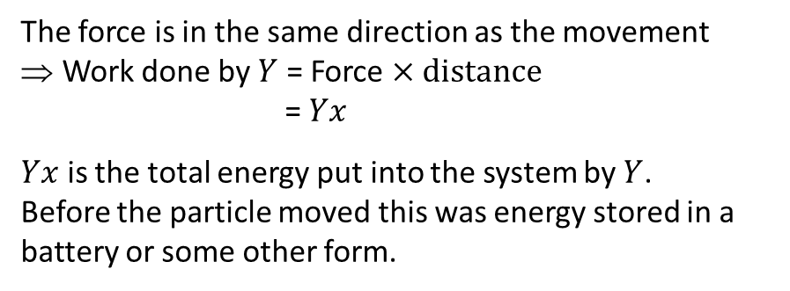







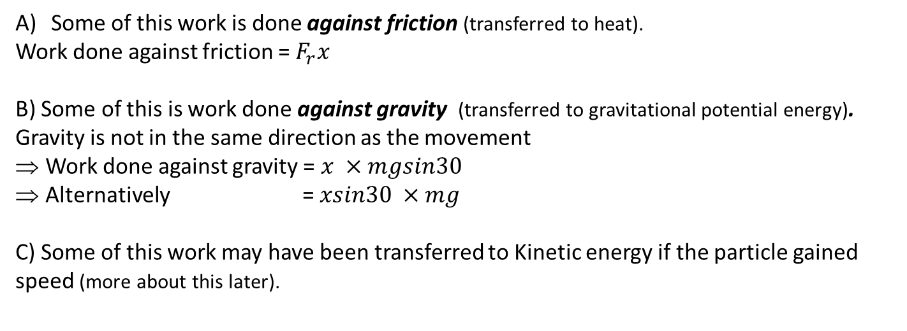
What do we understand by Work?
The force $Y$N moves a particle, mass $m$kg, $x$m up a rough slope inclined at 30$°$ to the horizontal.
$$R$$
$$Y$$
The force is in the same direction as the movement
Work done by $Y$ = Force $×$ distance
=$Yx$
$Yx$ is the total energy put into the system by $Y$.
Before the particle moved this was energy stored in a battery or some other form.
$$F_{r}$$
$$mg$$
$$30°$$
Some of this work is done against friction (transferred to heat).
Work done against friction = $F_{r}x$
B) Some of this is work done against gravity (transferred to gravitational potential energy).
Gravity is not in the same direction as the movement
Work done against gravity = $x ×mgsin30$
Alternatively = $xsin30 ×mg$
C) Some of this work may have been transferred to Kinetic energy if the particle gained speed (more about this later).
$F_{r}$ and $x$ are in the same direction
$mgsin30$ is the component of weight in the direction of $x$
Both (always) give the same answer
$xsin30$is the component of distance in the direction of $mg$
Note: Work done by Y = Work done against friction + Work done against gravity + Kinetic energy gained.

Slide 4

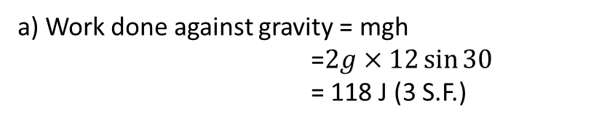


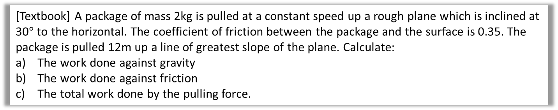

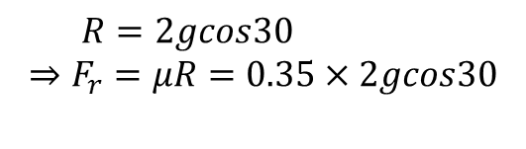

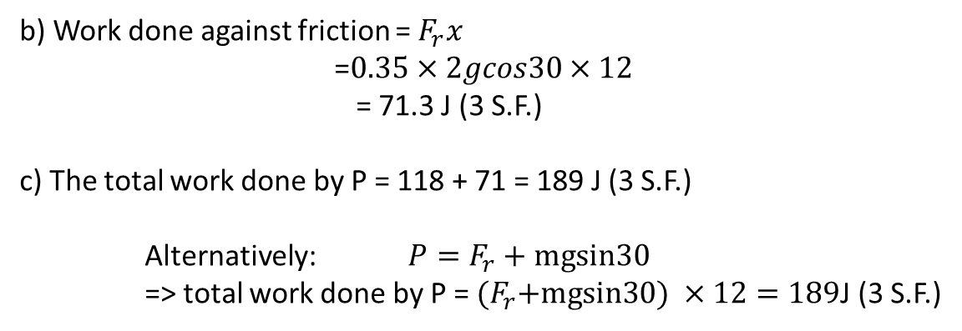

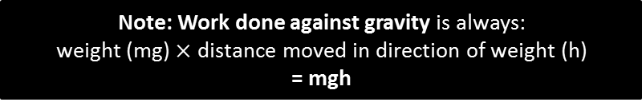
An Example
No change in kinetic energy
[Textbook] A package of mass 2kg is pulled at a constant speed up a rough plane which is inclined at 30$°$ to the horizontal. The coefficient of friction between the package and the surface is 0.35. The package is pulled 12m up a line of greatest slope of the plane. Calculate:
The work done against gravity
The work done against friction
The total work done by the pulling force.
$$R$$
Note: Work done against gravity is always:
weight (mg) $×$ distance moved in direction of weight (h)
= mgh
Diagram?
$$P$$
$$F_{r}$$
a) Work done against gravity = mgh
=$2g×12\sin{30}$
= 118 J (3 S.F.)
Solution to a)
2$g$
$$30°$$
b) Work done against friction = $F_{r}x$
=$0.35×2gcos30×12$
= 71.3 J (3 S.F.)
c) The total work done by P = 118 + 71 = 189 J (3 S.F.)
Alternatively: $P=F_{r}+mgsin30$
=> total work done by P = ${(F}_{r}+mgsin30) ×12=189$J (3 S.F.)
$$R=2gcos30$$
$$⇒F_{r}=μR=0.35×2gcos30$$
Solution to b)
Solution to c)
Note: There is a confusing and incorrect solution to this problem in the text book which suggests that $F_{r}=P$ which is not true.

Slide 5
Exercise 2A
Pearson Further Mechanics 1
Pages 18-19
Complete before the lesson Q1-3
In Class:
Green Q4-7
Amber Q8-10
Red Q14-17

Slide 6

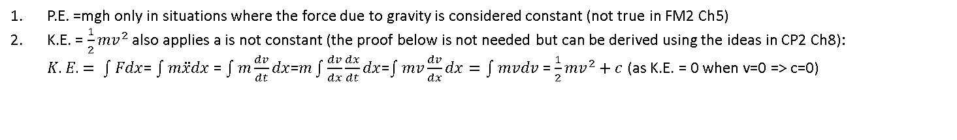
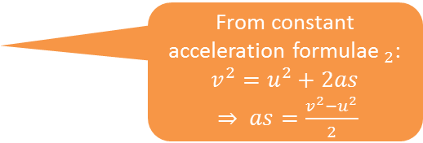

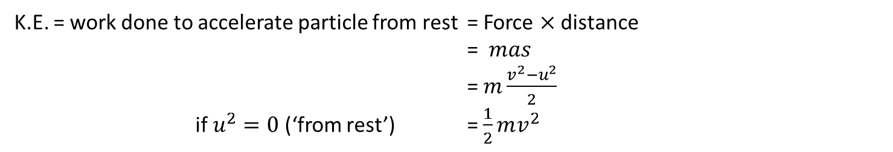

Energy
The Kinetic Energy (K.E.) of an object, mass $m$, speed $v,$ is the energy possessed due to motion
K.E. = $\frac{1}{2}mv^{2}$
Note: $v$ is speed, not velocity. Speed is the magnitude of velocity
The Gravitational Potential Energy$._{1}$ (G.P.E.) is the energy of an object, mass $m$, due to it’s height $h$, above a level defined as G.P.E. = 0.
G.P.E. = $mgh$
Units: Energy, like work, is measured in Joules (J).
$∆$ means ‘the change in’
$∆$ G.P.E. = work done against gravity = $mg$($h_{2}−h_{1})$, if $h_{1}$=0 this gives us G.P.E. =$mgh$
K.E. = work done to accelerate particle from rest = Force $×$ distance
= $mas$
= $m\frac{v^{2}−u^{2}}{2}$
if $u^{2}=0$ (‘from rest’) = $\frac{1}{2}mv^{2}$
Let: F=ma and distance = s
From constant acceleration formulae$._{2}$: $v^{2}=u^{2}+2as$
$⇒ as=\frac{v^{2}−u^{2}}{2}$
P.E. =mgh only in situations where the force due to gravity is considered constant (not true in FM2 Ch5)
K.E. = $\frac{1}{2}mv^{2}$ also applies a is not constant (the proof below is not needed but can be derived using the ideas in CP2 Ch8):
$K.E. = \int{Fdx}$= $\int{m\ddot{x}dx}$ = $\int{m\frac{dv}{dt}dx}$=$m\int{\frac{dv}{dx}\frac{dx}{dt}dx}$=$\int{mv\frac{dv}{dx}dx}=\int{mvdv}$ = $\frac{1}{2}mv^{2}+c$ (as K.E. = 0 when v=0 => c=0)

Slide 7
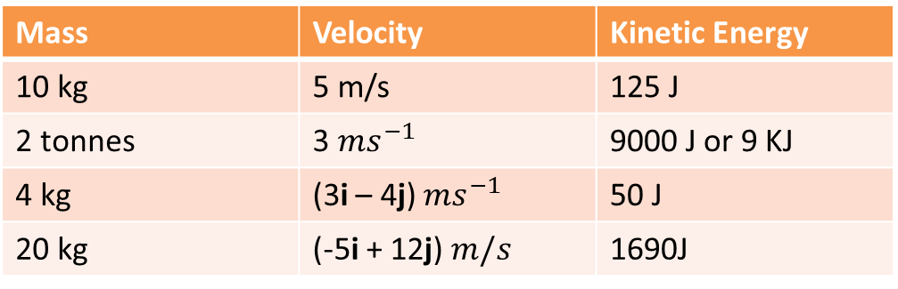
Quickfire Kinetic Energy
Fill in the gaps in the table below
Mass | Velocity | Kinetic Energy
10 kg | 5 m/s | 125 J
2 tonnes | 3 $ms^{−1}$ | 9000 J or 9 KJ
4 kg | (3i – 4j) $ms^{−1}$ | 50 J
20 kg | (-5i + 12j) $m/s$ | 1690J
?
?
?
?

Slide 8

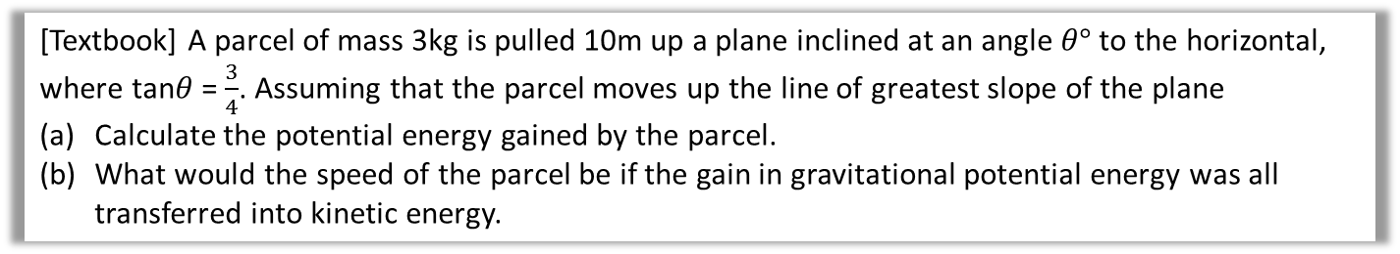
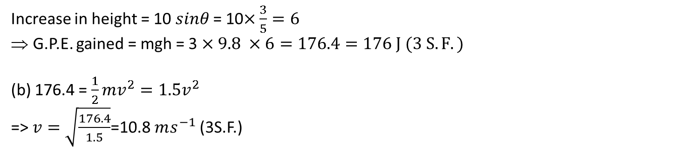

An Example
[Textbook] A parcel of mass 3kg is pulled 10m up a plane inclined at an angle $θ°$ to the horizontal, where tan$θ$ = $\frac{3}{4}$. Assuming that the parcel moves up the line of greatest slope of the plane
Calculate the potential energy gained by the parcel.
What would the speed of the parcel be if the gain in gravitational potential energy was all transferred into kinetic energy.
(a)
Solution to a)
10m
5
3
$$θ°$$
$$θ°$$
4
Increase in height = 10 $sinθ$ = 10$×\frac{3}{5}=6$
G.P.E. gained = mgh = 3 $×9.8 ×6=176.4=176 J (3 S.F.)$
(b) 176.4 = $\frac{1}{2}mv^{2}=1.5v^{2}$
=> $v=\sqrt{\frac{176.4}{1.5}}$=10.8$ms^{−1}$ (3S.F.)
Solution to b)
Note: The answer to part a was given to 3 S.F.(176)
Answers given to more than 3.S.F. claim ‘unjustifiable accuracy’ (as g = 9.8 which is only accurate to 2 S.F). This looses marks in the exam.
Give final answer to 2 or 3 significant figures.
However the full figure (176.4) was used as an input to the working in part b – this ensures answers to subsequent parts are as accurate as possible.
Use unrounded values in working.

Slide 9
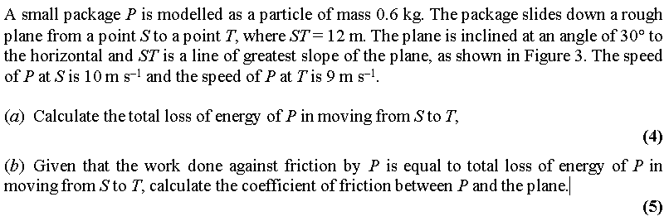
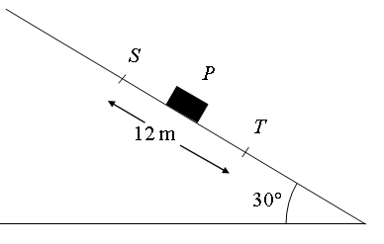
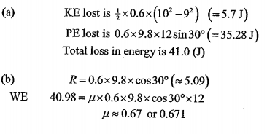
Test Your Understanding
Edexcel M2 Jan 2005 Q3 (modified)
?

Slide 10
Exercise 2B
Pearson Further Mechanics 1
Pages 22-23
Complete before the lesson Q1-2
In Class:
Green Q3-4
Amber Q5-8
Red Q9-11 & challenge

Slide 11
The law of Conservation of Energy
The law of Conservation of Energy: the total energy of an isolated system remains constant
Initial Energy = Final Energy
Some of the initial energy might have been stored in an engine or battery that then does work, transferring this energy to another form.
Some of the energy may be ‘lost’ if the object did work against a resistive force which transfers some energy into heat (and perhaps sound etc.)
Work in + Initial K.E. + Initial G.P.E. = Final K.E. + Final G.P.E. + Work out
Using the formulae we get:
driving force x distance + $\frac{1}{2}mu^{2}$+ $mgh_{1}$= $\frac{1}{2}mv^{2}$+ $mgh_{2}$ + resistance x distance
The idea underlying this formula is the ‘work energy principle’
In chapter 3 we will also add Elastic Potential Energy (the energy stored in a spring) to each side of this equations

Slide 12




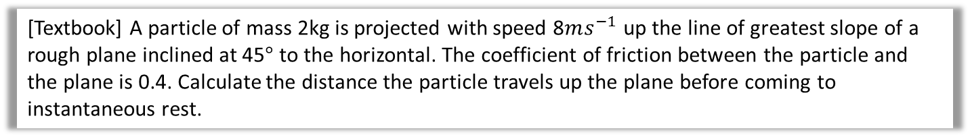

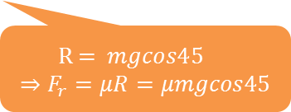



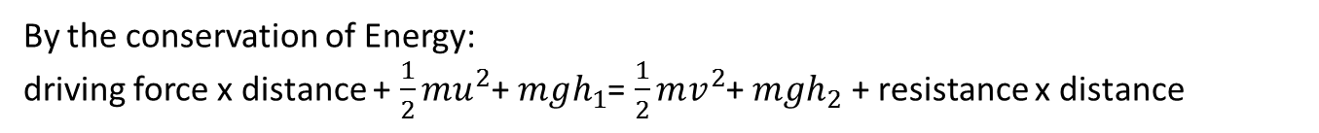
An Example
[Textbook] A particle of mass 2kg is projected with speed 8$ms^{−1}$ up the line of greatest slope of a rough plane inclined at 45$°$ to the horizontal. The coefficient of friction between the particle and the plane is 0.4. Calculate the distance the particle travels up the plane before coming to instantaneous rest.
By the conservation of Energy:
driving force x distance + $\frac{1}{2}mu^{2}$+ $mgh_{1}$= $\frac{1}{2}mv^{2}$+ $mgh_{2}$ + resistance x distance
Driving force?
There is no driving force: The particle is given initial kinetic energy but is not ‘powered’ or ‘driven’ up the slope after the initial ‘projection’
Initial G.P.E?
Define the starting position as G.P.E. =0
Final K.E?
The particle comes to instantaneous rest => Final K.E. = 0
Diagram?
0
$$R$$
8
$$xm$$
$$F_{r}$$
Solution (1st part)
$$\frac{1}{2}×2×8^{2}=2gh_{2}+ F_{r}x$$
$\frac{1}{2}×2×8^{2}=2gxsin45+2μgxcos45$
$x=\frac{64}{2gsin45+2×0.4gcos45}$
$x=3.30m$ (3S.F.) up the plane
$$45°$$
2$g$
$h_{2}$in terms of $x$?
$F_{r}$?
$$h_{2}=xsin 45$$
R = $mgcos45$
$$⇒F_{r}=μR=μmgcos45$$
Solution (remainder)

Slide 13
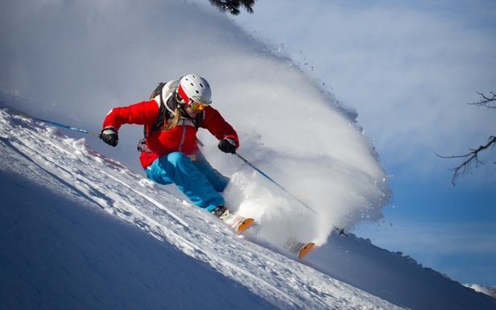
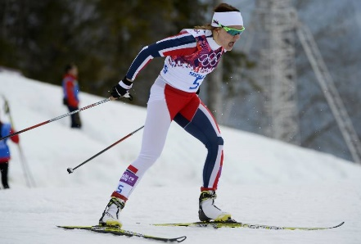
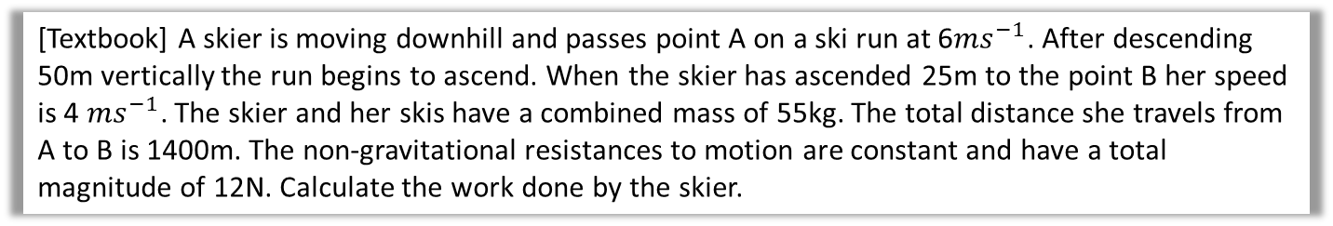
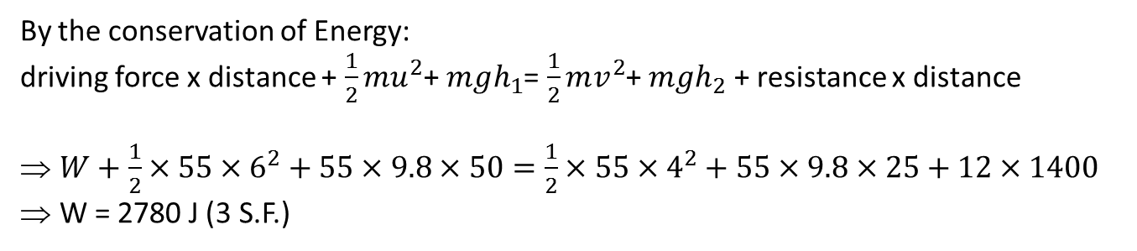
Another Example
[Textbook] A skier is moving downhill and passes point A on a ski run at 6$ms^{−1}$. After descending 50m vertically the run begins to ascend. When the skier has ascended 25m to the point B her speed is 4 $ms^{−1}$. The skier and her skis have a combined mass of 55kg. The total distance she travels from A to B is 1400m. The non-gravitational resistances to motion are constant and have a total magnitude of 12N. Calculate the work done by the skier.
By the conservation of Energy:
driving force x distance + $\frac{1}{2}mu^{2}$+ $mgh_{1}$= $\frac{1}{2}mv^{2}$+ $mgh_{2}$ + resistance x distance
$W+\frac{1}{2}×55×6^{2}+55×9.8×50=\frac{1}{2}×55×4^{2}+55×9.8×25+12×1400$
W = 2780 J (3 S.F.)
?
Note: It is not that common for skiers to ‘do work’. They mostly rely on their G.P.E. to slide downhill.
In this question the skier does do work and may look more like the skier in the bottom of the two pictures on the right.

Slide 14
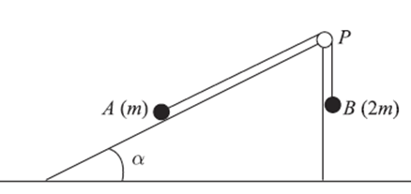
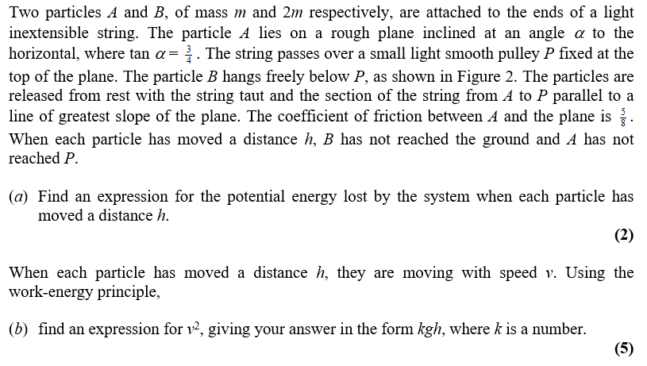
Test Your Understanding
Edexcel M2 June 2007 Q4
Extension: If B starts $s$ meters above the ground$.$ Find an expression, in terms of $s,$ for the total distance travelled by A before it first comes to rest.

Slide 15
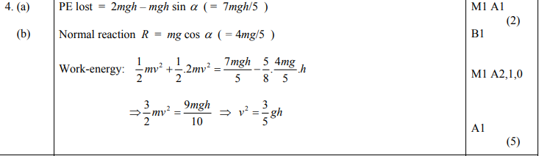
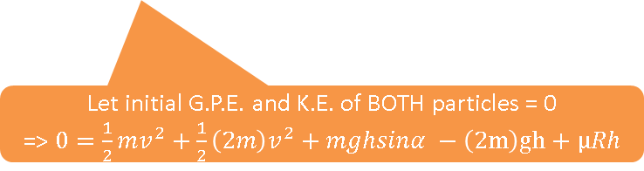

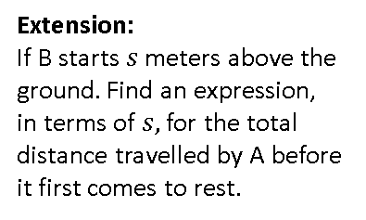
Test Your Understanding
Edexcel M2 June 2007 Q4
Extension:
If B starts $s$ meters above the ground$.$ Find an expression, in terms of $s,$ for the total distance travelled by A before it first comes to rest.
a?
b?
Answer to Extension:
Let extra distance = $x$
=> $\frac{1}{2}mv^{2}=mgh+F_{r}x$
=> $\frac{1}{2}m\frac{3}{5}gs=mgx\frac{3}{5}+\frac{5}{8}mg\frac{4}{5}x$
$\frac{3}{10}s=\frac{11}{10}x$
$x=\frac{3}{11}$
Total distance =$\frac{14s}{11}$
Let initial G.P.E. and K.E. of BOTH particles = 0
=> $0=\frac{1}{2}mv^{2}+\frac{1}{2}\left(2m\right)v^{2}+mghsinα −\left(2m\right)gh+μRh$

Slide 16
Exercise 2C
Pearson Further Mechanics 1
Pages 26-28
Complete before the lesson Q1-4
In Class:
Green Q5-9
Amber Q10-14
Red Q15-19 & challenge

Slide 17

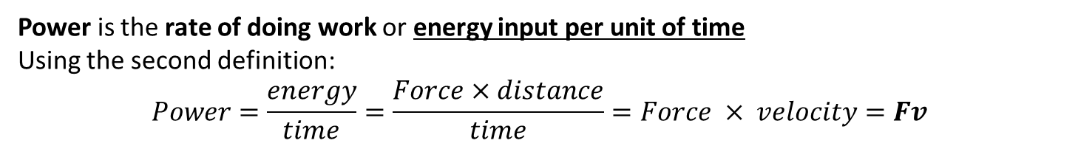

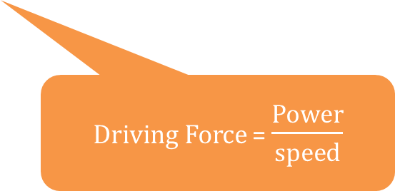
Power
Power is the rate of doing work or energy input per unit of time
Using the second definition:
$$Power=\frac{energy}{time}=\frac{Force×distance}{time}=Force × velocity=Fv$$
?
Directions must be consistent (if not, use components that do have consistent directions)
Units: Power is measured in Watts (W).
A Watt is equivalent to a $Js^{−1}$ or $kgm^{2}s^{−3}$.
driving force x distance + $\frac{1}{2}mu^{2}$+ $mgh_{1}$= $\frac{1}{2}mv^{2}$+ $mgh_{2}$ + resistance x distance
$Driving Force$= $\frac{Power}{speed}$
If $F$ and $v$ are vectors you can use the scalar product to calculate power (there is no evidence that this is required in the exam).

Slide 18
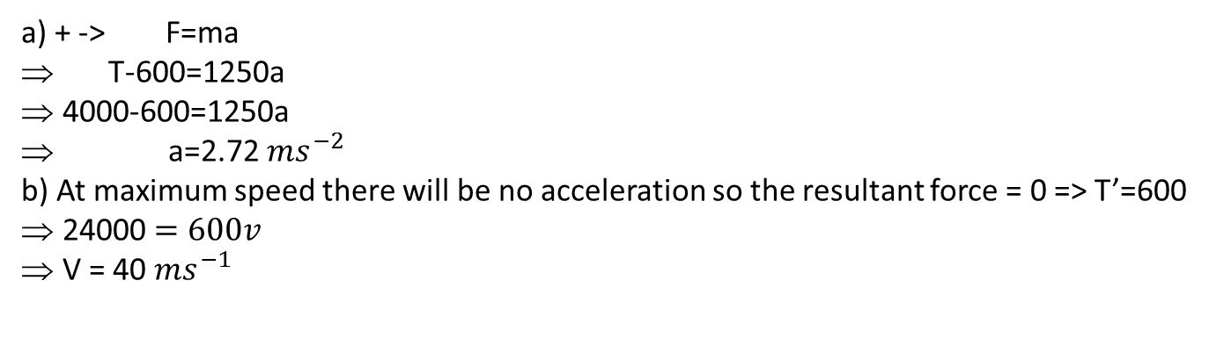
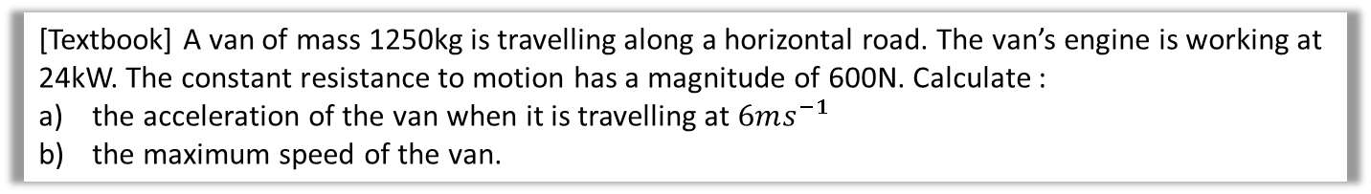
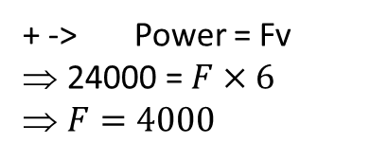
An Example
[Textbook] A van of mass 1250kg is travelling along a horizontal road. The van’s engine is working at 24kW. The constant resistance to motion has a magnitude of 600N. Calculate :
the acceleration of the van when it is travelling at $6ms^{−1}$
the maximum speed of the van.
Diagram?
6
a
600
T
a) + -> F=ma
T-600=1250a
4000-600=1250a
a=2.72 $ms^{−2}$
b) At maximum speed there will be no acceleration so the resultant force = 0 => T’=600
24000 $=600v$
V = 40 $ms^{−1}$
a?
+ -> Power = Fv
24000 = $F×6$
$F=4000$
b?
T’ used instead of T as the force has changed

Slide 19
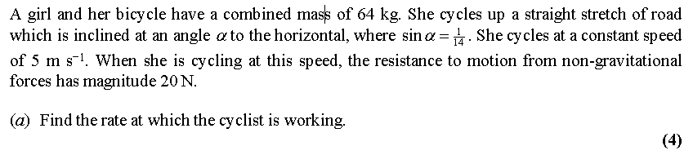
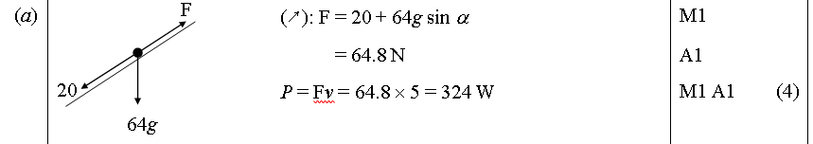
Test Your Understanding
Edexcel M2 June 2003 Q6
?

Slide 20
Exercise 2D
Pearson Further Mechanics 1
Pages 31-33
Complete before the lesson Q1-5
In Class:
Green Q6-10
Amber Q11-13
Red Q14-17

