Slide 1

Further Stats 1 Chapter 3 ::
Geometric and Negative Binomial Distribution
jfrost@tiffin.kingston.sch.uk
www.drfrostmaths.com
@DrFrostMaths
Last modified: 20th July 2018

Slide 2



Register at: www.drfrostmaths.com
Everything is completely free.
Practise questions by chapter, including past paper questions and extension questions (e.g. MAT).
Teachers: you can create student accounts (or students can register themselves).

Slide 3

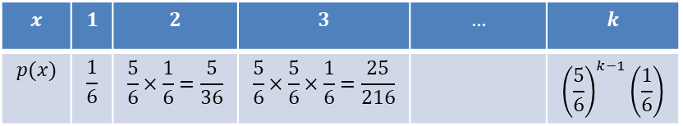
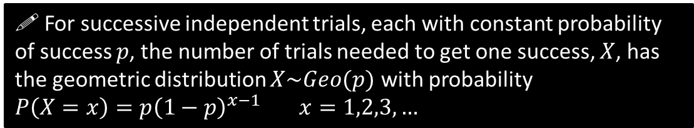
Geometric Distribution
Suppose we roll a fair die. We keep rolling until we roll a 6.
Can you form a distribution for the number of rolls required until this occurs?
$x$ is the number of trials until we stop
$$x$$ | $$1$$ | $$2$$ | $$3$$ | $$…$$ | $$k$$
$$p(x)$$ | $$\frac{1}{6}$$ | $$\frac{5}{6}×\frac{1}{6}=\frac{5}{36}$$ | $$\frac{5}{6}×\frac{5}{6}×\frac{1}{6}=\frac{25}{216}$$ |  | $${\left(\frac{5}{6}\right)}^{k−1}\left(\frac{1}{6}\right)$$
?
?
?
?
We have 1 ‘failure’ before a success on second trial (at which point we stop throwing)
! For successive independent trials, each with constant probability of success $p$, the number of trials needed to get one success, $X$, has the geometric distribution $X\sim Geo(p)$ with probability
$P\left(X=x\right)=p{\left(1−p\right)}^{x−1}$ $x=1,2,3,…$
It is known as a geometric distribution because the sequence of probabilities forms a geometric sequence, with first term $a=p$ and common ratio $r=1−p$. The probabilities add up to $S_{∞}=\frac{a}{1−r}=\frac{p}{1−\left(1−p\right)}=1$ as expected.

Slide 4
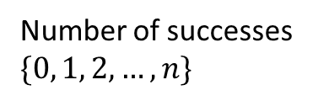
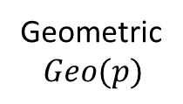
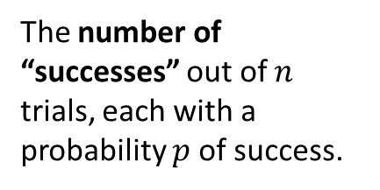
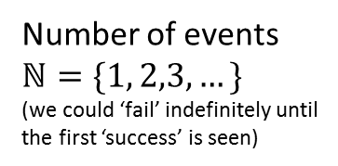
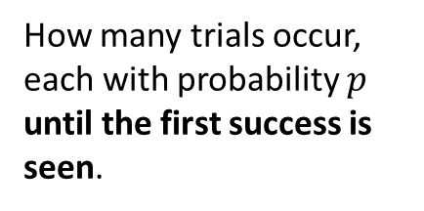
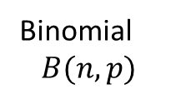
Binomial vs Geometric Distribution
Name
Description
Outcomes
?
Number of successes
$$\{0, 1, 2, …, n\}$$
Binomial
$$B(n,p)$$
The number of “successes” out of $n$ trials, each with a probability $p$ of success.
?
?
Number of events
$$ℕ=\{1, 2,3, …\}$$
(we could ‘fail’ indefinitely until the first ‘success’ is seen)
Geometric
$$Geo(p)$$
How many trials occur, each with probability $p$ until the first success is seen.
?

Slide 5
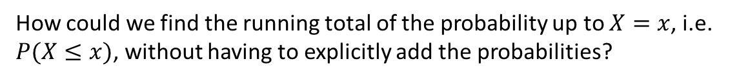
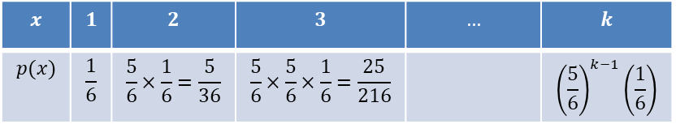
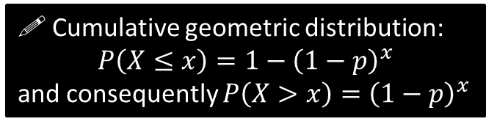


Cumulative Geometric Distribution
$$x$$ | $$1$$ | $$2$$ | $$3$$ | $$…$$ | $$k$$
$$p(x)$$ | $$\frac{1}{6}$$ | $$\frac{5}{6}×\frac{1}{6}=\frac{5}{36}$$ | $$\frac{5}{6}×\frac{5}{6}×\frac{1}{6}=\frac{25}{216}$$ |  | $${\left(\frac{5}{6}\right)}^{k−1}\left(\frac{1}{6}\right)$$
How could we find the running total of the probability up to $X=x$, i.e. $P(X≤x)$, without having to explicitly add the probabilities?
Method 1
Method 2
?
?
Sum of a geometric series:
$$a=p, r=1−p, n=x$$
$$P\left(X≤x\right)=S_{n} \\ =\frac{a\left(1−r^{n}\right)}{1−r}=\frac{p\left(1−{\left(1−p\right)}^{x}\right)}{1−(1−p)}=1−{\left(1−p\right)}^{x}$$
Consider the opposite!
What is the opposite of “the success appeared within the first $x$ throws”?
$→$“the success didn’t appear in the first $x$ throws”, i.e. the first $x$ throws were failures: ${\left(1−p\right)}^{x}$
$$∴P\left(X≤x\right)=1−{\left(1−p\right)}^{x}$$
! Cumulative geometric distribution:
$$P\left(X≤x\right)=1−{\left(1−p\right)}^{x}$$
and consequently $P\left(X>x\right)={\left(1−p\right)}^{x}$

Slide 6
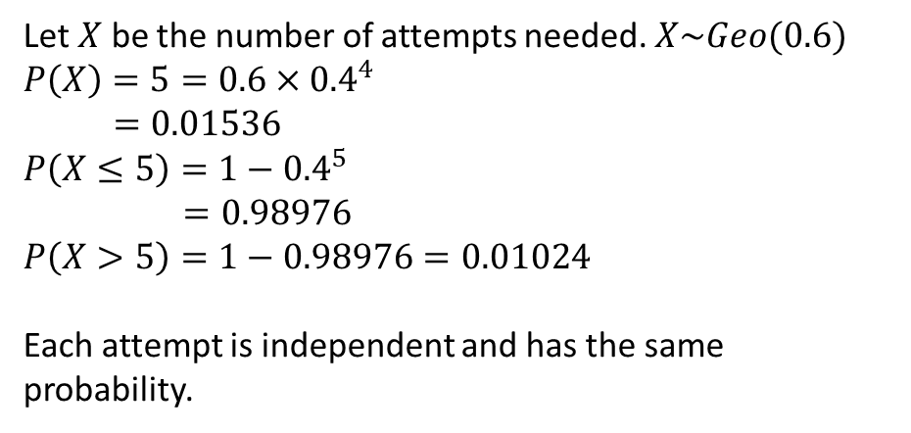
Example
[Textbook] The probability that Genevieve passes her driving test on any one attempt is 0.6.
Find the probability that:
(i) she passes on her fifth attempt
(ii) she needs five or fewer attempt to pass
(iii) she needs more than five attempts to pass.
(b) State two assumptions you have used in your calculation
a
i
Let $X$ be the number of attempts needed. $X\sim Geo(0.6)$
$P\left(X\right)=5=0.6×{0.4}^{4}$
$=0.01536$
$P\left(X≤5\right)=1−{0.4}^{5}$
$=0.98976$
$P\left(X>5\right)=1−0.98976=0.01024$
Each attempt is independent and has the same probability.
?
ii
?
iii
?
b
?

Slide 7
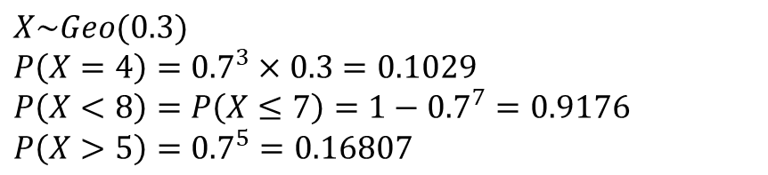
Test Your Understanding
A teacher will keep explaining how to answer a question about geometric distributions until the class all understands it. The probability they all understand the explanation each time is 0.3.
Determine the probability that the teacher will have to explain it:
Exactly 4 times
Less than 8 times.
More than 5 times.
a
?
$X\sim Geo(0.3)$
$P\left(X=4\right)={0.7}^{3}×0.3=0.1029$
$P\left(X<8\right)=P\left(X≤7\right)=1−{0.7}^{7}=0.9176$
$P\left(X>5\right)={0.7}^{5}=0.16807$
b
?
c
?

Slide 8
Exercise 3A
Pearson Further Statistics 1
Pages 45-47
Complete before the lesson Q1-3
In Class:
Green Q4-5
Amber Q6-7
Red Q8-11

Slide 9
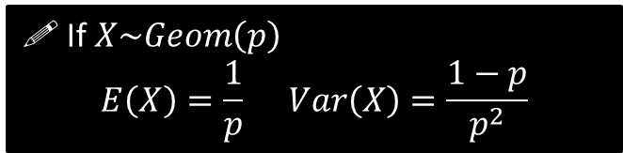
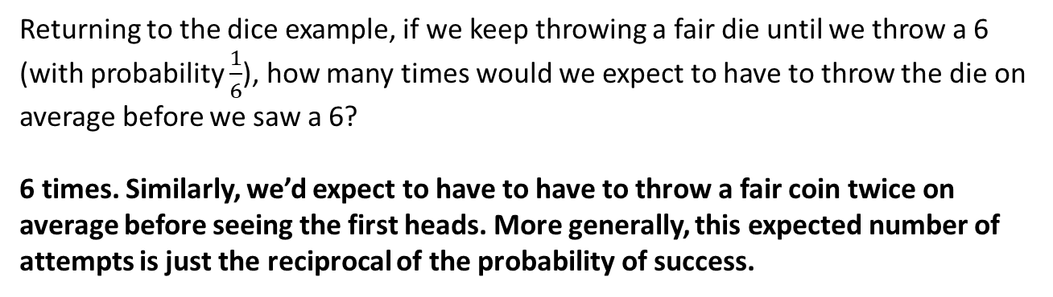
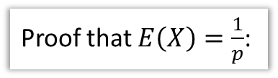

Mean and Variance
Returning to the dice example, if we keep throwing a fair die until we throw a 6 (with probability $\frac{1}{6}$), how many times would we expect to have to throw the die on average before we saw a 6?
6 times. Similarly, we’d expect to have to have to throw a fair coin twice on average before seeing the first heads. More generally, this expected number of attempts is just the reciprocal of the probability of success.
! If $X\sim Geom\left(p\right)$
$$E\left(X\right)=\frac{1}{p} Var\left(X\right)=\frac{1−p}{p^{2}}$$
Proof that $E\left(X\right)=\frac{1}{p}$:
?
$$E\left(X\right)=Σ_{x=1}^{∞}x p\left(x\right) \\ E\left(X\right) =1 p + 2\left(1−p\right)p+3{\left(1−p\right)}^{2}p+… \\ \left(1−p\right)E\left(X\right)= 1\left(1−p\right)p+2{\left(1−p\right)}^{2}p+…$$
Subtracting:
$$E\left(X\right)\left[1−\left(1−p\right)\right]=p+p\left(1−p\right)+p{\left(1−p\right)}^{2}+…$$
This is an infinite geometric series with $a=p, r=1−p$
$$S_{∞}=\frac{a}{1−r}=\frac{p}{1−\left(1−p\right)}=1 \\ ∴pE\left(X\right)=1 → E\left(X\right)=\frac{1}{p}$$
This strategy is similar to that of proving the sum of a geometric series. We find something suitable to multiply by; this effectively shifts the terms along so that subtracting the two sequences yields a simpler sequence that is easily simplified.

Slide 10
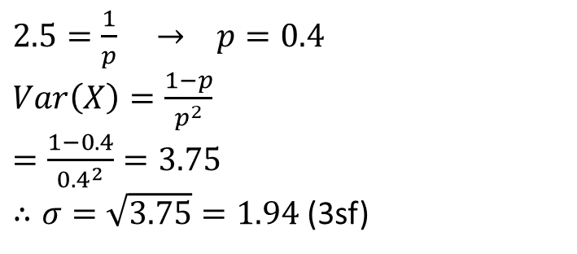
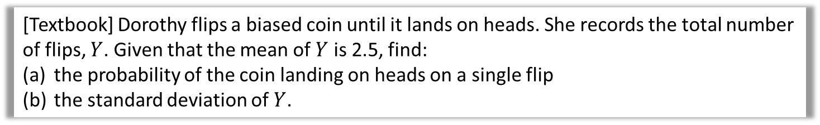
Examples
[Textbook] Dorothy flips a biased coin until it lands on heads. She records the total number of flips, $Y$. Given that the mean of $Y$ is 2.5, find:
the probability of the coin landing on heads on a single flip
the standard deviation of $Y$.
$2.5=\frac{1}{p} → p=0.4$
$Var\left(X\right)=\frac{1−p}{p^{2}}$
$=\frac{1−0.4}{{0.4}^{2}}=3.75$
$∴σ=\sqrt{3.75}=1.94$ (3sf)
a
?
b
?

Slide 11



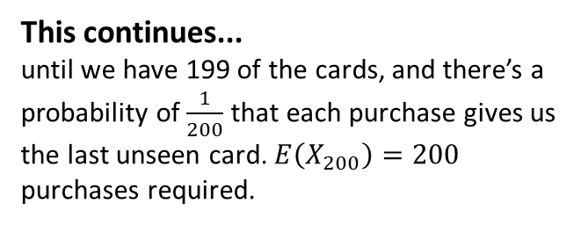


The time Dr Frost solved a maths problem for
It is known as the ‘coupon collector’s problem’.
The key is dividing purchasing into separate stages where each stage involves getting the next unseen card…
My mum, who worked at John Lewis, was selling London Olympics ‘trading cards’, of which there were about 200 different cards to collect, and could be bought in packs. Her manager was curious how many cards you would have to buy on average before you collected them all. The problem naturally was passed on to me.
We’ll solve it in a Mo…
Stage 1: Getting the first card.
We get a new card immediately on the first purchase. So 1 card purchase required.
This continues...
until we have 199 of the cards, and there’s a probability of $\frac{1}{200}$ that each purchase gives us the last unseen card. $E\left(X_{200}\right)=200$ purchases required.
Stage 2: Getting the second card.
We can describe the number of purchases required, before an unseen card is seen, as a geometric distribution.
There is a $\frac{199}{200}$ probability of seeing an unseen card on each purchase. So number of purchases required $X_{2}\sim Geo\left(\frac{199}{200}\right)$ and $E\left(X_{2}\right)=\frac{200}{199}$
The total number of cards on average we need to buy is therefore:
$$\frac{200}{200}+\frac{200}{199}+…+\frac{200}{2}+\frac{200}{1} \\ =200\left(\frac{1}{200}+\frac{1}{199}+…+\frac{1}{2}+1\right) \\ =200×H_{200}=1176 cards$$
where $H_{200}$ is a partial sum of the ‘Harmonic series’.
Stage 3: Getting the third card.
There is a $\frac{198}{200}$ probability of seeing an unseen card on each purchase (as we already possess two cards). So number of purchases required $X_{3}\sim Geo\left(\frac{198}{200}\right)$ and $E\left(X\right)=\frac{200}{198}$
You’re welcome John Lewis.

Slide 12

Exercise 3B
Complete before the lesson Q1-2
Green Q3-4
Amber Q5-6
Red Q7-10
Pearson Further Statistics 1
Pages 47-49
N
One way in which we can use a biased coin, with probability of heads of $p$, to model a fair coin, is to use the following process:
Flip the unfair coin twice.
If the first flip is Heads and the second Tails, declare “Heads”.
If the second flip is Tails and the second Heads, declare “Tails”.
Otherwise, go back to step 1 until a declaration is made.
Determine the average number of flips required of the biased coin, before we can declare “Heads” or “Tails”.
The probability of declaring is $p\left(1−p\right)+p\left(1−p\right)=2p(1−p)$
So number of times we do this process: $X\sim Geo\left(2p\left(1−p\right)\right).$
$E\left(X\right)=\frac{1}{2p\left(1−p\right)}$, but each application of the process involves 2 flips of the coin, so $\frac{2}{2p\left(1−p\right)}=\frac{1}{p\left(1−p\right)}$ flips required on average.
?

Slide 13
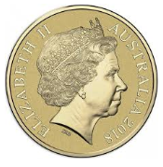
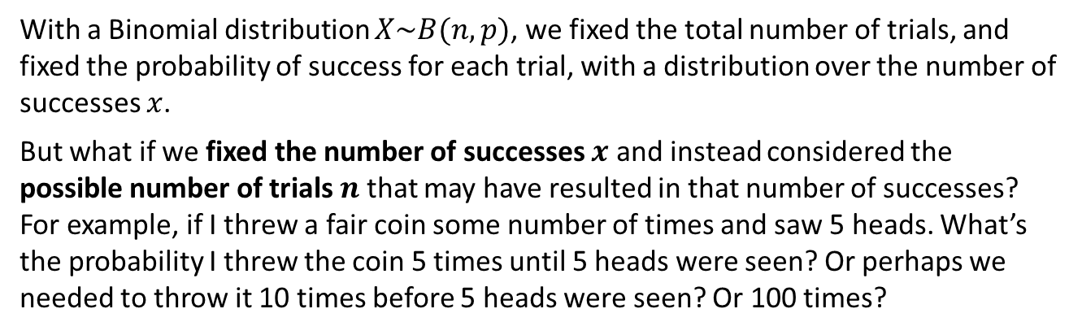
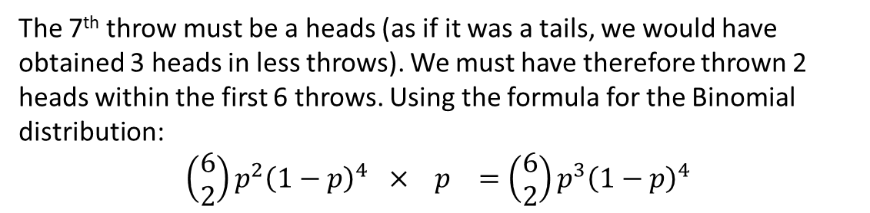
Negative Binomial
With a Binomial distribution $X\sim B(n,p)$, we fixed the total number of trials, and fixed the probability of success for each trial, with a distribution over the number of successes $x$.
But what if we fixed the number of successes $x$ and instead considered the possible number of trials $n$ that may have resulted in that number of successes?
For example, if I threw a fair coin some number of times and saw 5 heads. What’s the probability I threw the coin 5 times until 5 heads were seen? Or perhaps we needed to throw it 10 times before 5 heads were seen? Or 100 times?
I throw a biased coin, with probability $p$ of heads, 7 times, until I see $3$ heads. Determine the probability of this occurring.
?
The 7th throw must be a heads (as if it was a tails, we would have obtained 3 heads in less throws). We must have therefore thrown 2 heads within the first 6 throws. Using the formula for the Binomial distribution:
$$\left(\begin{matrix}6 \\ 2\end{matrix}\right)p^{2}{\left(1−p\right)}^{4} × p =\left(\begin{matrix}6 \\ 2\end{matrix}\right)p^{3}{\left(1−p\right)}^{4}$$

Slide 14

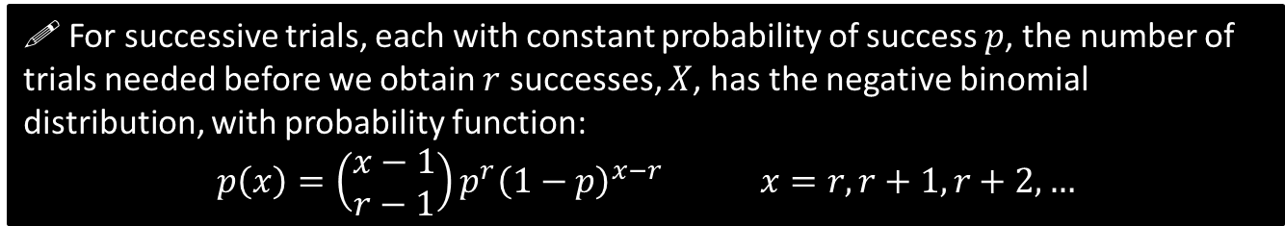


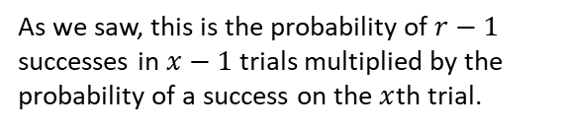
Negative Binomial
! For successive trials, each with constant probability of success $p$, the number of trials needed before we obtain $r$ successes, $X$, has the negative binomial distribution, with probability function:
$$p\left(x\right)=\left(\begin{matrix}x−1 \\ r−1\end{matrix}\right)p^{r}{\left(1−p\right)}^{x−r} x=r,r+1,r+2,…$$
As we saw, this is the probability of $r−1$ successes in $x−1$ trials multiplied by the probability of a success on the $x$th trial.
If we saw $r$ heads, we know we had to flip the coin at least $r$ times to obtain this.
[Textbook] Philomena is practising her piano scales. The probability that she completes a scale correctly on any one attempt is 0.4. She continues practising until she has completed four scales correctly.
Find the probability that she completes her fourth correct scale on her 12th attempt.
Find the probability that she completes her fourth correct scale on her 10th attempt, given that her first scale was correct.
Let $X$ be the number of attempts needed to complete four scales without error. $X\sim Negative B(4,0.4)$
$$P\left(X=12\right)=\left(\begin{matrix}11 \\ 3\end{matrix}\right)×{0.4}^{4}×{0.6}^{8} \\ =0.0709$$
b
After the first success, she needs to have 3 further successes in the next 9 attempts. $Y\sim NB(3,0.4)$
$$P\left(Y=9\right)=\left(\begin{matrix}8 \\ 2\end{matrix}\right)×{0.4}^{3}×{0.6}^{6} \\ =0.0836$$
a
?
?

Slide 15
Exercise 3C
Pearson Further Statistics 1
Pages 51-52
Complete before the lesson Q1-3
In Class:
Green Q4-5
Amber Q6-7
Red Q8-10 & Challenge

Slide 16
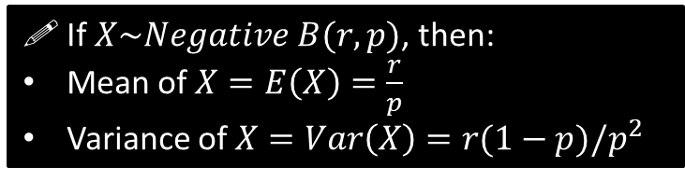
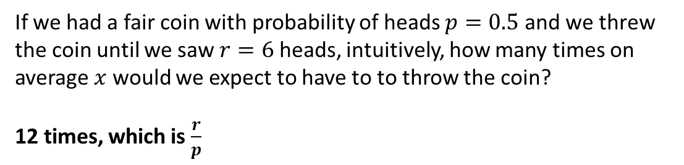

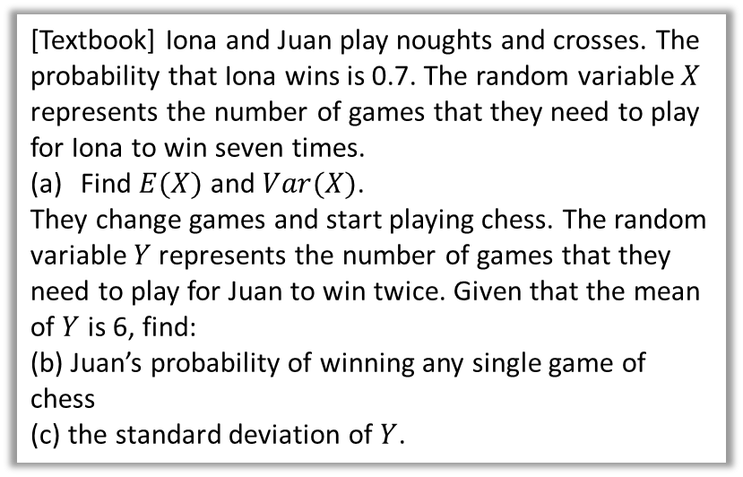
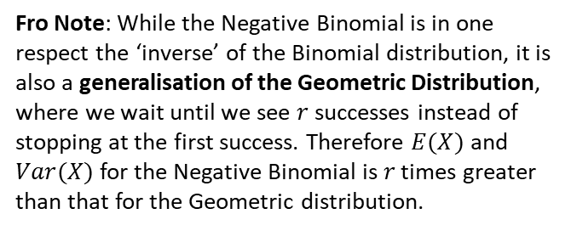
Mean and variance of Negative Binomial
If we had a fair coin with probability of heads $p=0.5$ and we threw the coin until we saw $r=6$ heads, intuitively, how many times on average $x$ would we expect to have to to throw the coin?
12 times, which is $\frac{r}{p}$
?
Fro Note: While the Negative Binomial is in one respect the ‘inverse’ of the Binomial distribution, it is also a generalisation of the Geometric Distribution, where we wait until we see $r$ successes instead of stopping at the first success. Therefore $E(X)$ and $Var(X)$ for the Negative Binomial is $r$ times greater than that for the Geometric distribution.
! If $X\sim Negative B(r,p)$, then:
Mean of $X=E\left(X\right)=\frac{r}{p}$
Variance of $X=Var\left(X\right)=r(1−p)/p^{2}$
a
$$X\sim Negative B\left(7,0.7\right) \\ E\left(X\right)=\frac{r}{p}=\frac{7}{0.7}=10 \\ Var\left(X\right)=\frac{7\left(1−0.7\right)}{{0.7}^{2}}=4.286$$
$$Y\sim Negative B\left(2,p\right) \\ \frac{2}{p}=6 ⇒ p=\frac{1}{3}$$
$$σ=\sqrt{\frac{2\left(1−\frac{1}{3}\right)}{{\left(\frac{1}{3}\right)}^{2}}}=3.46$$
?
[Textbook] Iona and Juan play noughts and crosses. The probability that Iona wins is 0.7. The random variable $X$ represents the number of games that they need to play for Iona to win seven times.
Find $E(X)$ and $Var(X)$.
They change games and start playing chess. The random variable $Y$ represents the number of games that they need to play for Juan to win twice. Given that the mean of $Y$ is 6, find:
(b) Juan’s probability of winning any single game of chess
(c) the standard deviation of $Y$.
b
?
c
?

Slide 17
Exercise 3D
Pearson Further Statistics 1
Pages 53-54
Complete before the lesson Q1-3
In Class:
Green Q4-5
Amber Q6-7
Red Q8-10

Slide 18
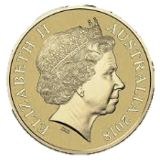







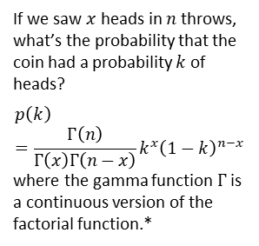
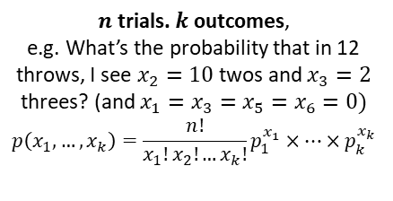
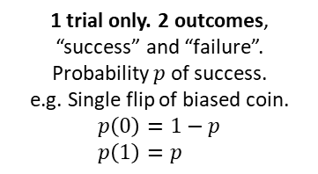




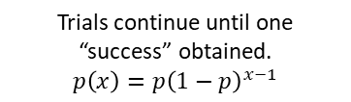



All Probability Distributions involving Successive Trials
$n$ trials. 2 outcomes
$x$ successes
BERNOULLI DISTRIBUTION
(not in A Level spec)
Fix $n$ and $x$. $p$ varies
BETA
DISTRIBUTION
(not in A Level spec)
1 trial only. 2 outcomes, “success” and “failure”.
Probability $p$ of success.
e.g. Single flip of biased coin.
$$p\left(0\right)=1−p \\ p\left(1\right)=p$$
Fix $n$ and $p$. $x$ varies
Fix $x$ and $p$. $n$ varies
If we saw $x$heads in $n$ throws, what’s the probability that the coin had a probability $k$ of heads?
$$p\left(k\right)=\frac{Γ\left(n\right)}{Γ\left(x\right)Γ\left(n−x\right)}k^{x}{\left(1−k\right)}^{n−x}$$
where the gamma function $Γ$ is a continuous version of the factorial function.*
BINOMIAL DISTRIBUTION
NEGATIVE BINOMIAL
DISTRIBUTION
$$p\left(x\right)=\frac{n!}{x!\left(n−x\right)!}p^{x}{\left(1−p\right)}^{n−x}$$
$$p\left(n\right)=\left(\begin{matrix}n−1 \\ x−1\end{matrix}\right)p^{x}{\left(1−p\right)}^{n−x}$$
Generalise to $k$ outcomes
Generalise to $k$ outcomes
Generalise to $x$ successes
Generalise to $n$ trials
MULTINOMIAL DISTRIBUTION
(not in A Level spec)
GEOMETRIC DISTRIBUTION
MULTIVARIATE DISTRIBUTION
(not specifically named in A Level spec)
$n$ trials. $k$ outcomes,
e.g. What’s the probability that in 12 throws, I see $x_{2}=10$ twos and $x_{3}=2$ threes? (and $x_{1}=x_{3}=x_{5}=x_{6}=0)$
$$p\left(x_{1},…,x_{k}\right)=\frac{n!}{x_{1}!x_{2}!…x_{k}!}p_{1}^{x_{1}}×…×p_{k}^{x_{k}}$$
Trials continue until one “success” obtained.
$$p\left(x\right)=p{\left(1−p\right)}^{x−1}$$
Generalise to $k$ outcomes
1 trial only. $k$ outcomes,
e.g. single throw of unfair die
$$x$$ | $$1$$ | $$2$$ | $$3$$ | $$4$$ | $$5$$ | $$6$$
$$p(x)$$ | $$0.1$$ | $$0.3$$ | $$0.2$$ | $$0.2$$ | $$0.1$$ | $$0.1$$
DIRICHLET
DISTRIBUTION
(not in A Level spec)
www.drfrostmaths.com
* Unfortunately for historical reasons, $Γ\left(x\right)=\left(x−1\right)!$ rather than $x!$. For consistency with the other formulae I assume $Γ\left(x\right)=x!$

