Slide 1
Year 1 Pure Mathematics
Sketching Graphs
Transformations
Chapter 4
(Part 4 of 4)

Slide 2
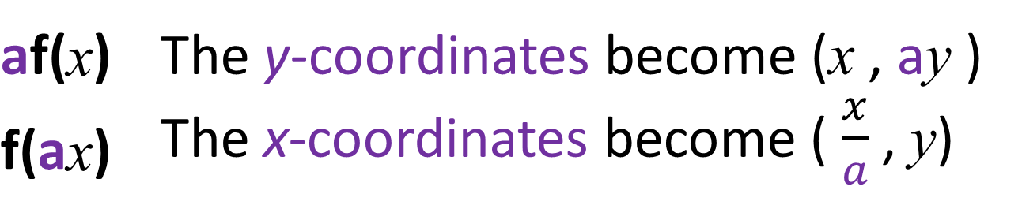
Transformations of Functions
f(x) + a |  | The graph moves up
f(x) - a |  | The graph moves down
f(x + a) |  | The graph moves left
f(x – a) |  | The graph moves right
af(x) | The y-coordinates become (x , ay )
f(ax) | The x-coordinates become ( $\frac{x}{a}$ , y)
-f(x) | The graph is reflected in the x axis
f(-x) | The graph is reflected in the y axis

Slide 3

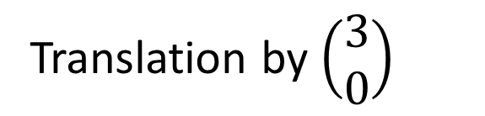
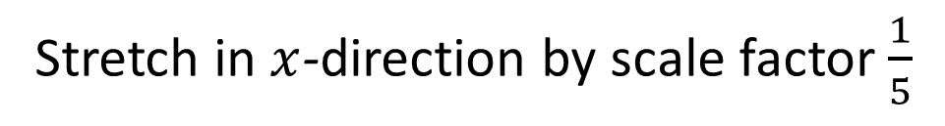


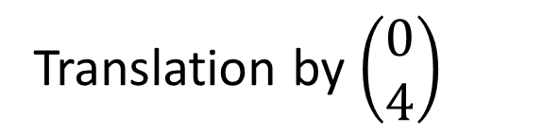


Transformations of Functions
What are the transformations?
Translation by $\left(\begin{matrix}3 \\ 0\end{matrix}\right)$
$$y=f\left(x−3\right)$$
$$y=f\left(x\right)+4$$
Translation by $\left(\begin{matrix}0 \\ 4\end{matrix}\right)$
$$y=f\left(5x\right)$$
Stretch in $x$-direction by scale factor $\frac{1}{5}$
$$y=2f\left(x\right)$$
Stretch in $x$-direction by scale factor 2

Slide 4

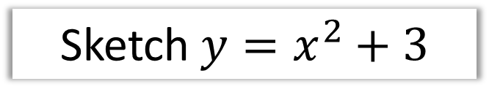
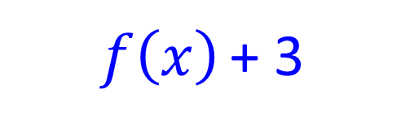

Transformations
$$y=x^{2}$$
Sketch $y=x^{2}+3$
$$f\left(x\right)$$
$f\left(x\right)$ + 3
y
y
3
x
x

Slide 5
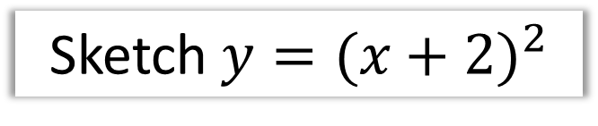

Transformations
$$y=x^{2}$$
Sketch $y={(x+2)}^{2}$
$$f\left(x\right)$$
$f\left(x+2\right)$
y
y
x
x
2

Slide 6





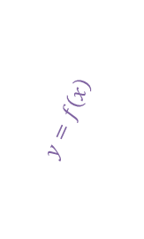

Transformations
$$f\left(x\right)$$
Sketch $−f\left(x\right)$
$$y$$
$$y$$
$$y=f\left(x\right)$$
$$x$$
$$x$$
-2
-2

Slide 7





Transformations
$$f\left(x\right)$$
Sketch $f$($\frac{x}{3}$)
$$y$$
$$y$$
-1
2
$$x$$
$$x$$
-3
6
-2
-2

Slide 8





Transformations
$$f\left(x\right)$$
Sketch $f$($2x$)
$$y$$
$$y$$
$$x$$
$$x$$
4
2

Slide 9






Transformations of Functions
$$f\left(x\right)$$
Sketch $f$($x$) + 2
$$y$$
$$y$$
$$y=2$$
$$x$$
$$x$$

Slide 10









Transformations
$$y=\frac{2}{x}$$
Sketch $y=\frac{2}{x+1}$
$$f\left(x\right)$$
$f\left(x+1\right)$
$$y$$
$$y$$
$$x=−1$$
2
$$x$$
$$x$$

Slide 11
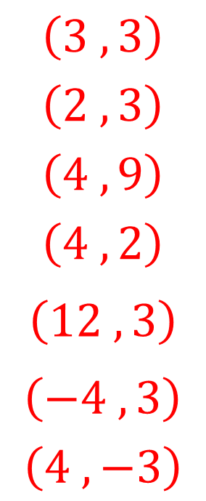
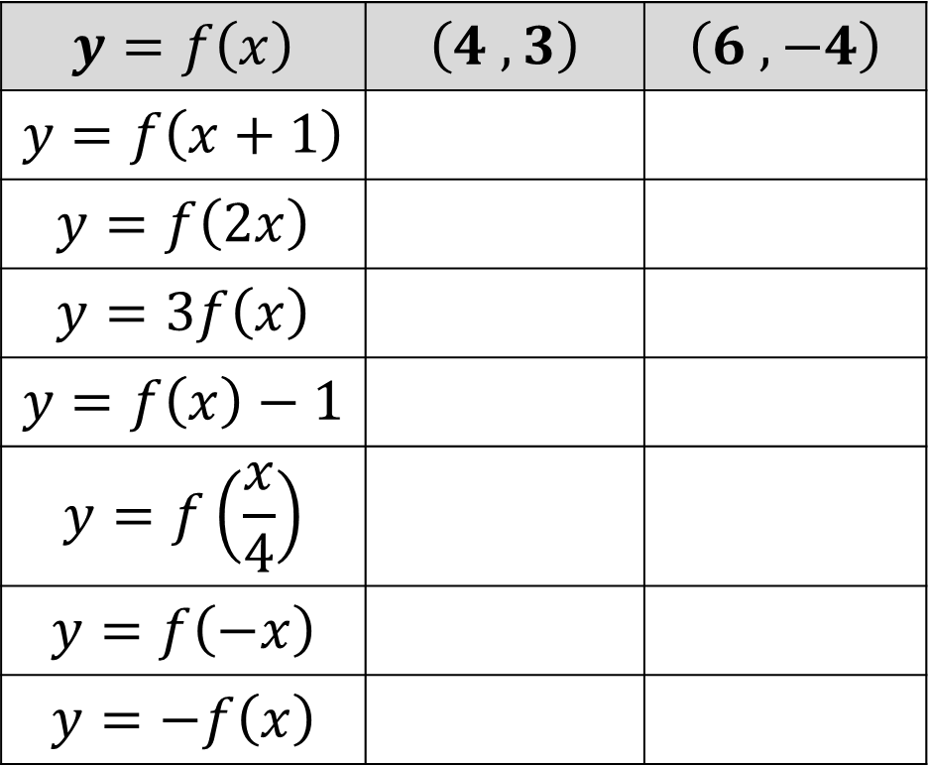
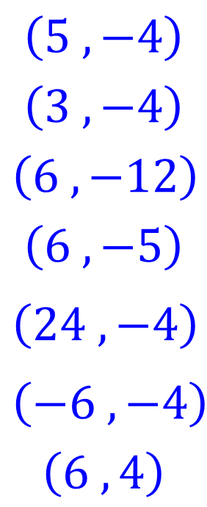
Transformations - Coordinates
Where would each of these points end up?
$$y=f\left(x\right)$$ | $$\left(4 ,3\right)$$ | $$\left(6 ,−4\right)$$
$$y=f\left(x+1\right)$$
$$y=f\left(2x\right)$$
$$y=3f\left(x\right)$$
$$y=f\left(x\right)−1$$
$$y=f\left(\frac{x}{4}\right)$$
$$y=f\left(−x\right)$$
$$y=−f\left(x\right)$$
$$\left(3 ,3\right)$$
$$\left(2 ,3\right)$$
$$\left(4 ,9\right)$$
$$\left(4 ,2\right)$$
$$\left(12 ,3\right)$$
$$\left(−4 ,3\right)$$
$$\left(4 ,−3\right)$$
$$\left(5 ,−4\right)$$
$$\left(3 , −4\right)$$
$$\left(6 ,−12\right)$$
$$\left(6 ,−5\right)$$
$$\left(24 ,−4\right)$$
$$\left(−6 ,−4\right)$$
$$\left(6 ,4\right)$$

Slide 12
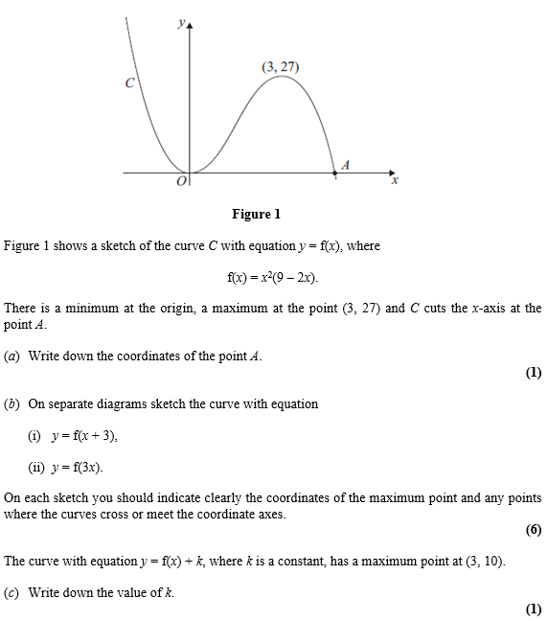
Transformations – Exam Question

Slide 13
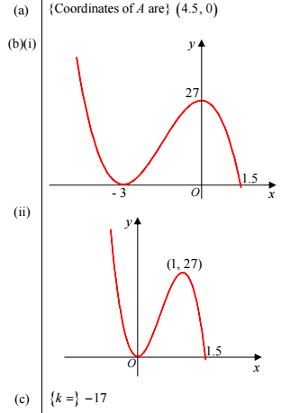
Transformations – Exam Question Answers

Slide 14
Exercise 4E/4F
Pearson Pure Mathematics Year 1/AS
Pages 74-75 (translations), 78 (stretches/reflections)
Complete before the lesson Q1 from Ex4E & F
Green Q2-6 on both
Amber Q7&8 on both
Red complete both and Challenges

Slide 15
Exercise 4G
Pearson Pure Mathematics Year 1/AS
Pages 80-81
Complete before the lesson Q1,2 & 4
Green Q5
Amber Q6

