Slide 1
Vectors
You need to know the definition of the scalar product of two vectors in 2 or 3 dimensions, and how it can be used to calculate the angle between 2 vectors
On the diagram to the right, the angle between a and b is θ. The two vectors must be directed away from point X
On the second diagram, vector b is directed towards X. Hence, the angle between the two vectors is 160°.
This comes from re-drawing the diagram with vector b pointing away from point X.
a
30°
X
b
a
20°
X
b
a
160°
20°
b
X
b
9C

Slide 2

Vectors
You need to know the definition of the scalar product of two vectors in 2 or 3 dimensions, and how it can be used to calculate the angle between 2 vectors
The scalar product of two vectors a and b is written as a.b (‘a dot b’) and is defined by:
The scalar product can be thought of as ‘the effect of one of the two vectors on the other’
Vector multiplication
a
b
a.b = |a||b|
By multiplication
$$a.b=\left|a\right||b|cosθ$$
a
θ
b
In this case, the vector a can be split into a horizontal and vertical component
→ Here we only consider the horizontal component as this is in the direction of vector b
|a|cosθ
a.b = |a|cosθ|b|
This is the formula for the scalar ‘dot’ product of 2 vectors
By GCSE trigonometry
a.b = |a||b|cosθ
9C

Slide 3
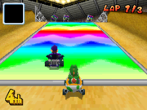
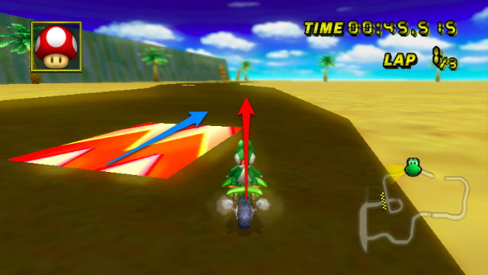

Vectors
$$a.b=\left|a\right||b|cosθ$$
You need to know the definition of the scalar product of two vectors in 2 or 3 dimensions, and how it can be used to calculate the angle between 2 vectors
Explanation source
Example 1
Example 2
a
a
b
θ
b
|a|cosθ
Two vectors in the same direction will have the biggest overall product
If they are not parallel, some of the maximum product is lost (due to Cosine)
9C

Slide 4
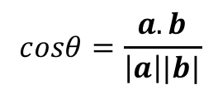
Vectors
$$a.b=\left|a\right||b|cosθ$$
You need to know the definition of the scalar product of two vectors in 2 or 3 dimensions, and how it can be used to calculate the angle between 2 vectors
The scalar product of two vectors a and b is written as a.b (‘a dot b’) and is defined by:
This formula can be rewritten in order to find the angle between 2 vectors:
a
b
If two vectors are perpendicular, then the angle between them is 90°.
As cos90° = 0, this will cause the dot product to be 0 as well
Hence, if vectors are perpendicular, the dot product is 0
If the dot product is 0, the vectors are perpendicular
$$a.b=\left|a\right||b|cosθ$$
$$cosθ=\frac{a.b}{\left|a\right||b|}$$
This leads to a potential problem though – if we need to find the angle, we need to know the dot product
So we must have a way to find the dot product, without using the angle itself…
9C

Slide 5
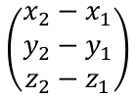




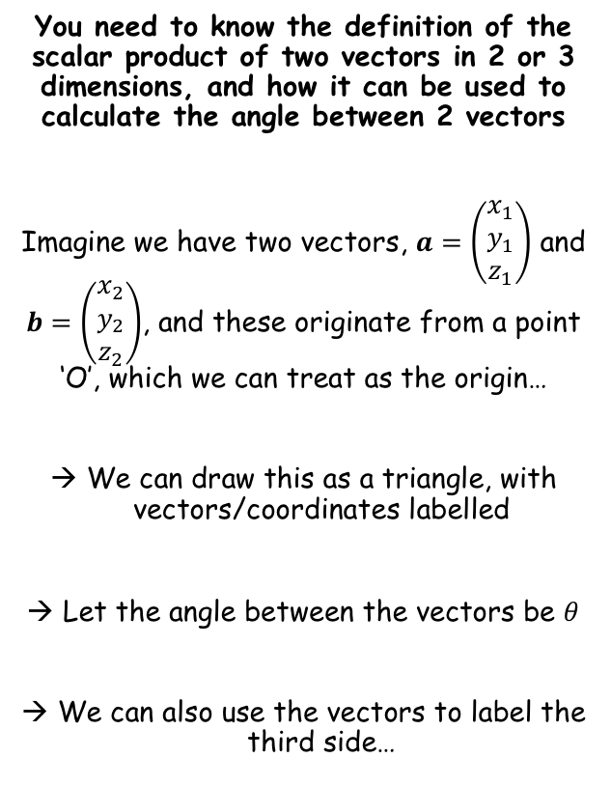









Vectors
$$a.b=\left|a\right||b|cosθ$$
$$cosθ=\frac{a.b}{\left|a\right||b|}$$
$$(x_{1},y_{1},z_{1})$$
$$\left(\begin{matrix}x_{1} \\ y_{1} \\ z_{1}\end{matrix}\right)$$
$$\left(\begin{matrix}x_{2}−x_{1} \\ y_{2}−y_{1} \\ z_{2}−z_{1}\end{matrix}\right)$$
You need to know the definition of the scalar product of two vectors in 2 or 3 dimensions, and how it can be used to calculate the angle between 2 vectors
Imagine we have two vectors, $a=\left(\begin{matrix}x_{1} \\ y_{1} \\ z_{1}\end{matrix}\right)$ and $b=\left(\begin{matrix}x_{2} \\ y_{2} \\ z_{2}\end{matrix}\right)$, and these originate from a point ‘O’, which we can treat as the origin…
We can draw this as a triangle, with vectors/coordinates labelled
Let the angle between the vectors be $θ$
We can also use the vectors to label the third side…
$$a$$
$$b−a$$
O
$$θ$$
$$(0,0,0)$$
$$\left(\begin{matrix}x_{2} \\ y_{2} \\ z_{2}\end{matrix}\right)$$
$$b$$
$$(x_{2},y_{2},z_{2})$$
→ We can use the cosine rule to link the angle to the vectors/sides…
$$a^{2}=b^{2}+c^{2}−2bcCosA$$
For this we need the magnitude of each side…
$$\left|a\right|=\sqrt{\left(x_{1}^{2}+y_{1}^{2}+z_{1}^{2}\right)}$$
$$\left|b\right|=\sqrt{\left(x_{2}^{2}+y_{2}^{2}+z_{2}^{2}\right)}$$
$$\left|b−a\right|=\sqrt{{\left(x_{2}−x_{1}\right)}^{2}+{\left(y_{2}−y_{1}\right)}^{2}+{\left(z_{2}−z_{1}\right)}^{2}}$$
9C

Slide 6



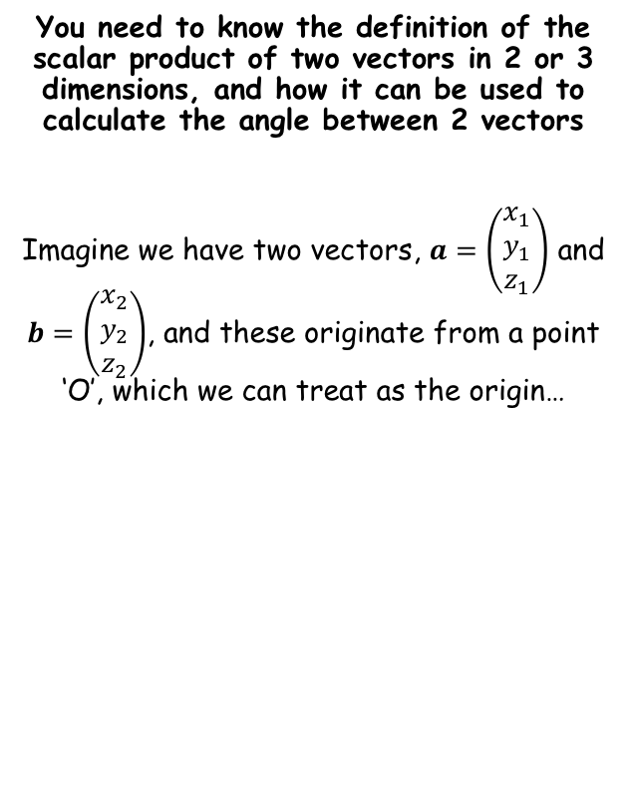










Vectors
$$a.b=\left|a\right||b|cosθ$$
$$\left|b−a\right|=\sqrt{{\left(x_{2}−x_{1}\right)}^{2}+{\left(y_{2}−y_{1}\right)}^{2}+{\left(z_{2}−z_{1}\right)}^{2}}$$
$$cosθ=\frac{a.b}{\left|a\right||b|}$$
$$(x_{1},y_{1},z_{1})$$
$$\left(\begin{matrix}x_{1} \\ y_{1} \\ z_{1}\end{matrix}\right)$$
c
$$\left|a\right|=\sqrt{\left(x_{1}^{2}+y_{1}^{2}+z_{1}^{2}\right)}$$
$$\left(\begin{matrix}x_{2}−x_{1} \\ y_{2}−y_{1} \\ z_{2}−z_{1}\end{matrix}\right)$$
You need to know the definition of the scalar product of two vectors in 2 or 3 dimensions, and how it can be used to calculate the angle between 2 vectors
Imagine we have two vectors, $a=\left(\begin{matrix}x_{1} \\ y_{1} \\ z_{1}\end{matrix}\right)$ and $b=\left(\begin{matrix}x_{2} \\ y_{2} \\ z_{2}\end{matrix}\right)$, and these originate from a point ‘O’, which we can treat as the origin…
$$a$$
a
A
$$b−a$$
O
$$θ$$
$$(0,0,0)$$
$$\left|b\right|=\sqrt{\left(x_{2}^{2}+y_{2}^{2}+z_{2}^{2}\right)}$$
$$\left(\begin{matrix}x_{2} \\ y_{2} \\ z_{2}\end{matrix}\right)$$
$$b$$
b
$$(x_{2},y_{2},z_{2})$$
$$a^{2}=b^{2}+c^{2}−2bcCosA$$
Square brackets
$${\left(\sqrt{{\left(x_{2}−x_{1}\right)}^{2}+{\left(y_{2}−y_{1}\right)}^{2}+{\left(z_{2}−z_{1}\right)}^{2}} \right)}^{2}={\left(\sqrt{\left(x_{2}^{2}+y_{2}^{2}+z_{2}^{2}\right)}\right)}^{2}+{\left(\sqrt{\left(x_{1}^{2}+y_{1}^{2}+z_{1}^{2}\right)}\right)}^{2}−2\sqrt{\left(x_{2}^{2}+y_{2}^{2}+z_{2}^{2}\right)}\sqrt{\left(x_{1}^{2}+y_{1}^{2}+z_{1}^{2}\right)}CosA$$
$${\left(x_{2}−x_{1}\right)}^{2}+{\left(y_{2}−y_{1}\right)}^{2}+{\left(z_{2}−z_{1}\right)}^{2}$$
$$=\left(x_{2}^{2}+y_{2}^{2}+z_{2}^{2}\right)$$
$$+ \left(x_{1}^{2}+y_{1}^{2}+z_{1}^{2}\right)$$
$$− 2\sqrt{\left(x_{2}^{2}+y_{2}^{2}+z_{2}^{2}\right)}\sqrt{\left(x_{1}^{2}+y_{1}^{2}+z_{1}^{2}\right)}CosA$$
Expand brackets
$$x_{2}^{2}−2x_{2}x_{1}+x_{1}^{2}$$
$$+ y_{2}^{2}−2y_{2}y_{1}+y_{1}^{2}$$
$$+ z_{2}^{2}−2z_{2}z_{1}+z_{1}^{2}$$
$$=x_{2}^{2}+y_{2}^{2}+z_{2}^{2}+x_{1}^{2}+y_{1}^{2}+z_{1}^{2}$$
$$− 2\sqrt{\left(x_{2}^{2}+y_{2}^{2}+z_{2}^{2}\right)}\sqrt{\left(x_{1}^{2}+y_{1}^{2}+z_{1}^{2}\right)}CosA$$
$$=− 2\sqrt{\left(x_{2}^{2}+y_{2}^{2}+z_{2}^{2}\right)}\sqrt{\left(x_{1}^{2}+y_{1}^{2}+z_{1}^{2}\right)}CosA$$
Simplify terms
$$−2x_{2}x_{1}−2y_{2}y_{1}−2z_{2}z_{1}$$
$$=\sqrt{\left(x_{2}^{2}+y_{2}^{2}+z_{2}^{2}\right)}\sqrt{\left(x_{1}^{2}+y_{1}^{2}+z_{1}^{2}\right)}CosA$$
Divide by -2
$$x_{2}x_{1}+y_{2}y_{1}+z_{2}z_{1}$$
9C

Slide 7



Vectors
$$a.b=\left|a\right||b|cosθ$$
$$\left|b−a\right|=\sqrt{{\left(x_{2}−x_{1}\right)}^{2}+{\left(y_{2}−y_{1}\right)}^{2}+{\left(z_{2}−z_{1}\right)}^{2}}$$
$$cosθ=\frac{a.b}{\left|a\right||b|}$$
$$(x_{1},y_{1},z_{1})$$
$$\left(\begin{matrix}x_{1} \\ y_{1} \\ z_{1}\end{matrix}\right)$$
c
$$\left|a\right|=\sqrt{\left(x_{1}^{2}+y_{1}^{2}+z_{1}^{2}\right)}$$
$$\left(\begin{matrix}x_{2}−x_{1} \\ y_{2}−y_{1} \\ z_{2}−z_{1}\end{matrix}\right)$$
You need to know the definition of the scalar product of two vectors in 2 or 3 dimensions, and how it can be used to calculate the angle between 2 vectors
Imagine we have two vectors, $a=\left(\begin{matrix}x_{1} \\ y_{1} \\ z_{1}\end{matrix}\right)$ and $b=\left(\begin{matrix}x_{2} \\ y_{2} \\ z_{2}\end{matrix}\right)$, and these originate from a point ‘O’, which we can treat as the origin…
$$a$$
a
A
$$b−a$$
O
$$θ$$
$$(0,0,0)$$
$$\left|b\right|=\sqrt{\left(x_{2}^{2}+y_{2}^{2}+z_{2}^{2}\right)}$$
$$\left(\begin{matrix}x_{2} \\ y_{2} \\ z_{2}\end{matrix}\right)$$
$$b$$
b
$$(x_{2},y_{2},z_{2})$$
$$x_{2}x_{1}+y_{2}y_{1}+z_{2}z_{1}$$
$$=\sqrt{\left(x_{2}^{2}+y_{2}^{2}+z_{2}^{2}\right)}\sqrt{\left(x_{1}^{2}+y_{1}^{2}+z_{1}^{2}\right)}CosA$$
Divide by the square roots
$$\frac{x_{2}x_{1}+y_{2}y_{1}+z_{2}z_{1} }{\sqrt{\left(x_{2}^{2}+y_{2}^{2}+z_{2}^{2}\right)}\sqrt{\left(x_{1}^{2}+y_{1}^{2}+z_{1}^{2}\right)}}$$
$$=CosA$$
Now we can substitute this into our original formula for the dot product…
9C

Slide 8





Vectors
$$a.b=\left|a\right||b|cosθ$$
$$a.b=x_{2}x_{1}+y_{2}y_{1}+z_{2}z_{1}$$
$$cosθ=\frac{a.b}{\left|a\right||b|}$$
$$(x_{1},y_{1},z_{1})$$
$$\left(\begin{matrix}x_{1} \\ y_{1} \\ z_{1}\end{matrix}\right)$$
$$\left|a\right|=\sqrt{\left(x_{1}^{2}+y_{1}^{2}+z_{1}^{2}\right)}$$
$$\left(\begin{matrix}x_{2}−x_{1} \\ y_{2}−y_{1} \\ z_{2}−z_{1}\end{matrix}\right)$$
You need to know the definition of the scalar product of two vectors in 2 or 3 dimensions, and how it can be used to calculate the angle between 2 vectors
Imagine we have two vectors, $a=\left(\begin{matrix}x_{1} \\ y_{1} \\ z_{1}\end{matrix}\right)$ and $b=\left(\begin{matrix}x_{2} \\ y_{2} \\ z_{2}\end{matrix}\right)$, and these originate from a point ‘O’, which we can treat as the origin…
$$a$$
$$b−a$$
O
$$θ$$
$$(0,0,0)$$
$$\left|b\right|=\sqrt{\left(x_{2}^{2}+y_{2}^{2}+z_{2}^{2}\right)}$$
$$\left(\begin{matrix}x_{2} \\ y_{2} \\ z_{2}\end{matrix}\right)$$
$$b$$
$$(x_{2},y_{2},z_{2})$$
Sub in the magnitudes, and cos of the angle…
$$\frac{x_{2}x_{1}+y_{2}y_{1}+z_{2}z_{1} }{\sqrt{\left(x_{2}^{2}+y_{2}^{2}+z_{2}^{2}\right)}\sqrt{\left(x_{1}^{2}+y_{1}^{2}+z_{1}^{2}\right)}}$$
$$a.b=\left|a\right||b|cosθ$$
$$Cosθ=$$
$$a.b=\sqrt{\left(x_{1}^{2}+y_{1}^{2}+z_{1}^{2}\right)}\sqrt{\left(x_{2}^{2}+y_{2}^{2}+z_{2}^{2}\right)}\frac{x_{2}x_{1}+y_{2}y_{1}+z_{2}z_{1} }{\sqrt{\left(x_{2}^{2}+y_{2}^{2}+z_{2}^{2}\right)}\sqrt{\left(x_{1}^{2}+y_{1}^{2}+z_{1}^{2}\right)}}$$
$$a.b=x_{2}x_{1}+y_{2}y_{1}+z_{2}z_{1}$$
This can be simplified!
This formula allows us to calculate the dot product without needing the angle itself
So in reverse, it can be used to help find the angle between two vectors!
9C

Slide 9




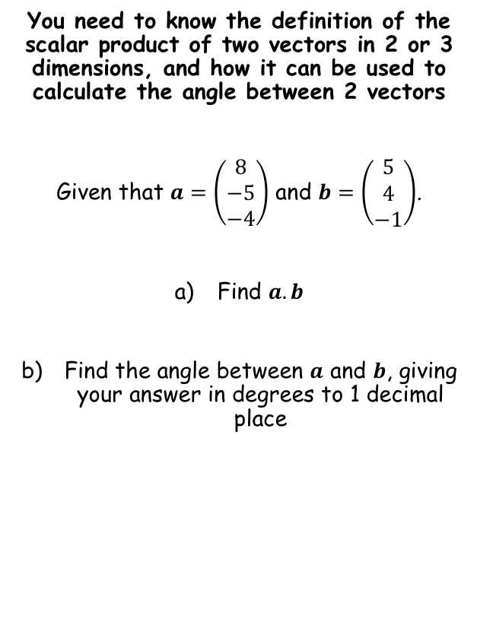




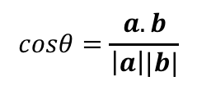
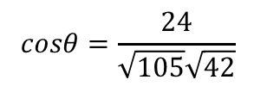
Vectors
$$a.b=\left|a\right||b|cosθ$$
$$a.b=x_{2}x_{1}+y_{2}y_{1}+z_{2}z_{1}$$
$$cosθ=\frac{a.b}{\left|a\right||b|}$$
$$a.b=x_{2}x_{1}+y_{2}y_{1}+z_{2}z_{1}$$
Sub in values from the vectors
You need to know the definition of the scalar product of two vectors in 2 or 3 dimensions, and how it can be used to calculate the angle between 2 vectors
Given that $a=\left(\begin{matrix}8 \\ −5 \\ −4\end{matrix}\right)$ and $b=\left(\begin{matrix}5 \\ 4 \\ −1\end{matrix}\right)$.
Find $a.b$
Find the angle between $a$ and $b$, giving your answer in degrees to 1 decimal place
$$a.b=(8)(5)+(−5)(4)+(−4)(−1)$$
$$a.b=24$$
Calculate
$$cosθ=\frac{a.b}{\left|a\right||b|}$$
Calculate the magnitudes of the vectors and substitute in
$$cosθ=\frac{24}{\sqrt{105}\sqrt{42}}$$
Inverse cos
$$\left|a\right|=\sqrt{{(8)}^{2}+{\left(−5\right)}^{2}+{\left(−4\right)}^{2}}$$
$$\left|a\right|=\sqrt{105}$$
$$θ=68.8^{°}$$
$$\left|b\right|=\sqrt{{(5)}^{2}+{\left(4\right)}^{2}+{\left(−1\right)}^{2}}$$
$$\left|b\right|=\sqrt{42}$$
9C

Slide 10







Vectors
$$a.b=\left|a\right||b|cosθ$$
$$a.b=x_{2}x_{1}+y_{2}y_{1}+z_{2}z_{1}$$
$$cosθ=\frac{a.b}{\left|a\right||b|}$$
You need to know the definition of the scalar product of two vectors in 2 or 3 dimensions, and how it can be used to calculate the angle between 2 vectors
Given that the vectors $a=2i−6j+k$ and $b=5i+2j+λk$ are perpendicular, find the value of $λ$.
If the vectors are perpendicular, then the angle between them is 90˚
$$a.b=\left|a\right||b|cosθ$$
Cos90 = 0
$$a.b=0$$
Use the formula for the dot product
$$x_{2}x_{1}+y_{2}y_{1}+z_{2}z_{1}=0$$
Sub in values
$$(2)(5)+(−6)(2)+(1)(λ)=0$$
Simplify
$$λ−2=0$$
Solve
$$λ=2$$
9C

Slide 11



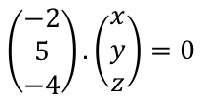


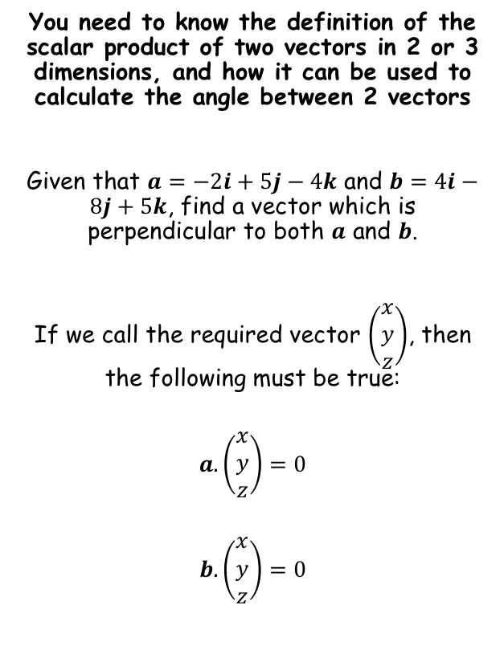




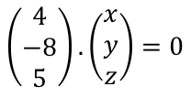



Vectors
$$a.b=\left|a\right||b|cosθ$$
$$a.b=x_{2}x_{1}+y_{2}y_{1}+z_{2}z_{1}$$
$$cosθ=\frac{a.b}{\left|a\right||b|}$$
$$a.\left(\begin{matrix}x \\ y \\ z\end{matrix}\right)=0$$
$$b.\left(\begin{matrix}x \\ y \\ z\end{matrix}\right)=0$$
You need to know the definition of the scalar product of two vectors in 2 or 3 dimensions, and how it can be used to calculate the angle between 2 vectors
Given that $a=−2i+5j−4k$ and $b=4i−8j+5k$, find a vector which is perpendicular to both $a$ and $b$.
If we call the required vector $\left(\begin{matrix}x \\ y \\ z\end{matrix}\right)$, then the following must be true:
$$a.\left(\begin{matrix}x \\ y \\ z\end{matrix}\right)=0$$
$$b.\left(\begin{matrix}x \\ y \\ z\end{matrix}\right)=0$$
Sub in $a$
Sub in $b$
$$\left(\begin{matrix}−2 \\ 5 \\ −4\end{matrix}\right).\left(\begin{matrix}x \\ y \\ z\end{matrix}\right)=0$$
$$\left(\begin{matrix}4 \\ −8 \\ 5\end{matrix}\right).\left(\begin{matrix}x \\ y \\ z\end{matrix}\right)=0$$
Work out
Work out
$$−2x+5y−4z=0$$
$$4x−8y+5z=0$$
At this point we can choose a non-zero value for $z$, and find the values of $x$ and $y$ that would make the vector perpendicular
→ Let z = 1
$$−2x+5y−4=0$$
$$4x−8y+5=0$$
Solving these simultaneously gives:
$x=\frac{7}{4}$ and $y=\frac{3}{2}$
So a possible vector would be:
$$\frac{7}{4}i+\frac{3}{2}j+k$$
Multiply by 4 (or any scalar value) for an alternative
$$7i+6j+4k$$
9C

Slide 12
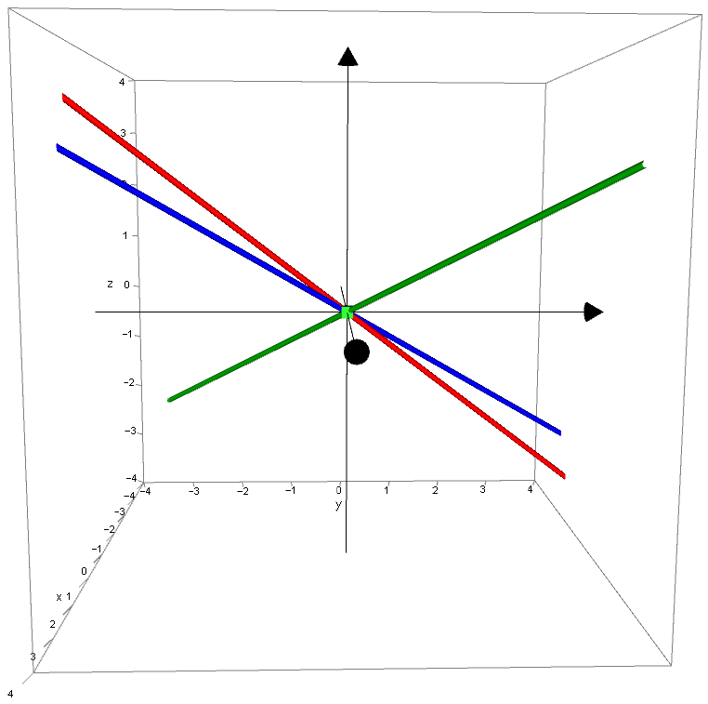





Vectors
$$a.b=\left|a\right||b|cosθ$$
$$a.b=x_{2}x_{1}+y_{2}y_{1}+z_{2}z_{1}$$
$$cosθ=\frac{a.b}{\left|a\right||b|}$$
You need to know the definition of the scalar product of two vectors in 2 or 3 dimensions, and how it can be used to calculate the angle between 2 vectors
Given that $a=−2i+5j−4k$ and $b=4i−8j+5k$, find a vector which is perpendicular to both $a$ and $b$.
$$\left(\begin{matrix}−2 \\ 5 \\ −4\end{matrix}\right)$$
$$\left(\begin{matrix}7 \\ 6 \\ 4\end{matrix}\right)$$
$$\left(\begin{matrix}4 \\ −8 \\ 5\end{matrix}\right)$$
$$7i+6j+4k$$
CLICK
9C

Slide 13
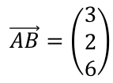


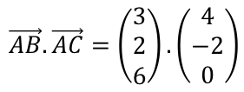
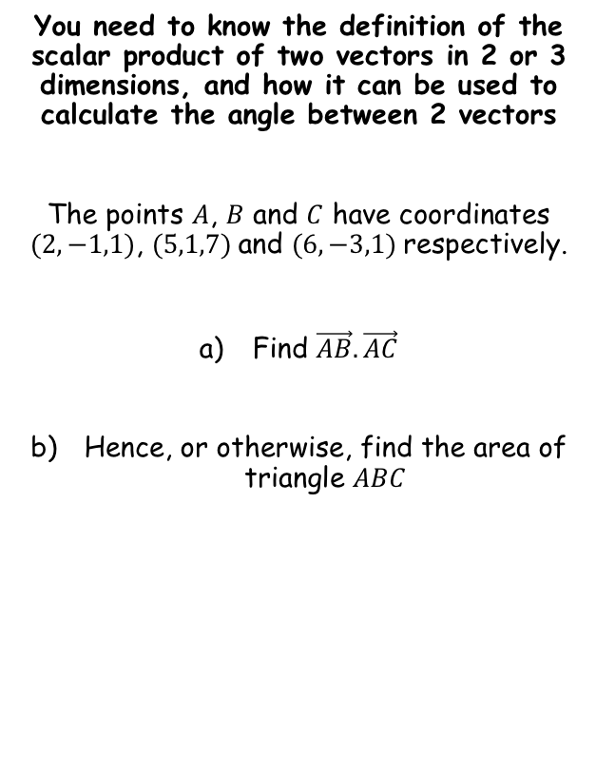

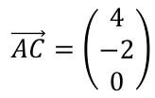

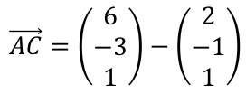


Vectors
$$a.b=\left|a\right||b|cosθ$$
$$a.b=x_{2}x_{1}+y_{2}y_{1}+z_{2}z_{1}$$
$$cosθ=\frac{a.b}{\left|a\right||b|}$$
You can find the vectors from A to B and A to C by considering the coordinates as position vectors…
You need to know the definition of the scalar product of two vectors in 2 or 3 dimensions, and how it can be used to calculate the angle between 2 vectors
The points $A$, $B$ and $C$ have coordinates $(2,−1,1)$, $(5,1,7)$and $(6,−3,1)$respectively.
Find $\vec{AB}.\vec{AC}$
Hence, or otherwise, find the area of triangle $ABC$
$$\vec{AB}=b−a$$
$$\vec{AC}=c−a$$
$$\vec{AB}=\left(\begin{matrix}5 \\ 1 \\ 7\end{matrix}\right)−\left(\begin{matrix}2 \\ −1 \\ 1\end{matrix}\right)$$
$$\vec{AC}=\left(\begin{matrix}6 \\ −3 \\ 1\end{matrix}\right)−\left(\begin{matrix}2 \\ −1 \\ 1\end{matrix}\right)$$
$$\vec{AB}=\left(\begin{matrix}3 \\ 2 \\ 6\end{matrix}\right)$$
$$\vec{AC}=\left(\begin{matrix}4 \\ −2 \\ 0\end{matrix}\right)$$
Now we can find the dot product…
$$=8$$
$$\vec{AB}.\vec{AC}=\left(\begin{matrix}3 \\ 2 \\ 6\end{matrix}\right).\left(\begin{matrix}4 \\ −2 \\ 0\end{matrix}\right)$$
Rewrite
$$=\left(3\right)\left(4\right)+\left(2\right)\left(−2\right)+(6)(0)$$
Calculate
$$=8$$
9C

Slide 14

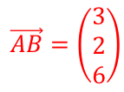







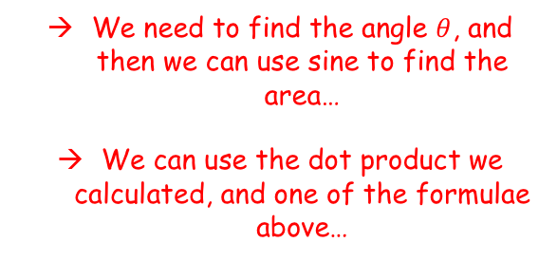



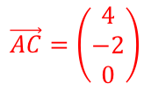
Vectors
$$a.b=\left|a\right||b|cosθ$$
$$a.b=x_{2}x_{1}+y_{2}y_{1}+z_{2}z_{1}$$
$$cosθ=\frac{a.b}{\left|a\right||b|}$$
B
$$(5,1,7)$$
$$\left(\begin{matrix}3 \\ 2 \\ 6\end{matrix}\right)$$
$$\left|a\right|=7$$
You need to know the definition of the scalar product of two vectors in 2 or 3 dimensions, and how it can be used to calculate the angle between 2 vectors
The points $A$, $B$ and $C$ have coordinates $(2,−1,1)$, $(5,1,7)$and $(6,−3,1)$respectively.
Find $\vec{AB}.\vec{AC}$
Hence, or otherwise, find the area of triangle $ABC$
$$75.193…$$
A
$$θ$$
$$(2,−1,1)$$
$$\left|b\right|=2\sqrt{5}$$
$$\left(\begin{matrix}4 \\ −2 \\ 0\end{matrix}\right)$$
C
$$(6,−3,1)$$
$$\vec{AB}=\left(\begin{matrix}3 \\ 2 \\ 6\end{matrix}\right)$$
$$\vec{AC}=\left(\begin{matrix}4 \\ −2 \\ 0\end{matrix}\right)$$
$$cosθ=\frac{a.b}{\left|a\right||b|}$$
$$=8$$
Sub in values
$$cosθ=\frac{8}{7×2\sqrt{5}}$$
We need to find the angle $θ$, and then we can use sine to find the area…
We can use the dot product we calculated, and one of the formulae above…
Calculate
$$θ=75.193…$$
9C

Slide 15



Vectors
$$a.b=\left|a\right||b|cosθ$$
$$a.b=x_{2}x_{1}+y_{2}y_{1}+z_{2}z_{1}$$
$$cosθ=\frac{a.b}{\left|a\right||b|}$$
B
$$(5,1,7)$$
$$\left(\begin{matrix}3 \\ 2 \\ 6\end{matrix}\right)$$
$$\left|a\right|=7$$
You need to know the definition of the scalar product of two vectors in 2 or 3 dimensions, and how it can be used to calculate the angle between 2 vectors
The points $A$, $B$ and $C$ have coordinates $(2,−1,1)$, $(5,1,7)$and $(6,−3,1)$respectively.
Find $\vec{AB}.\vec{AC}$
Hence, or otherwise, find the area of triangle $ABC$
A
$$75.193…$$
$$(2,−1,1)$$
$$\left|b\right|=2\sqrt{5}$$
$$\left(\begin{matrix}4 \\ −2 \\ 0\end{matrix}\right)$$
C
$$(6,−3,1)$$
$$\vec{AB}=\left(\begin{matrix}3 \\ 2 \\ 6\end{matrix}\right)$$
$$\vec{AC}=\left(\begin{matrix}4 \\ −2 \\ 0\end{matrix}\right)$$
$$=8$$
$$Area=\frac{1}{2}abSinC$$
Sub in exact values
$$=\frac{1}{2}(7)(2\sqrt{5})Sin(75.193…)$$
Calculate
$=15.13$ (2dp)
9C

Slide 16
Exercise 9C
Pearson Pure Mathematics Year 1/AS
Pages 3-5
Complete before the lesson Q1-4 a-d only in each question
In Class:
Green Q5-9
Amber Q10-12
Red Q13-15 & challenge

