Slide 1
Year 1 Pure Mathematics
Algebraic Methods
- Proofs
Chapter 7
(Part 4 of 4)

Slide 2
Proofs
A proof must show all assumptions you are using,
have a clear sequential list of steps that logically follow,
and must cover all possible cases.
You should usually make a concluding statement,
e.g. restating the original conjecture that you have proven.
a. Proof by Deduction
c. Disproof by Counter-Example
This is the simplest type, where you start from known facts and reach the desired conclusion via deductive steps.
While to prove a statement is true,
we need to prove every possible case (potentially infinitely many!),
we only need one example to disprove
a statement.
b. Proof by Exhaustion
This means breaking down the statement into all possible smaller cases,
where we prove each individual case.

Slide 3
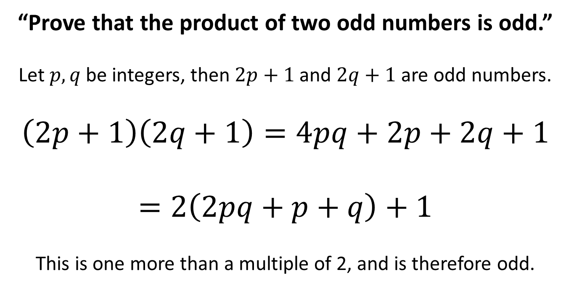
Proof by Deduction
a. Proof by Deduction
“Prove that the product of two odd numbers is odd.”
Let $p,q$ be integers, then $2p+1$ and $2q+1$ are odd numbers.
$$\left(2p+1\right)\left(2q+1\right)=4pq+2p+2q+1$$
$$=2\left(2pq+p+q\right)+1$$
This is one more than a multiple of 2, and is therefore odd.

Slide 4
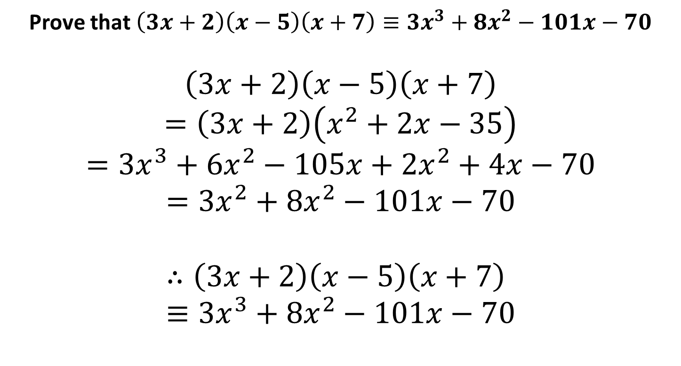
Proof by Deduction
a. Proof by Deduction
Prove that $\left(3x+2\right)\left(x−5\right)\left(x+7\right)≡3x^{3}+8x^{2}−101x−70$
$$\left(3x+2\right)\left(x−5\right)\left(x+7\right) \\ =\left(3x+2\right)\left(x^{2}+2x−35\right) \\ =3x^{3}+6x^{2}−105x+2x^{2}+4x−70 \\ =3x^{2}+8x^{2}−101x−70$$
$$∴\left(3x+2\right)\left(x−5\right)\left(x+7\right)≡3x^{3}+8x^{2}−101x−70$$

Slide 5
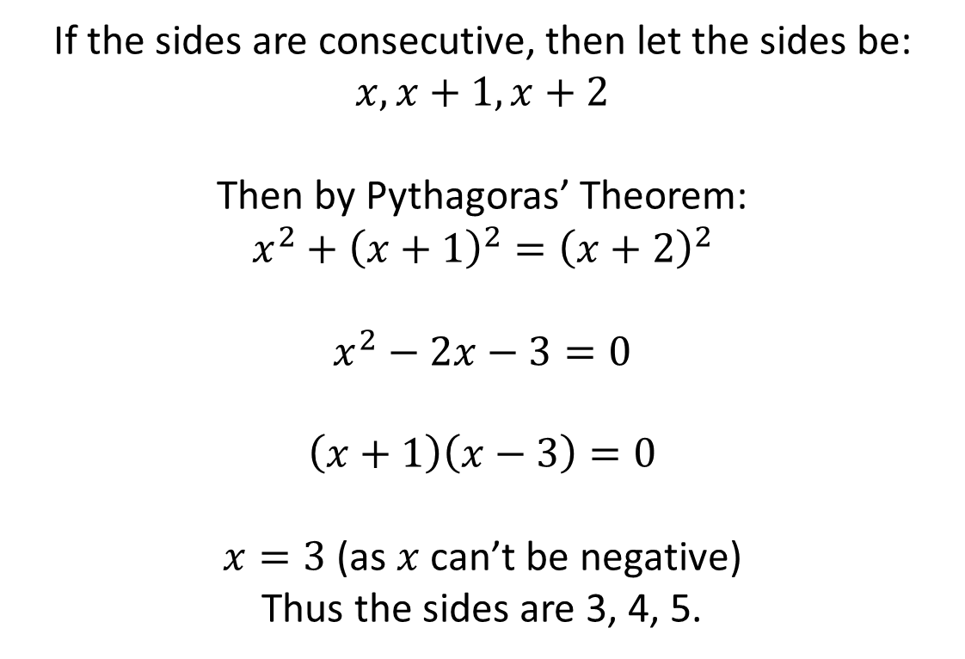
Proofs
Prove that if three consecutive integers are
the sides of a right-angled triangle, they must be 3, 4 and 5.
If the sides are consecutive, then let the sides be:
$$x,x+1,x+2$$
Then by Pythagoras’ Theorem:
$$x^{2}+{\left(x+1\right)}^{2}={\left(x+2\right)}^{2}$$
$$x^{2}−2x−3=0$$
$$\left(x+1\right)\left(x−3\right)=0$$
$x=3$ (as $x$ can’t be negative)
Thus the sides are 3, 4, 5.

Slide 6
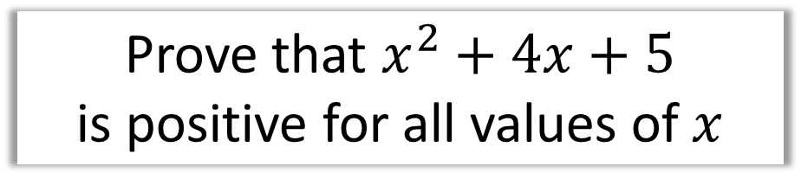
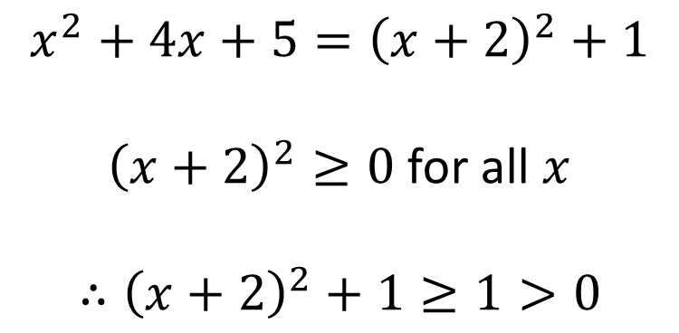
Proof by Deduction
a. Proof by Deduction
Prove that $x^{2}+4x+5$
is positive for all values of $x$
Hint: Complete the square
$$x^{2}+4x+5={\left(x+2\right)}^{2}+1$$
${\left(x+2\right)}^{2}≥0$ for all $x$
$$∴{\left(x+2\right)}^{2}+1≥1>0$$

Slide 7
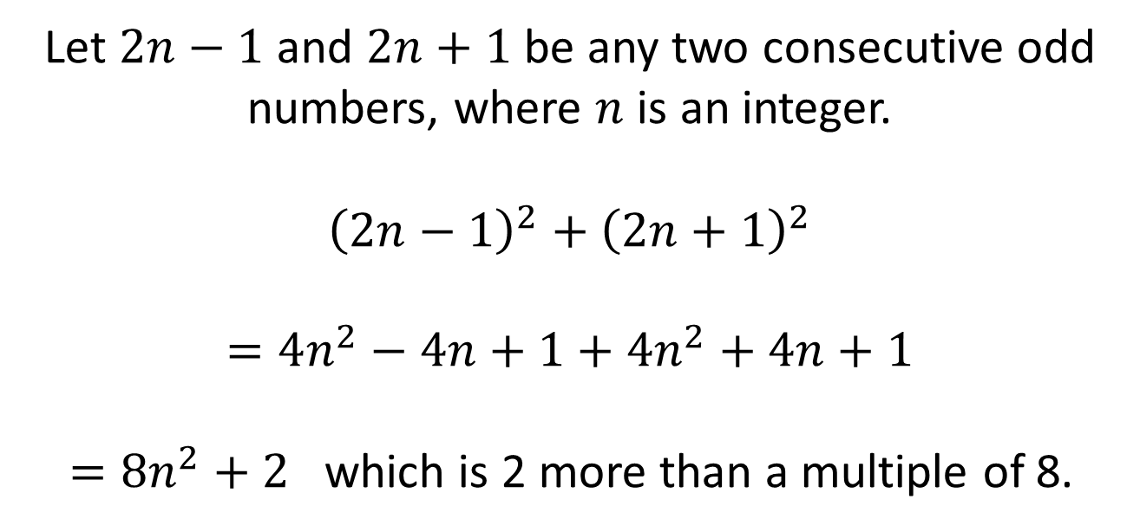
Proof by Deduction
a. Proof by Deduction
Prove that the sum of the squares
of two consecutive odd numbers
is 2 more than a multiple of 8.
Let $2n−1$ and $2n+1$ be any two consecutive odd numbers, where $n$ is an integer.
$${\left(2n−1\right)}^{2}+{\left(2n+1\right)}^{2}$$
$$=4n^{2}−4n+1+4n^{2}+4n+1$$
$=8n^{2}+2$ which is 2 more than a multiple of 8.

Slide 8
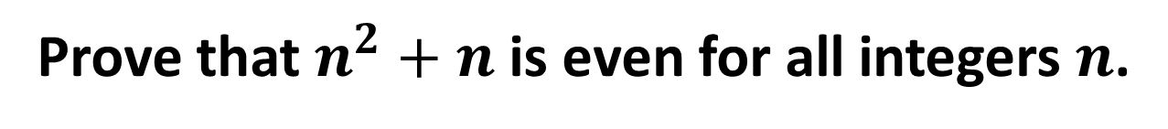
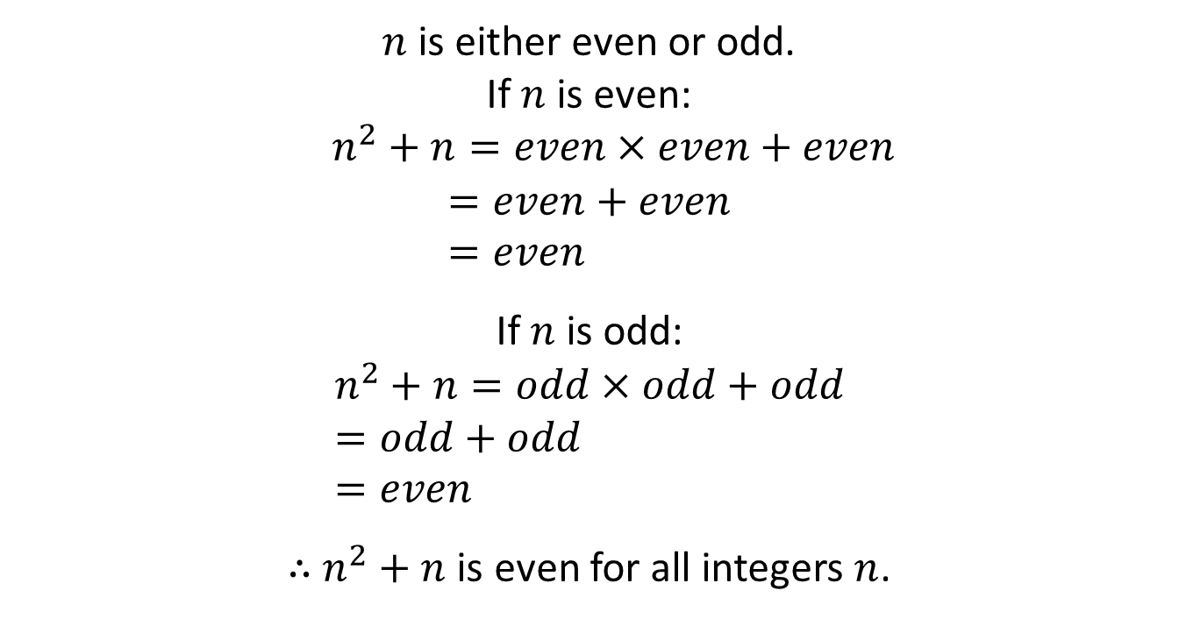
Proof by Exhaustion
b. Proof by Exhaustion
Prove that $n^{2}+n$ is even for all integers $n$.
$n$ is either even or odd.
If $n$ is even:
$n^{2}+n=even×even+even$
$$=even+even \\ =even$$
If $n$ is odd:
$$n^{2}+n=odd×odd+odd \\ =odd+odd \\ =even$$
$∴$ $n^{2}+n$ is even for all integers $n$.

Slide 9
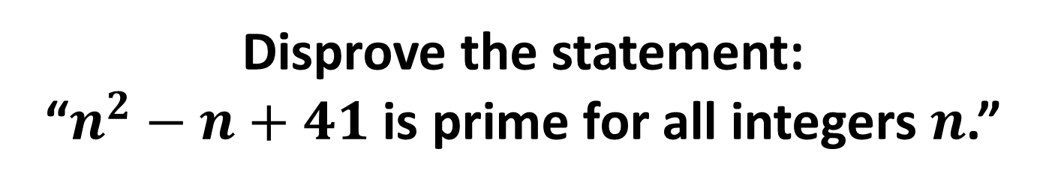
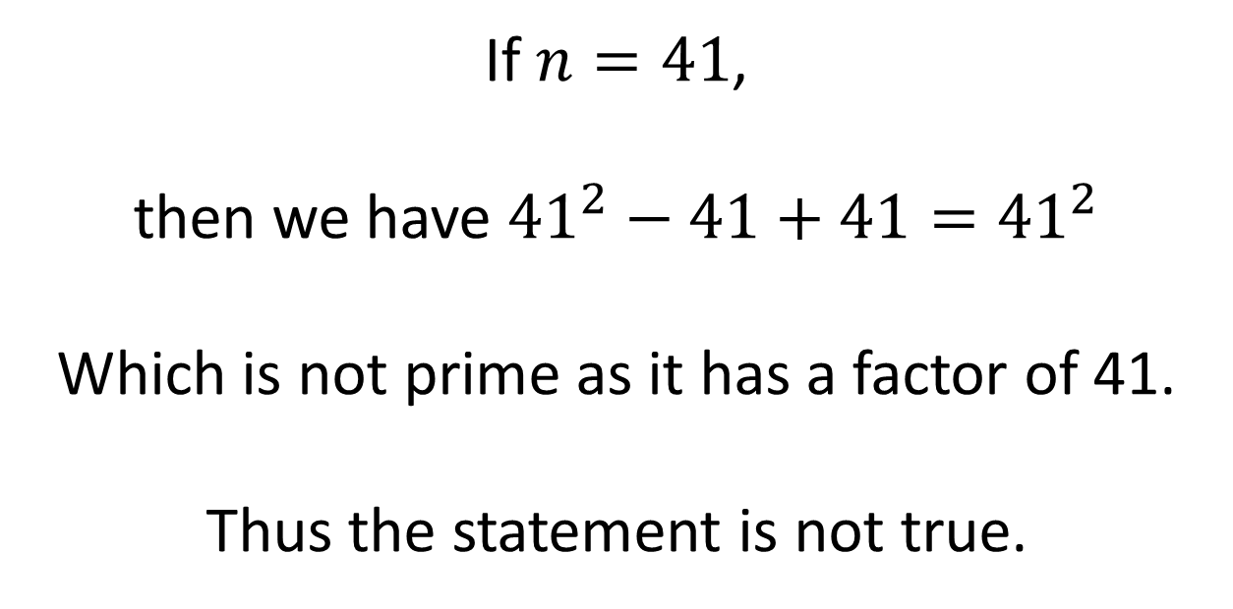
Proofs by Counter-Example
c. Disproof by Counter-Example
Disprove the statement:
“$n^{2}−n+41$ is prime for all integers $n$.”
If $n=41$,
then we have ${41}^{2}−41+41={41}^{2}$
Which is not prime as it has a factor of 41.
Thus the statement is not true.

Slide 10
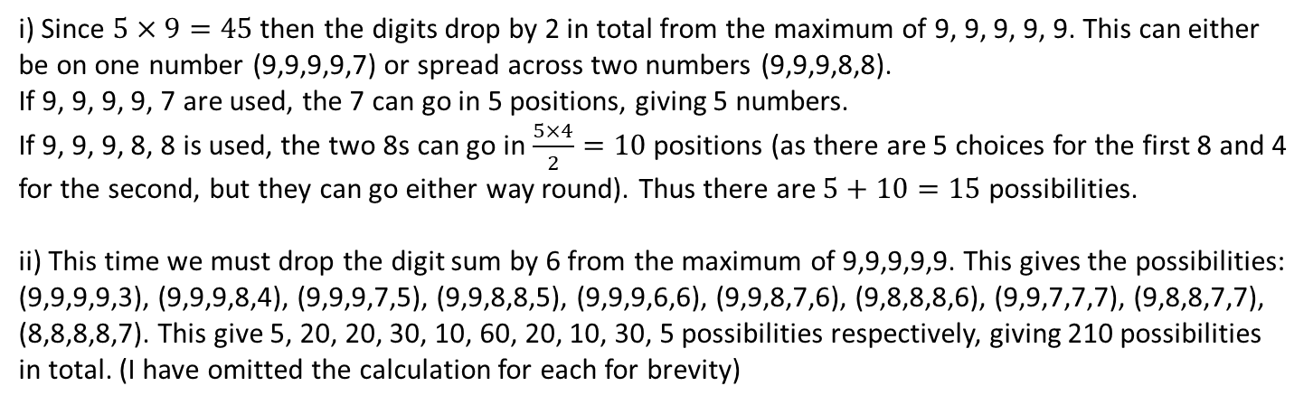
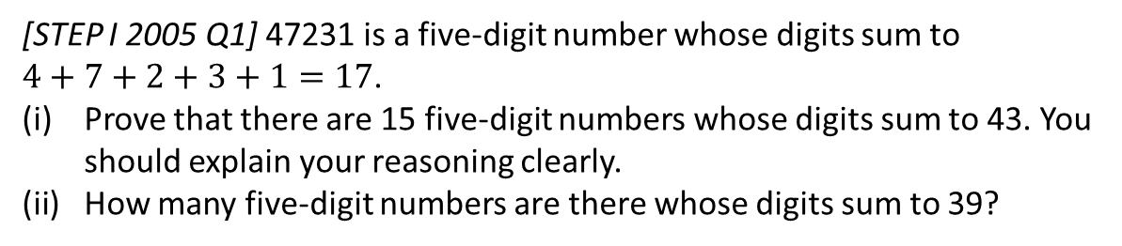
Exercise 7D
Pearson Pure Mathematics Year 1/AS Pages 149-150
Complete before the lesson Ex7D
You should attempt all. During this lesson we will discuss all problems encountered.
Extension
[STEP I 2005 Q1] 47231 is a five-digit number whose digits sum to
$4+7+2+3+1=17$.
Prove that there are 15 five-digit numbers whose digits sum to 43. You should explain your reasoning clearly.
How many five-digit numbers are there whose digits sum to 39?
i) Since $5×9=45$ then the digits drop by 2 in total from the maximum of 9, 9, 9, 9, 9. This can either be on one number (9,9,9,9,7) or spread across two numbers (9,9,9,8,8).
If 9, 9, 9, 9, 7 are used, the 7 can go in 5 positions, giving 5 numbers.
If 9, 9, 9, 8, 8 is used, the two 8s can go in $\frac{5×4}{2}=10$ positions (as there are 5 choices for the first 8 and 4 for the second, but they can go either way round). Thus there are $5+10=15$ possibilities.
ii) This time we must drop the digit sum by 6 from the maximum of 9,9,9,9,9. This gives the possibilities: (9,9,9,9,3), (9,9,9,8,4), (9,9,9,7,5), (9,9,8,8,5), (9,9,9,6,6), (9,9,8,7,6), (9,8,8,8,6), (9,9,7,7,7), (9,8,8,7,7), (8,8,8,8,7). This give 5, 20, 20, 30, 10, 60, 20, 10, 30, 5 possibilities respectively, giving 210 possibilities in total. (I have omitted the calculation for each for brevity)
? i
? ii

Slide 11
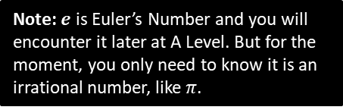
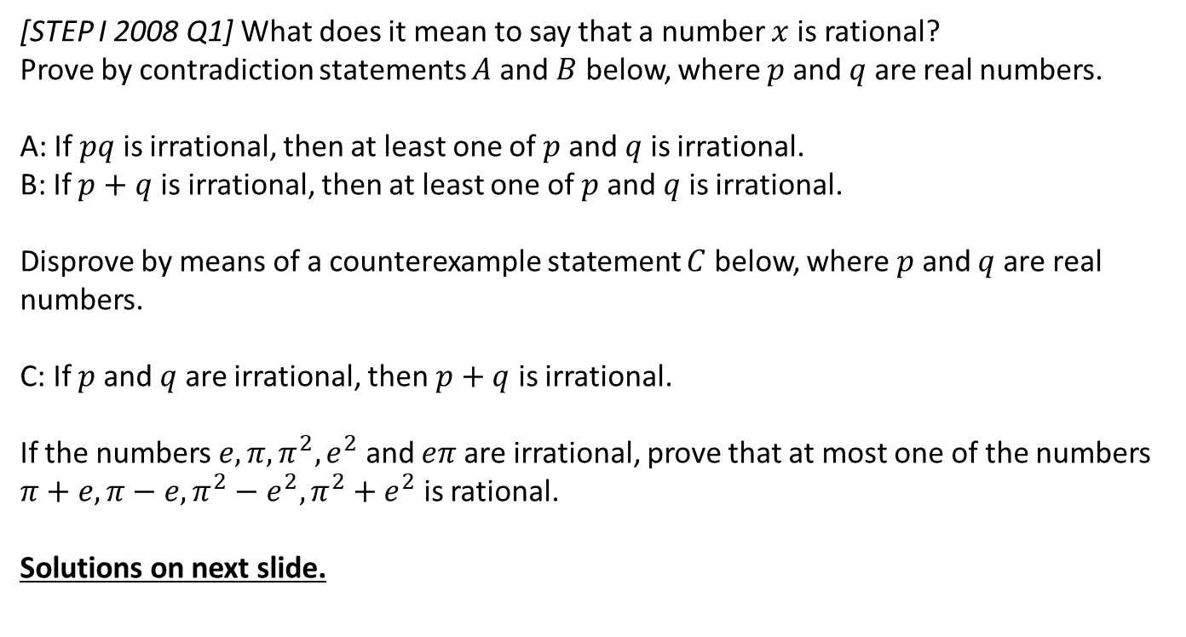
Exercise 7E
Complete before the lesson Ex7E
You should attempt ALL. During this lesson we will discuss all problems encountered.
Pearson Pure Mathematics Year 1/AS
Pages 152-154
Extension
[STEP I 2008 Q1] What does it mean to say that a number $x$ is rational?
Prove by contradiction statements $A$ and $B$ below, where $p$ and $q$ are real numbers.
A: If $pq$ is irrational, then at least one of $p$ and $q$ is irrational.
B: If $p+q$ is irrational, then at least one of $p$ and $q$ is irrational.
Disprove by means of a counterexample statement $C$ below, where $p$ and $q$ are real numbers.
C: If $p$ and $q$ are irrational, then $p+q$ is irrational.
If the numbers $e,π,π^{2}, e^{2}$ and $eπ$ are irrational, prove that at most one of the numbers $π+e, π−e, π^{2}−e^{2}, π^{2}+e^{2}$ is rational.
Solutions on next slide.
Note: $e$ is Euler’s Number and you will encounter it later at A Level. But for the moment, you only need to know it is an irrational number, like $π$.

