Slide 1
Year 1 Pure Mathematics
Sketching Graphs
- Cubic Graphs
Chapter 4
(Part 1 of 5)

Slide 2
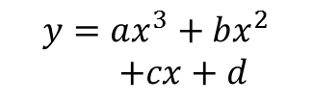

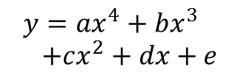
Polynomial Graphs
Equation
Positive Gradient
a = positive
Negative Gradient
a = negative
$$y=ax^{2}+bx+c$$
Quadratic
$$y=ax^{3}+bx^{2}$$
$+cx+d$
Cubic
$$y=ax^{4}+bx^{3} \\ +cx^{2}+dx+e$$
Quartic

Slide 3






Cubic Graphs – 3 Different Roots
Sketch the curve with equation
$$y=(x−2)(1−x)(1+x)$$
Features you must consider:
Shape?
Cubic and Negative Gradient $\left(x\right)\left(−x\right)\left(x\right)=−x3$
Roots?
$$x=2, 1 and −1$$
$y$-intercept?
$$\left(−2\right)\left(1\right)\left(1\right)=−2$$
$$y$$
$$x$$
-1
1
2
-2

Slide 4






Cubic Graphs – 2 Equal Roots
Sketch the curve with equation
$$y=x^{2}(x−1)$$
Shape?
$x^{3}$ term is positive so ‘uphill’ shape.
Roots?
$$x=0 and x=1$$
$y$-intercept?
(0)(0)(-1) = 0
$$y$$
1
$$x$$

Slide 5





Cubic Graphs – 3 Equal Roots
Sketch the curve with equation
$$y={\left(x−4\right)}^{3}$$
Shape?
Uphill.
Roots?
$$x=4$$
$y$-intercept?
-64
$$y$$
4
$$x$$
-64

Slide 6
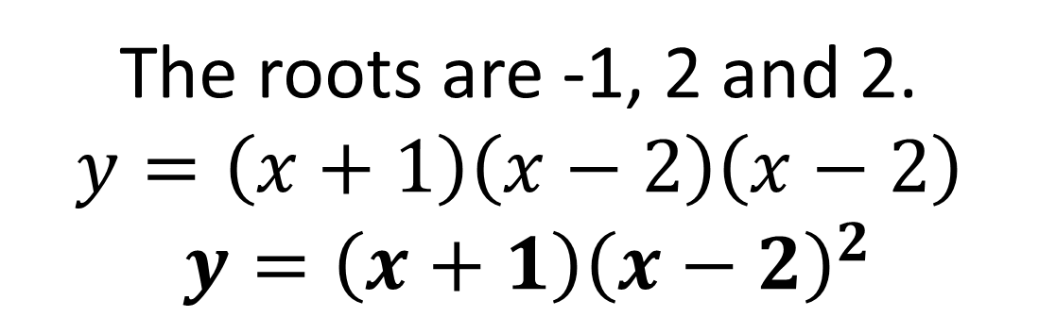
Cubic Graphs – Exam Question
Write the equation of the curve in the diagram
The roots are -1, 2 and 2.
$$y=\left(x+1\right)\left(x−2\right)\left(x−2\right)$$
$$y={\left(x+1\right)\left(x−2\right)}^{2}$$

Slide 7
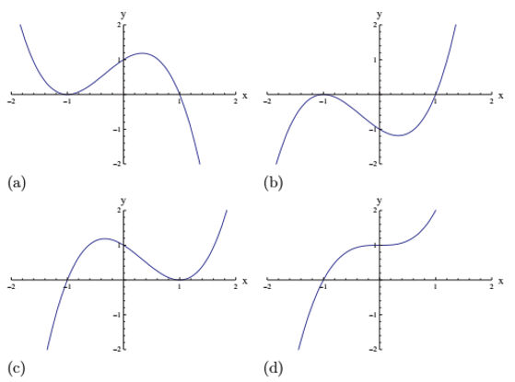
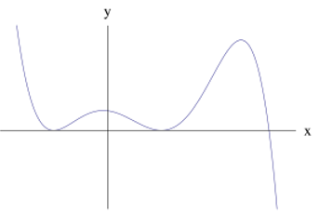
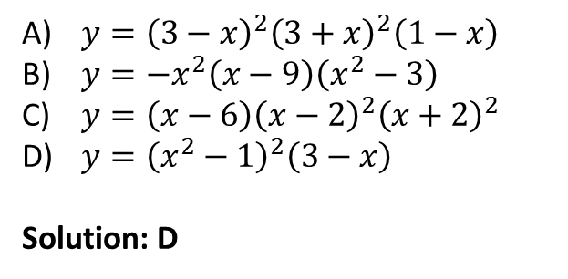
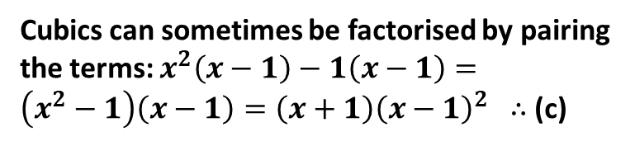
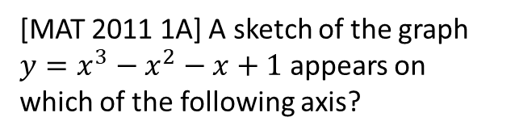
Exercise 4A
Complete before the lesson Q1-2 a-d only
Green Q3-4
Amber Q5
Red Q6-7
Pearson Pure Mathematics Year 1/AS Pages 62-63
Extension
2
[MAT 2011 1A] A sketch of the graph $y=x^{3}−x^{2}−x+1$ appears on which of the following axis?
1
[MAT 2012 1E] Which one of the following equations could possibly have the graph given below?
(a)
(b)
$y={\left(3−x\right)}^{2}{\left(3+x\right)}^{2}\left(1−x\right)$
$y=−x^{2}\left(x−9\right)\left(x^{2}−3\right)$
$y=\left(x−6\right){\left(x−2\right)}^{2}{\left(x+2\right)}^{2}$
$y={\left(x^{2}−1\right)}^{2}\left(3−x\right)$
Solution: D
(c)
(d)
?
Cubics can sometimes be factorised by pairing the terms: $x^{2}\left(x−1\right)−1\left(x−1\right)=\left(x^{2}−1\right)\left(x−1\right)=\left(x+1\right){\left(x−1\right)}^{2}$ $∴$ (c)
?

