Slide 1
Year 1 Pure Mathematics
Straight Line Graphs
- Equations of a Line
Chapter 5
(Part 1 of 5)

Slide 2



Straight Line Graphs
$$y=mx+c$$
$m$ = gradient
$c$ = y intercept

Slide 3

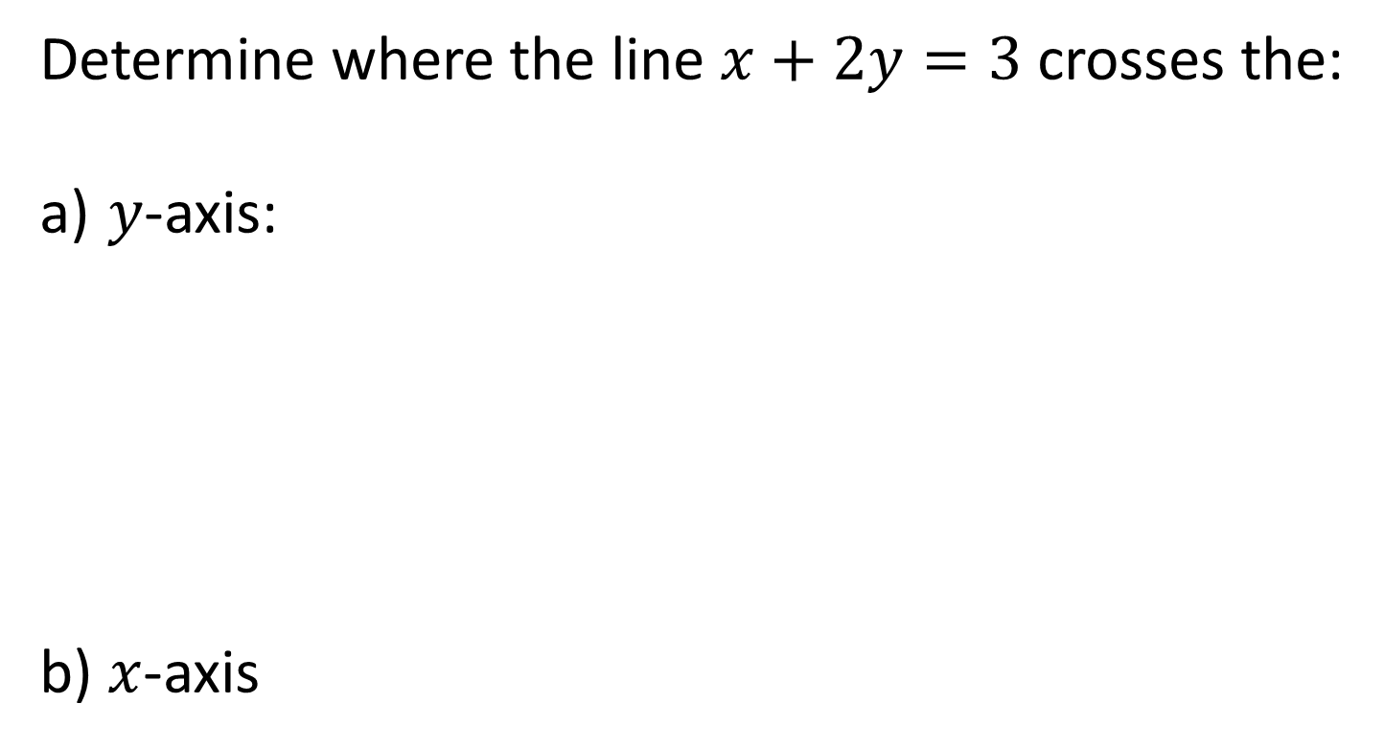
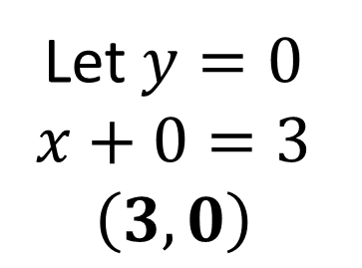
Straight Line Graphs
Determine where the line $x+2y=3$ crosses the:
$y$-axis:
$x$-axis
Let $x=0$
$$2y=3$$
$y=\frac{3}{2}$ $\left(0,\frac{3}{2}\right)$
Let $y=0$
$$x+0=3 \\ \left(3,0\right)$$

Slide 4
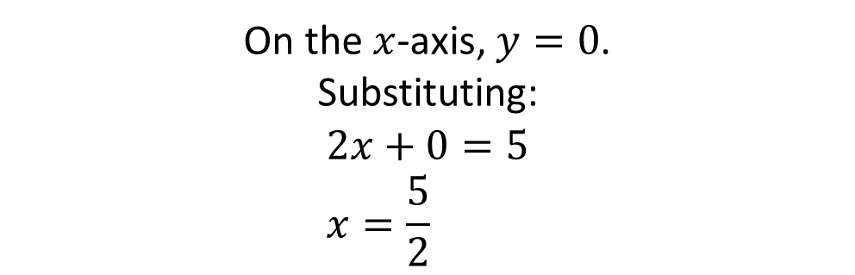
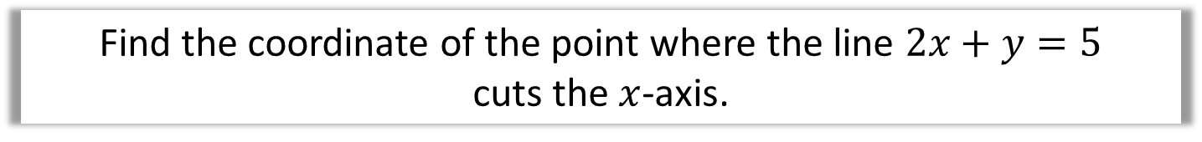


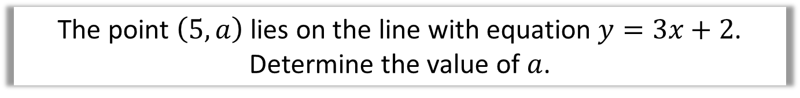
Straight Line Graphs
The point $\left(5,a\right)$ lies on the line with equation $y=3x+2$. Determine the value of $a$.
Substituting in $x$ and $y$ value:
$$a=3\left(5\right)+2 \\ a=17$$
Find the coordinate of the point where the line $2x+y=5$
cuts the $x$-axis.
On the $x$-axis, $y=0$.
Substituting:
$$2x+0=5 \\ x=\frac{5}{2}$$
$$\left(\frac{5}{2}, 0\right)$$

Slide 5
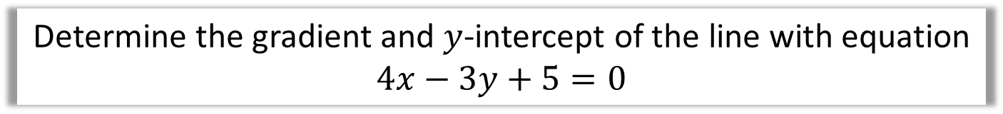
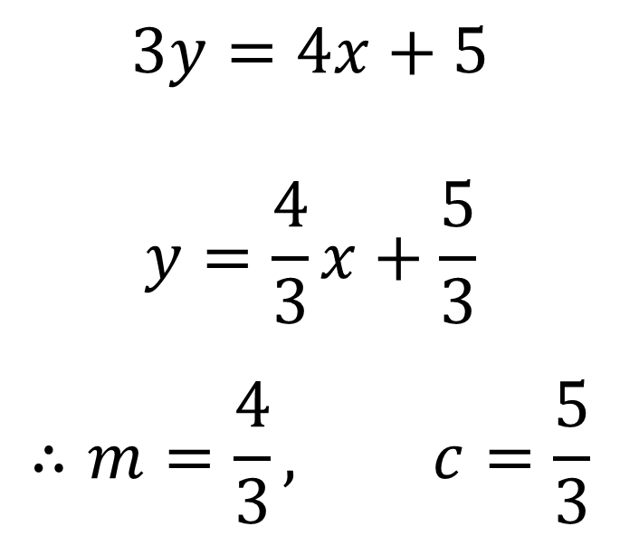
$$\text{Straight} \text{Line} \text{Graphs}$$
Determine the gradient and $y$-intercept of the line with equation $4x−3y+5=0$
$$3y=4x+5$$
$$y=\frac{4}{3}x+\frac{5}{3}$$
$$∴m=\frac{4}{3}, c=\frac{5}{3}$$

Slide 6
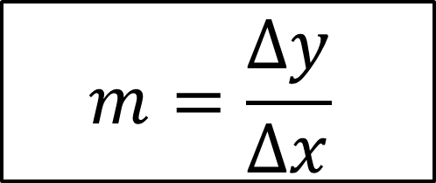

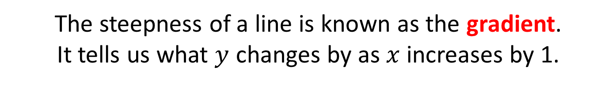


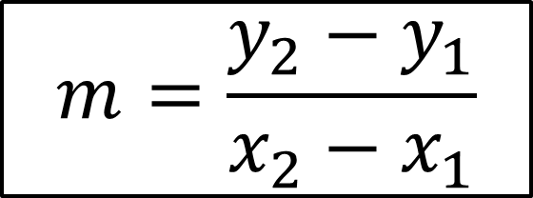
Straight Line Graphs – gradient
The steepness of a line is known as the gradient.
It tells us what $y$ changes by as $x$ increases by 1.
$$\left(x_{2},y_{2}\right)$$
$$1$$
$\left(x_{1},y_{1}\right)$
$$m=\frac{Δy}{Δx}$$
$$m=\frac{y_{2}−y_{1}}{x_{2}−x_{1}}$$

Slide 7
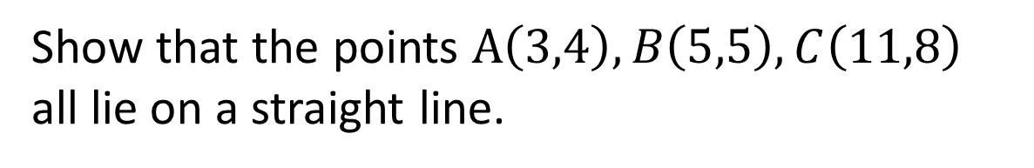



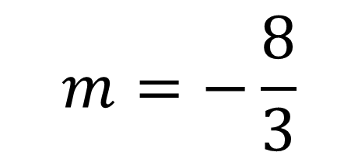
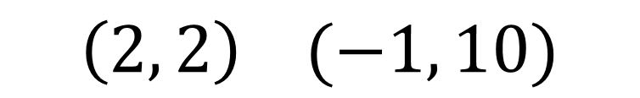
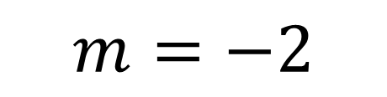
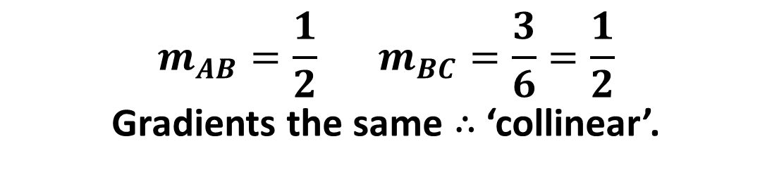
Straight Line Graphs – gradient
Find the gradient of the line that goes through the points:
$$\left(1, 4\right) (3, 10)$$
$$m=3$$
1
$$m=−2$$
$$\left(5, 7\right) (8, 1)$$
2
$$m=−\frac{8}{3}$$
$$\left(2, 2\right) (−1, 10)$$
3
4
Show that the points $A\left(3,4\right),B\left(5,5\right),C\left(11,8\right)$ all lie on a straight line.
$$m_{AB}=\frac{1}{2} m_{BC}=\frac{3}{6}=\frac{1}{2}$$
Gradients the same $∴$ ‘collinear’.

Slide 8
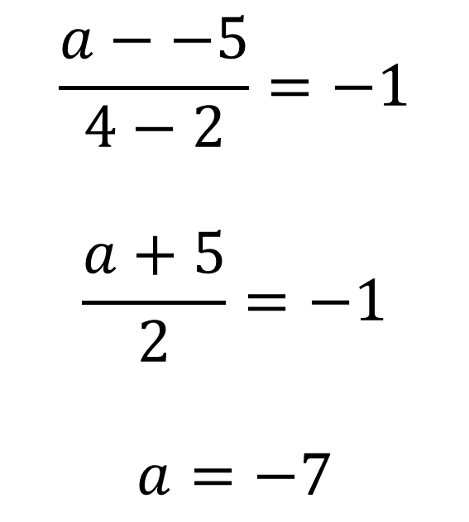
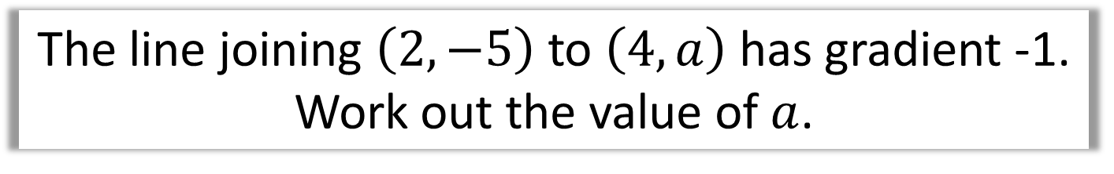
Straight Line Graphs – gradient
The line joining $\left(2,−5\right)$ to $\left(4,a\right)$ has gradient -1.
Work out the value of $a$.
$$\frac{a−−5}{4−2}=−1$$
$$\frac{a+5}{2}=−1$$
$$a=−7$$

Slide 9
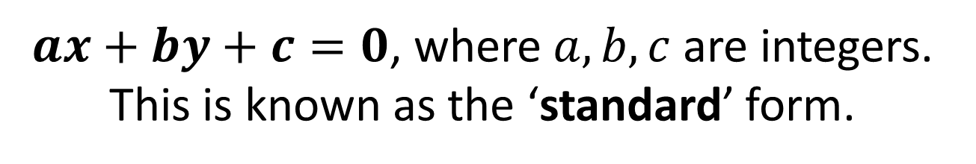
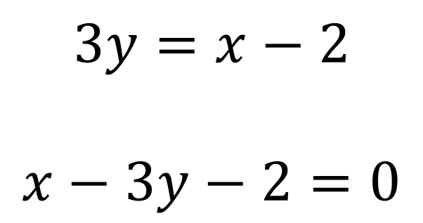
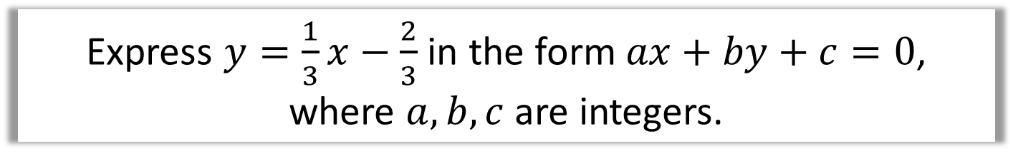
$$\text{Straight} \text{Line} \text{Graphs} −ax+by+c=0$$
$ax+by+c=0$, where $a,b,c$ are integers.
This is known as the ‘standard’ form.
Express $y=\frac{1}{3}x−\frac{2}{3}$ in the form $ax+by+c=0$, where $a,b,c$ are integers.
$$3y=x−2$$
$$x−3y−2=0$$
multiply through by 3

Slide 10
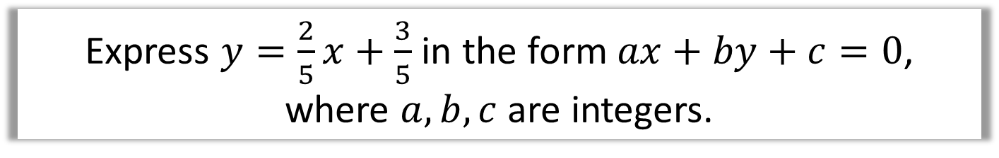
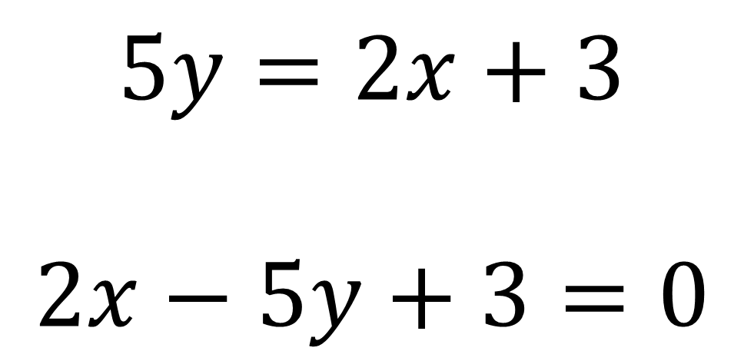
$$\text{Straight} \text{Line} \text{Graphs} −ax+by+c=0$$
Express $y=\frac{2}{5}x+\frac{3}{5}$ in the form $ax+by+c=0$, where $a,b,c$ are integers.
$$5y=2x+3$$
$$2x−5y+3=0$$

Slide 11

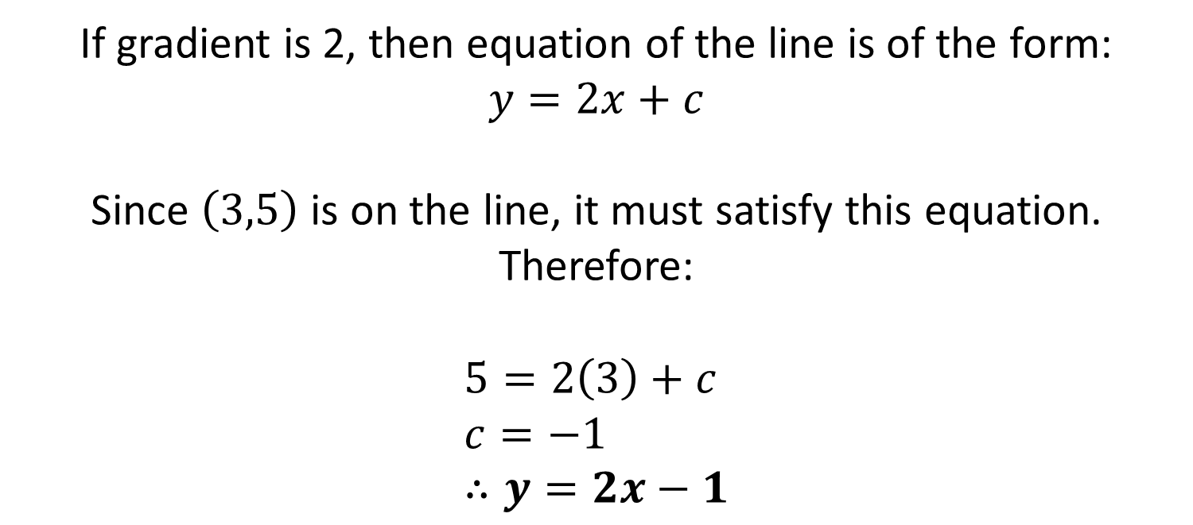
$\text{Straight} \text{Line} \text{Graphs} −$ Writing Equations
Find the equation of the line that goes through $\left(3,5\right)$ and has gradient 2.
If gradient is 2, then equation of the line is of the form:
$$y=2x+c$$
Since $\left(3,5\right)$ is on the line, it must satisfy this equation. Therefore:
$$5=2\left(3\right)+c \\ c=−1 \\ ∴y=2x−1$$

Slide 12


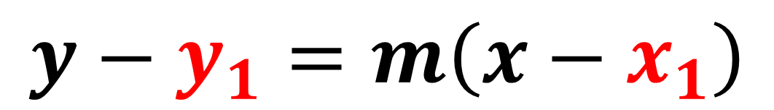



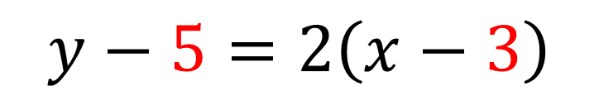
$\text{Straight} \text{Line} \text{Graphs} −$ Writing Equations
$$y$$
$$\left(x,y\right)$$
$$\left(x_{1},y_{1}\right)$$
$$x$$
$$y−y_{1}=m\left(x−x_{1}\right)$$
Find the equation of the line that goes through
$\left(3,5\right)$ and has gradient 2.
$$y−5=2\left(x−3\right)$$

Slide 13
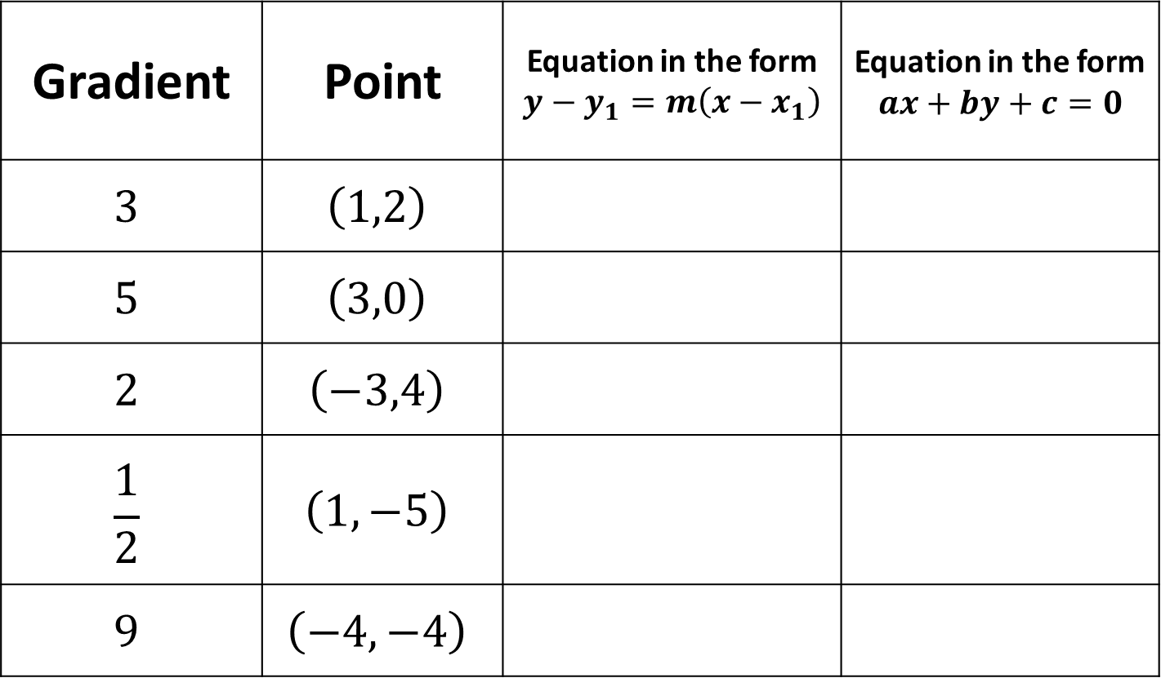
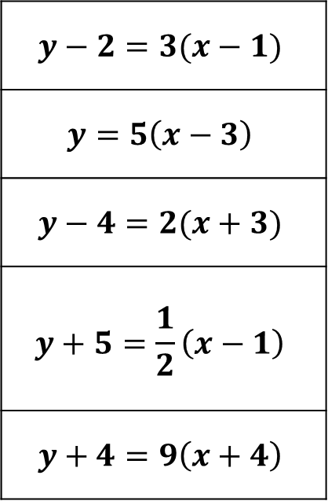
$\text{Straight} \text{Line} \text{Graphs} −$ Writing Equations
Gradient | Point | Equation in the form $$y−y_{1}=m\left(x−x_{1}\right)$$ | Equation in the form $$ax+by+c=0$$
$$3$$ | $$\left(1,2\right)$$
$$5$$ | $$\left(3,0\right)$$
$$2$$ | $$\left(−3,4\right)$$
$$\frac{1}{2}$$ | $$\left(1,−5\right)$$
$$9$$ | $$\left(−4,−4\right)$$
$$y−2=3(x−1)$$
$$y=5\left(x−3\right)$$
$$y−4=2(x+3)$$
$$y+5=\frac{1}{2}\left(x−1\right)$$
$$y+4=9\left(x+4\right)$$

Slide 14
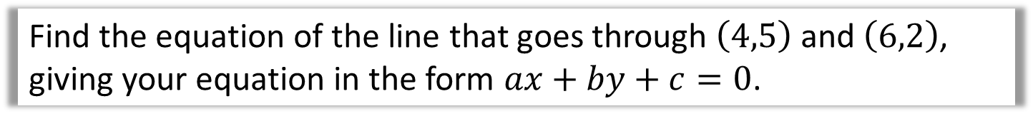
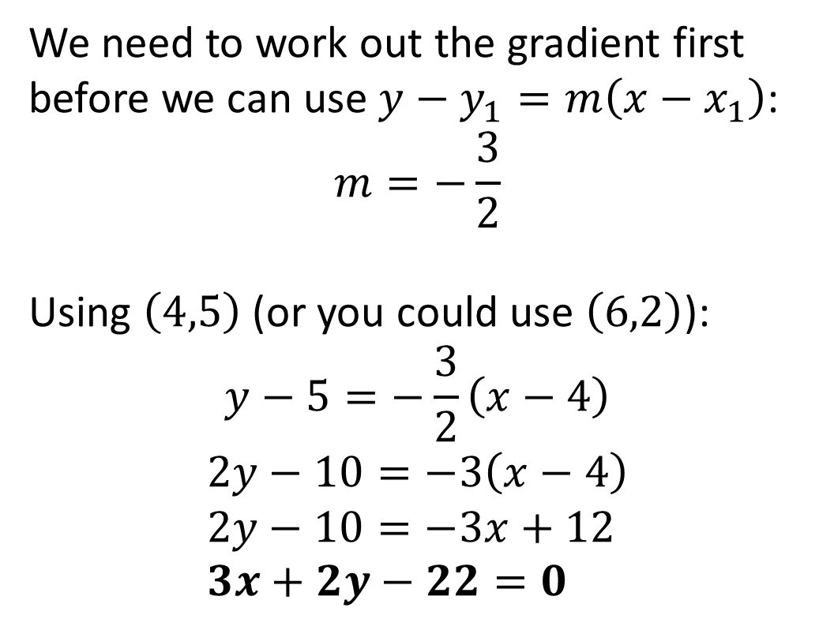
$\text{Straight} \text{Line} \text{Graphs}$- Using 2 points
Find the equation of the line that goes through $\left(4,5\right)$ and $\left(6,2\right)$, giving your equation in the form $ax+by+c=0$.
We need to work out the gradient first before we can use $y−y_{1}=m\left(x−x_{1}\right)$:
$$m=−\frac{3}{2}$$
Using $\left(4,5\right)$ (or you could use $\left(6,2\right)$):
$$y−5=−\frac{3}{2}\left(x−4\right)$$
$$2y−10=−3\left(x−4\right) \\ 2y−10=−3x+12 \\ 3x+2y−22=0$$

Slide 15
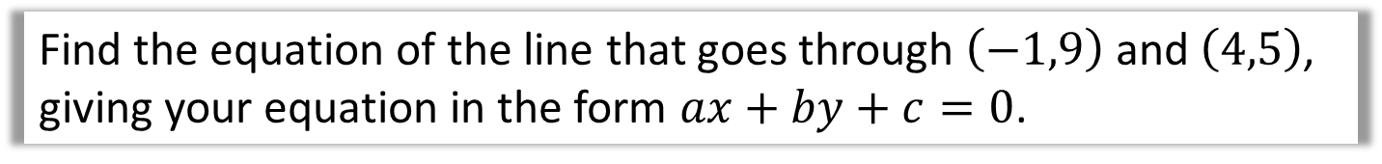
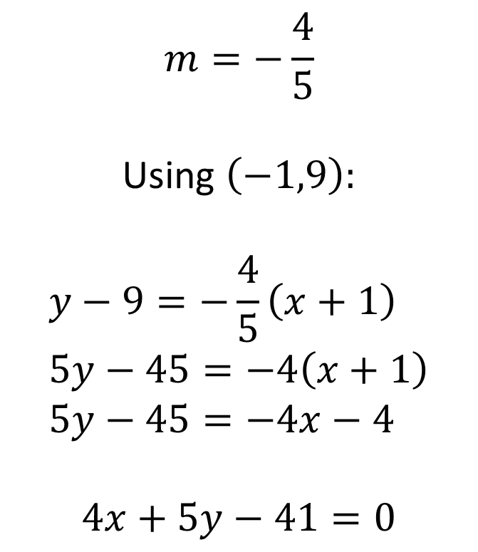
$\text{Straight} \text{Line} \text{Graphs}$- Using 2 points
Find the equation of the line that goes through $\left(−1,9\right)$ and $\left(4,5\right)$, giving your equation in the form $ax+by+c=0$.
$$m=−\frac{4}{5}$$
Using $\left(−1,9\right)$:
$$y−9=−\frac{4}{5}\left(x+1\right) \\ 5y−45=−4\left(x+1\right) \\ 5y−45=−4x−4$$
$$4x+5y−41=0$$

Slide 16
Exercise 5A/5B
Pearson Pure Mathematics Year 1/AS
Pages 90-91, 92-93
Complete before the lesson Ex5A Q1, 2, 8, 9 & 10
Green Ex5B Q1-3 a-d only
Amber Q4-8
Red Q9-12 & Challenge

Slide 17
Exercise 5C
Pearson Pure Mathematics Year 1/AS
Pages 94-95
Complete before the lesson Q1-2 a-d only
Green Q3-4
Amber Q5-6 & Challenge

