Slide 1
Year 2 Pure Mathematics
Radians
– Introduction
Chapter 5
(Part 1 of 5)

Slide 2

Radians
So far you’ve used degrees as the unit to measure angles.
But outside geometry, mathematicians pretty much always use radians.
r
1°
r
1 rad
1 Degree
1 Radian
$360°=2π$ rad

Slide 3
Radians
…but WHY use radians?
it helps makes certain
calculations easier.

Slide 4
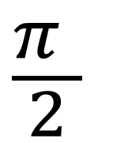

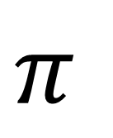
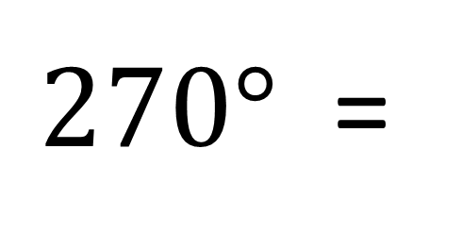
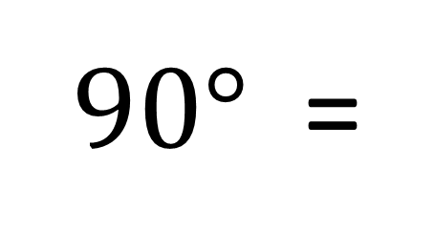
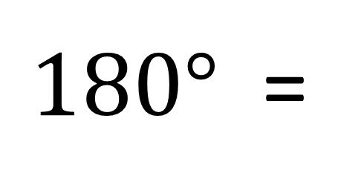
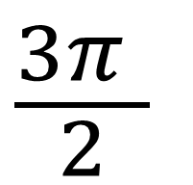
Radians - Converting
$360°$ = $2π$
$180°$ =
$$π$$
$90°$ =
$$\frac{π }{2}$$
$270°$ =
$$\frac{3π }{2}$$

Slide 5
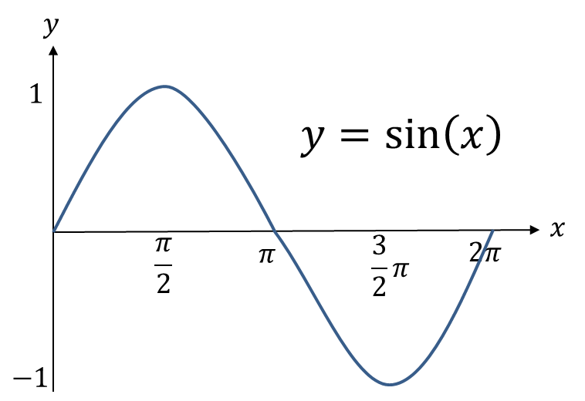
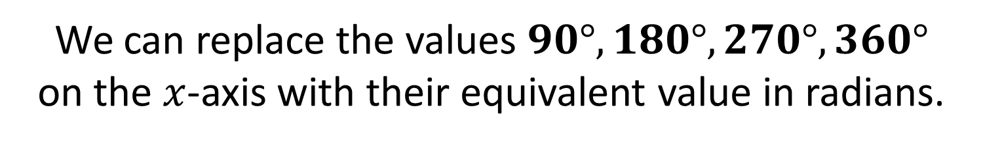
Radians - Graph Sketching
We can replace the values $90°, 180°, 270°, 360°$
on the $x$-axis with their equivalent value in radians.

Slide 6

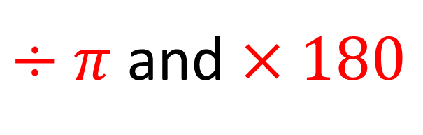
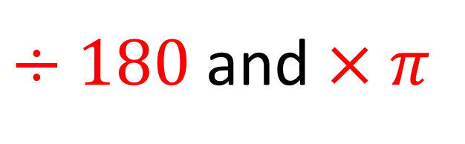
Radians - Converting
$÷180$ and $×π$
$Degress$= $Radian$
$÷π$ and $×180$

Slide 7

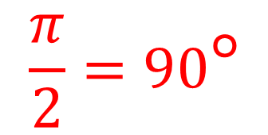



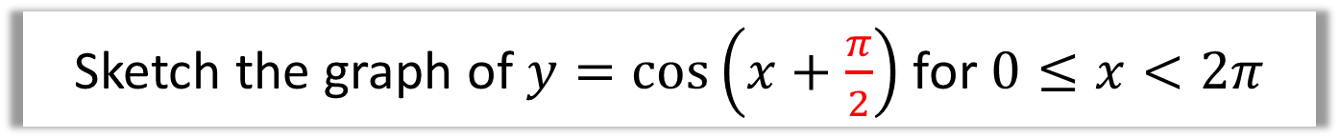






Radians - Graph Sketching
Sketch the graph of $y=\cos\left(x+\frac{π}{2}\right)$ for $0≤x<2π$
$$\frac{π}{2}=90°$$
$$y$$
$$y=cos\left(x+\frac{π}{2}\right)$$
$$1$$
$$y=cos\left(x\right)$$
$$x$$
$$\frac{π}{2}$$
$$π$$
$$\frac{3}{2}π$$
$$2π$$
$$−1$$

Slide 8
Exercises 5A/5B
Pearson Pure Mathematics Year 2/AS
Pages 116, 118
Complete before the lesson Ex5A
In Class Ex5B:
Green Q1
Amber Q2
Red Q3

